Slide 1
Failures of PTSD Care

Slide 4
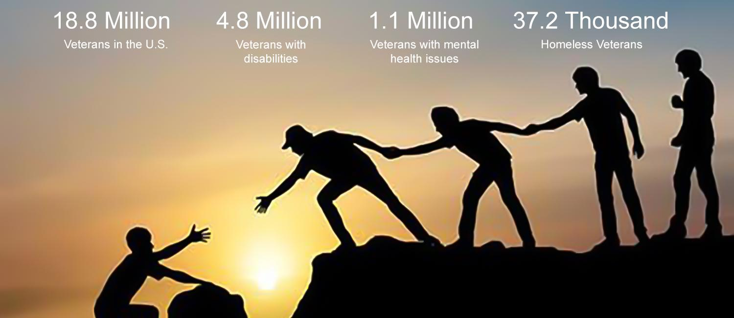
My favorite part of our trip
I most enjoyed the moment when the HUGE turtle swam right past me. I wouldn’t have believed that turtles could ever get that big if I hadn’t seen it for myself!

Slide 5
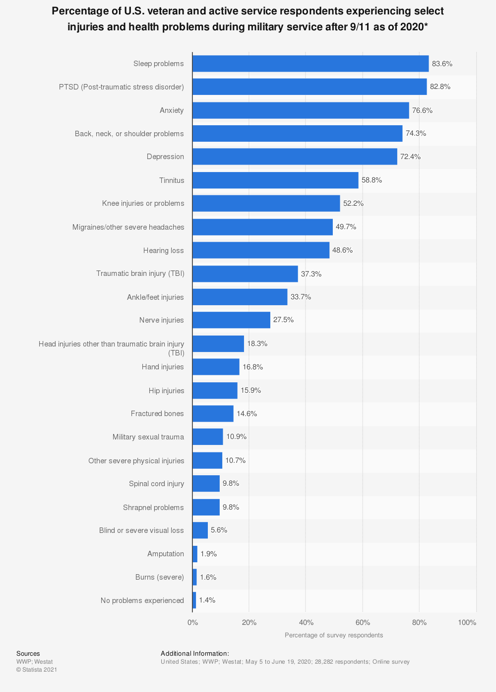

Slide 7
