Slide 1
Managing Diversity L. 4

Slide 2
Essay title
Kirton and Greene argue that the term managing diversity ‘just reflects a business orientated catch phrase for employer-led initiatives designed to value workforce diversity and is more concerned with utility than justice’. Critically consider the extent to which you agree with them.
Due end week 10 – Sunday 15th April, 2018 on SafeAssign and hard copy in class on Monday 16th April, 2018.
Word count 3,000 words.

Slide 3
Defining Diversity
Society for Human Resource Management - the differences based on ethnicity, gender, age, religion, disability, national origin, and sexual orientation, including an infinite range of unique characteristics and traits such as the way one communicates, one’s height and weight, and speed of learning and comprehension .
American Institute for Managing Diversity - any mixture of items characterized by differences and similarities., and it must be all-inclusive.
CIPD - Diversity is where difference is recognised and emphasised, but not actively leveraged to drive organisational success. There is acknowledgement of the benefit of having a range of perspectives in decision-making and the workforce being representative of the organisation’s customers.
Marilyn Loden - The Diversity Wheel
Anita Rowe/Lee Gardenswartz - Four Layers of Diversity
Notes:
CIPD Inclusion - Inclusion is where difference is seen as a benefit to use, and where perspectives and differences are shared, leading to better decisions. An inclusive working environment is one in which everyone feels valued, that their contribution matters and they are able to perform to their potential, no matter their background, identity or circumstances. Essentially it enables a diverse range of people to work together effectively.

Slide 4
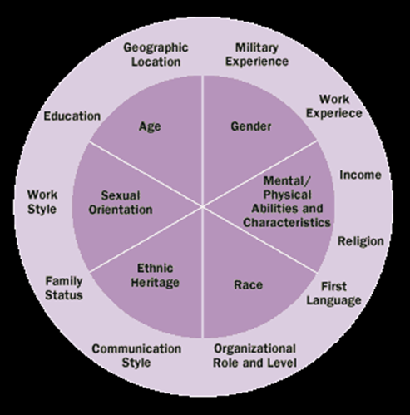
Marilyn Loden The Diversity Wheel

Slide 5
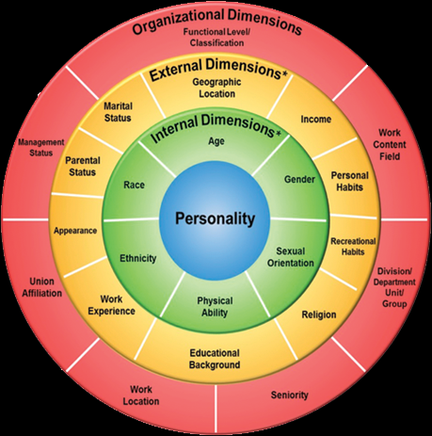
Anita Rowe/Lee Gardenswartz Four Layers of Diversity

Slide 6
CIPD Viewpoint
The moral case for building fairer and more inclusive labour markets and workplaces is indisputable: people matter, and, as disparities in wealth and opportunity become ever more apparent, organisations must ensure their people management approaches do not put any group at a disadvantage. Regardless of our identity or background, we all deserve to develop our skills and talents to our full potential, work in a safe, supportive and inclusive environment, be fairly rewarded and recognised for our work and have a meaningful voice on matters that affect us.
But it’s also vital for the sustainability of businesses and economies. Everyone stands to benefit when we embrace and value the diversity of thoughts, ideas and ways of working that people from different backgrounds, experiences and identities bring to an organisation. It helps people grow and learn, tackles under-utilisation of skills by enabling people to reach their full potential, improves decision-making, boosts engagement and innovation, and enables businesses to better understand and meet the needs of a diverse customer base.

Slide 7
A Framework for Understanding Diversity
Diversity is expansive but not unbounded
Diversity is fluid and dynamic
Diversity is based on both similarities and differences
Diversity is rooted in nonessentialist thought

Slide 8
Understanding Leadership-Based Organizational Paradigms for Managing Diversity
The Resistance Paradigm
The Rhetoric of Resistance, 1950s and 60s
The Discrimination-and-Fairness Paradigm
The Rhetoric of Affirmative Action, 1960s and 70s
The Access-and-Legitimacy Paradigm
The Rhetoric of Valuing Diversity, 1980s and 90s
The Integration-and-Learning Paradigm
The Rhetoric of Diversity Management and Beyond, present

Slide 9
The Business Case for Diversity
Cost Savings
Turnover
Commitment and absenteeism
Discrimination lawsuits
Winning the Competition for Talent
Driving Business Growth
Marketplace
Creativity and Problem-Solving
Flexibility and Global Relations

Slide 10
Challenging the Business Case for Diversity
Assumptions:
A diverse workforce will increase overall productivity
The results of diversity effects are easy to measure
Diverse employees embrace diversity initiatives
Diversity training adds value to the organization
Diverse employees are more likely to capitalize on diverse markets
The relationship between white men and diversity is clearly articulated

Slide 11
The social justice case for managing diversity
The social justice case is based on the belief that everyone should have a right to equal access to employment and training and development based solely on merit. Everyone should have the right to be free of any direct or indirect discrimination and harassment or bullying. This can be described as the right to be treated fairly.

Slide 12
Academic Writing
AKA How to get a good grade

Slide 13
Aims of this session
To help you understand what constitutes a good essay
To consider the importance of critical thinking in academic writing
To revise some of the key concepts that are central to good academic writing
To identify some key readings that will be useful for your essay
Introduction
Academic Writing
Critical Thinking
Conclusion
Essay
Editing

Slide 14
The Conscious Competence Framework
Introduction
Academic Writing
Critical Thinking
Conclusion
Essay
Editing

Slide 15
Academic Writing
Academic writing is a key skill…without it you have no submission, you cannot communicate your thoughts, arguments, results, or develop your ideas.
Academic writing is a recursive process filled with stops and starts.
You must create time and space for your writing.
“Certain expectations underpin the way in which academic writing operates. The most fundamental expectation is that when a claim is made, it will be backed up by reasons based on some form of evidence” (Wallace & Wray, 2008: 4).
Introduction
Academic Writing
Critical Thinking
Conclusion
Essay
Editing

Slide 16
Academic writing is:
Formal (impersonal, no slang, formal sentence structure)
Reasoned (critical thinking: how and why)
Impartial (gives a balanced point of view, more than one point of view)
Logical (ideas flow logically from one to another: signposts, topic sentences and linked paragraphs)
Structured (keeps to the structure of an essay, report etc)
Supported (evidence and examples, referencing)
Introduction
Academic Writing
Critical Thinking
Conclusion
Essay
Editing

Slide 17
There are a number of myths around academic writing
Being able to write well is a gift
What matters is that the content and facts are correct. The way it is written, presented and structured does not really matter.
Writing is just a question of getting down what you know, it will all come together when the time comes
Writing is what you do last, that's why it is called 'writing up‘
These myths are dangerous – they are very unhelpful excuses for procrastinating, or for writing to a low standard.
Introduction
Academic Writing
Essay
Conclusion
Critical Thinking
Editing

Slide 18
Characteristics of an argument:
Position – author has a position that they want the audience to accept (may or may not be stated at the beginning)
Reasons (propositions) are given to support (justify) the author’s position
Line of reasoning is the logical ‘unpacking’ of the reasons why ‘on balance’, considering everything, this argument (viewpoint) is justifiable
Conclusions – not just a summary of the essay but makes the author’s position clear. You will often have several smaller arguments/conclusions, leading to one overall conclusion.
Adapted from Cottrel (2005:47)
Introduction
Academic Writing
Critical Thinking
Conclusion
Essay
Editing

Slide 19
What is Good Evidence?
Contemporary research evidence – valid and reliable
Seminal research evidence
Published in peer reviewed journals
Primary research as opposed to secondary citation
But don’t overlook the value of other forms of evidence.....
Evidence is more than research….
Expert opinion – so some ‘opinion pieces’ may be ‘good evidence’
In some instances, practitioner perspectives
Your own experiences
…can also be important provided they are used judiciously
The notion of a ‘hierarchy of evidence’ is key here.
Introduction
Academic Writing
Critical Thinking
Conclusion
Essay
Editing

Slide 20
Good writing requires good reading –
You need to develop your skills to read actively and critically.
Being selective with the material
How does the item relate to others that I have read and to my own research question too?
It is an iterative process - You should continue with your revision throughout your research
Do not try to fit in everything that you read - some material may undermine the relevance of your study
Do not stop reading!
Bryman & Bell (2007)
Introduction
Academic Writing
Critical Thinking
Conclusion
Essay
Editing

Slide 21
Good writing requires clarity – (you may be clear what you are saying but is it clear for your reader):
All the faith he had had had had no effect on his life.
Time flies like an arrow, but fruit flies like a banana.
The old man the boats.
The horse raced past the barn fell.
I sometimes read read as read, when it’s supposed to be read as read.
Buffalo buffalo Buffalo buffalo buffalo buffalo Buffalo buffalo.
Have you ever noticed that read rhymes with lead, and read rhymes with lead? Also read and lead don’t rhyme. Neither do read and lead.
Wouldn’t the sentence “I want to put a hyphen between the words Fish and And and And and Chips in my Fish-And-Chips sign” have been clearer if quotation marks had been placed before Fish, and between Fish and and, and and and And, and And and and, and and and And, and And and and, and and and Chips, as well as after Chips?
“I never said she stole my money” (If you place an emphasis on one word at a time it changes the meaning. I never said she stole my money, I never said she stole my money. I never said she stole my money, etc.)
Introduction
Academic Writing
Critical Thinking
Conclusion
Essay
Editing
Notes:
“

Slide 22
Plagiarism
Plagiarism is a form of academic dishonesty and is defined as: ‘inclusion of another person’s writing/ideas/works, in any formally presented work (essays, exams, etc.) …, without due acknowledgement either wholly or in part of the original source of the material through appropriate citation’.
Only list references you have referred to in the text.
Referencing is simply acknowledging the source of the information you use in your writing.
It is defined by the action rather than the intention.
Plagiarism may result in serious consequences.
Introduction
Academic Writing
Critical Thinking
Conclusion
Essay
Editing

Slide 23
Harvard referencing system
The advantages of the Harvard referencing style:
(i) it ensures that the author's name, year of publication and page number
where appropriate appear within the text and
(ii) the alphabetical order makes the reference list easy to consult.
There are two aspects to learn:
(i) references within the text (i.e. in-text citations)
(ii) a list of references cited given at the end (i.e. a reference list)
Introduction
Academic Writing
Critical Thinking
Conclusion
Essay
Editing

Slide 24
In-text citations
Using the Harvard style a reference in your paper requires only the name of the author (or authors) and the year of publication (with no punctuation between the two items).
References can be placed at the end of a sentence (before the concluding punctuation) for example: ...as one writer put it "the darkest days were still ahead" (Weston 1988, p.45).
Alternatively, the author's surname may be integrated into the text, followed by the year of publication in brackets for example: Scholtz (1990, p.564) has argued that…
If you need to reference a work written by two or more authors, write the first author's name followed by et al., for example: Edwards et al. (2004) report…
Introduction
Academic Writing
Critical Thinking
Conclusion
Essay
Editing

Slide 25
How to present the texts on your reference list
BOOK: Rose, S. & Bullock, S. (1991) The Chemistry of Life. Harmondsworth, Penguin.
JOURNAL ARTICLE: Monacelli, T. (2001) New International Monetary Arrangements and the Exchange Rate. International Journal of Finance & Economics, Vol 6 (4), pp. 389-400.
WEBSITE: NASA Spacelink (undated) Chandra X-Ray Observatory. [online] Washington, NASA. Available from: http://spacelink.nasa.gov/NASA.Projects/Space.Science/Universe/ Chandra.X-Ray.Observatory/ [accessed 13 May 2010]
CONFERENCE PAPER: Anderson, J. C. (1987) Current Status of Chorion Villus Biopsy. In: Tudenhope, D. & Chenoweth, J., eds. Proceedings of the Fourth Congress of the Australian Perinatal Society, Sept. 3-6. Queensland, Australian Perinatal Society, pp. 190-196.
Introduction
Academic Writing
Critical Thinking
Conclusion
Essay
Editing

Slide 26
Paraphrasing - Exercise
The original passage:
“Students frequently overuse direct quotation in taking notes, and as a result they overuse quotations in the final [research] paper. Probably only about 10% of your final manuscript should appear as directly quoted matter. Therefore, you should strive to limit the amount of exact transcribing of source materials while taking notes.” (Lester, 1976: 46-4).
Lester, J. (1976) Writing Research Papers. 2nd ed 46-47.
Is this a legitimate paraphrase or a plagiarized version?
In research papers students often quote excessively, failing to keep quoted material down to a desirable level. Since the problem usually originates during note taking, it is essential to minimize the material recorded verbatim (Lester, 1976).
Introduction
Academic Writing
Critical Thinking
Conclusion
Essay
Editing
Notes:
This is legitimate

Slide 27
Legitimate
Paraphrasing Exercise
The original passage:
“Students frequently overuse direct quotation in taking notes, and as a result they overuse quotations in the final [research] paper. Probably only about 10% of your final manuscript should appear as directly quoted matter. Therefore, you should strive to limit the amount of exact transcribing of source materials while taking notes.” (Lester, 1976: 46-4).
Lester, J. (1976) Writing Research Papers. 2nd ed 46-47.
Is this a legitimate paraphrase or a plagiarized version?
In research papers students often quote excessively, failing to keep quoted material down to a desirable level. Since the problem usually originates during note taking, it is essential to minimize the material recorded verbatim (Lester, 1976).
Introduction
Academic Writing
Critical Thinking
Conclusion
Essay
Editing

Slide 28
Six Steps to Effective Paraphrasing
1. Reread the original passage until you understand its full meaning.
2. Set the original aside, and write your paraphrase.
3. Jot down a few words about your paraphrase to remind you later how you envision using this material. You could also write a key word or phrase to indicate the subject of your paraphrase.
4. Check your rendition with the original to make sure your version accurately expresses all the essential information in a new form.
5. Use quotation marks to identify any unique term or phraseology you have borrowed exactly from the source.
6. Record the source (including the page) with your notes so that you can credit it easily if you decide to incorporate the material into your paper.
Introduction
Academic Writing
Critical Thinking
Conclusion
Essay
Editing

Slide 29
Always distinguish between references you have read from unread sources
Never use a secondary source as a primary source without reference to both authors (e.g. Bloggs, 1980 in Smith, 1984) because
(a) it is dishonest and
(b) it is possible that the second author paraphrased or misquoted the first author.
In the following example, a paper by Allerston is found quoted in a textbook by Dixon.
Allerston (1986, in Dixon 1989) suggested that rural settlement patterns owe more to the contingencies of history than to a structured planning process.
Introduction
Academic Writing
Critical Thinking
Conclusion
Essay
Editing

Slide 30
Critical Thinking… but first, just thinking about your thinking
What do you know about the connection between thinking and learning?
Did you ever study your thinking?
What have you learned about how you think?
What information do you have, for example, about the intellectual processes that occur as your mind thinks?
What do you know about how to analyze, evaluate, or reconstruct your thinking?
Where does your thinking come from?
How much of it is of ‘good’ quality? How much of it is of ‘poor’ quality?
Are you, in any real sense, in control of your thinking?
How do you control your thinking?
Do you know how to test it?
Do you have any conscious standards for determining when you are thinking well and when you are thinking poorly?
Introduction
Academic Writing
Critical Thinking
Conclusion
Essay
Editing

Slide 31
Critical Thinking
In most disciplines there is not a universal truth rather a range of view-points, interpretations and perspectives. Thus when studying it is important to develop reasonable scepticism which is being open-minded and willing to be convinced if the claim is backed up adequately.
There are three bad reasons to believe something:
(i) tradition;
(ii) authority and
(iii) revelation
There is only one good reason to believe something: EVIDENCE.
Introduction
Academic Writing
Critical Thinking
Conclusion
Essay
Editing

Slide 32
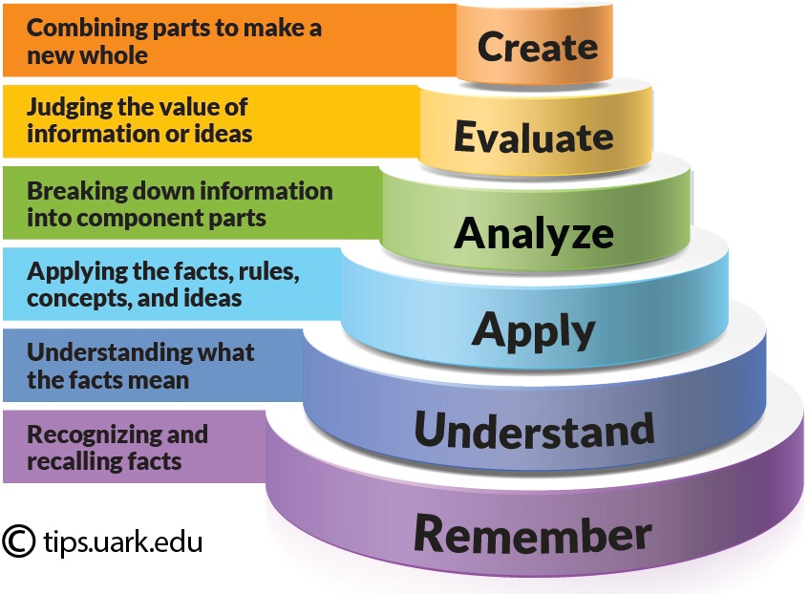
Bloom’s Taxonomy in the Cognitive Domain (revised)
Introduction
Academic Writing
Critical Thinking
Conclusion
Essay
Editing

Slide 33
Learning to be critical in academic enquiry
“The skill of critical reading lies in assessing the extent to which authors have provided adequate justification for the claims they make. This assessment depends partly on what the authors have communicated and partly on other relevant knowledge, experience and inference that you are able to bring to the frame.”
“The skill of critical writing lies in convincing your readers to accept your claims. You achieve this through the effective communication of adequate reasons and evidence for these claims.”
Wallace & Wray (2008, p. 7)
Introduction
Academic Writing
Critical Thinking
Conclusion
Essay
Editing

Slide 34
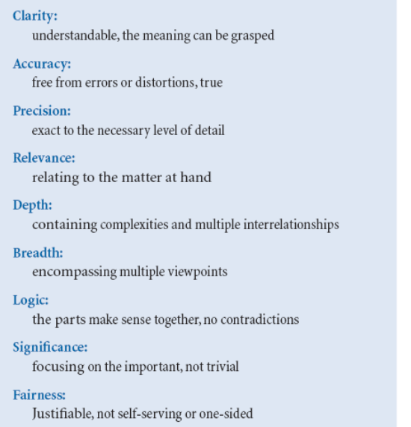
Critical Thinking Standards
Critical thinking is a desire to seek, patience to doubt, fondness to meditate, slowness to assert, readiness to consider, carefulness to dispose and set in order; and hatred for every kind of imposture.
Francis Bacon (1605).
Introduction
Academic Writing
Critical Thinking
Conclusion
Essay
Editing

Slide 35
Critical Reading – making a critical choice
In order to read critically you must first become a critical selector of the texts that you choose to read, and not read. This involves:
- Reading from the recommended reading list is provided;
- Finding the other sources that the lecturer referred to in lectures and reading them;
- Using the reference lists on the above to source additional reading material;
- Do a search for peer-reviewed articles on the library’s website to source other quality;
- Check out books that have been reviewed in recent academic journals;
- Bear in mind textbooks have limitations;
- And finally, a radical suggestion - go to the library and see what books are stored alongside the recommended readings.
Introduction
Academic Writing
Critical Thinking
Conclusion
Essay
Editing

Slide 36
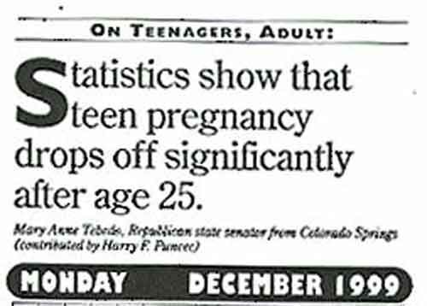
Do not accept that everything that you read is true
Introduction
Academic Writing
Critical Thinking
Conclusion
Essay
Editing

Slide 37
Evaluating what you read
Critical reading is an active process.
To read critically you must be aware of your own expectations, prejudices and previous knowledge and ALSO be aware of identifying authors’ underlying aims and agenda and take them into account in your evaluation.
To make the texts work for you:
- formulate a broad central question
- formulate review questions
- identify and evaluate the arguments in what your read
Consider five critical synopsis questions – Why am I reading this? What is the author trying to do in writing this? What is the author saying that is relevant to what I want to find out? How convincing is what the author is saying? What use can I make of this?
Introduction
Academic Writing
Critical Thinking
Conclusion
Essay
Editing

Slide 38
Be aware of the possibility of ‘mutant statistics’ e.g. ‘Every year since 1950, the number of American children gunned down has doubled’
1950 = 1
1951 = 2
1952 = 4
1953 = 8
1960 = 1,024
1965 = 32,768
1970 = >1 million
1980 = 1 billion
1983 = 8.6 billion/twice the Earth’s population
1995 = > 35 trillion !
Introduction
Academic Writing
Critical Thinking
Conclusion
Essay
Editing

Slide 39
Critical Writing
Even when asked for your own view on an issue, do not give your instinct or opinion – you must construct an argument using the available evidence as the warrant for your conclusion.
You must be aware of your audience as there may be emphases according to the purpose and destination of the material.
Your writing must be presented in a structured format – whatever is the requirement for the particular assessment you are addressing.
The points you make must be back up by citations which must be fully referenced on the reference list.
Introduction
Academic Writing
Critical Thinking
Conclusion
Essay
Editing

Slide 40
Evaluating the work of others
It is important to be able to evaluate the quality of what is being read. In order to evaluate the work of authors, know what their claim is for both the reliability and validity of their work.
- Reliability: where researchers can repeat a piece of research and obtain precisely the same results. In practice in the social sciences reliability can never to total.
- Validity: where a piece of research does what it is intended to do, it is said to be valid.
Before accepting the validity of any research it is always worth asking whether it would be reasonable or difficult to try to prove or argue for the opposite and where there might be flaws in the reasoning.
Cryer (2008)
Introduction
Academic Writing
Critical Thinking
Conclusion
Essay
Editing

Slide 41
Introduction
Academic Writing
Critical Thinking
Conclusion
Essay
Editing

Slide 42
Identifying flaws in arguments
Flaw
Questions that indicate the flaw
Conclusion without a warrant Why? How do you know?
(a warrant is the logical connection
between a claim and a supporting fact)
Warrant without a conclusion So what? Why are you telling me this? What does it imply?
Conclusion with an inadequate Does this evidence really mean as much as
warrant you claim? Is this evidence robust enough?
Warrant leading to an illogical Does this reasoning add up? Aren’t there other conclusion more plausible conclusions?
Conclusion that is not explicitly What are you trying to claim? What is the
linked to its warrant factors causal relationship between the factors.
Wallace & Wray (2008, p. 31)
Introduction
Academic Writing
Critical Thinking
Conclusion
Essay
Editing

Slide 43
Barriers to critical thinking
Reluctance to critique experts
Mistaking critical analysis for ‘just commenting on the bad points’
Assuming teachers and experts always ‘have the answers’. Critical thinking means pursuing your own answers.
Our own assumptions, preconceptions, biases, experiences, beliefs etc.
Cottrell (2005) Ch. 1
Introduction
Academic Writing
Critical Thinking
Conclusion
Essay
Editing

Slide 44
Essay Writing
If the reader is to grasp what the writer means, the writer must understand what the reader needs (Gopen and Swan 1990)
The essay should be written impersonally, the writer should never address the reader as ‘you’ or refer to him/herself as ‘I’ or ‘me’.
The author should not add personal comments about s/he felt about the work.
The writing should be concise and cautious, and sentences should be properly constructed and grammatically correct.
Introduction
Academic Writing
Critical Thinking
Conclusion
Essay
Editing

Slide 45
Introduction
Academic Writing
Critical Thinking
Conclusion
Essay
Editing

Slide 46
1. Analyse the question
Sample questions I asked earlier this year:
Critically assess both the role and the impact of social media on workplace learning.
OR
Evaluate some of the main ethical issues identified by the critics of workplace learning.
Introduction
Academic Writing
Critical Thinking
Conclusion
Essay
Editing

Slide 47
2. Academic Research
Core readings
Additional readings
Library database
Academic journals
Use websites (carefully) – the good, the bad and the ugly!
Be selective with your readings
Make sure your reading is relevant
Make sure your reading covers differing perspectives
Take notes/highlight potential quotes/arguments you might want to use
Keep a reference list as you read
Introduction
Academic Writing
Critical Thinking
Conclusion
Essay
Editing

Slide 48
3. Plan your essay
Write a broad outline of how you want to approach the question
Summarise the articles read, covering the main thrust of each one
Decide on a central argument/position - this is imperative as it dictates which articles you will use
Try to synthesise the information into one coherent and consistent discussion that focuses on analysis rather than description
Be selective in the issues you chose to discuss - remember the marker may be looking for depth of analysis, so try to cover a few issues well rather than a lot superficially.
Ensure that your reading has provided enough material to argue points and counterpoints – remember that critical analysis requires a knowledge of various positions/ perspectives.
Introduction
Academic Writing
Critical Thinking
Conclusion
Essay
Editing

Slide 49
4. Write your essay
Introduction - Say what you are going to say i.e. Your argument and issues (~10%):
What is your argument, i.e. your perspective on the question. State it clearly at the beginning: it will focus the flow of your essay
What specific issues will you cover (i.e. set your boundaries so the reader can follow your train of thought)
Main Body – connection and flow of points: Say what you want to say:
Not too many major issues; fewer points, more analysis and discussion
Explore/evaluate/contrast different points of view on an issue in making your argument i.e. how why one set of arguments is better than another
Allow for nuance in your argument
Conclusion - Say what you have said (~10%):
Briefly sum up your argument
Highlight any unanswered questions
Offer conclusions and observations
Introduction
Academic Writing
Critical Thinking
Conclusion
Essay
Editing

Slide 50
When writing...
Do not rely on too few books/articles.
There must be awareness of seminal texts as well as recent and relevant ones
Be critical in the review of the literature you have researched
Demonstrate an ability to argue, illustrate and discuss
Avoid descriptive/unconnected treatment of sources: the ‘he says, she says’ approach
Ensure the work is logically organised into themes, for example: social, cultural, economic etc.
Deal with theoretical, conceptual perspectives beyond a superficial level
Combine/integrate sources and reference these meticulously
Employ direct quotations selectively
Ensure there is no plagiarism
Introduction
Academic Writing
Critical Thinking
Conclusion
Essay
Editing

Slide 51
Some tips on style…
Signpost the direction the essay is taking – do not spring new ideas on the reader.
Adopt an impartial/detached tone – rather than ‘I think’ or ‘in my opinion’ say ‘it can be argued’, or ‘however’.
Make average sentence length 15 to 20 words, but there should be plenty of variety.
Be concise – long, convoluted sentences can obscure the point you are trying to make.
Do not overuse one source of information.
A sentence should contain no unnecessary words, a paragraph no unnecessary sentences, for the same reason that a drawing should contain no unnecessary lines and a machine no unnecessary parts. (Strunk , 2000)
Introduction
Academic Writing
Critical Thinking
Conclusion
Essay
Editing

Slide 52
Avoid sexist usage of language
Inclusive writing usually makes more sense and is more accurate.
(1) Use sex-neutral terms – see examples on the right.
(2) Avoid ‘he’ and ‘she’, when you intend to include both men and women – how? Simple, use the plural ‘they’ – it is neutral.
Sex specific words Sex-neutral words
authoress author
clergymen clergy, clerics
man, mankind, the human species, human
beings, people,
humans
man-hours working hours,
work-hours
workman worker
Introduction
Academic Writing
Critical Thinking
Conclusion
Essay
Editing

Slide 53
Stephen King’s (2000) book ‘On writing’:
King admits that he took more time to write this non-fiction book than most of the novels he is famous for, and have been turned into successful films.
“When you write a story, you’re telling yourself the story…when you rewrite, your main job is taking out all the things that are not the story”(p.56).
“Write with the door closed, rewrite with the door open. Your stuff starts out being just for you…but then it goes out. Once you know what the story is and get it right - as right as you can, anyway - it belongs to anyone who wants to read it. Or criticize it.” (p.56).
Introduction
Academic Writing
Critical Thinking
Conclusion
Essay
Editing

Slide 54
Editing (Remember - all good writing is re-writing)
Remember that your first draft is just that – a first draft
Cut, cut, cut – learn to part with your words. Reduce dead weight words and phrases, get rid of jargon and repetition. “Verbose is not a synonym for literary” (Hale, 2001)
It is recommended that you give yourself a day or two before the final edit
Be severe – compare the final draft to your outline/plan
Examine your language and consistency carefully
Check your work against the critical thinking standards
Check all your in-text citations and references
Also ‘edit by ear’ for rhythm, word repetition and clarity in general (Becker 1986).
Introduction
Academic Writing
Critical Thinking
Conclusion
Essay
Editing

Slide 55
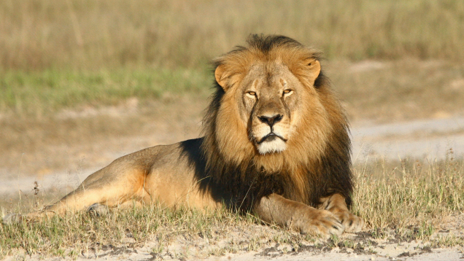
Famous example of the overuse of words:
“Such preparations shall be made as will completely obscure all Federal buildings and non-Federal buildings occupied by the Federal government during an air raid for any period of time from visibility by reason of internal or external illumination.” (from a government blackout order in 1942).
FDR’s response: “Tell them that in the buildings where they have to keep the work going to put something across the windows.”
More recently from: http://gawker.com/cnn-cecil-the-lions-brother-jericho-has-been-killed-1721525978 (08.01.15)
CNN reports that, according to a senior park official, Cecil the lion’s brother Jericho, who is also a lion, was killed on Saturday in Zimbabwe’s Hwange National Park. Others have called this account into question.

Slide 56
Ambiguity: some gems of wisdom (from Moran, A. (2000): Managing your own learning at university. Dublin, UCD Press)
The following are from examination answers and from written assignments:-
Girls grow up to be women quicker than boys do
The subjects were both male and female
The group consisted of 21 students from UCD with an equal distribution of both genders
Europeans speak from left to right whereas Arabs speak from right to left
The Pyramids are a range of mountains between France and Spain
Involuntary muscles are not as willing as voluntary muscles
As the rain forests in America are shrinking, so too are the Indians.
Introduction
Academic Writing
Conclusion
Essay
Editing
Critical Thinking

Slide 57
Rewriting ‘rules’
1. Change passive to active construction (e.g. ‘Jack built the house’ rather than ‘The house was built by Jack’) – exception: ‘The experiment was done …’
2. Cut excess words, e.g. ‘the way in which’ = ‘how’
3. Combine short sentences and split long sentences
4. Combine short paragraphs
5. Split long paragraphs
6. Remove redundancy in terms of words and phrases (e.g. when the same thing is said in two ways in successive sentences, take out less effective version)
7. Remove academic flourish
8. Make phrases sound less pretentious
9. Eliminate ‘tired metaphors’, wrong metaphors or clichés.
10.Replace abstract words (e.g. “relation”, “complex”) by concrete words and get examples.
Introduction
Academic Writing
Conclusion
Essay
Editing
Critical Thinking

Slide 58
Watch your grammar
Dear David … Adapted from Truss, L. (2003) Eats, Shoots and Leaves. London: Profile Books, p.9-10.
I want a man who knows what love is all about. You are generous, kind, thoughtful. People who are not like you admit to being useless and inferior. You have ruined me for other men. I yearn for you. I have no feelings whatsoever when we’re apart. I can be forever happy – will you let me be yours? Victoria
I want a man who knows what love is. All about you are generous, kind, thoughtful people, who are not like you. Admit to being useless and inferior. You have ruined me. For other men I yearn! For you I have no feelings whatsoever. When we’re apart I can be forever happy. Will you let me be? Yours, Victoria

Slide 61
Essay title
Kirton and Greene argue that the term managing diversity ‘just reflects a business orientated catch phrase for employer-led initiatives designed to value workforce diversity and is more concerned with utility than justice’. Critically consider the extent to which you agree with them.
Due end week 10 – Sunday 15th April, 2018 on SafeAssign and hard copy in class on Monday 16th April, 2018.
Introduction
Academic Writing
Critical Thinking
Conclusion
Essay
Editing

Slide 62
References
Becker, H. (1986): Writing for Social Scientists: How to Start and Finish your Thesis, Book or Article. Chicago: University of Chicago Press.
Bryman A. & Bell, E. (2007): Business Research Methods. Oxford: OUP.
Cooper, H.M. (1988): "The structure of knowledge synthesis", Knowledge in Society, Vol. 1, pp. 104-126.
Cottrel, S. (2005): Critical Thinking Skills, Basingstoke, Palgrave Macmillan.
Cryer, P. (2010): The Research Student’s Guide to Success. Maidenhead: McGraw Hill.
Gopen, G. & Swan, J. (1990): The Science of Scientific Writing. American Scientist. Nov/Dec.
Hart, C. (1998): Doing a literature review. London, Sage.
King, S. (2000): On writing – A memoir of the craft. Holder & Stoughton: New English Library.
Taylor, N.A.J. (2011): Reading and Writing for the Social Sciences: How to Interpret and Marshal the Literature Rather than be Terrorised by it. In Revista Romaneasca pentru Educatie Multidimensionala, No. 6 April.
van de Ven, A. H. (1989): Nothing Is Quite so Practical as a Good Theory. The Academy of Management Review. Vol. 14, No. 4, pp. 486-489.
Wallace, M. & Wrey, A. (2008): Critical Reading and Writing for Postgraduates. London: Sage.

Slide 63
Reading List
ACAS. (2014) Delivering equality and diversity. Advisory booklet. London: ACAS.
FROST, S. and KALMAN, D. (2016) Inclusive talent management: how business can thrive in an age of diversity. London: Kogan Page.
KUMRA, S. and MANFREDI, S. (2012) Managing equality and diversity: theory and practice. Oxford: Oxford University Press.
CASTRO, A. (2013) Rethinking diversity. T+D. Vol 67, No 2, February. pp36-40
JACOBS, K. (2013) Getting the right mix. Human Resources. August. pp22,24-27
JONES, P. (2011) What is unconscious bias? Equal Opportunities Review. No 215, August. pp21-24.
WOODS, D. (2012) Diversity: still a long way to go. Human Resources. October. pp37-41.

