Slide 1
System Forensics, Investigation, and Response
Lesson 1
Introduction to Forensics

Slide 2
Learning Objectives
Summarize the basic principles of computer forensics.
Summarize important laws regarding computer forensics.

Slide 3
Key Concepts
The chain of custody
Hardware and networking knowledge used in forensics
Laws related to computer forensics

Slide 4
What Is Computer Forensics?
A subset of forensics
  Forensics: Using “science and technology to investigate and establish facts in criminal or civil courts of law”
Focuses on extracting data from electronic devices
Objective is to recover, analyze, and present computer-based material to be used as evidence

Slide 5
What Is Computer Forensics?
Digital forensics is a more encompassing term
  Includes forensics of cell phones, routers, global positioning system (GPS) devices, tablets, and many other devices
Can consider computer forensics and digital forensics as interchangeable terms
Computer forensics applies to all domains of a typical IT infrastructure

Slide 6
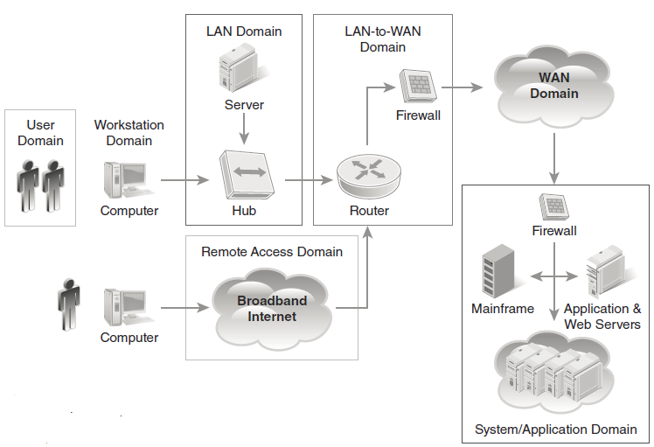
Seven Domains of a Typical IT Infrastructure

Slide 7
Using Scientific Knowledge
Computer forensics is a science
You apply scientific methods and processes
You must have:
  Knowledge of relevant scientific disciplines
  Scientific knowledge of the field
Computer forensics begins with a thorough understanding of computer hardware

Slide 8
Process in Computer Forensics
Collecting
Analyzing
Presenting
Notes:
Computer forensics follows a specific process to establish facts in a case.
The process is the same regardless whether the case is civil or criminal.
The process must be followed diligently to ensure that evidence is not accidentally altered and that conclusions drawn from the evidence are appropriate.

Slide 9
Collecting
Maintain the chain of custody from point of seizure to the moment it is shown in court by recording where it was, how it was stored, and who had access to it.
Don’t touch the suspect drive. Make a forensic copy and work with the copy.
Create a document trail.
Secure the evidence.

Slide 10
Analyzing
Look at every detail.
Ask what each detail means.
Make sure you have evidence to support each conclusion.
Consider possible alternative conclusions.

Slide 11
Presenting
Write an expert report that lists what tests you conducted, what you found, and your conclusions.
Testify as an expert witness in a disposition or in the actual trial.
Notes:
Writing an expert report
Back up your conclusions with two or three references per conclusion.
Use credible sources for references (such as the FBI and Secret Service).
Include your curriculum vitae.
Testifying
Answer questions honestly but as briefly as possible.
Don’t volunteer information that is not requested.
Ask for clarification if you don’t understand a question.
If you don’t know an answer to a question, say so.
If you are not 100% certain of an answer, say so.
Use graphics to explain particular technical points.
Avoid jargon: testify in clear, plain English.

Slide 12
The Field of Digital Forensics
Involves processing and assembling data so that it becomes relevant to an investigation
Data that supports a specific finding or determination is evidence

Slide 13
Who Uses Computer Forensics?
The military
Government agencies
Law firms
Criminal prosecutors
Academia
Data recovery firms
Corporations
Insurance companies
Individuals
Notes:
The military
Use digital forensics to gather intelligence information from captured computers.
Government agencies
Use digital forensics to investigate crimes involving computers.
Law firms
Need experienced system forensics professionals to conduct investigations and testify as expert witnesses.
Criminal prosecutors
Use digital evidence when working with incriminating documents.
Academia
Involved with forensic research and education.
Data recovery firms
Use digital forensics techniques to recover data after hardware or software failures and when data has been lost.
Corporations
Use digital forensics to assist in employee termination and prosecution.
Insurance companies
Use digital evidence of possible fraud.
Individuals
Sometimes hire forensic specialists in support of possible claims.

Slide 14
What Is Digital Evidence?
Information that has been processed and assembled so that it is relevant to an investigation and supports a specific finding or determination
Raw information is not, in and of itself, evidence
Data has to be relevant to a case in order to be evidence

Slide 15
Types of Evidence
Real
Documentary
Testimonial
Demonstrative
Notes:
Real
Physical objects that can be touched, held, or seen
Example: A smartphone with fingerprints on it
Documentary
Data that is stored in hard copy or electronically
Examples: Email messages, phone call logs
Testimonial
Information used to support real or documentary evidence
Example: Expert witness testimony that system access controls indicate a specific user accessed certain web addresses from a particular computer
Demonstrative
Evidence that helps explain other evidence
Example: Documentation showing the chain of custody for a seized laptop

Slide 16
Scope-Related Challenges
Large volumes of data
System complexity
Distributed crime scenes
Growing caseloads/limited resources
Notes:
Is challenging because:
Volume of data to be analyzed is often large
Modern computer systems are complex, have lots of storage, and wide array of data and formats
State, federal, and foreign jurisdictions may be involved
Caseloads are often high, resources are often limited

Slide 17
Types of Digital System Forensics Analysis
Physical storage media
Email
Network
Internet
Software
Live system
Cell phone/
mobile

Slide 18
General Guidelines
Maintain chain of custody
Don’t touch suspect drive
Create a document trail
Secure evidence

Slide 19
Knowledge Needed for Forensic Analysis
Hardware
Software
Networks
Addresses
Notes:
Computer forensics specialists should have a strong understanding of computer hardware.
They must have working knowledge of software including operating systems such as Windows, Linux, and Macintosh as well as files and file systems.
They must also have at least a basic knowledge of networks including physical connections, hubs, switches, routers, data transmission, protocols, IP addresses, MAC addresses, URLs, and basic network utilities but should know much more than the common computer technician.
When collecting information computer forensic specialists must keep in mind the lifespan of the information, the importance of collecting evidence quickly, and the need to collect information at the bit level. They should know how to obtain evidence from hidden or deleted data and cope with counter-forensics activities that are designed to conceal the perpetrator’s location, actions, or identity. Examples of counter-forensics include destruction/deletion, hiding, encryption, fabrication and falsification and file system alteration.

Slide 20
Computer Hardware
Memory
Hard drives/storage devices
Notes:
There are several different types of memory including:
Random Access Memory (RAM)—Consists of volatile memory. As long as the computer is on, it stores the programs and data that are currently open. When the power is turned off, the data is gone.
Read-Only Memory (ROM)—Includes instructions embedded in chips. This memory is not volatile. It cannot be changed.
Programmable Read-Only Memory (PROM)—This information can only be programmed once. It is also not volatile.
Erasable Programmable Read-Only Memory (EPROM)—While the data can be changed, it is not volatile. It is not lost when power is removed.
Electronically Erasable Programmable Read-Only Memory (EEPROM)—Used for storing instructions in the computer’s BIOS.
There are several types of storage devices including:
Small Computer System Interface (SCSI)—Older technology that must have a terminator at the end of the chain of devices to work and are limited to 16 chained devices.
Integrated Drive Electronics (IDE)—Older technology that was commonly used on PCs. It had a 40-pin drive connector.
Extended Integrated Drive Electronics (EIDE)—An extension/enhancement to IDE.
Parallel Advanced Technology Attachment (PATA)—Also an enhancement to IDE. It uses either a 40-pin (like IDE) or 80-pin connector.
Serial Advanced Technology Attachment (SATA)—Common today. While the internals of the hard drive are very similar to IDE and EIDE, it connects to the computer’s motherboard differently. This type of drive has no jumpers to set the drive.
Serial SCSI—An enhancement to SCSI. It supports up to 65,537 devices and does not require termination.
Solid-state drives (SSDs)—Becoming more common. SSDs use microchips that retain data in non-volatile memory chips and contain no moving parts.

Slide 21
Software: Operating Systems
Windows
Linux
Macintosh
Notes:
Windows—Includes a Registry that includes important information such as the passwords for wireless networks and serial numbers for all USB devices that are connected to the computer. Also includes many files and folders as well as browser cookies and history that can be useful in forensics.
Linux—Not as widely used as Windows, but common in forensics and security. Includes many free forensic tools.
Macintosh—Based on FreeBSD (a UNIX clone very similar to Linux).

Slide 22

Files and File Systems
File
  Any document, spreadsheet, picture, video, or even program
File systems
  Physical journaling
  Logical journaling
Notes:
A file is any document, spreadsheet, picture, video, or even program. File extensions can be easily changed to look like some other type of file. However, the file header, a part of the file itself, reveals the type of file even if the extension has been changed.
File systems are used to organize files. There are two types of file systems:
Physical journaling—The system logs a copy of every block that is about to be written to the storage device, before it is written. The log also includes a checksum of those blocks, to make sure there is no error in writing the block.
Logical journaling—Only changes to file metadata are stored in the journal.

Slide 23
Networking: Addressing
Physical ports
MAC address
IP address
  IPv4 example: 192.2.132.8
Port number
Uniform resource locator (URL)
Notes:
A communication contains many addresses simultaneously for a number of reasons. Addresses that you will need to be concerned with include:
Physical ports—These are ports you can actually touch, and include wireless ports. Physical ports operate at OSI Layer 1, the Physical Layer.
MAC addresses—A unique address for a physical connection to the network. Every MAC address is controlled and is allegedly unique. However, this may not be true in practice for a number of reasons, among which can be intentional spoofing of the MAC address by hackers.
IP addresses—Are either IPv4 or IPv6. IP addresses can be either public or private. The public IP addresses are for computers connected to the Internet. No two public IP addresses should be the same. However, a private IP address, such as one on a private company network, has to be unique only in that sub-network. For IPv4 addresses, these are a series of 32 bits normally represented by four numbers of up to three digits separated by periods, such as 192.2.132.8. Each of the three-digit numbers must be between 0 and 255.
Port number—Also known as a logical port number or TCP Port number the port numbers are broken down into three kinds: well-known port numbers, assigned port numbers and ethereal (or temporary) port numbers. A given communication may use more than one port number during its duration but only one at a time.
Uniform resource locators (URLs)—A URL is a name that you type into your browser’s address bar when you want to visit a website. The URL, such as www.thetargetwebsite.com must be translated into an IP address by the Domain Name Service (DNS).

Slide 24
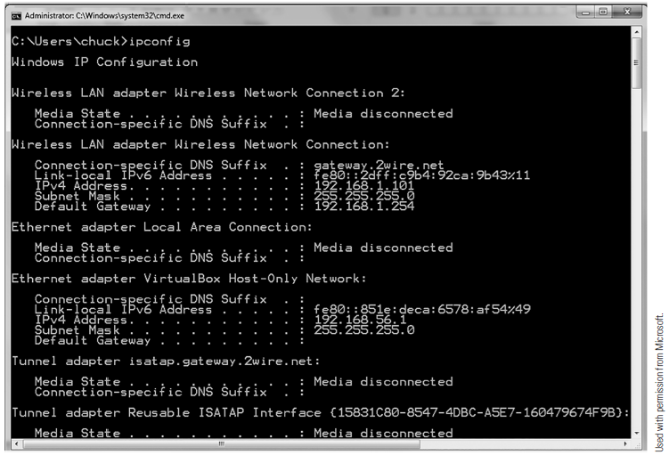
Networking Utilities: ipconfig
Notes:
IPConfig gives you some information about the computer’s connection to a network. It reveals the computer’s own IP address.

Slide 25
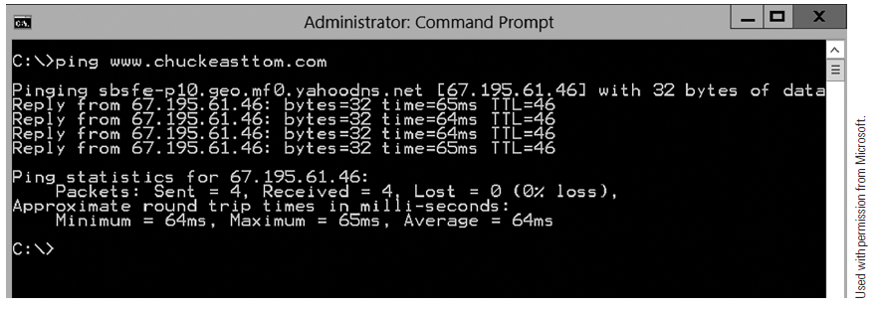
Networking Utilities: ping
Notes:
ping—Used to send a test packet, or echo packet, to a machine to find out if the machine is reachable and how long the packet takes to reach the machine.

Slide 26
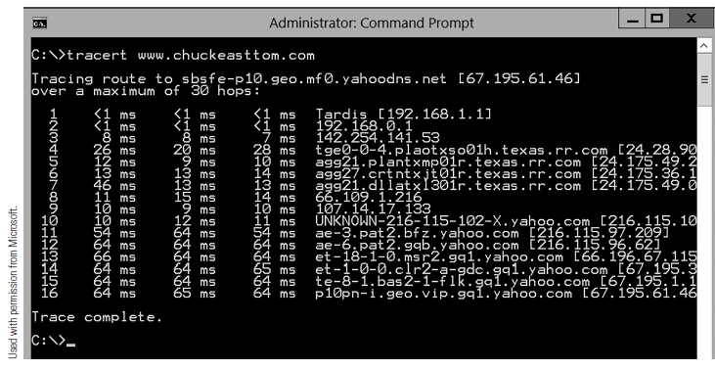
Networking Utilities: tracert
Notes:
Tracert—Also used to send test packets. In addition to telling you if the packet got there and how long it took, it also tells you something about the intermediate hops it took to get there.

Slide 27
Obscured Information and Anti-Forensics
Obscured information
  May be scrambled by encryption, hidden using steganographic software, compressed, or a proprietary format
  Cybercriminals sometimes obscure information to deter forensic examination
  Companies use certain manipulation and storage techniques to protect business-sensitive information

Slide 28
Obscured Information and Anti-Forensics (Cont.)
Anti-forensics
  Attackers may use techniques to intentionally conceal their identities, locations, and behavior
  Examples:
    Perpetrators may conceal their identities by using networked connections at a library
    Perpetrators may use encryption or anonymous services to protect themselves

Slide 29
The Daubert Standard
Legal precedent set in the 1993 Supreme Court case of Daubert v. Merrill Dow Pharmaceuticals [509 U.S. 579 (1993)]
Regards the admissibility of expert witnesses’ testimony during legal proceedings
Any scientific evidence presented in a trial has to have been reviewed and tested by the relevant scientific community
Notes:
Standard used by a trial judge to make a preliminary assessment of whether an expert’s scientific testimony is based on reasoning or methodology that is scientifically valid and can properly be applied to the facts at issue.

Slide 30
Daubert Standard (Cont.)
Empirical testing
Peer review
Error rate and standards
Generally accepted theory/technique
Notes:
Under this standard, the factors that may be considered in determining whether the methodology is valid are:
whether the theory or technique in question can be and has been tested;
whether it has been subjected to peer review and publication;
its known or potential error rate;
the existence and maintenance of standards controlling its operation; and
whether it has attracted widespread acceptance within a relevant scientific community.

Slide 31

Laws Important to Digital Forensics
Federal Privacy Act of 1974
Privacy Protection Act of 1980 (PPA)
Communications Assistance for Law Enforcement Act of 1994
Electronic Communications Privacy Act of 1986
Computer Security Act of 1987

Slide 32
Laws Important to Digital Forensics (Cont.)
Foreign Intelligence Surveillance Act of 1978
Child Protection and Sexual Predator Punishment Act of 1998
Children’s Online Privacy Protection Act of 1988
Communications Decency Act of 1996

Slide 33
Laws Important to Digital Forensics (Cont.)
Telecommunications Act of 1996
Wireless Communications and Public Safety Act of 1999
USA Patriot Act
Sarbanes-Oxley Act of 2002

Slide 34
Laws Important to Digital Forensics (Cont.)
18 U.S.C. § 1030: Fraud and Related Activity in Connection with Computers
18 U.S.C. § 1020: Fraud and Related Activity in Connection with Access Devices
The Digital Millennium Copyright Act (DMCA) of 1998
18 U.S.C. § 1028A: Identity Theft and Aggravated Identity Theft
18 U.S.C. § 2251: Sexual Exploitation of Children

Slide 35
The Communications Assistance for Law Enforcement Act (CALEA) of 1994
A federal wiretap law for traditional wired telephony
Was expanded to include wireless, Voice over Internet Protocol (VoIP), and other forms of electronic communications
  Including signaling traffic and metadata

Slide 36
The Foreign Intelligence Surveillance Act of 1978
A law that allows for the collection of “foreign intelligence information” between foreign powers and agents of foreign powers using physical and electronic surveillance
FISA court issues a warrant for actions under FISA

Slide 37
The Child Protection and Sexual Predator Punishment Act of 1998
Requires service providers that become aware of the storage or transmission of child pornography to report it to law enforcement

Slide 38
The Wireless Communications and Public Safety Act of 1999
Allows for the collection and use of “empty” communications
  Nonverbal and nontext communications, such as GPS information

Slide 39
The USA Patriot Act of 2001
The primary law under which a wide variety of Internet and communications information content and metadata is currently collected
Provisions exist within the Patriot Act to protect identity and privacy of U.S. citizens

Slide 40
Warrants/Search and Seizure/Fourth Amendment
Warrants
Search and seizure
Fourth Amendment and reasonable expectation of privacy
Notes:
There are many laws that affect forensic investigations and they vary by jurisdiction.
Computer forensic specialists must understand laws that apply to search and seizure. The U.S. Supreme Court has ruled that a “seizure” occurs when there is some meaningful interference with a person’s access to their property, including communications. Law enforcement does not need to actually take the property.
In addition, the Fourth Amendment requires a search warrant in situations where a person would have a “reasonable expectation of privacy.” In other words, information that can be viewed in public such as in a chat room or on Facebook would not require a search warrant. Information that is stored in a file on a person’s own computer hard drive would require a search warrant.

Slide 41
Federal Guidelines
FBI computer forensics guidelines
Secret Service "golden rules"
Regional Computer Forensics Laboratory (RCFL) Program
Notes:
The FBI and Secret Service have established guidelines that are important in setting up forensic labs. The FBI stresses the importance of securing evidence while preserving the state of the computer. The FBI recommends that first responders make a backup copy of any logs, damaged or altered files, and any files left by the suspect. If investigators arrive while the incident is in progress, they should immediately activate auditing or recording software. Investigators should work with a copy of the hard drive, not the original.
The Secret Service has released a guide that includes “golden rules” for beginning a computer forensics investigation including:
Secure the scene.
Take immediate steps to preserve any computer evidence.
Make sure there is legal basis for seizing a computer.
Do not access any computer files at the scene.
If the computer is on, follow guidelines for shutting it down and preparing it for transportation as evidence.
Immediately shut down a computer if you believe it is destroying evidence. Do so by pulling the power cord.
Take photographs of the computer screen (if it is on) or the computer, its location, and any attached electronic media.
Follow any special legal considerations that may apply (such as those for doctors, attorneys, clergy, etc.).
The RCFL Program is a national network of forensic laboratories and training centers which are funded and staffed by the FBI. This program provides law enforcement at all levels of government with digital forensics expertise and training.

Slide 42
Summary
Basic concepts of computer forensics, including the chain of custody
The process of computer forensics
Types of evidence
Hardware, software, networking, and address knowledge used in forensics
Laws related to computer forensics

