Slide 1
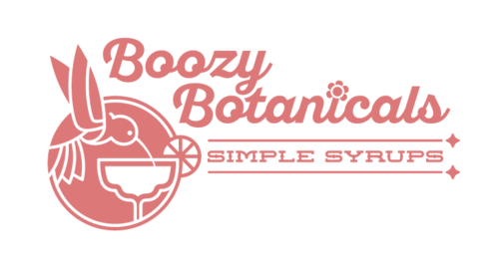
Boozy Botanicals
Danny Jaeger, Grace Holcomb, Shammawi Wellington, Sarah Nguyen, Brandon Brock

Slide 2
Who is Boozy Botanicals?
Kansas City brand specializing in all-natural syrups for cocktail mixers
Product is mainly known through its distributors
Differentiate themselves through premium products, bold flavors, and lower costs
What Problems Are They Facing?
Wanting to grow as a national brand
Emphasize business-to-business or business-to-consumer?

Slide 3
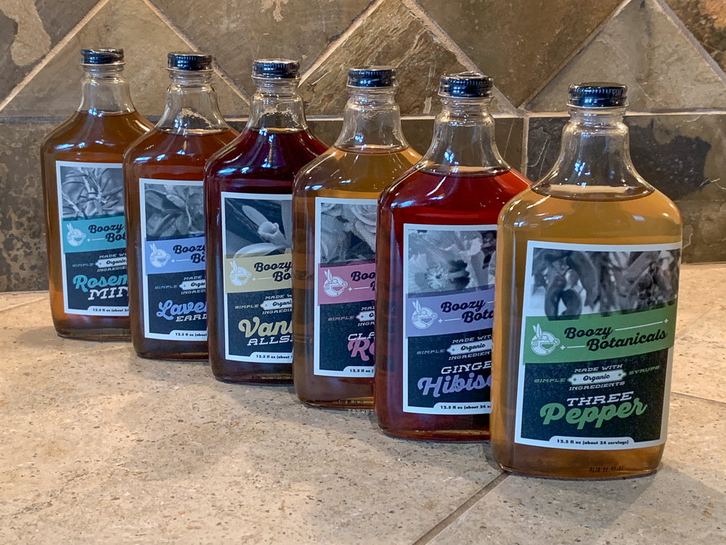
Summary of Resources Influencing Our Data Perspective
Understanding the market with secondary data
The cocktail market has exploded upwards since Covid-19
30% growth in premium mixer industry
Global market is expected to be $1.4 billion by 2026
Cocktails are mostly distributed at bars and restaurants
North America is the largest producer of cocktails
Consumer awareness is still low
Boozy is in a great position to reach a national market
All-natural and botanical products are attractive to customers
Their product line is optimal, but their marketing plan is holding them back

Slide 4
As Well As...
Understanding the Market with Primary Data.
Small local businesses are not familiar with customers.
People haven’t seen Boozy Botanicals in grocery stores like Wal-Mart and/or Aldi.
People who go to the local market don’t see Boozy Botanicals being sold or even used.
Boozy has a higher price than the overall syrups market.
People agreed that it is too expensive for a small bottle of syrup.
Most customers won’t spend over $20 for a syrup bottle from a strange brand.

Slide 5
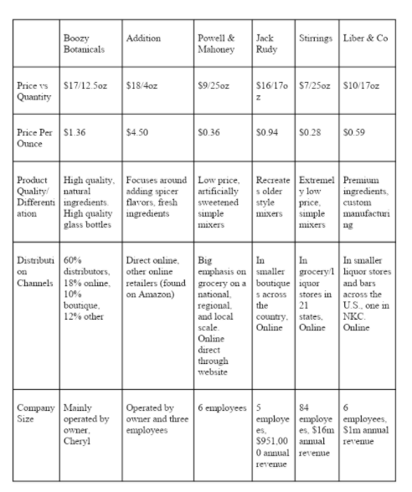
Manipulation of Data
Differentiation
-Boozy Botanicals is different from competitors
because they offer a premium product
in premium packaging for a lower cost
-For sale is 12.5 oz bottles for $12
-Even though this is a steal, it does not appeal to a
majority of consumers

Slide 6
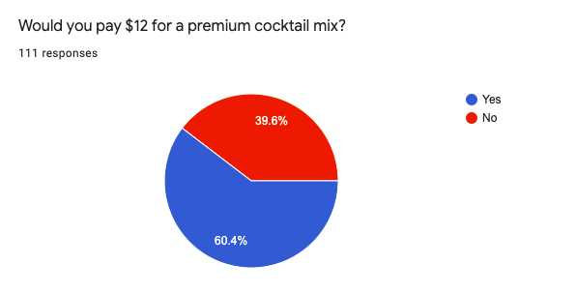
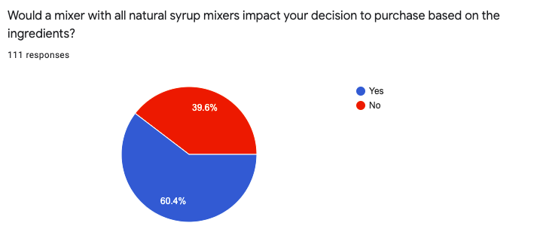
Manipulation of Data (cont.)
Marketing Segment
-The average consumer spends 13 seconds
purchasing in store, 19 online
-Small window of opportunity for attention
- Keep bottles clear, easy label, premium cocktail in big font ,
as well as natural ingredients

Slide 7
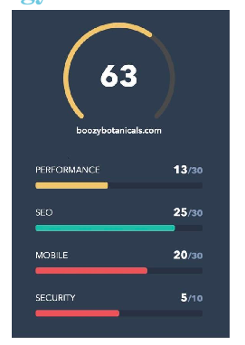
Manipulation of Data (cont.)
Search Engine Strategy
-It is important that we note
the overall score of the website, which was 63
-There needs to be improvement
on mobile optimization & button layout/design
-When the website is just ok, this means we
are not satisfying customers

Slide 8
Summary of Insights Derived From Data
In terms of being different, Boozy Botanicals offers a premium product in premium packaging more cheaper than any other high end drink mixer.
Compared to some of their competitors such as Jack Rudy and Addition, Boozy Botanicals offers a wider range of unique ingredients that are all natural.
Boozy Botanicals is not only limited to alcohol. They cater to people who prefer non alcoholic beverages as well such as tea.
Some of their natural plants used is Rosemary Mint(tea), Classic Rose(champagne) and Ginger Hibiscus(vodka)

Slide 9
Summary (cont.)
Our marketing strategies is very important as that will decide how Boozy Botanicals will stand out from other competitors
Because people spend only seconds to purchase liquor we have to ensure we get their attention by clearly stating at the front of the bottle that it is a premium cocktail mixer.
Our cheap prices for premium cocktail mixers will attract customers compared to other competitors
60.4 percent of our survey said that they will be willing to pay $12 for a cocktail mixer as they usually pay more.

Slide 10
Summary (cont.)
Our search engine strategy we believe will get Boozy Botanicals to the next level of growing and development.
Our aim is to get more people to know about Boozy Botanicals so we have to make content we know our primary consumers will search for on google. This provides a greater chance for the company to pop up in the consumers search bar.
Our research shows that the more you update your website the better chance you will have for customers to click on your website.
Lastly we will use google ads to get Boozy Botanical out there more. We chose the area of kansas city for our main area to be exposed to and chose some keywords that would allow google to give Boozy Botanical a brief advertisement based on the search of potential customers.

Slide 11
Recommendations Based on Our Data
For sales promotion, we want to target a more alcohol experienced user by;
Frequent sales (less bottles in stores)
Increase pricing ($15)
Free samples (around P&L)
Money Back Guarantee

Slide 12
Conclusion
Boozy Botanicals problems:
Need a better marketing strategy.
Choosing whether business-to-business or business-to-consumer.
Suggestion for Boozy Botanicals:
Provide free samples as expanding familiar feeling to customers.
Increasing price as Boozy guarantees money back.
Market competition:
Boozy has unique factors compared to its competitors, such as Jack Rudy and Addition.
They contribute premium products with lower cost, limited alcohol, as well as offering natural ingredients.
Boozy Botanicals Mission:
To grow as a national brand.

