Slide 1
The Future of Development?

Slide 2
Agenda tonight
Brief recap of the course

Slide 3
Big Thanks to my Team!

Slide 5
What have we learned about development, and what may be in store for the future?

Slide 6
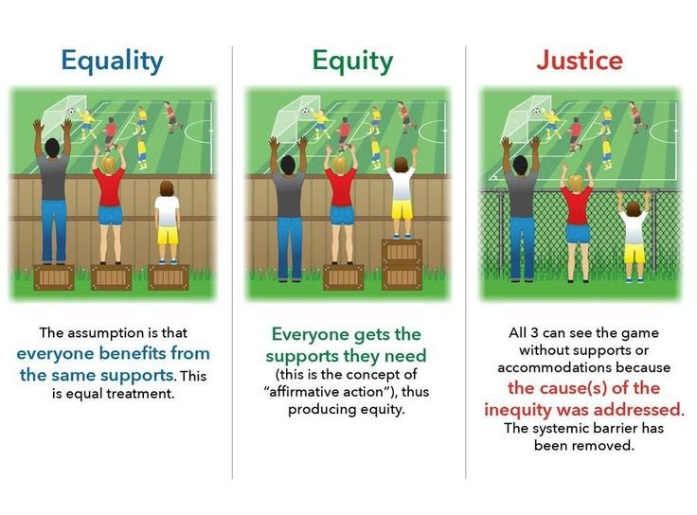
Last week
“Where inequalities in health are avoidable, yet are not avoided, they are inequitable.” (Marmot 2007)
https://www.reddit.com/r/GCdebatesQT/comments/7qpbpp/food_for_thought_equality_vs_equity_vs_justice/

Slide 7
Health is not simply the absence of disease Health is more than a bio-medical issue, but a social justice and human rights issue
Social Vaccine (public policies) that addresses structural and systemic factors determining our health and well-being

Slide 8
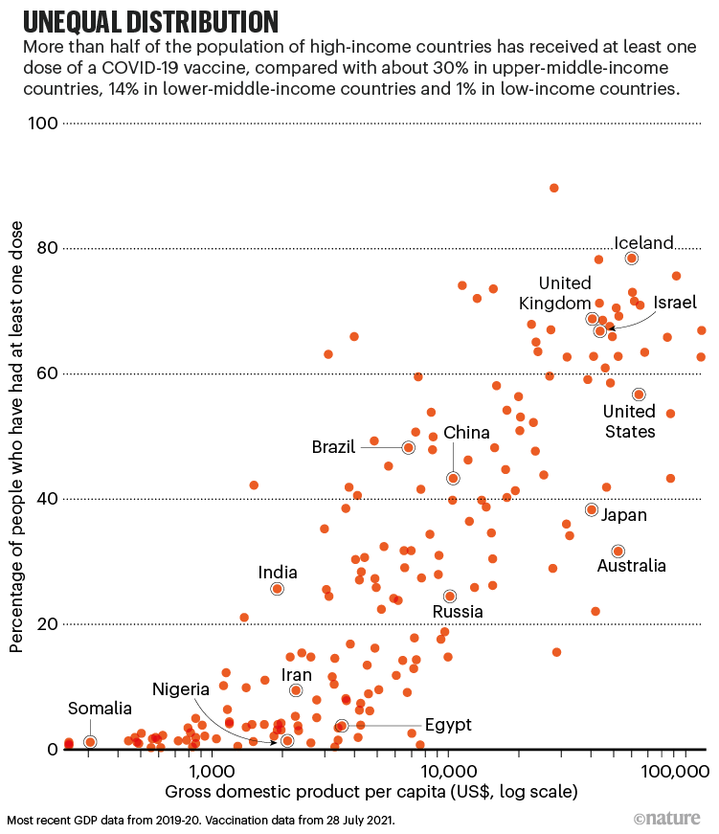
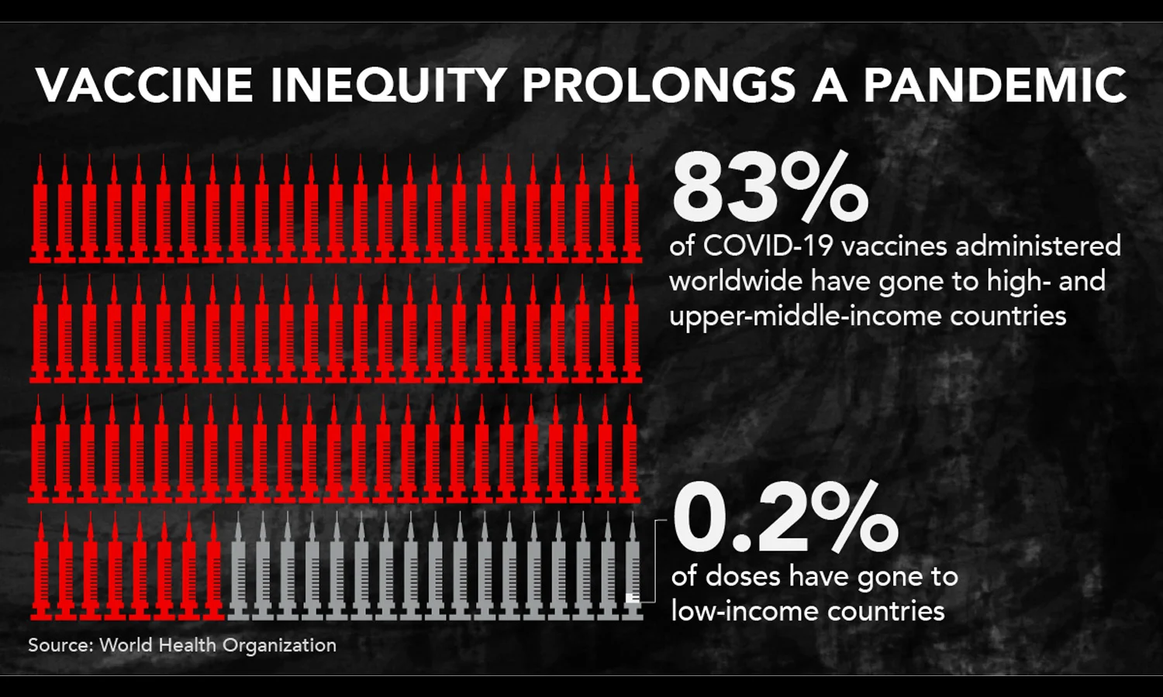
Vaccine Inequity

Slide 9
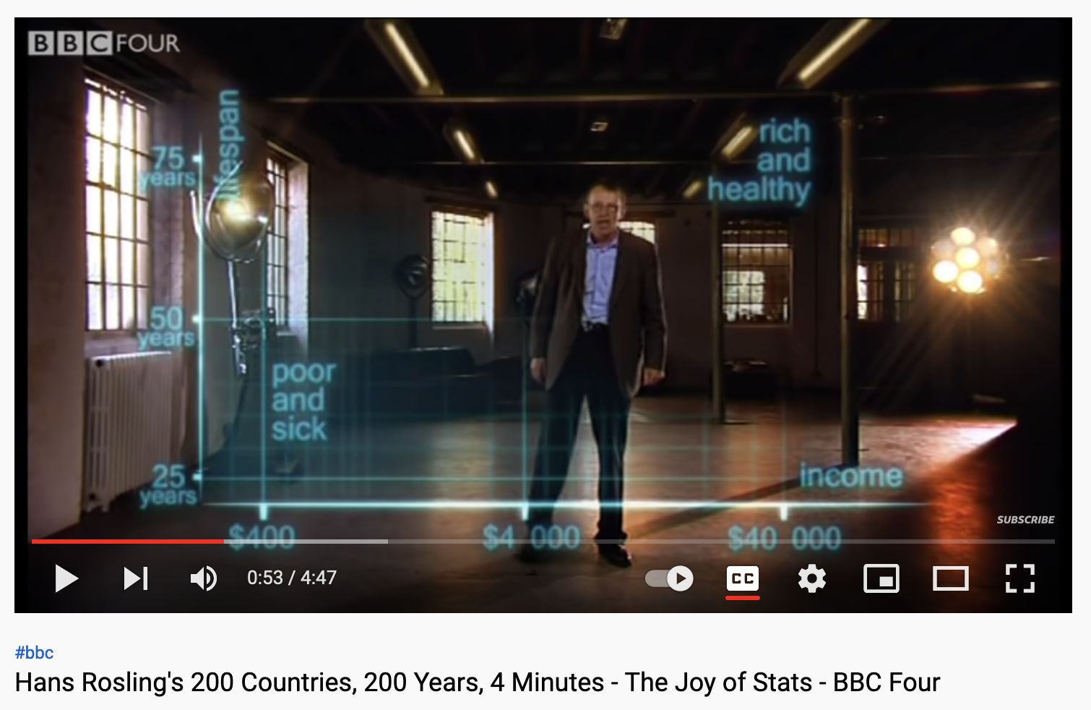
https://www.youtube.com/watch?v=jbkSRLYSojo

Slide 10
https://www.youtube.com/watch?v=kpSLhxZUC40

Slide 11
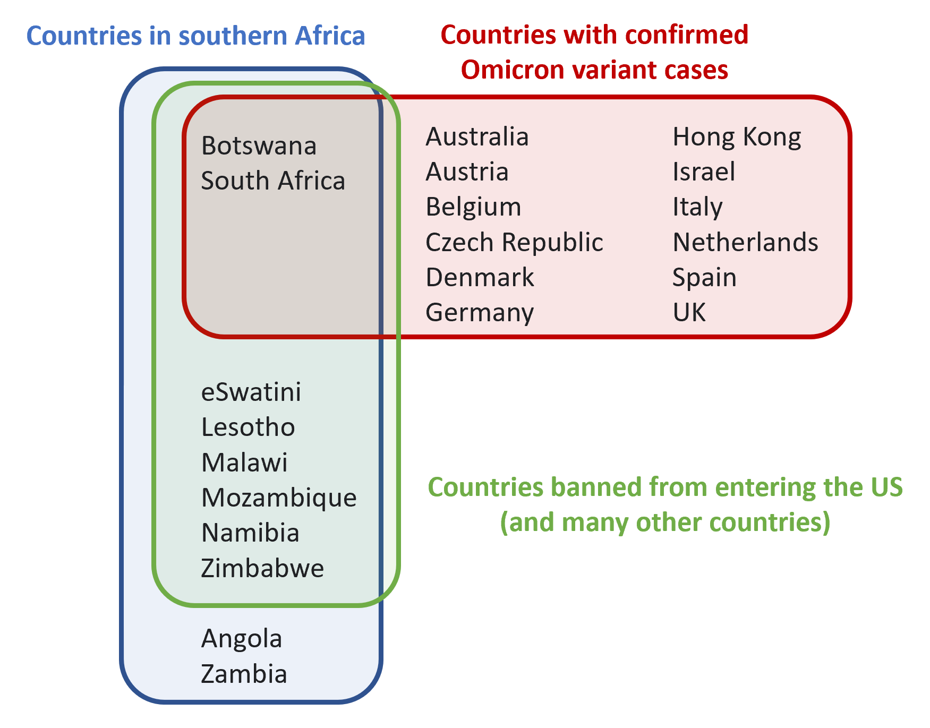
https://twitter.com/sleepyknave/status/1465062525951688711/photo/1

Slide 12
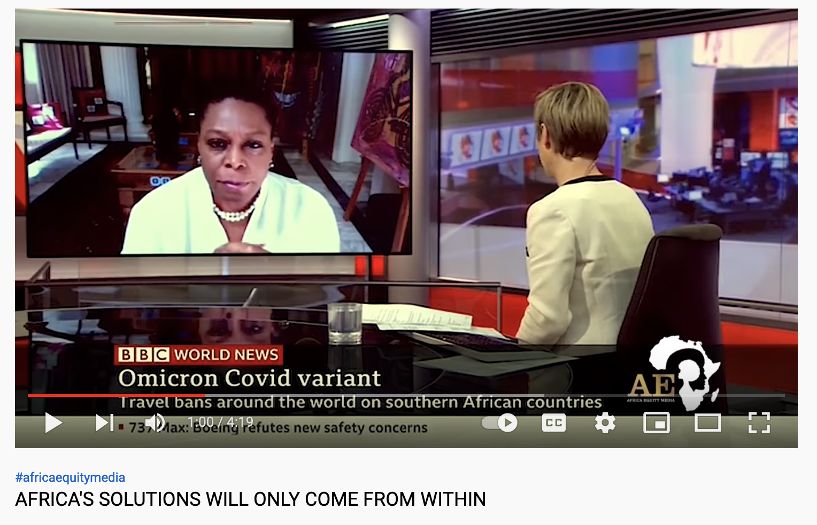
https://www.youtube.com/watch?v=KFUApXoanP4

Slide 13
Critical Development Studies as Challenging Conventional wisdom

Slide 14
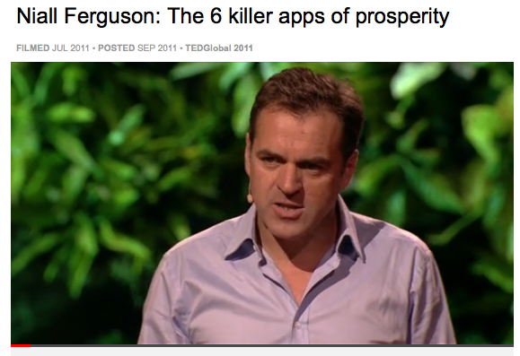
“Conventional Wisdom”
Competition
The Scientific Revolution
Property Rights
Modern Medicine
The Consumer Society
The Work Ethics
http://www.ted.com/talks/niall_ferguson_the_6_killer_apps_of_prosperity.html

Slide 15
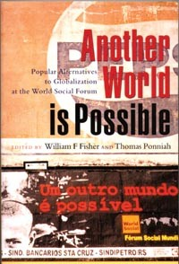
Grass root Movements
Thinking beyond development alternatives and towards alternatives TO development
Notes:
neo-Marxist Latin American dependency theory and searching for a Latin American identity through the work of authors such as Gabriel García Márquez. Writers from the North such as Herbert Marcuse and Jean-Paul Sartre, who were deeply critical of industrialized societies, were part of our education as well.
radical critique of the dominant, capitalist development model. This led to publication of The Development Dictionary in 1992 and now, twenty-five years later, the forthcoming Post-Development Dictionary.
This requires a deeper understanding of the underpinnings of the development concept and an unbundling and redefining of its core assumptions. For example, conventional development locates the individual as the central agent and beneficiary of development. Gustavo Esteva, a radical Mexican critic of development close to the Zapatista movement, argues that the idea of the individual was the Trojan Horse by which Western nations infused their ideology of development—including private property, secularism, and anthropocentrism—into traditional, communitarian ways of being.
About a year ago, I attended a meeting in Bogotá with the Minister of the Environment about the Pacific Coast, a rainforest region rich in biodiversity and populated largely by black and indigenous peoples. For thirty years, research and strategies to “develop” the area have centered on large-scale development interventions, such as the expansion of oil palm plantations, mining, and large port development. Against this backdrop, poverty, inequality, and violence have deepened. To say the problem facing the region—and other parts of Latin America—is lack of development is fundamentally flawed. At that meeting, I argued that we should dare to reverse the picture: to entertain the idea that the problem of this region, is not underdevelopment but, in fact, excessive development. Recognizing this opens possibilities for new thinking based on alternative notions of human and ecological well-being.

Slide 16
‘Sustainable development’ is an oxymoron
Contradictions between continuous growth and environmental degradation
Still highly technocratic
Who is driving the discourse on the “Green Economy”?
What policies are being implemented?
Who benefits?
Failure to address the historical and structural roots of poverty

Slide 17
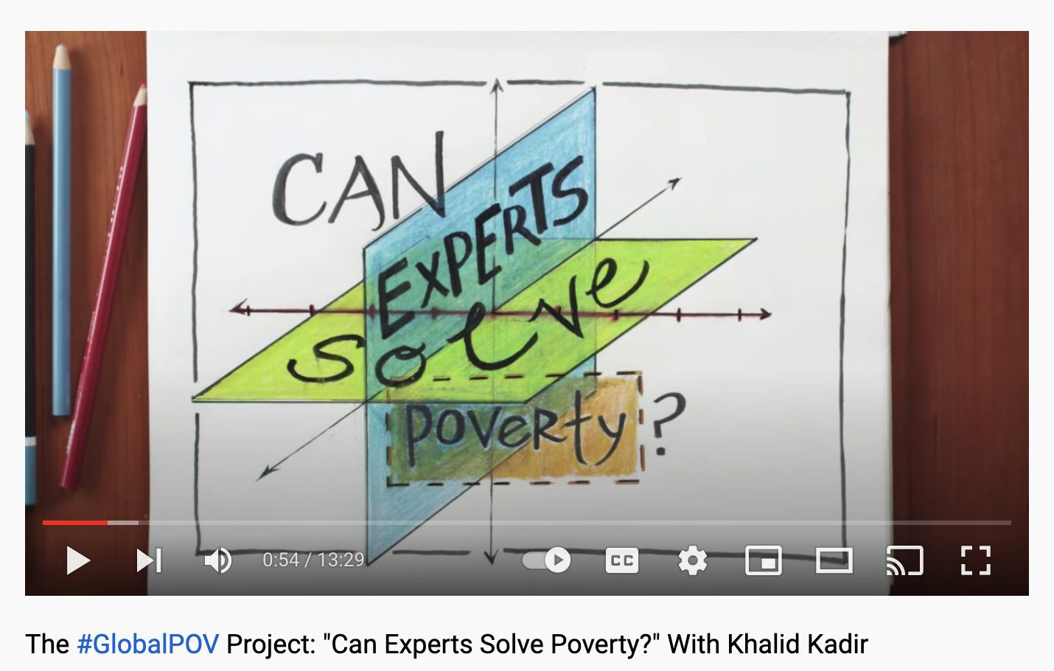
Can expert solve poverty?
https://www.youtube.com/watch?v=8jqEj8XUPlk

Slide 18
Final Exam
https://q.utoronto.ca/courses/223500/discussion_topics/1499238

Slide 19
Your Feedback?

