Slide 1
World Economies Presentation
China Vs India

Slide 2
China Vs India Introduction
China and India are the among the top emerging economies in the world.
On a nominal basis, China and India are the 2nd and the 5th largest economies in the world respectively.
In the public-private partnership and nominal terms, the two countries share 21% and 26% of the total global wealth.
The two countries GDP was almost equal in 1987, in both nominal and PPP terms.
Notes:
The two countries have been head to head for years.
China is leading at first place and India at 3rd place.

Slide 3
GDP Per Capita Growth Over Time
The two countries have been back to back in GDP per capita terms until 1990.
In 1990 India was wealthier than China.
In 2021, China is 5.4 times richer than India in per capita terms and 2.58 richer in nominal terms.
China overtook India in GDP growth in 2015.
India’s GDP is $1.5 trillion while China’s is $7 trillion.
Notes:
China has grown so much in terms of economy that it would be almost impossible for India to catch up.
Inflation in India is 6 times that of China and has been stable at 0.8% for many years.
China’s GDP has grown over 10% in 22 years while India’s was not growing.

Slide 4
Inflation Rate Over Time- India
In India inflation for consumer prices has moved between -7.6% and 28.6% in the time frame of 60 years.
In 2020 the inflation rate was calculated at 6.6%.
In 2022 the average year-on-year inflation was 6.3%
Notes:
The average inflation between 1960 and 2021 is 7.5% that means that an item bought in 1960 has increased in prices at a 7.5% rate.

Slide 5
Inflation overtime in India
Notes:
When consumer prices decrease in some instances, it is known as deflation and may occur due to political unrest.

Slide 6
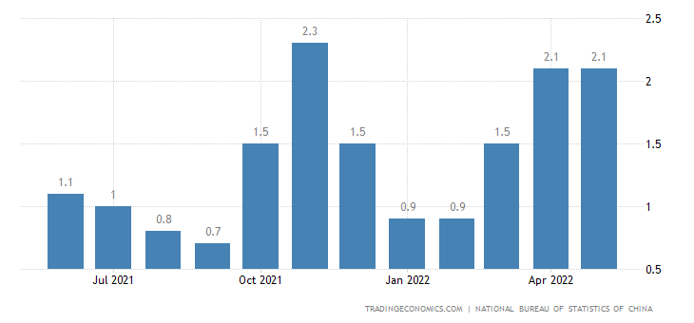
Inflation rate over time- China
Notes:
The chart shows that China’s inflation is at 2.1% in may 2022, constant for the past five months despite the forecast for 2.2%.
In 2020, following the easing of Cocid-19, consumption strengthened especially in majir cities of China like Beijing and Shanghai.
The cost for both food and non-food items continue to rise.

Slide 7
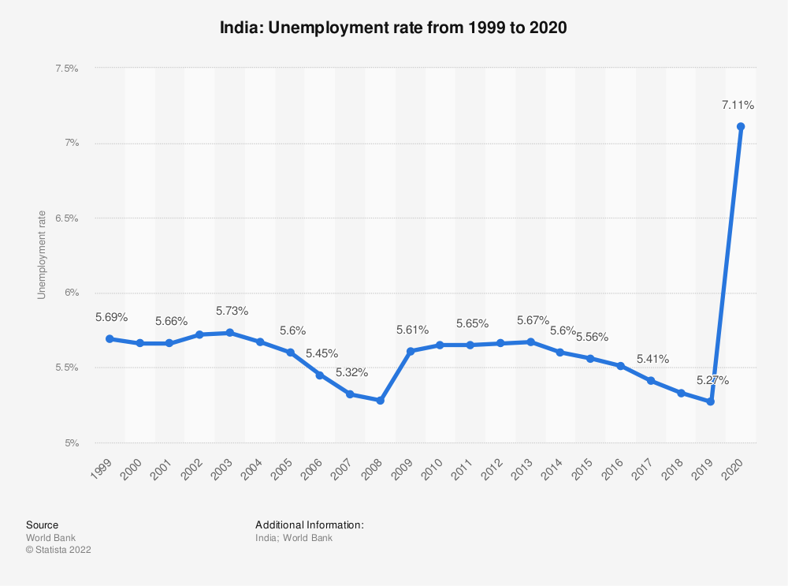
Unemployment Rate
Notes:
One of India’s largest dependant for economic growth is the manufacturing industry. Although its most significant economic factor is the industry services.
India is recognized as one of the fastest growing economy countries together with China, Brazil, and Russia.

Slide 8
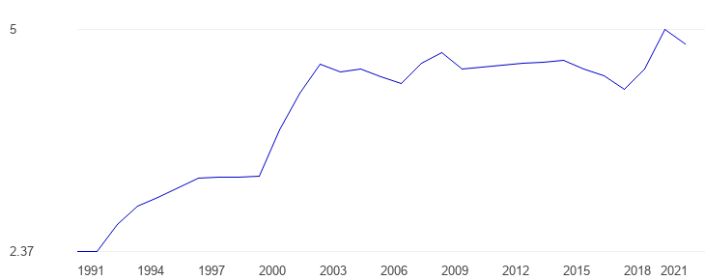
Unemployment Rate in China
Notes:
The average for China’s unemployment rate for 1991 was 4.01% with a minimum of 2.37% and a maximum of 5% in 2020.
In 2021 it is at 4.82%.

Slide 9
Exports as a percentage of GDP over time
China | India
2020 18.5% | 2020 18.7%
Notes:
The most recent figures as shown by the world bank for both countries. They show that India's GDP for the most recent figures are 0.2% higher than that of China.

Slide 10
National government debt as a percentage of GDP
Country comparison China Vs India
 |  | China | India
Debt ($M) [+] | 2020 | 10,115,837 | 2,402,408
Debt (%GDP) [+] | 2020 | 68.06% | 90.06%
Debt Per Capita [+] | 2020 | $7,164 | $1,741
Notes:
India’s government debt has been higher than China’s from 1990 to 2020 although the percentage of debt for both countries has increased over the years.

Slide 11
Variation in Economic Growth
Difference in political systems of economy.
India adopts a parliamentary democracy.
China is a one party dictatorship.
China opened up for more trade and allowed for Shanghai stock exchange in 1990. in 1998 China began a $500 billion bail out to strengthen financial sector.
Due to world trade organization, China opened up foreign investment and domestic economic liberation.
Notes:
The systems have seen India scale back on industries run by the state.
China on the other hand have pseudo-free market command economy.
China exercised self-interest (McConnell et., 2021).

Slide 12
Continued
India pursued the traditional western economic reforms that saw it to the world third largest economy.
State owned enterprises affected their economy.
India encountered an economic crisis that led to it floating their currency.
India has picked up since 1991 through privatization and opening up the country to foreign nvestment.

Slide 13
Value Added Trade Measures
Failure to include value added trade measures will not include the value added by the country during production.
It eliminates multiple or double counting problems.
Value added trade measures enable the countries in accounting for global supply chain value systems with the policies put in place (Munichello, 2021).

Slide 14
Industries
China | India
Manufacturing industry | Labor costs
Technology manufactured for export | Skill intensive tradable service
Notes:
The manufacturing industry in China gave it a comparative advantage in form of cheap labor.
Countries like the US has used this cheap labor in India to shift some of their companies.

Slide 15
References
McConnell, C. R., Brue, S. L., & Flynn, S. M. (2021). Economics: Principles, problems, and policies (22nd ed.). McGraw-Hill Education.Pugel, T. A. (2020). International economics (17th ed.). McGraw-Hill Education.
MUNICHIELLO, K. (2021). Trade in Value Added (TiVA). Retrieved 25 June 2022, from https://www.investopedia.com/terms/t/trade-value-added-tiva.asp

