Slide 1
Relationships Between Industries: The Forces Moving Us Toward Long-Run Equilibrium
9

Slide 2
A competitive firm can earn positive or negative profit in the short run until entry or exit occurs. In the long run, competitive firms are condemned to earn only an average rate of return.
Profit exhibits what is called mean reversion, or “regression toward the mean.”
If an asset is mobile, then in equilibrium the asset will be indifferent about where it is used (i.e., it will make the same profit no matter where it goes). This implies that unattractive jobs will pay compensating wage differentials, and risky investments will pay compensating risk differentials (or a risk premium).

Slide 3
continued
The difference between stock returns and bond yields includes a compensating risk premium. When risk premia become too small, some investors view this as a time to get out of risky assets because the market may be ignoring risk in pursuit of higher returns.
Monopoly firms can earn positive profit for a longer period of time than competitive firms, but entry and imitation eventually erode their profit as well.

Slide 4
Good to Great
In 2001, Jim Collin published Good to Great, a book detailing how 11 companies used management principals to go from “good” to “great”
By 2009 many of these same companies were bankrupt – they had done amazingly well during the research period but failed to outperform the market after the book’s publication. Why?
Mr. Collin’s made two fatal errors
The “fundamental error of attribution”
Successful firms aren’t necessarily successful because of their observed behavior (this will be discusses in a later chapter)
Ignoring long-run forces that erode profit
Competition erodes above-average profit (this will be discussed in this chapter)

Slide 5
Competitive Firms
Definition: A competitive firm is one that cannot affect price.
They produce a product or service with very close substitutes so they have very elastic demand
They have many rivals and no cost advantage over them
The industry has no barriers to entry or exit
Competitive firms,
cannot affect price; they can choose only how much to produce
can sell all they want at the competitive price, so the marginal revenue of another unit is equal to the price (sometimes called “price taking” behavior).
For competitive firms price = marginal revenue
so if P>MC, produce more and if P<MC, produce less

Slide 6
Competitive Firms (cont.)
Perfect competition is a theoretical benchmark
No industry is perfectly competitive, but many industries come close to it
The benchmark is valuable to expose the forces that move prices and firm profit in the long run
A competitive firm can earn positive or negative profit, but only in the short-run. In the long run:
Positive profit (P>AC) leads to entry, decreasing price and profit
Negative profit (P<AC) leads to exit, increasing price and profit
In the long-run, competitive firms are condemned to earn only an average rate of return.

Slide 7
Competitive Firms in the Long Run
Proposition: In equilibrium, capital is indifferent between entering one industry or any other, because P=AC (economic profit is zero)
In the short run, a price increase that leads to a profit increase attracts capital to existing firms or new entrants come into the industry.
This increases supply, which leads to a decrease in price until firms are no longer earning above-average profit, so capital flow stops = long-run equilibrium
A competitive firm can earn positive or negative profit in the short run but only entry and exit occurs. In the long run, competitive firms earn only an average rate of return.

Slide 8
“Mean Reversion” of Profits
Asset flows (entry and exit) force price to average cost
e.g. even with demand and supply shocks that result in short-run price increases/decreases, economic profit will always revert back to zero
We say that “profits exhibit mean reversion”
Silver lining to dark cloud (low profit will increase as firms exit the industry)
Reversion speed is 38% per year
So, if profits are 20% above the mean one year, in the next year they will be only 12.4% above the mean, on average

Slide 9
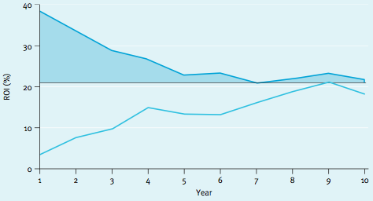
“Mean Reversion” of Profits (cont.)
An analysis of over 700 business units found the 90% of both above-average and below-average profitability differentials disappeared over a 10-year period
Return on investment reverted back to the mean level of approximately 20% for both over- and underperformers (shown below)

Slide 10
Indifference Principle
The ability of assets to move from lower- to higher-valued uses is the force that moves an industry toward long-run equilibrium
Indifference principle: If an asset is mobile, then in long-run equilibrium, the asset will be indifferent about where it is used; that is, it will make the same profit no matter where it goes
Labor and capital are generally highly mobile assets
They flow into an industry when profits are high and out of an industry when profits are negative

Slide 11
Indifference Principle Example
Suppose San Diego, CA is more attractive to live in than Nashville, TN
If labor is mobile, people will move from Nashville to San Diego
This will increase demand for housing ghousing prices will increase to a point where San Diego becomes as unattractive as Nashville g migration to San Diego will stop g long run equilibrium!

Slide 12
Compensating Wage Differentials
Wages adjust to restore equilibrium
The indifference principle tells us that in long-run equilibrium, all professions should be equally attractive, provided labor is mobile
Once long-run equilibrium is reached, differences in wages are “compensating wage differentials”
Compensating wage differentials reflect differences in the inherent attractiveness of various professions
Example: embalmers make 30% more than rehabilitation counselors because it is considered a relatively unattractive profession

Slide 13
Finance: Risk vs. Return
Can apply long-run analysis to fundamental relationships in finance
Investors prefer higher returns and lower risk if two investment options have the same return and one is less risky, the less risky one will be chosen and it will bid up the price of the less risky investment
The higher price decreases the investment’s expected rage of return
Therefore, n equilibrium, differences in the rate of return reflect differences in the riskiness of the investment, e.g. risk premium
Expected return = (E[P_{t+1}] - P_{t})/P_{t}
The higher return on a risky stock is known as the risk premium
In equilibrium, differences in the rate of return reflect differences in the riskiness of an investment.
Risk premia are analogous to compensating wage differentials: just as workers are compensated for unpleasant work, so too are investors compensated for bearing risk

Slide 14
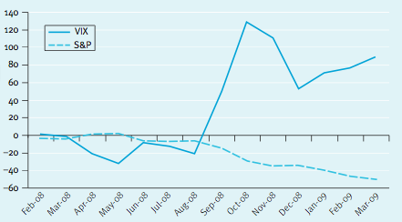
Stock Volatility and Returns
CBOE Volatility Index (VIX) against the price of the S&P 500 stock index (GSPC)
From Fall of 2008 through the Spring of 2009, the stock market declined by about 50% while the volatility index increased by about 100%
Greater volatility reduced stock prices, increased expected returns to compensate investors for bearing more risk
Change since Jan. 2008 (%)

Slide 15
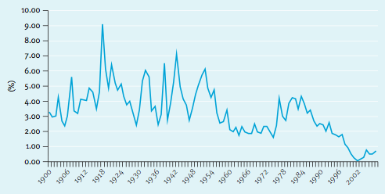
Historical Equity Risk Premium
Government bonds are considered risk-free, they returned 1.7% over the last 80 years while stocks returned 6.9%.
The difference is a risk premium that compensates investors for holding the more risky stocks
The equity risk premium of stocks over bonds (in the graph below) has varied over time, from 0% to 9%

Slide 16
Monopoly-Different Story, Same Ending
Monopoly firms have attributes that protect them from the forces of competition:
They produce a product or service with no close substitutes
they have no rivals
there are barriers to entry, so no other firms can enter the industry.
Proposition: In the very long run, monopoly profits are driven to zero by the same competitive forces though
Entry makes demand more elastic (P-MC)/P=1/|e|, which forces price back down towards MC
Example: In Oct. 2001, Apple released the iPod, which was a unique, user-friendly product with low elasticity of demand and high margins. Rivals began producing competing music players, which made demand for iPods more elastic. This reduced price-cost margins and lowered profit for Apple.

Slide 17
Title?
In 1924, Kleenex tissue was invented as a means to remove cold cream.
After studying customer usage habits, however, the manufacturer (Kimberly-Clark) realized that many customers were using the product as a disposable handkerchief. The company switched its advertising focus, and sales more than doubled.
Kimberly-Clark built a leadership position by creating an innovative use for a relatively common product.

Slide 18
Title continued?
As others saw the profits, however, they moved into the market.
The managers of the company maintained profitability through a continuing stream of innovations and investment in advertising/promotion.
Printed tissue in the 1930’s
Eyeglass tissue in the 1940’s
Space-saving packaging in the 1960’s
Lotion-filled tissue in the 1980’s.
Without this continuing stream of innovations and brand support, the product’s profits would have been slowly eroded away by the forces of competition.

