Slide 1
SWK 6622 – Crisis Intervention
BRENT EUBANKS, LICSW

Slide 2
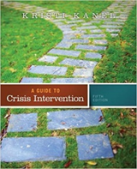
Week 2 – Crisis Intervention
Lecture (Thursday)
Chapter 2 – Ethical, Legal, and Professional Issues
Review upcoming assignments

Slide 3
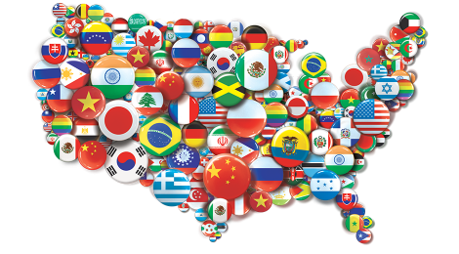
Multicultural competence (p. 36)
Crisis workers are encouraged to be open and knowledgeable towards subgroups that differ from mainstream culture
According to the text, multicultural refers to 5 major cultural groups within the US: African Americans, Asian Americans, Caucasians, Latinos, and Native Americans
Additional subgroups: individuals with disabilities, gays, lesbians, bisexuals, and transgenders, and certain religious groups
Cultural sensitivity is an ethical mandate

Slide 4
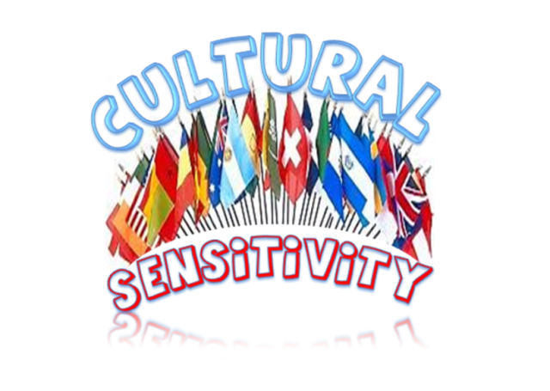
Development of cultural sensitivity (p. 37)
Developing cultural sensitivity is not an easy task
How many of you have taken Diversity? What did you learn?
Important factors: culture, ethnicity, religion and gender issues
Knowledge of various cultures before meeting with a client is important, BUT it is more important to follow a client’s lead in order to help the client feel understood and validated

Slide 5
Etic vs. emic issues (p. 38)
Etic – behaviors and traditions of all or most humans regardless of race, ethnicity, or culture
Emic – behaviors and traditions particular to a certain cultural group
The goal is NOT to use cultural norms to justify behaviors, especially if they are abusive, but to understand and find effective interventions
Cultural traditions can sometimes be the source of a crisis

Slide 6
Latinos (p. 39)
Personalismo – relating to others in a manner that may include exaggerated warmth and emotions and a strong need for rapport in order to feel safe or to trust others
Marianisma – expectations for Latina females to be pure, self-sacrificing, and place children & spouse before themselves (how can this be at odds with mainstream culture?)
Machismo – for Latino males to take pride in being virile and protective of his family; strong sense of male privilege in this culture (protection vs. abuse)
Catholicism – religion of choice for most Latinos, but many today are choosing more fundamental Christian religions; do not assume that every Latino is Catholic
Familismo – value of family above all (can cause resistance in feeling they might be talking negatively about their family in counseling; can feel awkward in support groups or with non-family members)
Enmeshed Family Structure – may include support, but can also include feelings of a lack of privacy
Emotionalism – exaggerated expression that borders on the dramatic

Slide 7
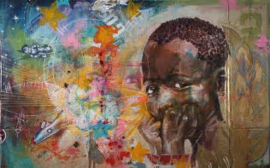
African American families (p. 40)
Have lived in the US longer than many other ethnic groups who immigrated during the late 1800s
History of slavery, racism, and discrimination that must be considered
Religion – many have strong religious beliefs that have been passed down from generation to generation
Many African Americans do not place much trust in mainstream, middle-class mental health counselors
Racism – worker must always acknowledge that racism is present in our society and must understand the world of a client who deals with racism every day

Slide 8
Asian American families (p. 41)
Family Structure – traditional Asian families show more respect for males than females; oldest son has more privileges than his mother; the mother plays the role of nurturer and domestic structure; father dictates all family decisions; once a daughter marries, she belongs to her husband’s household and family
Shame & Obligation – a sense of shame to not only the individual but the entire family line can occur if cultural norms are not followed; having to choose between obligation and individual freedom can bring feelings of depression and anxiety; crisis workers to be sensitive to the struggles
Communication Process – conditioned to avoid eye contact and direct confrontations, especially with doctors and authority figures; some Asian clients might feel they cannot disagree with the professional; they may have difficulty confronting family; best to provide educational, problem-solving approaches that focus on a presenting problem

Slide 9
Subculture – LGBT (p. 42-43)
Terminology
Bisexual – person who experiences social & romantic attraction to both genders
Closet Gay – person who is unaware of his or her homosexuality or is unwilling to publicly acknowledge
Coming Out – process of identifying and coming to terms with one’s homosexuality; telling others
Gay – man who is mostly sexually attracted to men
Heterosexism – bias against homosexuals based on the belief that heterosexuality is superior
Homophobia – unreasonable fear or hatred of a homosexual
Homosexuality – sexual desires primarily for a person of the same sex
Lesbian – woman who feels sexual desire predominantly for another woman
Transgender – person who experiences himself or herself socially, emotionally, and psychologically as a different gender

Slide 10
Generation LGTBQIA (new York times)
“Q” – queer or questioning – an umbrella term
“I” – intersex – for someone who’s anatomy is not exclusively male or female
“A” – ally or asexual – for someone who’s a friend of the cause or absence of sexual attraction
http://www.nytimes.com/2013/01/10/fashion/generation-lgbtqia.html
Additional terms
Pansexual - not limited in sexual choice with regard to biological sex, gender, or gender identity
Trisexual – not gender oriented; willing to have sexual relations and/or experiment with any other person regardless of their gender or tendency toward a specific sexual orientation
Bi-gender - denoting or relating to a person whose sense of personal identity encompasses two genders
Agender - denoting or relating to a person who does not identify themselves as having a particular gender
Transvestite - a person, typically a man, who derives pleasure from dressing in clothes appropriate to the opposite sex.

Slide 11
upcoming
Discussion #2 due Sunday by midnight (Canvas)
Week 3 – Chapter 3 & beginning of Chapter 4
Week 3 – Quiz #1– due Sunday by midnight (Canvas) - covers Chapters 1-3 (multiple choice)

