Slide 1
Module 2: Literature review
Capstone Tutoring Materials

Slide 2
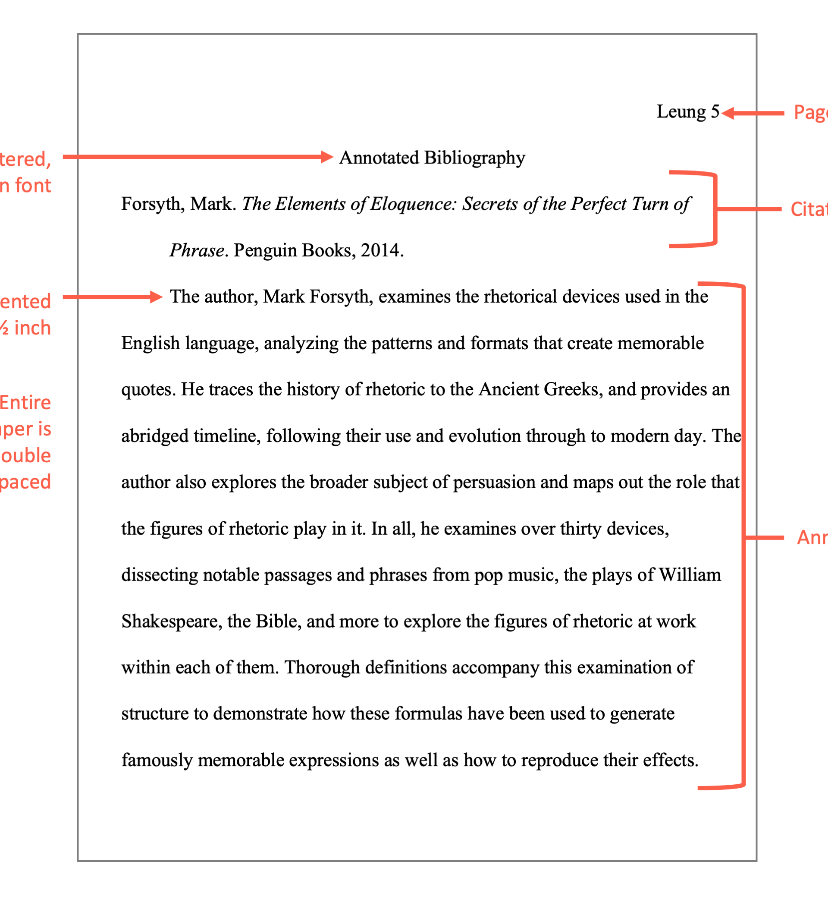
Annotated Bibliography
Annotations are added to the reference list to verify the researcher has thoroughly read all the research.
(Course Hero, 2021)

Slide 3
Annotation
A short paragraph that offers a brief overview of the cited material
An annotation should contain the main idea of the articles and the authors’ view of the topic.
An annotation should include clear and concise sentences with proper spelling and grammar.
An annotation should include why you used this source.
What does it add to your research?
Does it lack any information?
The annotation should connect the article to your research.
What did you learn from the article that made your research better?
(Course Hero, 2021)

Slide 4
Things to consider:
If the article produces a negative review, do not use it.
It is acceptable to mention limitations or small issues.
There is no need to include the article’s title as the citation for that article is right above the citation.
Each citation and annotation should focus on one article.
Do not include more than one reference in each citation.
(Course Hero, 2021)

Slide 5
LOCATING RESEARCH

Slide 6
Scholarly source:
An expert in a particular field writes a scholarly source.
It serves to keep others interested in that field on the most recent research, findings, and news.
These resources will provide the most up-to-date information for your research papers.
(Library.Illinois.edu, 2021)

Slide 7
Peer-reviewed source:
A peer-reviewed source has undergone the review and scrutiny of a review board.
The review board consists of colleagues in the authors’ field. They help determine its readiness for publication.
The source is evaluated as part of the body of research for a particular discipline and makes recommendations regarding publication in a journal.
(Library.Illinois.edu, 2021)

Slide 8
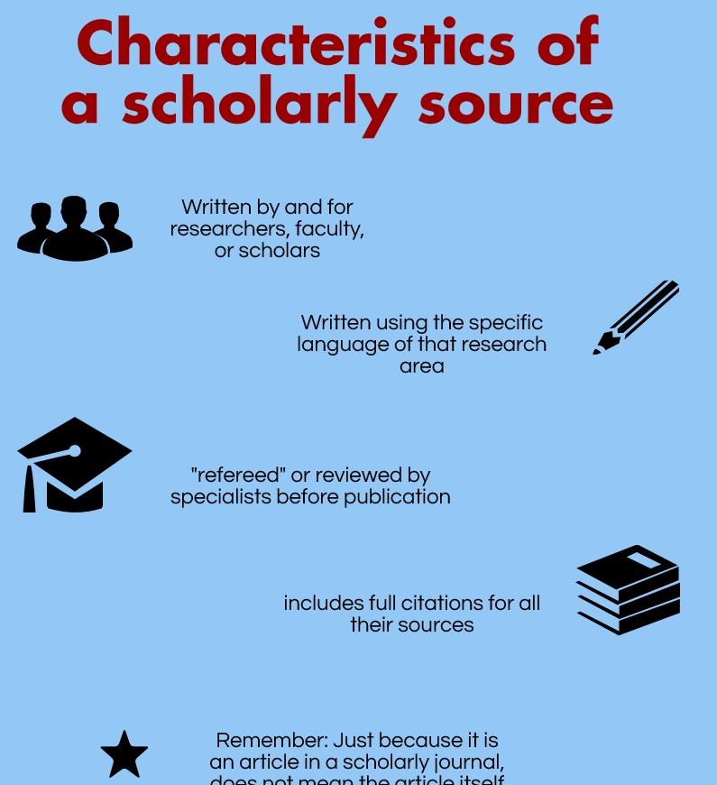
Sources
Scholarly sources are used because they contain authority and credibility that improve the quality of your paper or the research project.
(Library.Illinois.edu., 2021)

Slide 9
Is this a scholarly source?
The article is most likely scholarly if:
You found the article in a library database or google scholar
The journal the article appears in is peer-reviewed
The author provides their credentials
The author is affiliated with a university or other research institution
The source is longer than ten pages
The source has a works cited or bibliography
It does not attempt to persuade or bias the reader

Slide 10
Using the school library
The following link directs you to the school library
http://uagm.summon.serialssolutions.com
Using the white search box, enter your topic and press enter
Along the left side of the screen; you can narrow your search results
Limiting the search results will help you locate acceptable sources
You should select
Scholarly/peer-reviewed
Journal articles
Last five years
This will give you the best articles for a research paper.
Articles that have an unlocked padlock are free for you to use. You may have to log in with your username and password.

Slide 11
Using Google scholar
The following link directs you to google scholar
https://scholar.google.com
Using the white search box, enter your topic and press enter
Along the top of the webpage is an option to select a time frame
You are not given any other options because these results have already been filtered to include only scholarly/peer-reviewed research
Articles with a notation of pdf or HTML to the left will allow you free access to the report by clicking the link
If the article is relevant to your research, download a copy to your computer.

Slide 12
Literature Review
A literature review should be a critical analysis of “literature” on an existing topic.
A literature review summarizes the other research that has been done on a topic.
The review will describe, summarize, evaluate, and explain the previous research.

Slide 13
Structure of a Literature Review
Introduction
State the reason for your work
State the aspects of your research that will be included in the literature review
What exactly will you be talking about
Your research questions should be included in this section
Stay focused and include only the introductory information.
Avoid including information that does not relate to your topic

Slide 14
Structure – Continued
Body
The central part of the literature review
Made up of several paragraphs
Each paragraph should address one topic
The body should be broken up into sections
Each section should focus on a research question
Include a heading before each section
This alerts the reader of a topic change
As you draft your literature review body, you should point out similarities and difference in the research you read as it relates to the research you are doing

Slide 15
Structure – Continued
Conclusion
Summarize all your main ideas
Restate your research questions and your recommended solutions
Point out anything that was out of the ordinary
Restate the goal of your research
References
The page can be built from your annotated bibliography
Do not include your annotations
Make sure the references are in APA format
The reference should be double spaced
You should also apply the hanging indent function to your resources (Scribbr, 2021).

Slide 16
Assignments

Slide 17
Activity: Annotated Bibliography
Prepare an annotated bibliography.
Include at least five entries
Submit it to the course.

Slide 18
An annotation should contain roughly eight sentences.
It should summarize the main points of the source in your own words.
It should explain how the source is relevant to your research paper.
It should explain how this source will help you develop one or more of the main points of the essay.

Slide 19
When preparing the assignment
Use the Word template and record an APA citation for each reference.
The template provided has sample citations that you can use for guidance.
You can also use https://owl.purdue.edu/research/research.html to double-check citations
Remember:
An annotation is roughly 150 words or approximately eight sentences.
An annotation should contain relevant information as it relates to your research.

Slide 20
Assignment: Literature Review or Background
Write the literature review and prepare the list of references.
Use the latest version of APA Style formatting for citations.
Submit it to the course

Slide 21
Discussion Forum
Upload your literature review and the list of references in the corresponding discussion forum.
Read your classmates uploaded works and comment on at least 2 of them.
Offer advice on how they can improve their literature review
Responses must be at least 150 words.
Answer the comments and questions your classmates made about your work.

Slide 22
References
Coursehero. 2021. https://www.coursehero.com/
Illinois University Library. 2021. https://www.library.illinois.edu/
Scribbr. 2021. https://www.scribbr.com/category/research-paper/

