Slide 1
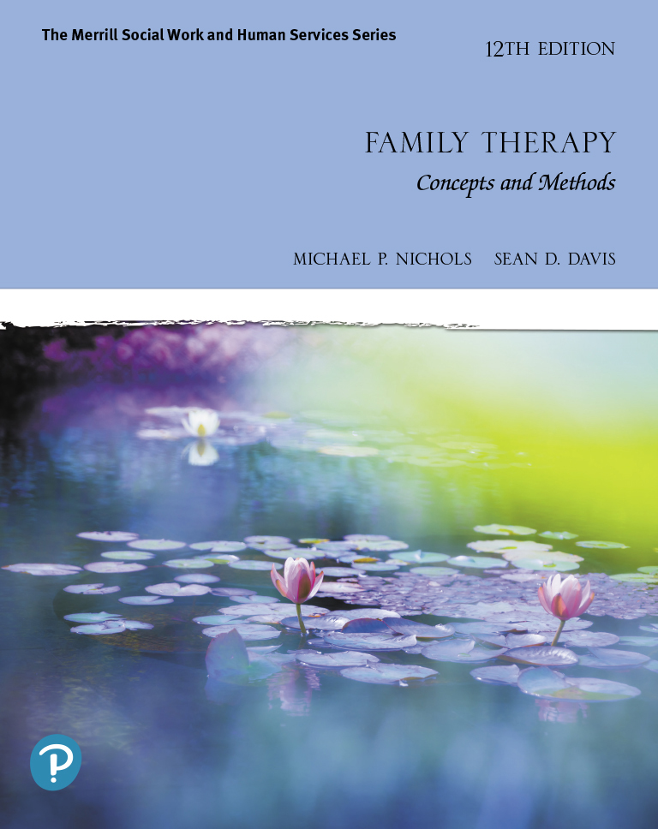
Family Therapy: Concepts and Methods
Twelfth Edition
Chapter 4
Bowen Family Systems Therapy
Slides in this presentation contain hyperlinks. JAWS users should be able to get a list of links by using INSERT+F7
Copyright © 2021, 2017, 2013 Pearson Education, Inc. All Rights Reserved
Notes:
If this PowerPoint presentation contains mathematical equations, you may need to check that your computer has the following installed:
1) MathType Plugin
2) Math Player (free versions available)
3) NVDA Reader (free versions available)

Slide 2
Learning Outcomes
4.1 Describe the evolution of Bowen Family Systems Therapy.
4.2 Describe the main tenets of Bowen’s Family Systems Theory.
4.3 Describe healthy and unhealthy family development from a Bowen Family Systems Theory perspective.
4.4 Describe the clinical goals and the conditions necessary for meeting those goals from a Bowen Systems Theory perspective.
4.5 Discuss and demonstrate the assessment and intervention techniques of Bowen Family Systems Theory.
4.6 Discuss methods for evaluating Bowen’s Systems Theory.

Slide 3
Bowen’s Theory (1 of 2)
Centers around two counterbalancing/competing life forces:
Togetherness and individuality
Need for companionship and the need for independence
First and last name
Unbalance toward individuality leads to emotional cutoff;
Unbalance toward togetherness leads to fusion

Slide 4
Bowen’s Theory (2 of 2)
Central premise
Unresolved emotional attachment to one’s family must be resolved before one can:
Differentiate a mature, healthy personality

Slide 5
Differentiation of Self (1 of 2)
Degree to which one balances emotional and intellectual functioning and intimacy
And autonomy in interpersonal relationships
Ability to think and reflect – to not respond automatically to emotional pressures

Slide 6
Differentiation of Self (2 of 2)
More highly differentiated individuals can experience strong emotion
But can also shift to logical reasoning for decision making and problem solving
Undifferentiated individuals tend to act based on emotional reactions
Undifferentiated individuals find it difficult to maintain their own autonomy

Slide 7
Emotional Triangles (1 of 2)
Emotionally significant relationships shadowed by third parties
Friends; Family
Anxiety is the driving force behind emotional triangles
Can be temporary or fixed

Slide 8
Emotional Triangles (2 of 2)
Triangulation freezes conflict in place and becomes a chronic diversion that undermines relationships
Most family problems are triangular
Teaching a mother better parenting techniques won’t resolve the problem if:
She is over-involved with her son as a result of her husband’s emotional distance

Slide 9
Nuclear Family Emotional Process
The emotional forces in family – excessive emotional reactivity or fusion
Problems can include:
reactive distancing between spouses
emotional dysfunction in one spouse
marital conflict
projection of the problems onto children

Slide 10
Family Projection Process (1 of 2)
The process by which parents transmit their lack of differentiation to their children
Emotional fusion in a couple leads to:
Conflict, emotional distance, or reciprocal over-and-under functioning

Slide 11
Family Projection Process (2 of 2)
Spouses with unresolved family-of-origin issues create a family environment;
An intense focus on one or more children
The child who is the object of the projection process becomes the:
Child most attached to the parents and has the least differentiation of self;

Slide 12
Multigenerational Emotional Process (1 of 2)
Defined as the family emotional process across multiple generations
In each generation, the child most involved in the family’s fusion moves toward a:
Lower level of differentiation of self;
The least involved child moves toward a higher level of differentiation

Slide 13
Multigenerational Emotional Process (2 of 2)
Couples establish a new family
Which influences a child’s ability to regulate emotionality
Problems in the family are products of the relationships with parents
Which is a product of the relationship with the parents’ parents (i.e., grandparents)

Slide 14
Sibling Position
Children develop characteristics depending on sibling position in family
Frank Sulloway
Firstborns identify with power and authority
Laterborns are more open to experience and may be rebellious

Slide 15
Emotional Cutoff
How people manage anxiety between generations
Denies the importance of his/her family
Boasts of his/her independence from family
Has infrequent communications with family
Exaggerated façade of independence
Finds intimacy extremely threatening

Slide 16
Societal Emotional Process
Emotional process in society; influences the emotional process in families
Background influence affecting all families
Prolonged increase in social anxiety can result in gradual lowering of the:
Functional level of differentiation in families
Monica McGoldrick and Betty Carter

Slide 17
Normal Family Development
Families vary along single continuum of differentiation, low to high
Optimal development when:
Individuals are relatively differentiated
Anxiety is low
Parents are in good emotional contact with their families

Slide 18
Development of Behavior Disorders (1 of 2)
Symptoms come when stress exceeds the system’s ability to handle it
Emotional fusion is the genesis of psychological problems
Family symptoms reflect:
Level of chronic anxiety
Level of differentiation in family system

Slide 19
Development of Behavior Disorders (2 of 2)
The more well-differentiated the person:
The more resilient and more sustaining his/her relationships
The less differentiated, the less stress it takes to produce symptoms
Undifferentiation in family leads to marital problems in nuclear family

Slide 20
Goals of Therapy (1 of 2)
Not interested in solving problems
Therapist helps client get past blame to examine their own role in the family
Goals of therapy:
Decrease anxiety; increase differentiation
Help individuals gain insight into their family-of-origin patterns

Slide 21
Goals of Therapy (2 of 2)
Examine process and structure of therapy
Process: patterns of emotional reactivity
Structure: patterns of interlocking triangles
Modify marital system to change the family
Increase parents’ ability to manage their own anxiety
Help couple have less anxiety in their family-of- origin

Slide 22
Conditions for Behavior Change
Understanding, not action, is the vehicle of cure
Bowen differed from most systems therapists in believing that:
Meaningful change doesn’t require the presence of the entire family
Extended family

Slide 23
Therapy (1 of 2)
Assessment
Begins with assessment: description and history of relationship context of problem
Genogram: traces significant relationship patterns through at least three generations
Assess emotional patterns and stresses endured and adaptation

Slide 24
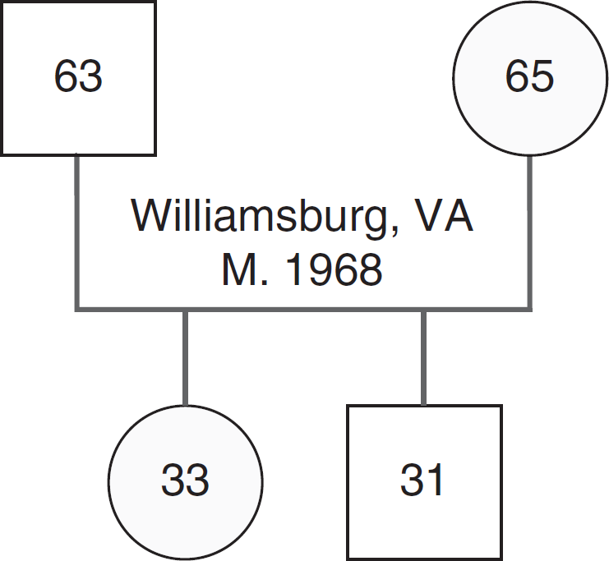
Figure 4.1 Basic Symbols Used in Genograms
Notes:
A square with 63 in it connects to a circle with 65 in it. Between the horizontal line connecting the square and circle is the entry “Williamsburg, Virginia, M (meaning married) 1968.” A vertical line connects the horizontal line to a circle with 33 in it. Another vertical line to the right of the first connects the horizontal line to a square with 31 in it.

Slide 25
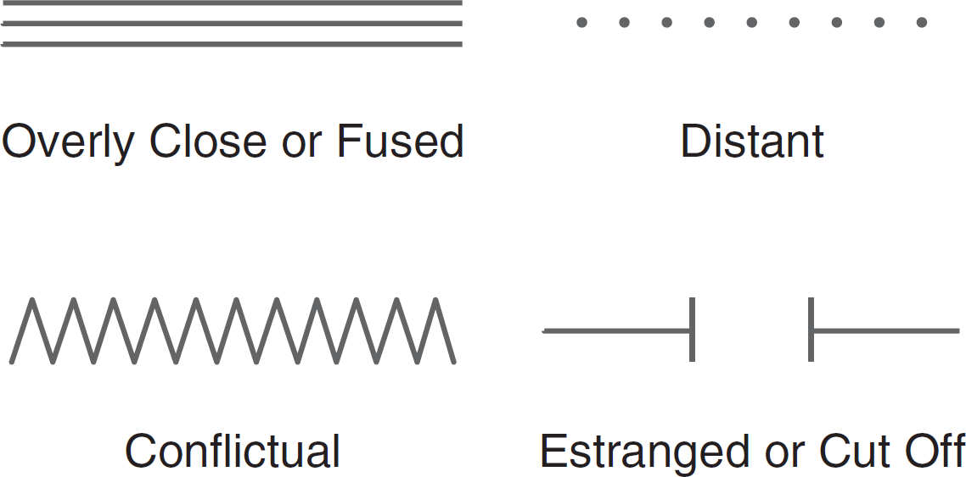
Figure 4.2 Genogram Symbols for Relationship Dynamics
Notes:
Three parallel lines represent an overly close relationship. A series of dots represents a distant relationship. A zigzagging line represents a conflictual relationship. A horizontal line ending at a vertical line represents an estranged or cut off relationship.

Slide 26
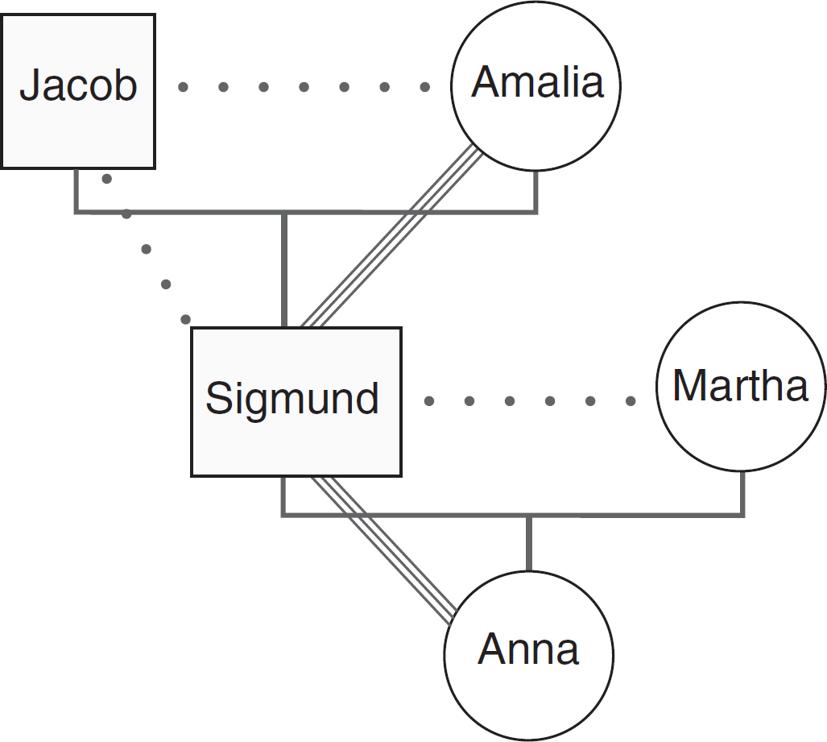
Figure 4.3 Genogram of Sigmund Freud’s Family

Slide 27
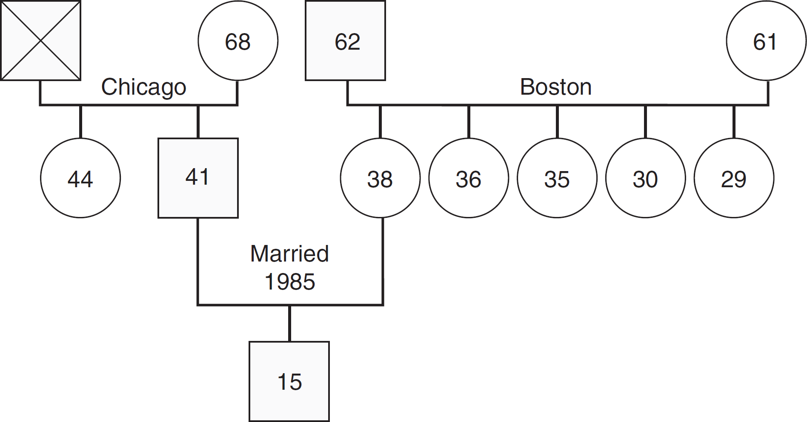
Figure 4.4 Langdon Family Genogram
Notes:
A square with an x represents Warren Langford’s deceased father. A circle with 68 in it represents his mother. Warren’s parents were married in Chicago. Warren’s 44-year-old sister is represented by a circle with 44 in it. Warren is represented by a square with 41 in it. Janet Langford is represented by a circle with a 38 in it. Her parents were married in Boston and her father is 62 while her mother is 61. Janet has four younger sisters whose ages are 36, 35, 30, and 29. Warren and Janet married in 1985. Their son Martin is 15.

Slide 28
Therapy (2 of 2)
Change occurs as one learns about the larger family
Typically work with couples or individuals
If individuals, the goal is differentiation of self
1) knowledge of how family systems function; 2) strong motivation to change

Slide 29
Therapeutic Techniques (1 of 3)
Process questions:
Encourage families to think about how they react and respond with other family members
Used to slow people down, diminish reactive anxiety

Slide 30
Therapeutic Techniques (2 of 3)
Genograms
Therapeutic Triangle
Bowenian Therapy with Couples
Bowenian Therapy with Individuals
Coaching (helping increase self-focus)

Slide 31
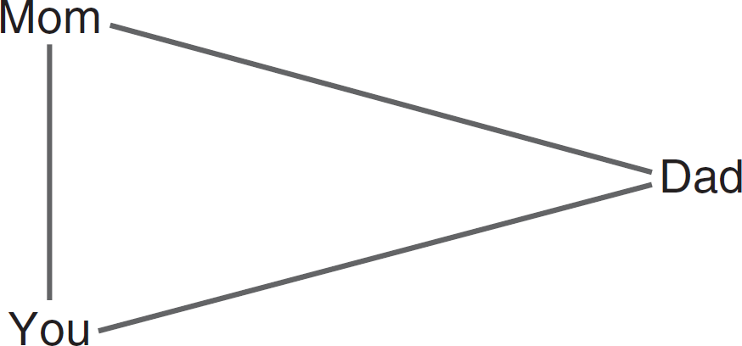
Figure 4.5 Cross-Generational Triangle

Slide 32
Therapeutic Techniques (3 of 3)
Relationship experiments:
Becoming aware of system processes (pursuer/distancer)
The I - Position
Multiple family therapy
Displacement stories

Slide 33
Evaluating Therapy Theory and Results
A possible shortcoming of the Bowenian approach
Phil Guerin and Tom Fogarty have made notable contributions
Research has supported Bowen’s notion that differentiation is related to trait anxiety

Slide 34
Where Is Bowen Theory Today?
Dr. Phil Guerin, director of the Center for Family Learning, Rye Brook, New York
Dr. Michael Kerr, director of the Bowen Theory Academy, Islesbory, Maine
Dr. Monica McGoldrick, Multicultural Family Institute, Highland Park, New Jersey

Slide 35
Recommended Readings (1 of 2)
Anonymous. 1972. Differentiation of Self in One’s Family. In Family Interaction, J. Framo, ed. New York: Springer.
Bowen, M. 1978. Family Therapy in Clinical Practice. New York: Jason Aronson.
Butler, J. F. (ed, 2015). The Origins of Family Psychotherapy, by Murray Bowen. Lanham, Maryland: Rowman and Littlefield.
Carter, E., and M. M. Orfanidis. 1976. Family Therapy with One Person and the Family Therapist’s Own Family. In Family Therapy: Theory and Practice, P. J. Guerin, ed. New York: Gardner Press.
Fogarty, T. F. 1976a. Systems Concepts and Dimensions of Self. In Family Therapy: Theory and Practice, P. J. Guerin, ed. New York: Gardner Press.
Fogarty, T. F. 1976b. Marital Crisis. In Family Therapy: Theory and Practice, P. J. Guerin, ed. New York: Gardner Press.

Slide 36
Recommended Readings (2 of 2)
Guerin, P. J., L. Fay, S. Burden, and J. Kautto. 1987. The Evaluation and Treatment of Marital Conflict: A Four-Stage Approach. New York: Basic Books.
Guerin, P. J., T. F. Fogarty, L. F. Fay, and J. G. Kautto. 1996. Working with Relationship Triangles: The One-Two-Three of Psychotherapy. New York: Guilford Press.
Guerin, P. J., and E. G. Pendagast. 1976. Evaluation of Family System and Geogram. In Family Therapy: Theory and Practice, P. J. Guerin, ed. New York: Gardner Press.
Kerr, M. E., and M. Bowen. 1988. Family Evaluation. New York: Norton.
Noone, R. J. and Papero, D. V. (eds, 2017). The Family Emotional System: An Integrative Concept for Theory, Science and Practice. Lanham, Maryland: Lexington Books.
Kerr, M. D. (2019). Bowen Theory’s Secrets: Revealing the Hidden Life of Families. New York: W. W. Norton & Co.

Slide 37
Contemporary Training Centers (1 of 2)
Southern California Training in Bowen Theory, San Diego California.
http://www.socalbowentheory.com/
Florida Family Research Network, Miami, Florida.
http://ffrnbowentheory.org/
Center for Family Consultation, Evanston Illinois.
https://thecenterforfamilyconsultation.com/
The Kansas City Center for Family and Organizational Systems,
Kansas City, Missouri.
https://www.kcfamilysystems.org/

Slide 38
Contemporary Training Centers (2 of 2)
Western Pennsylvania Family Center, Pittsburgh, Pennsylvania.
http://wpfc.net/
Center for the Study of Natural Systems, Houston, Texas.
https://www.csnsf.org/
Living Systems, Vancouver, Canada.
https://livingsystems.ca/
The Family Systems Institute, Sydney, Australia.
http://www.thefsi.com.au/
International Social Service Institute, International Social Services, Hong Kong.
https://www.issfi.org/en/
Bowen Theory Academy, Islesboro, Maine.
https://bowentheoryacademy.org/

Slide 39
Copyright
This work is protected by United States copyright laws and is provided solely for the use of instructors in teaching their courses and assessing student learning. Dissemination or sale of any part of this work (including on the World Wide Web) will destroy the integrity of the work and is not permitted. The work and materials from it should never be made available to students except by instructors using the accompanying text in their classes. All recipients of this work are expected to abide by these restrictions and to honor the intended pedagogical purposes and the needs of other instructors who rely on these materials.

