Slide 1
Understanding Markets and Industry Changes
8

Slide 2
A market has a product, geographic, and time dimension. Define the market before using supply–demand analysis.
Market demand describes buyer behavior; market supply describes seller behavior in a competitive market.
If price changes, quantity demanded increases or decreases (represented by a movement along the demand curve).
If a factor other than price (like income) changes, we say that demand curve increases or decreases (a shift of demand curve).
Supply curves describe the behavior of sellers and tell you how much will be sold at a given price.

Slide 3
continued
Market equilibrium is the price at which quantity supplied equals quantity demanded. If price is above the equilibrium price, there are too many sellers, forcing price down, and vice versa.
Prices are a primary way that market participants communicate with one another. High prices tell consumers to consume less, and suppliers to supply more, and vice-versa.
Making a market is costly, and competition between market makers forces the bid–ask spread down to the costs of making a market. If the costs of making a market are large, then the equilibrium price may be better viewed as a spread rather than a single price.

Slide 4
Y2K and Generator Sales
From 1990-98, sales of portable generators grew 2% yearly.
In 1999, public anticipation of Y2K power outages increased demand for generators
AMP invested to increase capacity in anticipation of this demand growth – they vertically integrated their company to increase capacity and reduce variable costs
Demand grew as expected – Industry shipments increased by 87%. Prices also increased by an average of 21%
The following year – a bust! Demand fell, and AMP’s Y2K strategy to increase production led it to bankruptcy in 2000.
Lesson: AMP could have anticipated this.

Slide 5
Which Industry or Market?
Setting a single price for a single product of a single firm is referred to as a “monopoly” model of pricing
This chapter focuses on the “market” setting, showing how prices are determined in an industry where many sellers and many buyers come together (still a single price for a single product)
Caution: Do not use demand and supply analysis for an individual firm
Example: You would talk about changes to the “smart phone” industry, not the “demand and supply of iPhones because there is only one seller of iPhones
The behavior of sellers is determined by a “supply” curve
The behavior of buyers is determined by a “demand” curve

Slide 6
Which Industry or Market? (cont.)
Before you begin analyzing an industry, you must consider what you want to learn from analysis
Usually this yields a particular market definition
Each market (or industry) has a time, product, and geographic dimension
For example: The yearly market for portable generators in the U.S.
Time: annual
Product: portable generators
Geography: US
When analyzing a problem, or investment opportunity, first define the time, product and geographic dimensions of the market in question

Slide 7
Shifts in the Demand Curve
Movement along the demand curve, i.e. a change in price leads to a change in the “quantity demanded”
Shifts in demand curve can occur for multiple reasons
Uncontrollable factor – something that affects demand that a company cannot control
Income, weather, interest rates, and prices of substitute and complementary products owned by other companies.
Controllable factor – something that affects demand that a company can control
Price, advertising, warranties, product quality, distribution speed, service quality, and prices of substitute or complementary products also owned by the company

Slide 8
Microsoft
In the late 1970s, Microsoft developed DOS, an operating system to control IBM computers
The price for DOS depended on the price and availability of computers that could run it and the applications that ran under it as well as the price of DOS itself
To increase demand for DOS Microsoft:
Licensed its operating system to other computer manufacturers so that competition would reduce price of a crucial complement
Developed its own versions of complimentary software
Kept the price of DOS low, to increase share to encourage complementary software development
Discussion: How did Microsoft control demand using these factors? How did competitors (Apple, for example) operate differently?
HINT: this was Steve Jobs’s biggest mistake

Slide 9
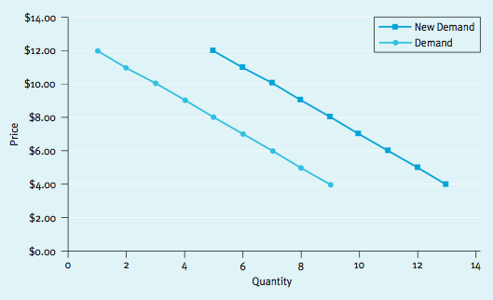
Demand Increase
At a given price, more quantity demanded = shift of the demand curve

Slide 10
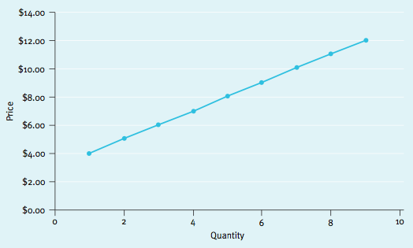
Supply Curves
Definition: Supply curves describe the behavior of a group of sellers and tell you how much will be sold at a given price
Supply curves slope upward g the higher the price, the higher the quantity supplied

Slide 11
Market Equilibrium
Definition: Market equilibrium is the price at which quantity supplied equals quantity demanded
At the equilibrium price, there is no pressure for the price to change because the number of sellers equals the number of buyers (quantity demanded = quantity supplied)

Slide 12
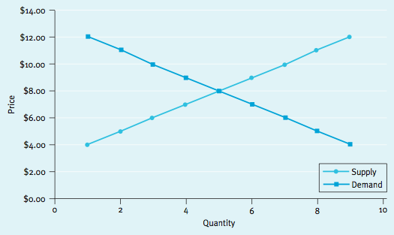
Market Equilibrium (cont.)
Proposition: In a competitive equilibrium there are no unconsummated wealth-creating transactions
RIDDLE: How many economists does it take to change a light bulb?
ANSWER: None. The market will do it.

Slide 13
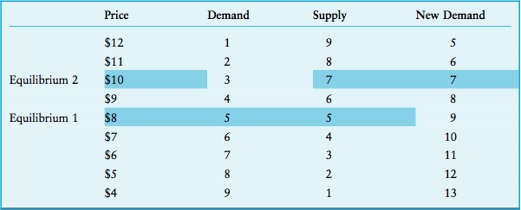
Using Supply and Demand
Supply and demand curves can be used to describe changes that occur at the industry level
Here, initial equilibrium is $8. After a demand shift, the new equilibrium is $10
Market Equilibrium Analysis

Slide 14
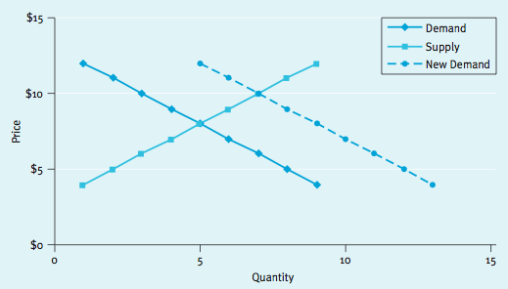
Using Supply and Demand (cont.)
Again: the mechanism driving price to the new equilibrium is competition
At the old price of $8, there is excess demand (9-5=4 more buyers than sellers), which puts upward pressure on price until it settles at the new $10 equilibrium

Slide 15
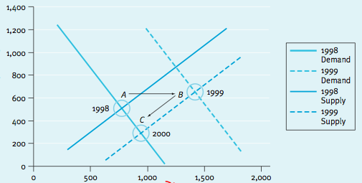
Portable Generator Market Revisited
Return to the electric generator industry:
1997– Stable industry sales with intense competition (2% avg. sales growth)
1997– Industry anticipates record demand will occur in 1999
1998 – Massive capital expenses throughout industry on vertical integration projects
A→B demand (anticipation) and supply (investment) increased
B→C price dropped but quantity stayed above the 1998 level

Slide 16
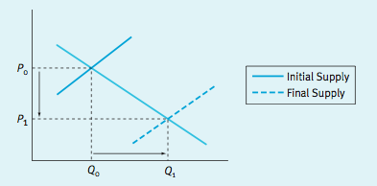
Using Supply and Demand (cont.)
Example: model the Increase in quantity of mobile phones and the decline in the price over the past decade
Use a graph to explain two points
Shift of the supply curve – that’s it!
Shows the increase in supply (Q₀Q₁) and the decrease in price (P₀P₁)

Slide 17
Prices Convey Information
Prices are a primary way that market participants communicate with one another
Buyers signal their willingness to pay
Sellers signal their willingness to sell with prices
Price information especially important in financial markets

Slide 18
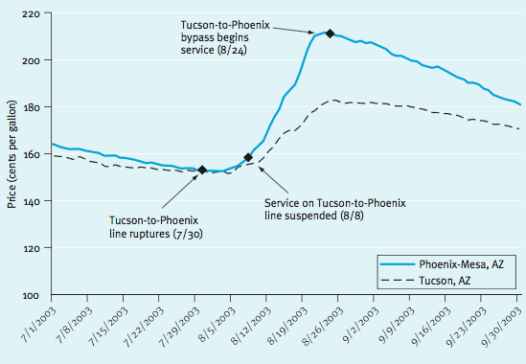
Prices Convey Information (cont.)
Example: Gas pipeline burst between Tucson and Phoenix

Slide 19
Prices Convey Information (cont.)
Tucson-Phoenix pipeline break reduced supply to Phoenix which raised price in Phoenix.
High prices in Phoenix conveyed information to sellers so they diverted tanker trucks from Tucson to Phoenix.
There was a limit to how many tanker trucks could fill up at the “rack” in Tuscon, so some Tuscon tanker trucks were displaced by the tanker trucks going to Phoenix.
The results was a reduction of supply in Tucson, resulting in a price increase in Tuscon.

Slide 20
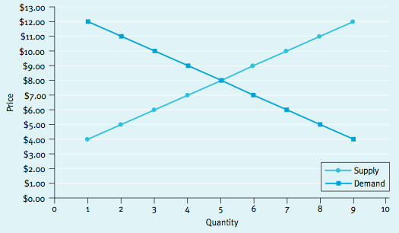
Market Making
A “market maker” makes a market – by buying low and selling high.
A single (monopoly) market maker does not want to have too much or hold too much inventory g She has to pick prices that equalize quantity supplied and demanded.

Slide 21
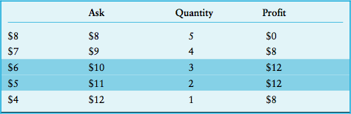
Market Makers (cont.)
If the market maker bought and sold at the competitive price ($8), she would earn zero profit
To earn more, she must buy low and sell high and can do that with varying numbers of transactions
She should either buy at $6/sell at $10, or buy at $5/sell at $11 since both earn a profit of $12
Competition between market makers will force the bid-ask spread down to the cost of making a market
Optimal Spread in Market Making

Slide 22
Title?
Video enhancement products are state-of-the-art graphics systems that capture, analyze, enhance, and edit all major video formats without altering underlying footage
In 1998, this market consisted of a small number of companies, and demand was relatively light due to the extremely high price of the technology (prices ranged between $45,000 and $80,000)
In 2000, Intergraph entered the market at a price of $25,000, attempting to quickly capture a major share of the market. Intergraph produced a product at a substantially lower cost than the competition

Slide 23
Title continued?
What happened?
Entry caused an increase in supply and a strong downward pressure on price (average pricing fell to around $40,000)
A number of firms exited and prices rose back to around $45,000
Later, the events of 9/11/01 caused demand to spike
What happened?
In the short run, average prices shot up.
Higher prices eventually attracted more entrants, increasing supply. Pricing fell back down to an average level of around $30,000

