Slide 1
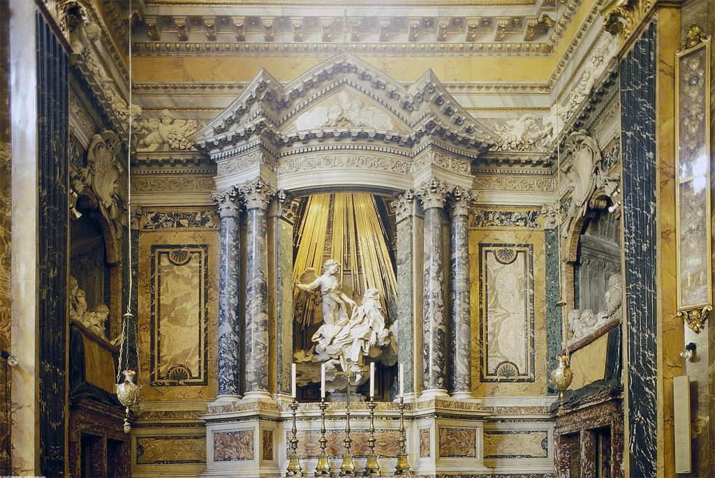
Notes:
Creator: Gian Lorenzo Bernini (Italian sculptor and architect, 1598-1680) Culture: Italian Title: Cornaro Chapel Title: Santa Maria della Vittoria; Cornaro Chapel Title: View: Frontal view of the entire chapel, with lateral "spectators" in view Date: 1647-1652 (creation) Date: Photograph: 10\/1\/1998 (creation) Collection: Archivision Library - Base Collection Rights: Rights: This image has been selected and made available by a user using Artstor's software tools. Artstor has not screened or selected this image or cleared any rights to it and is acting as an online service provider pursuant to 17 U.S.C. §512. Artstor disclaims any liability associated with the use of this image. Should you have any legal objection to the use of this image, please visit http:\/\/www.artstor.org\/copyright for contact information and instructions on how to proceed.

Slide 2
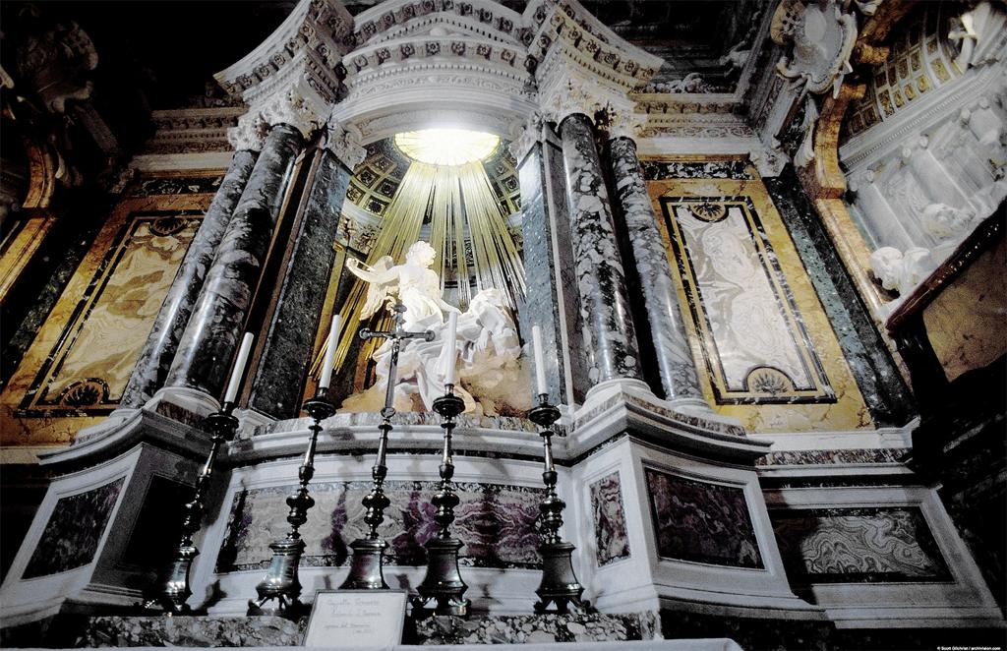
Notes:
Creator: Gian Lorenzo Bernini (Italian sculptor and architect, 1598-1680) Culture: Italian Title: Cornaro Chapel Title: Santa Maria della Vittoria; Cornaro Chapel Title: View: View looking up at the central altar and niche with the "Ecstasy of St. Theresa" and aedicule Date: 1647-1652 (creation) Date: Photograph: 10\/1\/1998 (creation) Collection: Archivision Library - Base Collection Rights: Rights: This image has been selected and made available by a user using Artstor's software tools. Artstor has not screened or selected this image or cleared any rights to it and is acting as an online service provider pursuant to 17 U.S.C. §512. Artstor disclaims any liability associated with the use of this image. Should you have any legal objection to the use of this image, please visit http:\/\/www.artstor.org\/copyright for contact information and instructions on how to proceed.

Slide 3
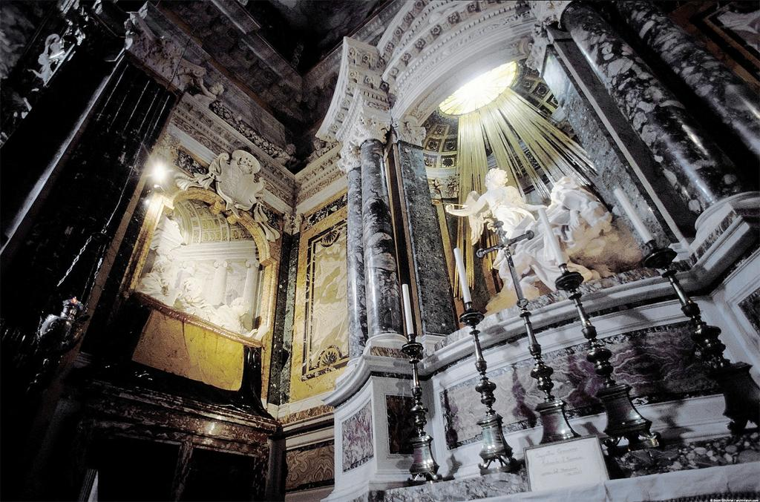
Notes:
Creator: Gian Lorenzo Bernini (Italian sculptor and architect, 1598-1680) Culture: Italian Title: Cornaro Chapel Title: Santa Maria della Vittoria; Cornaro Chapel Title: View: View of the altar and the south wall Date: 1647-1652 (creation) Date: Photograph: 10\/1\/1998 (creation) Collection: Archivision Library - Base Collection Rights: Rights: This image has been selected and made available by a user using Artstor's software tools. Artstor has not screened or selected this image or cleared any rights to it and is acting as an online service provider pursuant to 17 U.S.C. §512. Artstor disclaims any liability associated with the use of this image. Should you have any legal objection to the use of this image, please visit http:\/\/www.artstor.org\/copyright for contact information and instructions on how to proceed.

Slide 4
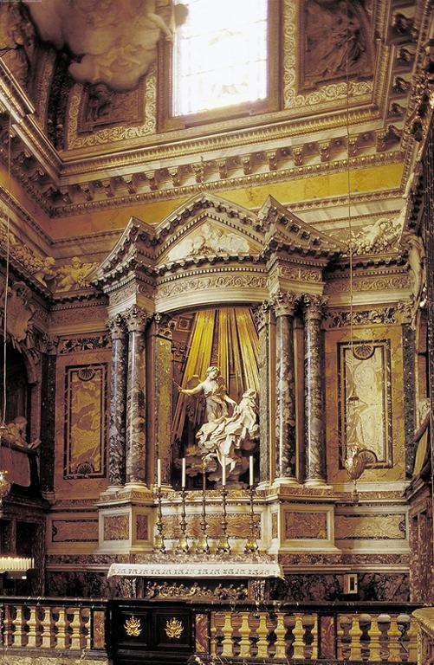
Notes:
Creator: Gian Lorenzo Bernini (Italian sculptor and architect, 1598-1680) Culture: Italian Title: Cornaro Chapel Title: Santa Maria della Vittoria; Cornaro Chapel Title: View: Vertical view of the altar, with full view of the sculptural group "Ecstasy of St. Theresa" and aedicule Date: 1647-1652 (creation) Date: Photograph: 10\/1\/1998 (creation) Collection: Archivision Library - Base Collection Rights: Rights: This image has been selected and made available by a user using Artstor's software tools. Artstor has not screened or selected this image or cleared any rights to it and is acting as an online service provider pursuant to 17 U.S.C. §512. Artstor disclaims any liability associated with the use of this image. Should you have any legal objection to the use of this image, please visit http:\/\/www.artstor.org\/copyright for contact information and instructions on how to proceed.

Slide 5
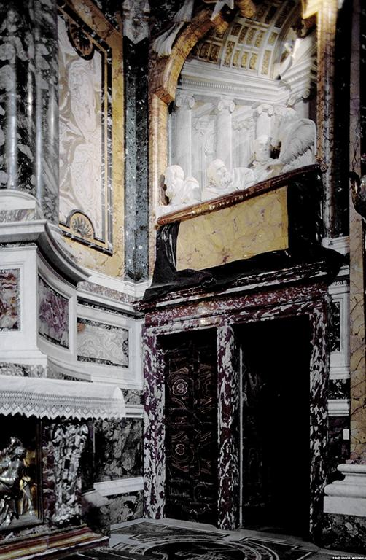
Notes:
Creator: Gian Lorenzo Bernini (Italian sculptor and architect, 1598-1680) Culture: Italian Title: Cornaro Chapel Title: Santa Maria della Vittoria; Cornaro Chapel Title: View: Side view within the chapel, looking north Date: 1647-1652 (creation) Date: Photograph: 10\/1\/1998 (creation) Collection: Archivision Library - Base Collection Rights: Rights: This image has been selected and made available by a user using Artstor's software tools. Artstor has not screened or selected this image or cleared any rights to it and is acting as an online service provider pursuant to 17 U.S.C. §512. Artstor disclaims any liability associated with the use of this image. Should you have any legal objection to the use of this image, please visit http:\/\/www.artstor.org\/copyright for contact information and instructions on how to proceed.

Slide 6
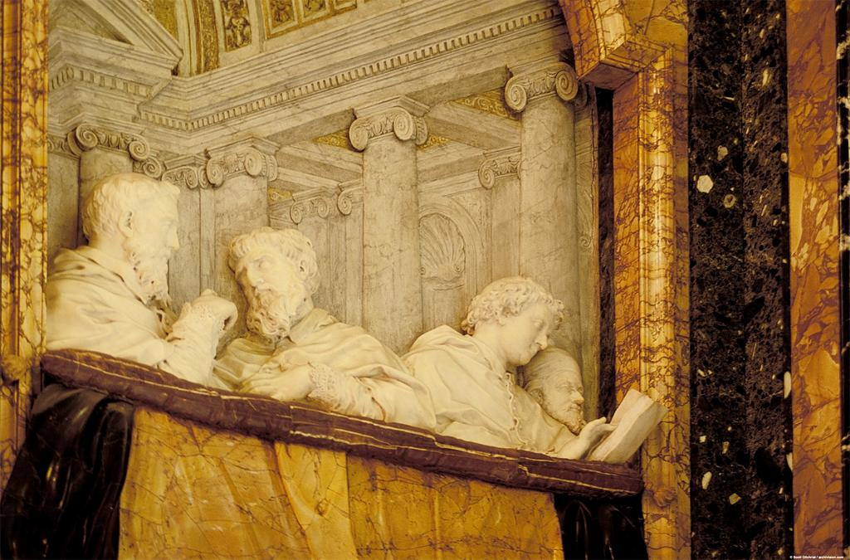
Notes:
Creator: Gian Lorenzo Bernini (Italian sculptor and architect, 1598-1680) Culture: Italian Title: Cornaro Chapel Title: Santa Maria della Vittoria; Cornaro Chapel Title: View: View of the left (south) gallery Date: 1647-1652 (creation) Date: Photograph: 10\/1\/1998 (creation) Collection: Archivision Library - Base Collection Rights: Rights: This image has been selected and made available by a user using Artstor's software tools. Artstor has not screened or selected this image or cleared any rights to it and is acting as an online service provider pursuant to 17 U.S.C. §512. Artstor disclaims any liability associated with the use of this image. Should you have any legal objection to the use of this image, please visit http:\/\/www.artstor.org\/copyright for contact information and instructions on how to proceed.

Slide 7
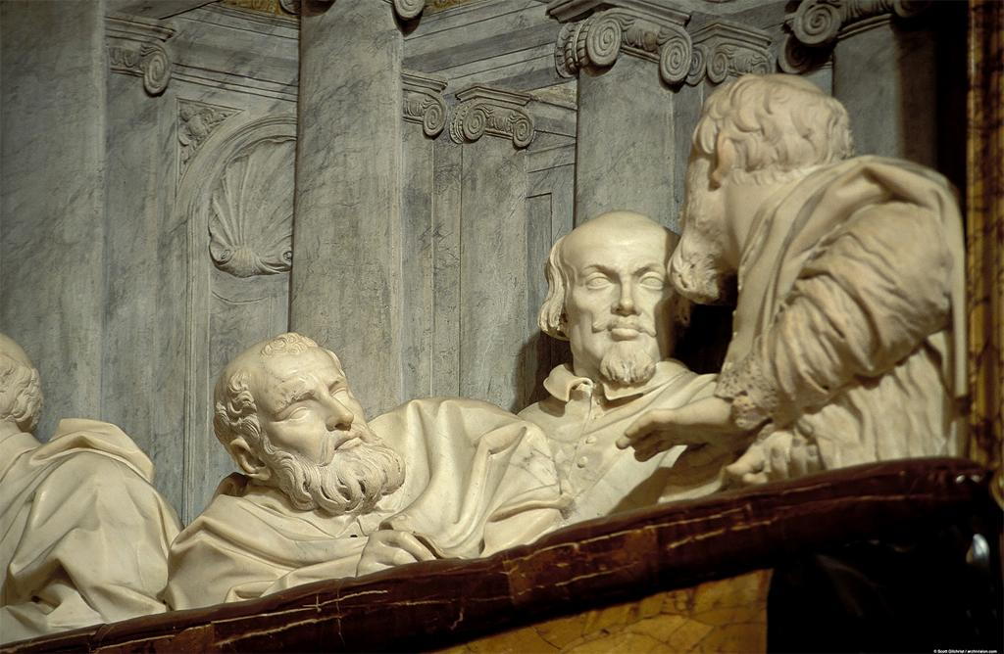
Notes:
Creator: Gian Lorenzo Bernini (Italian sculptor and architect, 1598-1680) Culture: Italian Title: Cornaro Chapel Title: Santa Maria della Vittoria; Cornaro Chapel Title: View: The right (north) gallery wall (the "spectators" are members of the Cornaro family - all deceased except for the Cardinal himself who appears second from right in right-hand relief - are shown disputing some theological point) Date: 1647-1652 (creation) Date: Photograph: 10\/1\/1998 (creation) Collection: Archivision Library - Base Collection Rights: Rights: This image has been selected and made available by a user using Artstor's software tools. Artstor has not screened or selected this image or cleared any rights to it and is acting as an online service provider pursuant to 17 U.S.C. §512. Artstor disclaims any liability associated with the use of this image. Should you have any legal objection to the use of this image, please visit http:\/\/www.artstor.org\/copyright for contact information and instructions on how to proceed.

Slide 8
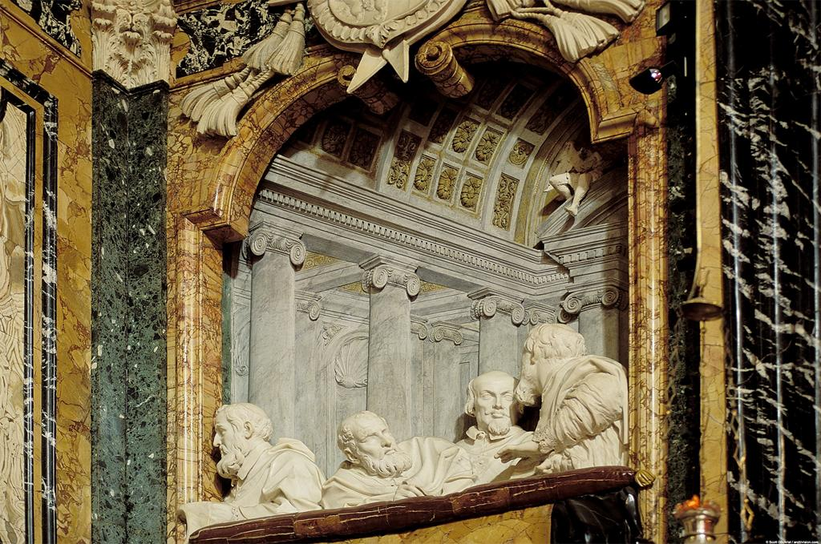
Notes:
Creator: Gian Lorenzo Bernini (Italian sculptor and architect, 1598-1680) Culture: Italian Title: Cornaro Chapel Title: Santa Maria della Vittoria; Cornaro Chapel Title: View: The right (north) gallery (the "spectators" are members of the Cornaro family - all deceased except for the Cardinal himself who appears second from right in right-hand relief - are shown disputing some theological point) Date: 1647-1652 (creation) Date: Photograph: 10\/1\/1998 (creation) Collection: Archivision Library - Base Collection Rights: Rights: This image has been selected and made available by a user using Artstor's software tools. Artstor has not screened or selected this image or cleared any rights to it and is acting as an online service provider pursuant to 17 U.S.C. §512. Artstor disclaims any liability associated with the use of this image. Should you have any legal objection to the use of this image, please visit http:\/\/www.artstor.org\/copyright for contact information and instructions on how to proceed.

Slide 9
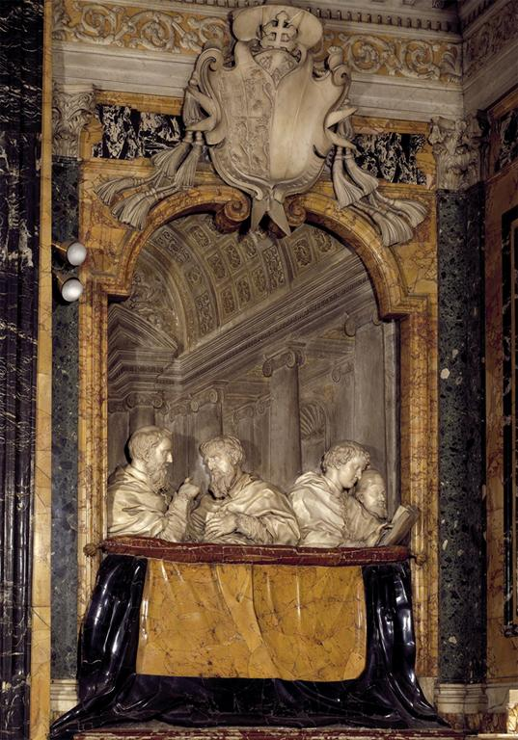
Notes:
Creator: Gian Lorenzo Bernini Title: Cornaro Chapel; detail of left with Members of the Cornaro Family on Balcony Work Type: sculpture Date: 1647-1652 Location: S. Maria della Vittoria (Rome, Italy) Collection: Italian and other European Art (Scala Archives) Source: Image and original data provided by SCALA, Florence\/ART RESOURCE, N.Y. Source: http:\/\/www.artres.com\/c\/htm\/Home.aspx Source: http:\/\/www.scalarchives.com Rights: (c) 2006, SCALA, Florence \/ ART RESOURCE, N.Y. Rights: Please note that if this image is under copyright, you may need to contact one or more copyright owners for any use that is not permitted under the ARTstor Terms and Conditions of Use or not otherwise permitted by law. While ARTstor tries to update contact information, it cannot guarantee that such information is always accurate. Determining whether those permissions are necessary, and obtaining such permissions, is your sole responsibility. Rights: Rights:

Slide 10
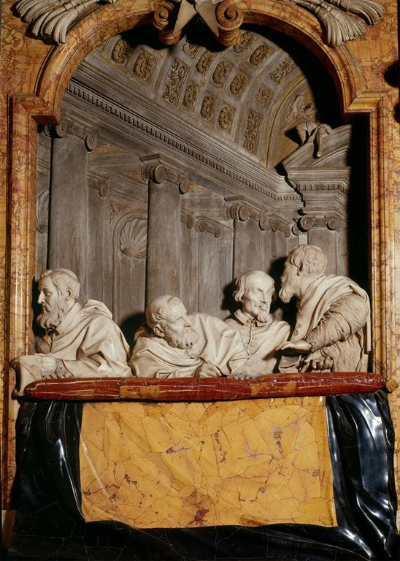
Notes:
Creator: Gian Lorenzo Bernini Title: Cornaro Chapel; detail of right with Members of the Cornaro Family on Balcony Work Type: sculpture Date: 1647-1652 Location: S. Maria della Vittoria (Rome, Italy) Collection: Italian and other European Art (Scala Archives) Source: Image and original data provided by SCALA, Florence\/ART RESOURCE, N.Y. Source: http:\/\/www.artres.com\/c\/htm\/Home.aspx Source: http:\/\/www.scalarchives.com Rights: (c) 2006, SCALA, Florence \/ ART RESOURCE, N.Y. Rights: Please note that if this image is under copyright, you may need to contact one or more copyright owners for any use that is not permitted under the ARTstor Terms and Conditions of Use or not otherwise permitted by law. While ARTstor tries to update contact information, it cannot guarantee that such information is always accurate. Determining whether those permissions are necessary, and obtaining such permissions, is your sole responsibility. Rights: Rights:

Slide 11
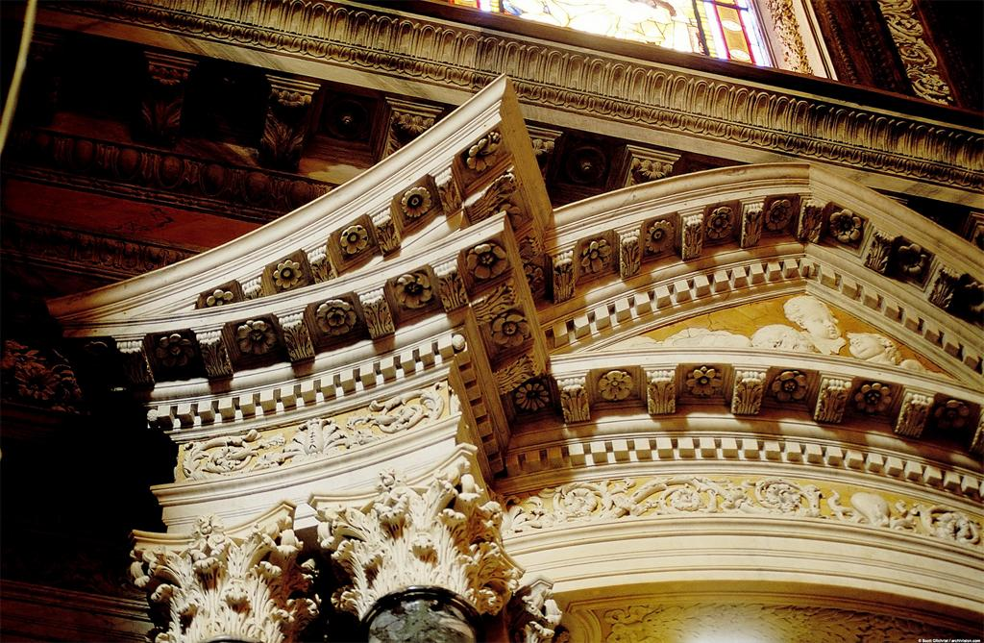
Notes:
Creator: Gian Lorenzo Bernini (Italian sculptor and architect, 1598-1680) Culture: Italian Title: Cornaro Chapel Title: Santa Maria della Vittoria; Cornaro Chapel Title: View: Aedicule exterior, side view of the broken pediment, upper left side Date: 1647-1652 (creation) Date: Photograph: 10\/1\/1998 (creation) Collection: Archivision Library - Base Collection Rights: Rights: This image has been selected and made available by a user using Artstor's software tools. Artstor has not screened or selected this image or cleared any rights to it and is acting as an online service provider pursuant to 17 U.S.C. §512. Artstor disclaims any liability associated with the use of this image. Should you have any legal objection to the use of this image, please visit http:\/\/www.artstor.org\/copyright for contact information and instructions on how to proceed.

Slide 12
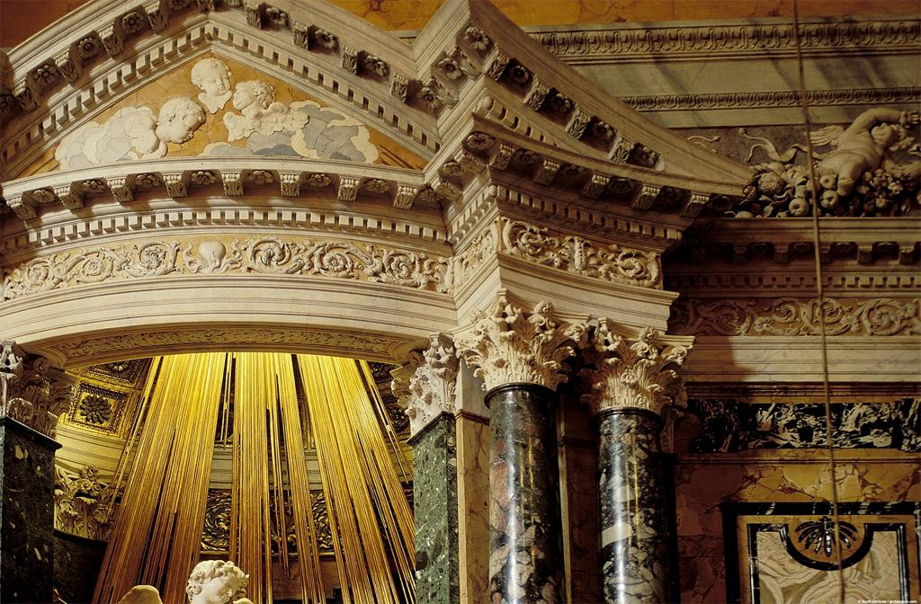
Notes:
Creator: Gian Lorenzo Bernini (Italian sculptor and architect, 1598-1680) Culture: Italian Title: Cornaro Chapel Title: Santa Maria della Vittoria; Cornaro Chapel Title: View: Aedicule exterior, frontal view, right side Date: 1647-1652 (creation) Date: Photograph: 10\/1\/1998 (creation) Collection: Archivision Library - Base Collection Rights: Rights: This image has been selected and made available by a user using Artstor's software tools. Artstor has not screened or selected this image or cleared any rights to it and is acting as an online service provider pursuant to 17 U.S.C. §512. Artstor disclaims any liability associated with the use of this image. Should you have any legal objection to the use of this image, please visit http:\/\/www.artstor.org\/copyright for contact information and instructions on how to proceed.

Slide 13
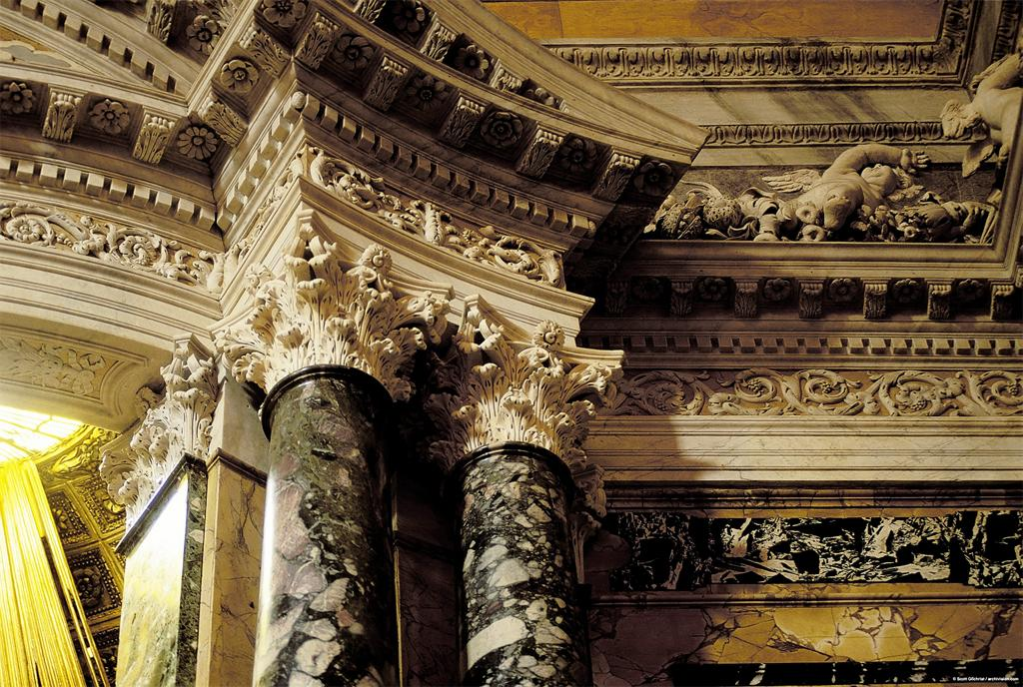
Notes:
Creator: Gian Lorenzo Bernini (Italian sculptor and architect, 1598-1680) Culture: Italian Title: Cornaro Chapel Title: Santa Maria della Vittoria; Cornaro Chapel Title: View: Aedicule exterior, columns and capitals, right side Date: 1647-1652 (creation) Date: Photograph: 10\/1\/1998 (creation) Collection: Archivision Library - Base Collection Rights: Rights: This image has been selected and made available by a user using Artstor's software tools. Artstor has not screened or selected this image or cleared any rights to it and is acting as an online service provider pursuant to 17 U.S.C. §512. Artstor disclaims any liability associated with the use of this image. Should you have any legal objection to the use of this image, please visit http:\/\/www.artstor.org\/copyright for contact information and instructions on how to proceed.

Slide 14
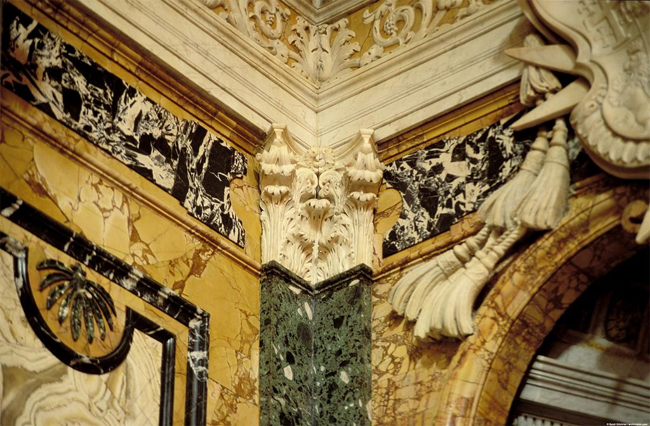
Notes:
Creator: Gian Lorenzo Bernini (Italian sculptor and architect, 1598-1680) Culture: Italian Title: Cornaro Chapel Title: Santa Maria della Vittoria; Cornaro Chapel Title: View: Wall behind the aedicule, the right corner, depicting the corner pilaster Date: 1647-1652 (creation) Date: Photograph: 10\/1\/1998 (creation) Collection: Archivision Library - Base Collection Rights: Rights: This image has been selected and made available by a user using Artstor's software tools. Artstor has not screened or selected this image or cleared any rights to it and is acting as an online service provider pursuant to 17 U.S.C. §512. Artstor disclaims any liability associated with the use of this image. Should you have any legal objection to the use of this image, please visit http:\/\/www.artstor.org\/copyright for contact information and instructions on how to proceed.

Slide 15
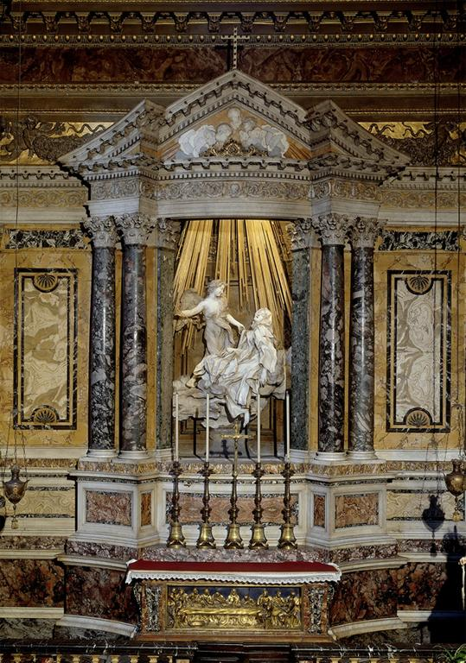
Notes:
Creator: Gian Lorenzo Bernini Title: Cornaro Chapel; altar Work Type: sculpture Date: 1647-1652 Location: S. Maria della Vittoria (Rome, Italy) Collection: Italian and other European Art (Scala Archives) Source: Image and original data provided by SCALA, Florence\/ART RESOURCE, N.Y. Source: http:\/\/www.artres.com\/c\/htm\/Home.aspx Source: http:\/\/www.scalarchives.com Rights: (c) 2006, SCALA, Florence \/ ART RESOURCE, N.Y. Rights: Please note that if this image is under copyright, you may need to contact one or more copyright owners for any use that is not permitted under the ARTstor Terms and Conditions of Use or not otherwise permitted by law. While ARTstor tries to update contact information, it cannot guarantee that such information is always accurate. Determining whether those permissions are necessary, and obtaining such permissions, is your sole responsibility. Rights: Rights:

Slide 16
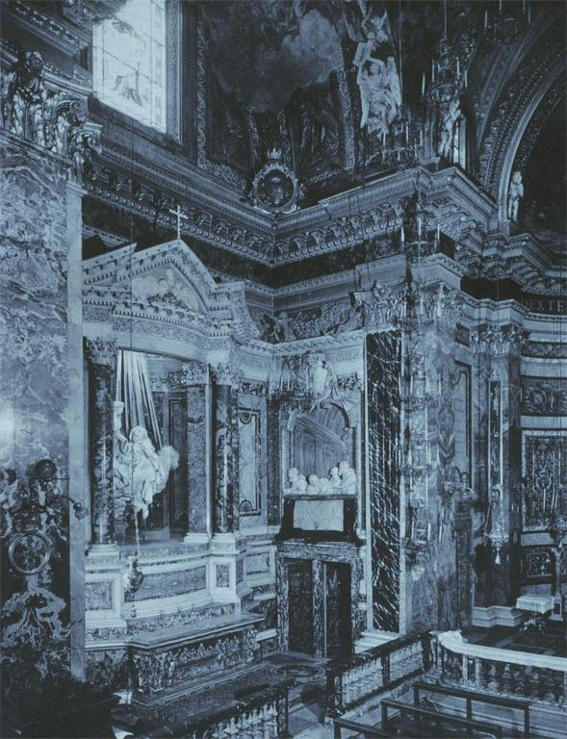
Notes:
Creator: Bernini, Gian Lorenzo, 1598-1680 Title: Rome: S. Maria della Vittoria Raking Cornaro Chapel altar wall Date: c.1647-51 Location: Rome Subject: Rome--S. Maria della Vittoria Subject: Architecture:Artist--Italy--17th C. A.D Collection: ARTstor Slide Gallery Source: Data from: University of California, San Diego Rights: Rights:

Slide 17
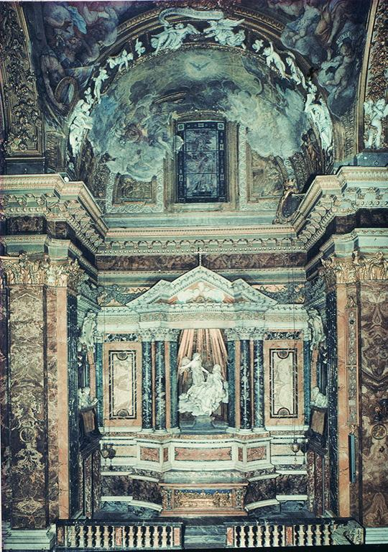
Notes:
Creator: Bernini, Gian Lorenzo, 1598-1680 Title: Rome: S. Maria della Vittoria Int: Cornaro Chapel altar Date: c.1647-51 Location: Rome Subject: Rome--S. Maria della Vittoria Subject: Architecture:Artist--Italy--17th C. A.D Collection: ARTstor Slide Gallery Source: Data from: University of California, San Diego Rights: Rights:

Slide 18
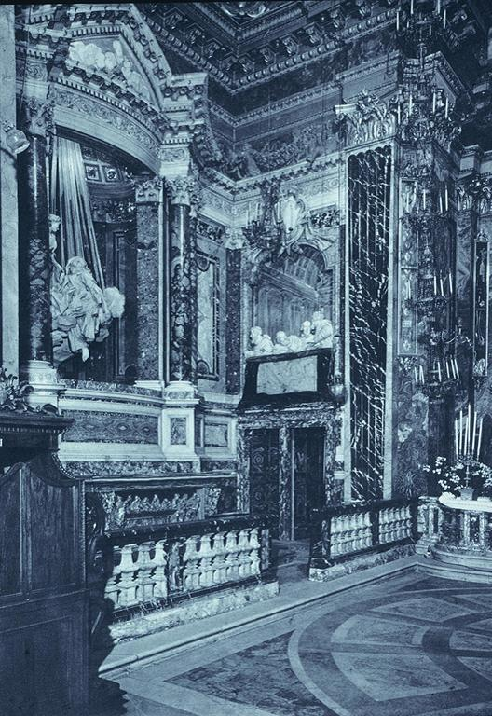
Notes:
Creator: Bernini, Gian Lorenzo, 1598-1680 Title: Rome: S. Maria della Vittoria Raking Cornaro Chapel altar wall Date: c.1647-51 Location: Rome Subject: Rome--S. Maria della Vittoria Subject: Architecture:Artist--Italy--17th C. A.D Collection: ARTstor Slide Gallery Source: Data from: University of California, San Diego Rights: Rights:

Slide 19
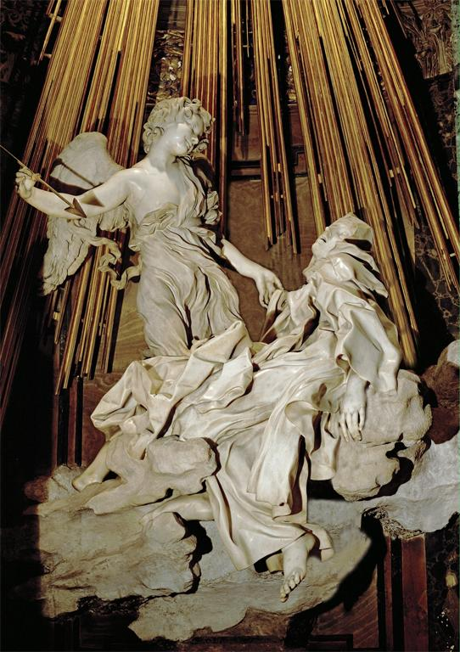
Notes:
Creator: Gian Lorenzo Bernini Title: Ecstasy of Saint Theresa of Ávila Date: 1645-1652 Location: Cornaro Chapel, S. Maria della Vittoria, Rome, Italy Material: marble Measurements: height of group 11' 6' (3.5 m) Collection: Art, Archaeology and Architecture (Erich Lessing Culture and Fine Arts Archives) Source: Image and original data provided by Erich Lessing Culture and Fine Arts Archives\/ART RESOURCE, N.Y. Source: http:\/\/www.artres.com\/c\/htm\/Home.aspx Source: http:\/\/www.artres.com\/c\/htm\/TreePfLight.aspx?ID=LES Rights: Photo Credit: Erich Lessing\/ART RESOURCE, N.Y. Rights: Please note that if this image is under copyright, you may need to contact one or more copyright owners for any use that is not permitted under the ARTstor Terms and Conditions of Use or not otherwise permitted by law. While ARTstor tries to update contact information, it cannot guarantee that such information is always accurate. Determining whether those permissions are necessary, and obtaining such permissions, is your sole responsibility. Rights: Rights:

Slide 20
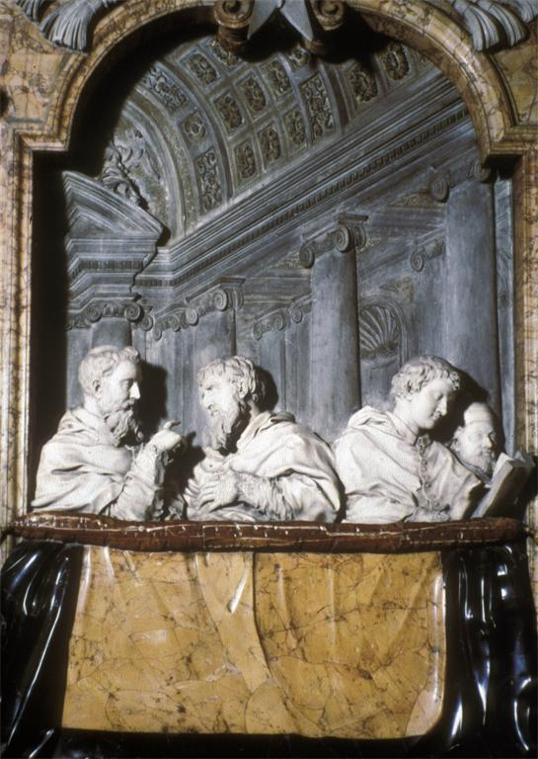
Notes:
Title: Bernini, G.L. 1598-1680 Title: Cornaro Chapel: Members Title: of The Cornaro Family. Title: 1647-52. Rome: S.M.Della Title: Vittoria Title: Scala, Bernini, #19V5934-006 Collection: UCB: Visual Resources Collection ID Number: UCB Accession Number: 49120 Rights: This image has been selected and made available for University of California Shared Images and is intended solely for noncommercial educational use. http:\/\/www.cdlib.org\/services\/dsc\/ucsi\/policies.html Rights: This image has been selected and made available by a user using Artstor's software tools. Artstor has not screened or selected this image or cleared any rights to it and is acting as an online service provider pursuant to 17 U.S.C. §512. Artstor disclaims any liability associated with the use of this image. Should you have any legal objection to the use of this image, please visit http:\/\/www.artstor.org\/copyright for contact information and instructions on how to proceed.

Slide 21
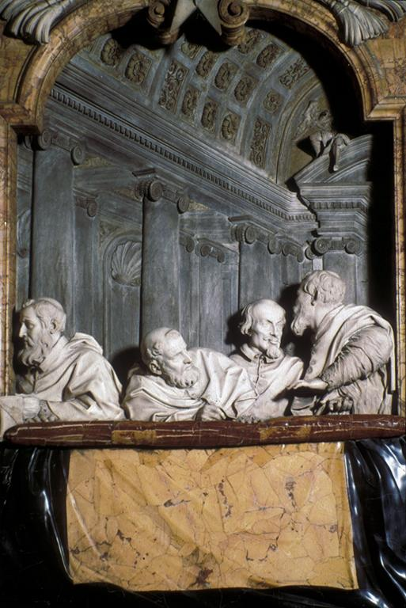
Notes:
Title: Bernini, G.L. 1598-1680 Title: Cornaro Chapel: Members Title: of Cornaro Family (Right Title: Wall). Rome: S.M. Della Title: Vittoria. Title: Scala, Bernini, #20 (?)V5934-006 Collection: UCB: Visual Resources Collection ID Number: UCB Accession Number: 49126 Rights: This image has been selected and made available for University of California Shared Images and is intended solely for noncommercial educational use. http:\/\/www.cdlib.org\/services\/dsc\/ucsi\/policies.html Rights: This image has been selected and made available by a user using Artstor's software tools. Artstor has not screened or selected this image or cleared any rights to it and is acting as an online service provider pursuant to 17 U.S.C. §512. Artstor disclaims any liability associated with the use of this image. Should you have any legal objection to the use of this image, please visit http:\/\/www.artstor.org\/copyright for contact information and instructions on how to proceed.

Slide 22
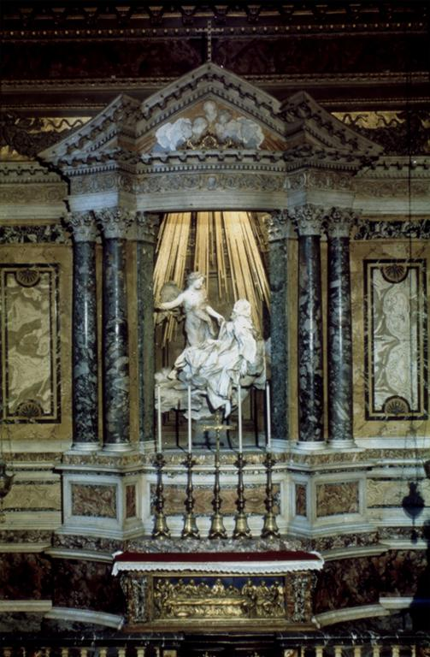
Notes:
Creator: Bernini,G.L. Creator: 1598-1680 Title: Ecstasy of St.Theresa Work Type: Sculptural Art Date: 1644-52 Location: Italy Description: Rome,S.Maria della Vittoria,Cornaro Chapel Accession Number: 272 Accession Number: B528 Accession Number: 38T(a)1a Collection: UCLA Visual Resources Collection ID Number: 234873 Rights: Because the photographs from which these images were made are copyrighted, any use beyond UC classroom presentations, unpublished student papers, and personal study requires the permission of the copyright holder. The user assumes full responsibility for any use of the materials, including but not limited to, infringement of copyright and publication rights of reproduced materials. Rights: This image has been selected and made available by a user using Artstor's software tools. Artstor has not screened or selected this image or cleared any rights to it and is acting as an online service provider pursuant to 17 U.S.C. §512. Artstor disclaims any liability associated with the use of this image. Should you have any legal objection to the use of this image, please visit http:\/\/www.artstor.org\/copyright for contact information and instructions on how to proceed.

Slide 23
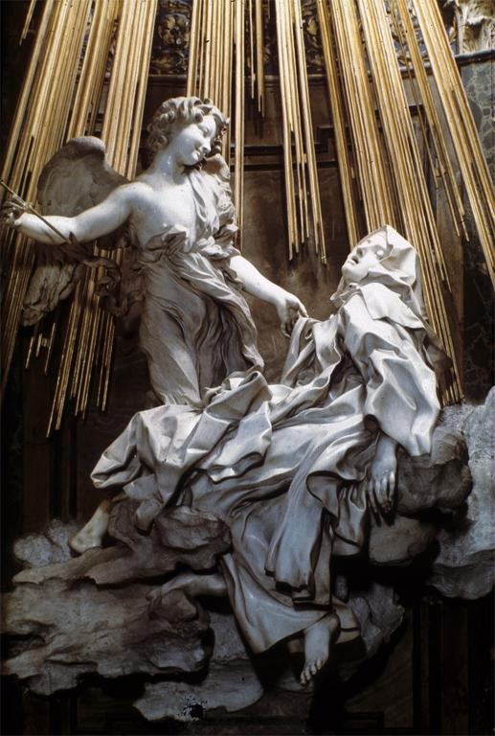
Notes:
Title: Bernini, Gian Lorenzo (1598-1680) Title: Cornaro Chapel: Ecstasy of St. Title: Theresa; Detail of Whole Group. Title: 1646. Title: Rome: S. M. Della Vittoria. Title: Source UnknownV5934-005 Collection: UCB: Visual Resources Collection ID Number: UCB Accession Number: 49096 Rights: This image has been selected and made available for University of California Shared Images and is intended solely for noncommercial educational use. http:\/\/www.cdlib.org\/services\/dsc\/ucsi\/policies.html Rights: This image has been selected and made available by a user using Artstor's software tools. Artstor has not screened or selected this image or cleared any rights to it and is acting as an online service provider pursuant to 17 U.S.C. §512. Artstor disclaims any liability associated with the use of this image. Should you have any legal objection to the use of this image, please visit http:\/\/www.artstor.org\/copyright for contact information and instructions on how to proceed.

Slide 24
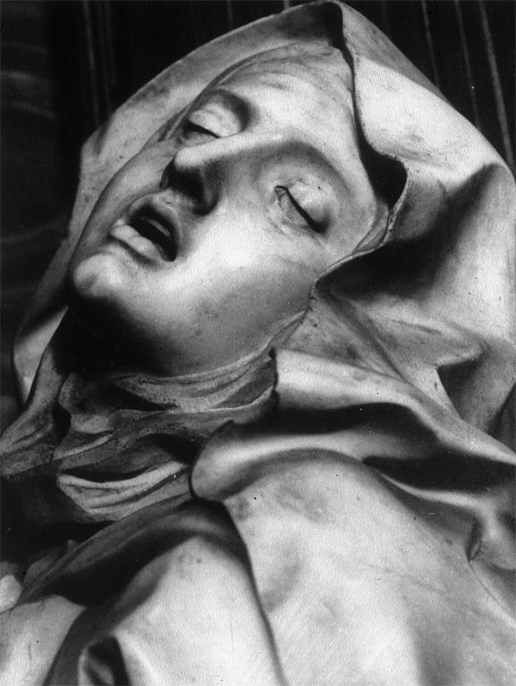
Notes:
Title: Bernini, G.L. 1598-1680 Title: Cornaro Chapel: Ecstasy Title: of St. Teresa. 1646. Title: Detail: St.Teresa'S Head. Title: Rome: S.M.Della Vittoria. Title: Pope-Hennessy, It.Hi.Ren. Title: 3:2, 151 T4151 Title: V5934-006 Collection: UCB: Visual Resources Collection ID Number: UCB Accession Number: 49105 Rights: This image has been selected and made available for University of California Shared Images and is intended solely for noncommercial educational use. http:\/\/www.cdlib.org\/services\/dsc\/ucsi\/policies.html Rights: This image has been selected and made available by a user using Artstor's software tools. Artstor has not screened or selected this image or cleared any rights to it and is acting as an online service provider pursuant to 17 U.S.C. §512. Artstor disclaims any liability associated with the use of this image. Should you have any legal objection to the use of this image, please visit http:\/\/www.artstor.org\/copyright for contact information and instructions on how to proceed.

Slide 25
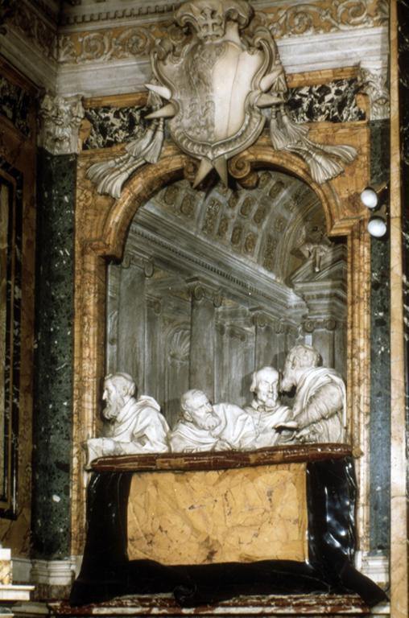
Notes:
Creator: Bernini,G.L. Creator: 1598-1680 Title: Ecstasy of St.Theresa Work Type: Sculptural Art Date: 1644-52 Location: Italy Description: detail,Cornaro family right side, Cornaro Chapel Repository: Rome,St.Maria Vittoria Repository: Collection Name: Rome,St.Maria della Vittoria Accession Number: 272 Accession Number: B528 Accession Number: 38TC(b) Collection: UCLA Visual Resources Collection ID Number: 234877 Rights: Because the photographs from which these images were made are copyrighted, any use beyond UC classroom presentations, unpublished student papers, and personal study requires the permission of the copyright holder. The user assumes full responsibility for any use of the materials, including but not limited to, infringement of copyright and publication rights of reproduced materials. Rights: This image has been selected and made available by a user using Artstor's software tools. Artstor has not screened or selected this image or cleared any rights to it and is acting as an online service provider pursuant to 17 U.S.C. §512. Artstor disclaims any liability associated with the use of this image. Should you have any legal objection to the use of this image, please visit http:\/\/www.artstor.org\/copyright for contact information and instructions on how to proceed.

Slide 26
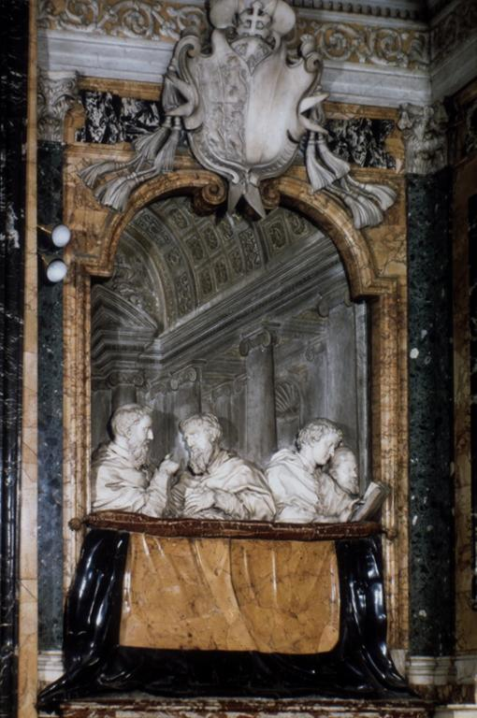
Notes:
Creator: Bernini,G.L. Creator: 1598-1680 Title: Ecstasy fo St.Theresa Work Type: Sculptural Art Date: 1644-52 Location: Italy Description: detail,Cornaro family Cornaro Chapel,left side Repository: Rome,St.Maria Vittoria Repository: Collection Name: Rome,St.Maria della Vittoria Accession Number: 272 Accession Number: B528 Accession Number: 38TC(a) Collection: UCLA Visual Resources Collection ID Number: 234878 Rights: Because the photographs from which these images were made are copyrighted, any use beyond UC classroom presentations, unpublished student papers, and personal study requires the permission of the copyright holder. The user assumes full responsibility for any use of the materials, including but not limited to, infringement of copyright and publication rights of reproduced materials. Rights: This image has been selected and made available by a user using Artstor's software tools. Artstor has not screened or selected this image or cleared any rights to it and is acting as an online service provider pursuant to 17 U.S.C. §512. Artstor disclaims any liability associated with the use of this image. Should you have any legal objection to the use of this image, please visit http:\/\/www.artstor.org\/copyright for contact information and instructions on how to proceed.

Slide 27
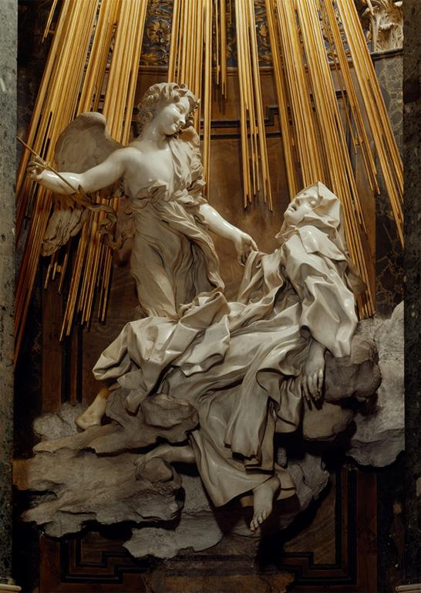
Notes:
Creator: Gian Lorenzo Bernini Title: Cornaro Chapel; Ecstasy of Saint Theresa Work Type: sculpture Date: 1645-1652 Location: S. Maria della Vittoria (Rome, Italy) Material: marble Measurements: life-size Collection: Italian and other European Art (Scala Archives) Source: Image and original data provided by SCALA, Florence\/ART RESOURCE, N.Y. Source: http:\/\/www.artres.com\/c\/htm\/Home.aspx Source: http:\/\/www.scalarchives.com Rights: (c) 2006, SCALA, Florence \/ ART RESOURCE, N.Y. Rights: Please note that if this image is under copyright, you may need to contact one or more copyright owners for any use that is not permitted under the ARTstor Terms and Conditions of Use or not otherwise permitted by law. While ARTstor tries to update contact information, it cannot guarantee that such information is always accurate. Determining whether those permissions are necessary, and obtaining such permissions, is your sole responsibility. Rights: Rights:

Slide 28
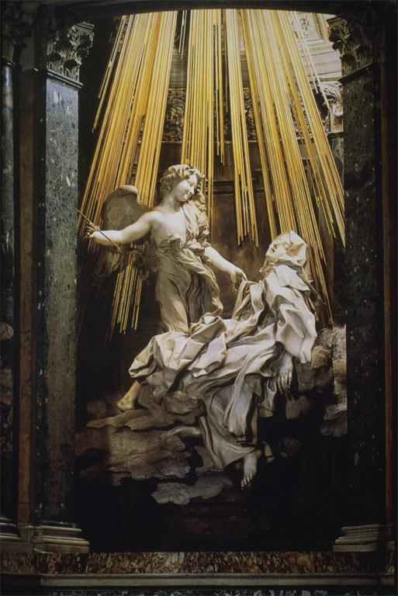
Notes:
Creator: Bernini, Gianlorenzo, Italian Title: Ecstasy of Saint Teresa of Avila; figure group from the Cornaro Chapel, Church of Santa Maria della Vittoria, Rome Date: 1645-1652 Location: Santa Maria della Vittoria, Rome Material: marble Measurements: h. 3.5m. Related Item: Adams AAT: 18.21 Related Item: Hartt 4: 26-15 Related Item: Gardner 10: 24-10 Related Item: H&F 4: 13.17 Related Item: Janson 5R: 753 Related Item: W&S 3: 7-26 Related Item: Stokstad R: 19-10 Collection: Art History Survey Collection Source: Catalogued by: Digital Library Federation Academic Image Cooperative Rights: Rights:

Slide 29
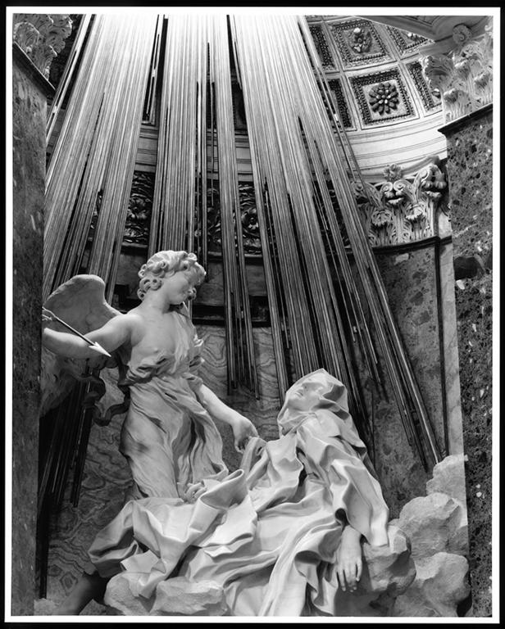
Notes:
Creator: Gian Lorenzo Bernini Title: Cornaro Chapel Title: detail of Ecstasy of Saint Teresa Date: 1645-1652 Location: Santa Maria della Vittoria, Rome, Italy Material: marble Description: Photographer: Ralph Lieberman Collection: Ralph Lieberman Archive (Harvard University) ID Number: VSCO162.02865 Rights: Contact: Special Collections, Fine Arts Library, Harvard University, falphoto@fas.harvard.edu, 617-495-4656 Rights: Please note that if this image is under copyright, you may need to contact one or more copyright owners for any use that is not permitted under the ARTstor Terms and Conditions of Use or not otherwise permitted by law. While ARTstor tries to update contact information, it cannot guarantee that such information is always accurate. Determining whether those permissions are necessary, and obtaining such permissions, is your sole responsibility. Rights: Rights:

Slide 30
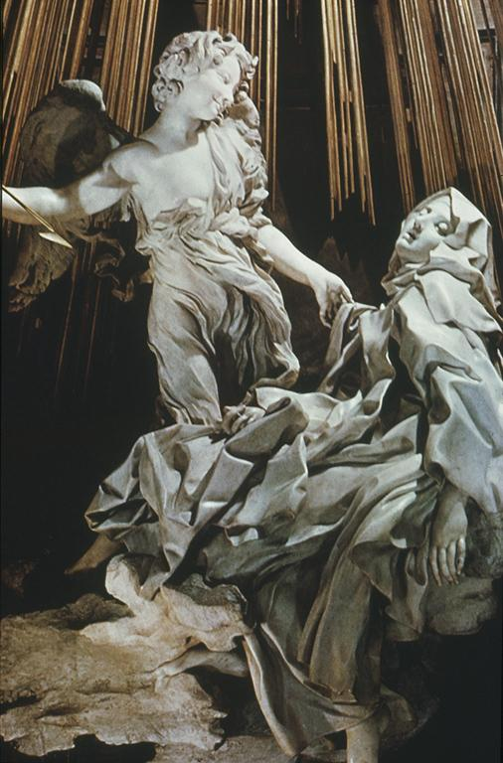
Notes:
Creator: Bernini, Gian Lorenzo, 1598-1680 Title: Santa Maria Della Vittoria Cornaro Chapel: Saint Theresa in Ecstasy: det.: Theresa and Angel Date: 1647-51 Material: marble Description: Rome Subject: Sculpture--Italy--17th C. A.D Collection: ARTstor Slide Gallery Source: Data from: University of California, San Diego Rights: Rights:

Slide 31
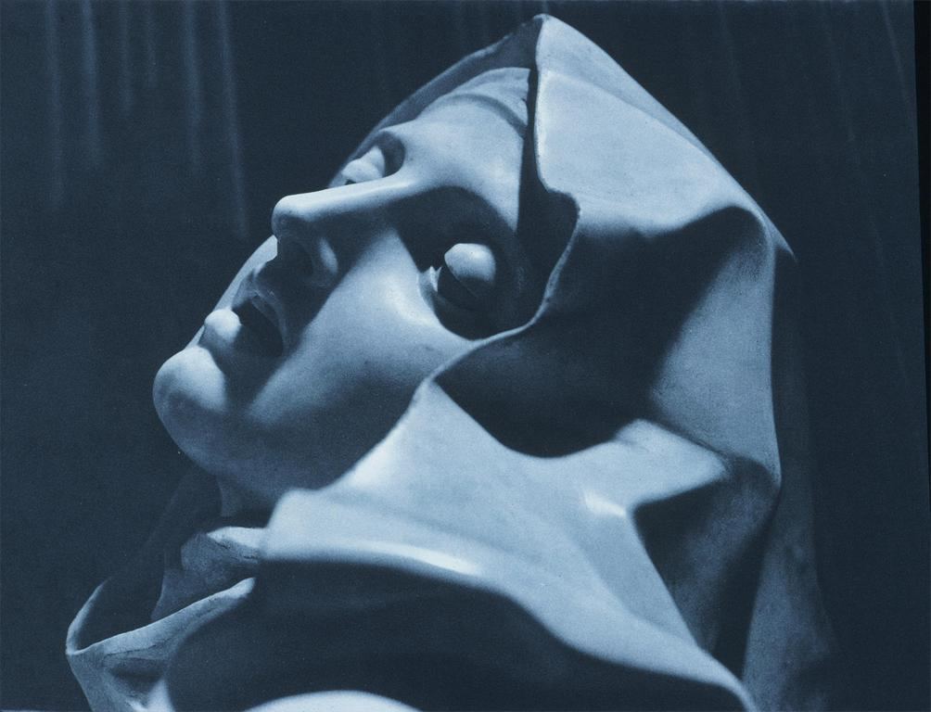
Notes:
Creator: Bernini, Gian Lorenzo, 1598-1680 Title: Santa Maria Della Vittoria Cornaro Chapel: Saint Theresa in Ecstasy: det.: Theresa, head Date: 1647-51 Material: marble Description: Rome Subject: Sculpture--Italy--17th C. A.D Collection: ARTstor Slide Gallery Source: Data from: University of California, San Diego Rights: Rights:

Slide 32
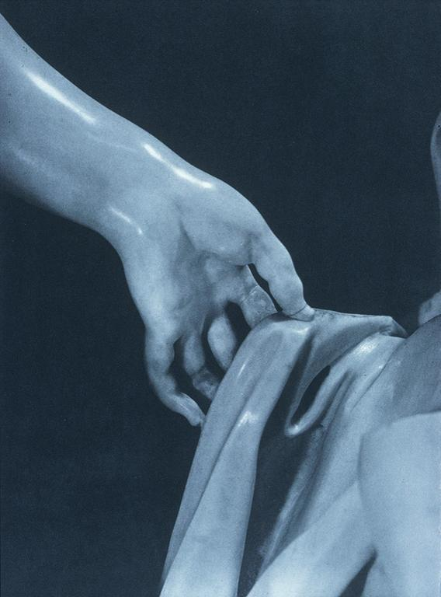
Notes:
Creator: Bernini, Gian Lorenzo, 1598-1680 Title: Santa Maria Della Vittoria Cornaro Chapel: Saint Theresa in Ecstasy: det.: Angel, left hand Date: 1647-51 Material: marble Description: Rome Subject: Sculpture--Italy--17th C. A.D Collection: ARTstor Slide Gallery Source: Data from: University of California, San Diego Rights: Rights:

Slide 33
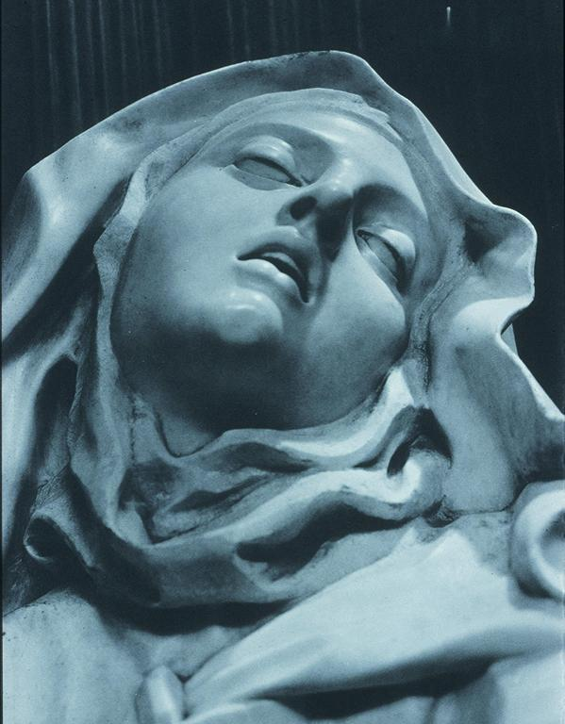
Notes:
Creator: Bernini, Gian Lorenzo, 1598-1680 Title: Santa Maria Della Vittoria Cornaro Chapel: Saint Theresa in Ecstasy: det.: Theresa, head Date: 1647-51 Material: marble Description: Rome Subject: Sculpture--Italy--17th C. A.D Collection: ARTstor Slide Gallery Source: Data from: University of California, San Diego Rights: Rights:

Slide 34
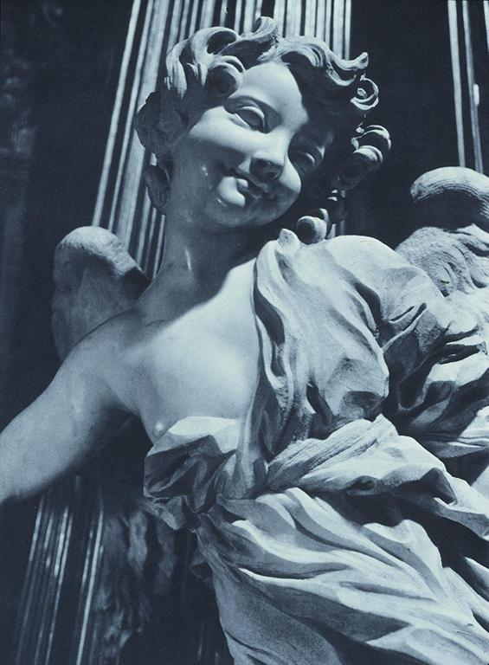
Notes:
Creator: Bernini, Gian Lorenzo, 1598-1680 Title: Santa Maria Della Vittoria Cornaro Chapel: Saint Theresa in Ecstasy: det.: Angel Date: 1647-51 Material: marble Description: Rome Subject: Sculpture--Italy--17th C. A.D Collection: ARTstor Slide Gallery Source: Data from: University of California, San Diego Rights: Rights:

Slide 35
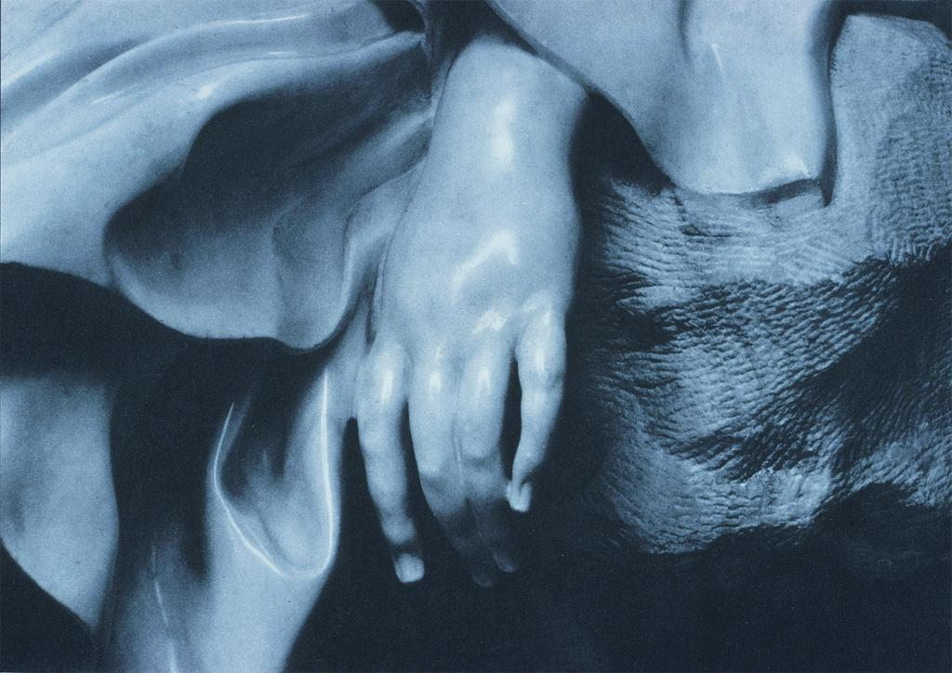
Notes:
Creator: Bernini, Gian Lorenzo, 1598-1680 Title: Santa Maria Della Vittoria Cornaro Chapel: Saint Theresa in Ecstasy: det.: left hand of saint Date: 1647-51 Material: marble Description: Rome Subject: Sculpture--Italy--17th C. A.D Collection: ARTstor Slide Gallery Source: Data from: University of California, San Diego Rights: Rights:

Slide 36
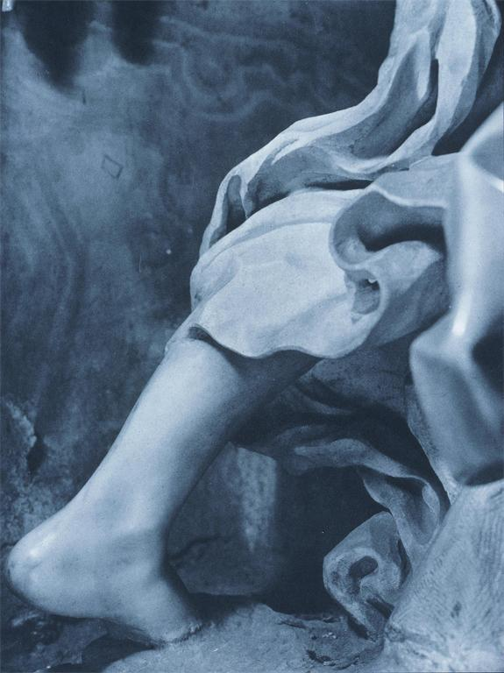
Notes:
Creator: Bernini, Gian Lorenzo, 1598-1680 Title: Santa Maria Della Vittoria Cornaro Chapel: Saint Theresa in Ecstasy: det.: Angel, feet back view Date: 1647-51 Material: marble Description: Rome Subject: Sculpture--Italy--17th C. A.D Collection: ARTstor Slide Gallery Source: Data from: University of California, San Diego Rights: Rights:

Slide 37
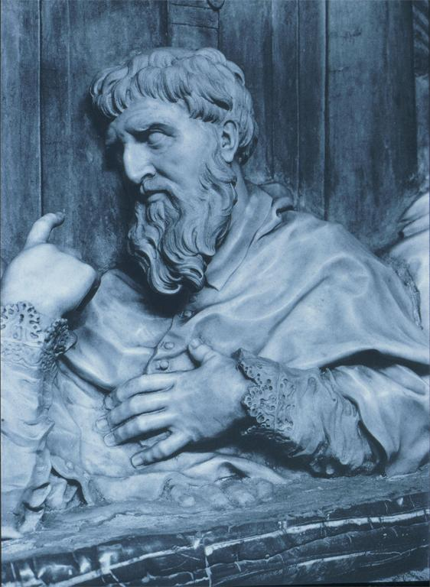
Notes:
Creator: Bernini, Gian Lorenzo, 1598-1680 Title: Santa Maria Della Vittoria Cornaro Chapel:Commemorative monument of Cornaro Cardinals and Doge: Cardinal: east wall Date: 1647-51 Material: marble Description: Rome Subject: Sculpture--Italy--17th C. A.D Collection: ARTstor Slide Gallery Source: Data from: University of California, San Diego Rights: Rights:

Slide 38
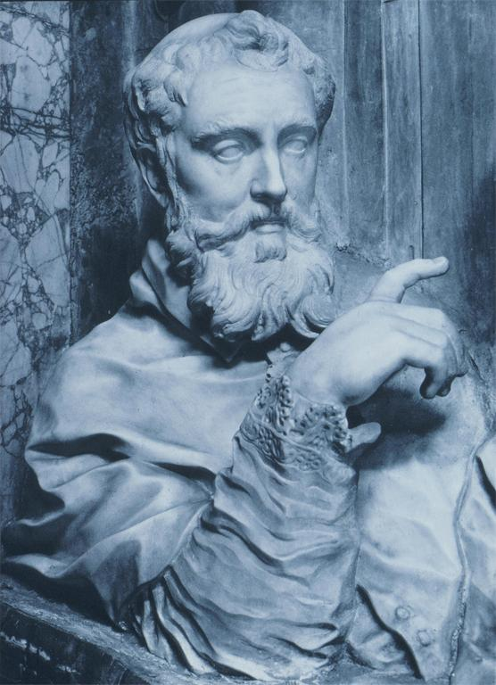
Notes:
Creator: Bernini, Gian Lorenzo, 1598-1680 Title: Santa Maria Della Vittoria Cornaro Chapel:Commemorative monument of Cornaro Cardinals and Doge: Cardinal: east wall Date: 1647-51 Material: marble Description: Rome Subject: Sculpture--Italy--17th C. A.D Collection: ARTstor Slide Gallery Source: Data from: University of California, San Diego Rights: Rights:

Slide 39
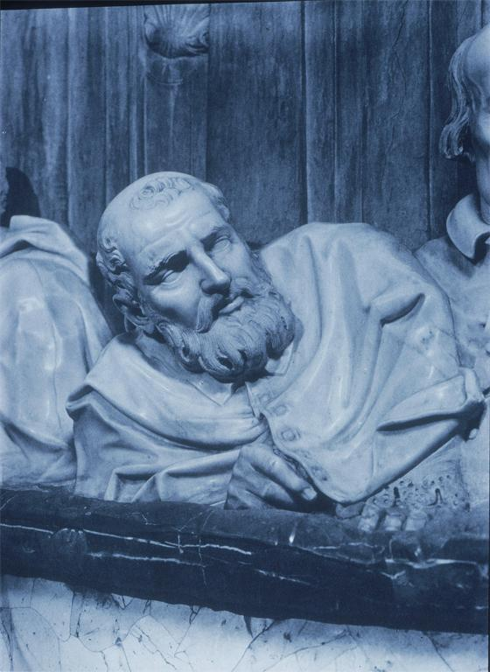
Notes:
Creator: Bernini, Gian Lorenzo, 1598-1680 Title: Santa Maria Della Vittoria Cornaro Chapel:Commemorative monument of Federico and other Cornaro Cardinals: Cardinal:west wall Date: 1647-51 Material: marble Description: Rome Subject: Commemorative monuments Subject: Sculpture--Italy--17th C. A.D Collection: ARTstor Slide Gallery Source: Data from: University of California, San Diego Rights: Rights:

Slide 40
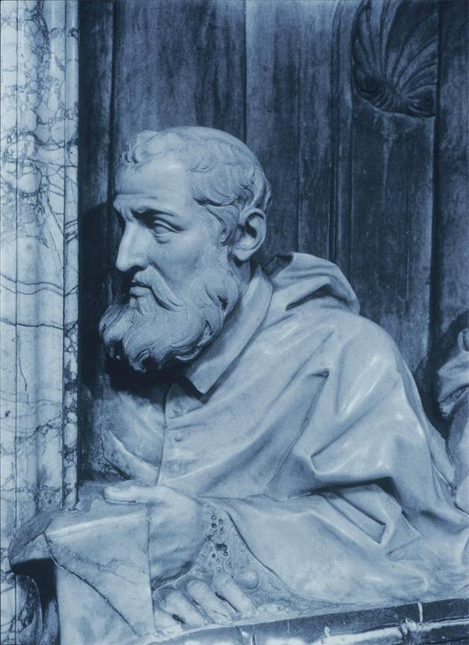
Notes:
Creator: Bernini, Gian Lorenzo, 1598-1680 Title: Santa Maria Della Vittoria Cornaro Chapel:Commemorative monument of Federico and other Cornaro Cardinals: Cardinal:west wall Date: 1647-51 Material: marble Description: Rome Subject: Commemorative monuments Subject: Sculpture--Italy--17th C. A.D Collection: ARTstor Slide Gallery Source: Data from: University of California, San Diego Rights: Rights:

Slide 41
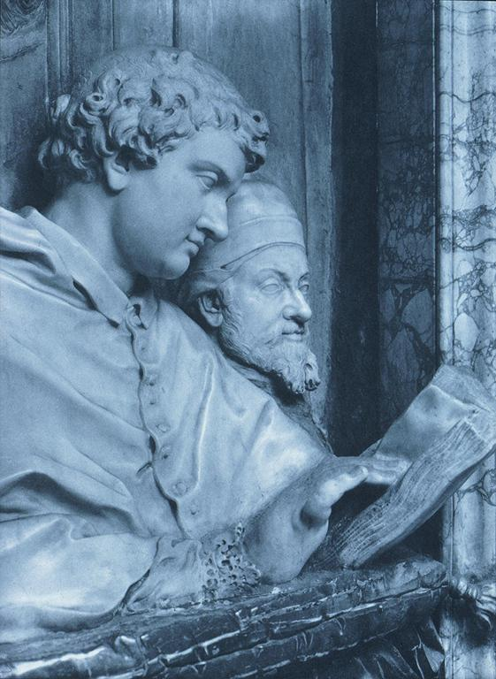
Notes:
Creator: Bernini, Gian Lorenzo, 1598-1680 Title: Santa Maria Della Vittoria Cornaro Chapel:Commemorative monument of Cornaro Cardinals and Doge: Cardinal Marco and Doge:E. Wall Date: 1647-51 Material: marble Description: Rome Subject: Commemorative monuments Subject: Sculpture--Italy--17th C. A.D Collection: ARTstor Slide Gallery Source: Data from: University of California, San Diego Rights: Rights:

Slide 42
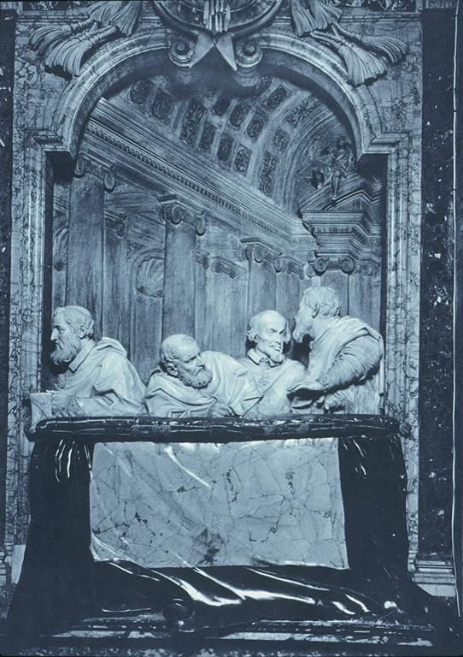
Notes:
Creator: Bernini, Gian Lorenzo, 1598-1680 Title: Santa Maria Della Vittoria Cornaro Chapel:Commemorative monument of Federico and other Cornaro Cardinals: west wall Date: 1647-51 Material: marble Description: Rome Subject: Commemorative monuments Subject: Sculpture--Italy--17th C. A.D Collection: ARTstor Slide Gallery Source: Data from: University of California, San Diego Rights: Rights:

Slide 43
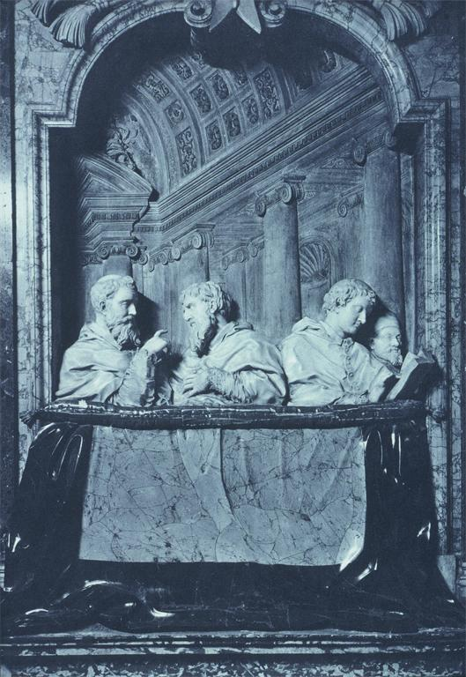
Notes:
Creator: Bernini, Gian Lorenzo, 1598-1680 Title: Santa Maria Della Vittoria Cornaro Chapel:Commemorative monument of Cornaro Cardinals and Doge: east wall Date: 1647-51 Material: marble Description: Rome Subject: Sculpture--Italy--17th C. A.D Collection: ARTstor Slide Gallery Source: Data from: University of California, San Diego Rights: Rights:

