Slide 1
Principles of Incident Response and Disaster Recovery, 2nd Edition
Chapter 4
Incident Response: Planning
Notes:
1

Slide 2
Objectives
Describe the process used to organize the incident response planning process
Describe the activities and deliverables used to develop an incident response policy, including how policy affects the incident response planning process and how policy can be implemented to support incident response practices
Explain the techniques that can be employed when forming a security incident response team

Slide 3
Objectives (cont’d.)
List the skills and components required to devise an incident response plan
Discuss some of the concerns and trade-offs to be managed when assembling the final incident response plan

Slide 4
Introduction
Contingency planning (CP)
Addresses everything to prepare for the unexpected
Incident response (IR): element of CP
Focus: detect and evaluate the severity of emerging unexpected events
Documented escalation process
Used when other CP process elements activated
IR process phases
Preparation, detection and analysis, containment, eradication and recovery, and post-incident activity

Slide 5
The IR Planning Process
Contingency planning management committee (CPMT)
Completes each business impact analysis component
Transfers information to subordinate committees
IR committee, disaster recovery (DR) committee, business continuity (BC) committee
Provides information that may overlap
Attack information
Attack prioritization information
Attack scenario end cases

Slide 6
The IR Planning Process (cont’d.)
Committee members begin their subordinate plans
Incident planning stages
Form the IR planning committee
Develop the IR planning policy
Integrate the BIA
Identify preventive controls
Organize the Computer Security Incident Response Team (CSIRT)
Create IR strategies and procedures
Develop the IR plan
Ensure plan testing, training, exercises, maintenance

Slide 7
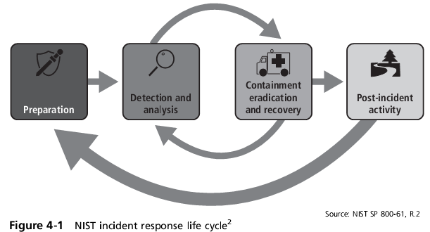

Slide 8
The IR Planning Process (cont’d.)
IR planning process organization
Begins with staffing the IR planning committee
IR team organized as a separate entity
Begins by identifying and engaging collection of stakeholders
Representative collection of individuals
Have a stake in the successful and uninterrupted operation of the information infrastructure
Used to collect vital information on the roles and responsibilities of the CSIRT

Slide 9
The IR Planning Process (cont’d.)
Typical stakeholders
General management
IT and InfoSec management
Organizational departments
Legal department
Human resources department (HR)
Public relations (PR)
Departments with an information security overlap
General end users, key business partners, contractors, temporary employee agencies, consultants

Slide 10
Forming the IR Planning Team
Incident response planning team (IRP team)
Performs planning and development activities
Built by executive leadership
Information technology (IT) involvement
Information security involvement
CPMT organizational management representatives
Team leader: liaison between IR team and CPMT
Champion: chief information officer (CIO) or vice president of IT
Should meet regularly to develop IR plan, structure, develop, and train CSIRT

Slide 11
Developing the Incident Response Policy
IR policy
First deliverable prepared by the IRP committee
Defines team operations
Articulates response to various types of incidents
Advises end users on how to contribute to the effective response
Rather than contributing to the problem at hand
Similar in structure to other organization policies

Slide 12
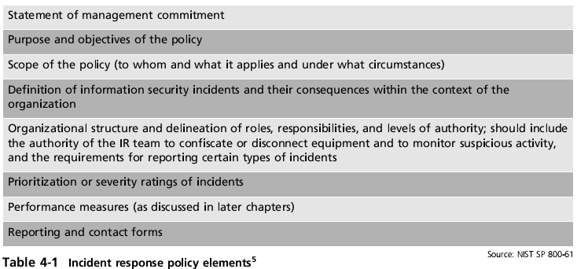

Slide 13
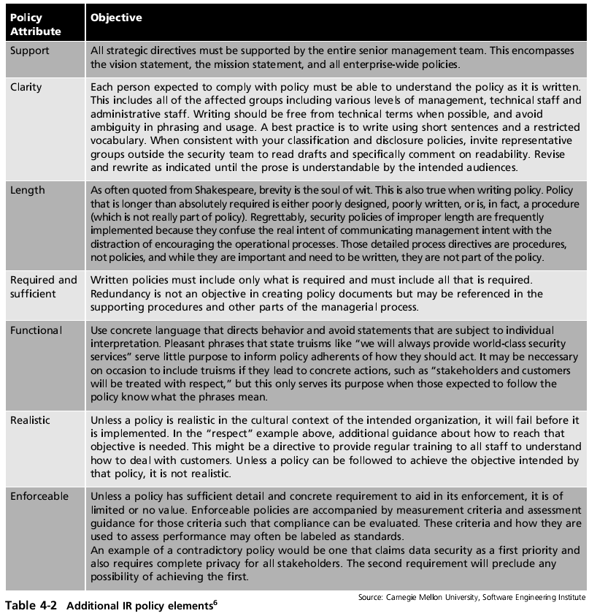

Slide 14
Developing the Incident Response Policy (cont’d.)
In developing the policy:
Critical to involve those who actually use the policies
Include interaction and review by other CP teams
Aids in developing clear, consistent, uniform policy elements and structure
Look at policies from other agencies and organizations

Slide 15
Developing the Incident Response Policy (cont’d.)
Policy information sources
Organization charts for the enterprise and specific business functions
Topologies for organizational or constituency systems and networks
Critical system and asset inventories
Existing DR or BC plans and any existing IR plans
Existing guidelines for notifying the organization of a physical security breach
Any parental or institutional regulations
Any existing security policies and procedures

Slide 16
Building the Computer Security Incident Response Team
Loose or informal CSIRT association
Consists of IT and InfoSec staffers
Informed if attack detected on information assets
Formal CSIRT implementation
Team of people and supporting policies, procedures, technologies, and data
Prevent, detect, react to, and recover from incident that could potentially damage information
At some level CSIRT team member come from all organization members
Every action could cause or avert an incident

Slide 17
Incident Response Planning
Incident response plan (IR plan)
Detailed set of processes and procedures
Anticipate, detect, and mitigate unexpected event effects that might compromise information resources and assets
Adverse events: organization viewpoint
Unexpected activities occurring periodically

Slide 18
Incident Response Planning (cont’d.)
Incident: contingency planning viewpoint
Adverse event threatening security of organization’s information
Adverse event: natural or human made
Occurs when adverse event affects information resources and/or assets
Causes actual damage or other disruptions
Incident response (IR)
Set of procedures
Commence when incident detected
Must be carefully planned and coordinated

Slide 19
Incident Response Planning (cont’d.)
IR plan activation
Occurs when incident causes minimal damage
According to criteria set in advance
Activated with little or no disruption to operations
Information security incident
Three required characteristics
Directed against information assets owned or operated by the organization
Has realistic chance of success
Threatens information resources and assets confidentiality, integrity, or availability

Slide 20
Incident Response Planning (cont’d.)
IR procedures
Reactive measures; not considered preventive control
Excluding efforts taken to prepare for such actions
Chief information security officer (CISO)
Responsible for creating organization’s IR plan
Creates CSIRT by selecting members from each community of interest
Should clearly document and communicate roles and responsibilities
May include an alert roster

Slide 21
Incident Response Planning (cont’d.)
IRP team and CSIRT
Develop series of predefined incident responses
IR plan creation
Part of the multistep CP process completed by IR team
Integral IR procedures begin to take shape
For every potential attack scenario IR team creates the incident plan
Incident plan made up of three sets of incident-handling procedures
Address steps taken before, during, & after incident

Slide 22
Planning for the Response During the Incident
IR planning activities
Begin with the middle: the actual incident response
Most important phase
Reaction to the incident (“during the incident”)
Team needs quick and easy access to specific procedures
Must identify, contain, and terminate the incident

Slide 23
Triggering the IR Plan
Viable attack scenario end cases
Examined in turn by IR team and CSIRT representatives
Understand actions needed to react to the incident
Discussion begins with the trigger
Circumstance causing IR team activation and IR plan initiation

Slide 24
Triggering the IR Plan (cont’d.)
Trigger situations or circumstances
Phone call from a user to the help desk about unusual computer or network behavior
Notification from systems administrator about unusual server or network behavior
Notification from an intrusion detection device
Review of system log files indicating an unusual pattern of entries
Loss of system connectivity
Device malfunctions

Slide 25
Triggering the IR Plan (cont’d.)
Once indicator reported:
IR team leader or IR duty officer determines IR plan activation
IR duty officer
CSIRT team member (not the team leader)
Currently performing team leader responsibilities
Scanning information infrastructure for signs of an incident
Team members notified once potential incident detected
Move forward with IR plan

Slide 26
The Reaction Force
IRP team determines individuals needed to respond to each particular end case
Unique team for each attack scenario end case
Team leader specified in IR plan
Resources and skill sets added as necessary
IR plan specifies the scribe (archivist or historian)
Develops and maintains event log used in reviewing actions during the after-action review
CSIRT reaction force
The resulting incident team

Slide 27
Actions Taken “During the Incident”
Reacting to a particular incident
Determining what must be done
Example: malware infestation
Verify virus presence
Confirm presence and determine extent of exposure
Quarantine infestation
Disconnect infected systems from network
Look for evidence of continued spread
Continue to look for “flare-ups”
Begin the next phase: decontamination

Slide 28
Actions Taken “During the Incident” (cont’d.)
Example: malware infestation (cont’d.)
Last phase: “actions during”
Disinfect systems by running anti-malware software, searching for spyware
Functional and up-to-date anti-malware detects and documents new malware presence
“Actions during” phase complete once all signs of contamination eliminated

Slide 29
Planning for “After the Incident”
“Actions after” phase
Begins once incident contained
Lost or damaged data restored
Systems scrubbed of infection
Essentially everything restored to its previous state
IR plan
Describes stages to recover from most likely incident
Details the protection from follow-on incidents, forensics analysis, after-action review events
Follow-on attacks
Identification should be of great concern

Slide 30
Planning for “After the Incident” (cont’d.)
Forensic analysis
Systematically examining information assets for evidentiary material providing insight into how incident transpired
Use an individual trained in forensic analysis
May be used in civil or criminal proceedings
After-action review (AAR)
Detailed examination of events
Key players review and verify notes, documentation
Update plan and train future staff
IR team action closed

Slide 31
Planning for “Before the Incident”
Also called “before actions”
Planners implement good IT and information security practices
Includes preventive measures
Manage risks associated with a particular attack
Preparations of the IR team
Routine rehearsal maintains a state of readiness to respond to attacks
CSIRT training, IR plan testing, selecting and maintaining CSIRT tools, training system users

Slide 32
Training the CSIRT
National training programs focusing on IR tools and techniques
SANS Institute national conferences
http://www.sans.org
SANSFIRE: specifically focused on IR
Microsoft, Cisco, and Sun
Department of Homeland Security (DHS) and the US CERT
http://www.fbcinc.com/gfirst
Organization training programs
Includes mentoring-type training

Slide 33
Training the CSIRT (cont’d.)
Professional reading program
Self-created list of trustworthy information sources
No dedicated IR journals or magazines
SANS Information Security Reading Room
http://www.sans.org/rr
Computer Security Officer
http://www.csoonline.com
SC Magazine
http://www.scmagazine.com
Information Security Magazine
http://informationsecurity.techtarget.com

Slide 34
Training the CSIRT (cont’d.)
Online resources for IR
Forum of Incident Response and Security Teams (FIRST): http://www.first.org
U.S. Computer Emergency Readiness Team (US CERT): http://www.us-cert.gov
CERT Coordination Center (CERT CC) at Carnegie Mellon University: http://www.cert.org
NIST Computer Security Resource Center (CSRC)
http://csrc.nist.gov
Honeypots.net: http://www.honeypots.net

Slide 35
Training the CSIRT (cont’d.)
IR plan testing
Key part of CSIRT training
Strategies
Desk check, structured walk-through, simulation, parallel testing, full interruption, war gaming
Desk check
Individual reviews plan and creates list of correct and incorrect components
Structured walk-through
Walk through steps taken during an actual event

Slide 36
Training the CSIRT (cont’d.)
Simulation
Potential participant individually simulates the performance of each task
Stops short of the actual physical tasks required
Parallel testing
Act as if actual incident occurred
Perform required tasks and executes necessary procedures without interfering with the normal operations of the business
Must ensure procedures performed do not halt operations of the business functions

Slide 37
Training the CSIRT (cont’d.)
Full interruption
Individuals follow each and every procedure
Often performed after normal business hours
In organizations that cannot afford to disrupt or simulate disruption of business functions
War gaming
Simulation of attack and defense activities
Uses realistic networks and information systems
The exercise of IR plans is an important element
National competitions at conferences and collegiate level

Slide 38
Training the CSIRT (cont’d.)
Common war-gaming variations
Capture the flag, king of the hill, computer simulations
Defend the flag, online programming-level war games
CIA and U.S. military war games
Train and test troops in information security and information warfare tactics
Hackers have war games (http://roothack.org)
Minimum test:
Periodic walk-through (chalk talk) of each CP component plans

Slide 39
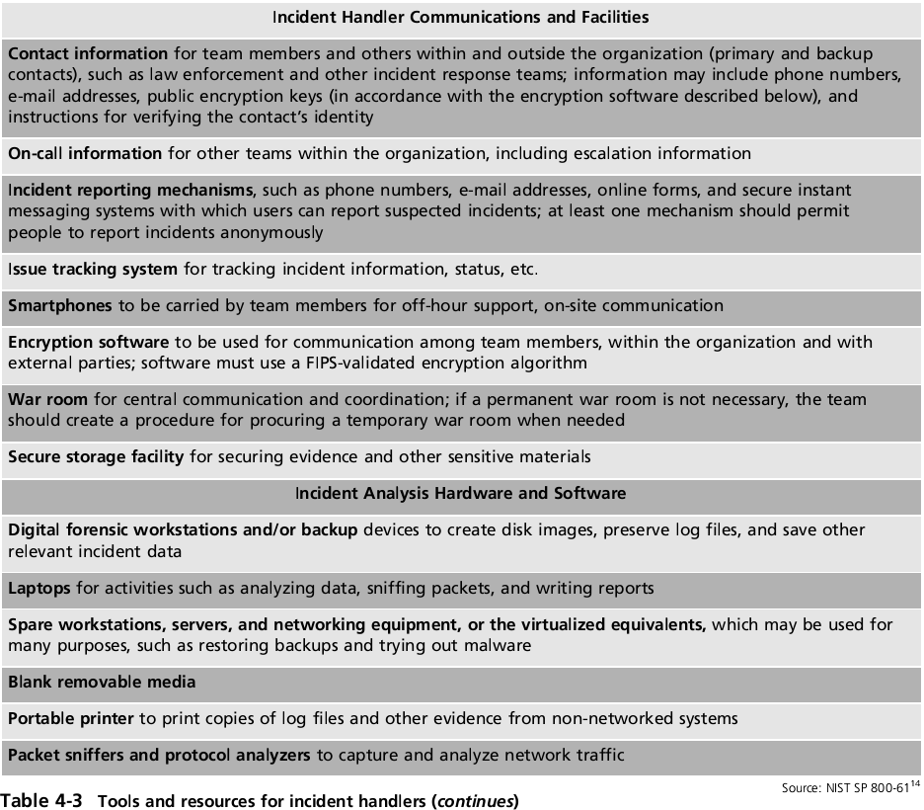

Slide 40
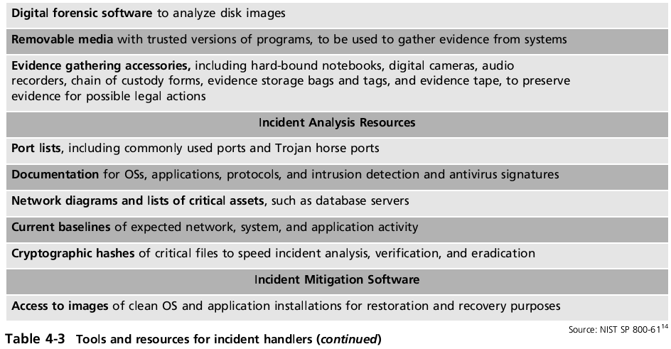

Slide 41
Training the Users
Security education training and awareness (SETA)
Responsible for training users
Tasks to instruct
What is expected of them
How to recognize an attack
How to report a suspected incident, and whom to report it to
How to mitigate the damage of attacks on the desktop

Slide 42
Training the Users (cont’d.)
Tasks to instruct (cont’d.)
Good information security practices
Keeping antivirus/anti-malware software up to date
Using spyware detection software
Keeping operating system and applications up to date with patches and updates
Not opening suspect e-mail attachments
Avoiding social engineering attacks
Not downloading and installing unauthorized software or software from untrusted sources
Protecting passwords and classified information

Slide 43
Training the Users (cont’d.)
Training for general users
Allows users to ask questions and receive specific guidance
Provide training on technical details of how to do jobs securely
Allows the organization to emphasize key points
Employee orientation
Convenient time to conduct training

Slide 44
Training the Users (cont’d.)
Training for managerial users
May have same requirements as general user
Managers expect more personal training
Managers often resist organized training
Champion can exert influence
Training for technical users
Training for IT staff, security staff, technically competent general users
More detailed than general user or managerial training
May require consultants or outside training organizations

Slide 45
Training Techniques and Delivery Methods
Successful training elements
Good training techniques
Thorough subject area knowledge
Selection of training delivery method
Not always based on the best outcome for the trainee
Often based on budget, time frame, organization needs

Slide 46
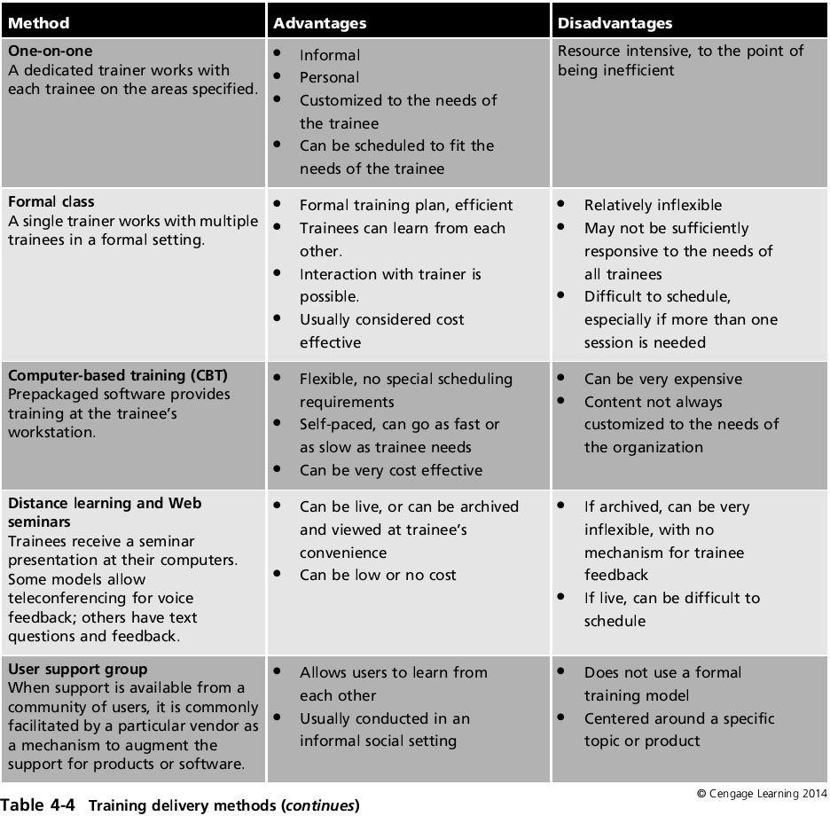

Slide 47
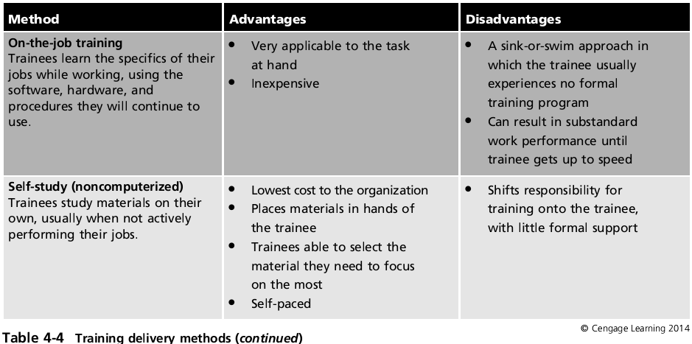

Slide 48
Assembling and Maintaining the Final IR Plan
Draft plan
Used for preliminary staff training and evaluating plan effectiveness
If any errors or difficulties are discovered
Remedied as draft plan matures
Commence final assembly
Once desired plan maturity is achieved, drafts are reviewed and tested

Slide 49
Assembling and Maintaining the Final IR Plan (cont’d.)
Final plan creation
Testing process does not stop: test semiannually
Modified plans retested at the earliest opportunity
Final IR plan document created
Once all individual IR plan components drafted and tested
IR plan format and content
Organization dependent
Ensure IR plan developed, tested, and placed in easy-to-access location

Slide 50
Assembling and Maintaining the Final IR Plan (cont’d.)
Recommended practices for physical IR plan
Select a uniquely colored binder
Place reflective tape on spine of binder
Place classified document cover sheet in slipcover
Place an index on the first inside page
Use common tab and label the index for documents
Organize the contents
Attach copies of relevant documents in the back
Add additional documents as needed
Store in a secure but easily reachable location

Slide 51
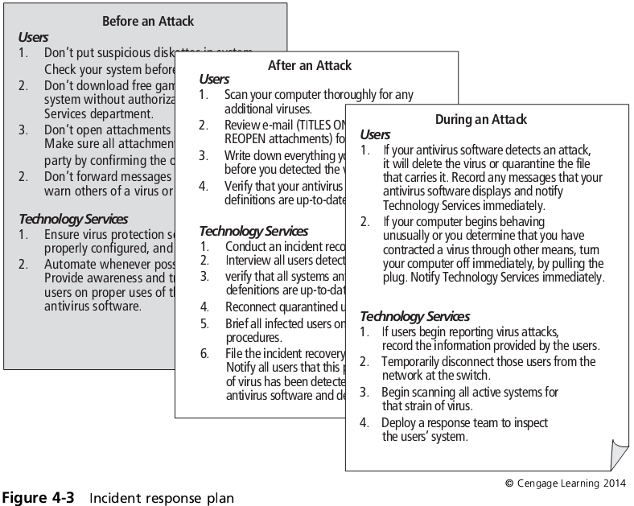

Slide 52
Summary
CP prepares organization for the unexpected
CPMT completes BIA components, and identifies information flow and subordinate committee responsibility
Incident planning has multiple stages
Organizing the IR planning process begins with IRP team staffing and identifying stakeholders
IRP team first deliverable: IR policy
CSIRT prevents, detects, reacts to, and recovers from an incident

Slide 53
Summary (cont’d.)
IR plan anticipates, detects, and mitigates unexpected event effects
Activated when incident causes minimal damage
Includes three sets of incident-handling procedures
IRP team determines individuals needed to respond
Ensures CSIRT prepared to respond to incident
Key part CSIRT training: testing the IR plan
Final IR plan document created
Once all individual IR plan components drafted and tested

