Slide 1
Principles of Incident Response and Disaster Recovery, 2nd Edition
Chapter 5
Incident Response: Detection and Decision Making
Notes:
1

Slide 2
Objectives
Define incidents that pose a risk to the organization
Discuss the elements necessary to detect incidents
Explain the components of an intrusion detection and prevention system
Describe the processes used in making decisions about incident detection and escalation

Slide 3
Introduction
Organizations’ challenge
Classifying events as they occur
Event
Any observable system or network occurrence
Adverse event
Event with negative consequences
Systems: computer, personnel, organization based
Not all events computer or network oriented
Event sources
Product of routine system activities, critical situations

Slide 4
Introduction (cont’d.)
Incident
Occurs when an adverse event becomes a genuine threat to ongoing operations
Incident classification process
Evaluating circumstances around events
Determining possible incidents (incident candidates)
Determining if adverse event constitutes an actual incident
Incident response (IR) design team role
Designing the process used to make a judgment

Slide 5
Introduction (cont’d.)
IR team responsibility
Classifying an incident
Sources for tracking and detecting incident candidates
End user reports and other documents
Intrusion detection and prevention systems (IDPSs)
Virus management software
Systems administrators
Careful incident candidate reporting training
Allows vital information to be relayed to the IR team

Slide 6
Introduction (cont’d.)
NIST incident classification scheme for network-based incident
Denial of service
Malicious code
Unauthorized access
Inappropriate usage
Multiple component

Slide 7
Detecting Incidents
Events occurring in and around an organization
May indicate presence of an incident candidate
May be normal operation mimicking incident candidate
Indication: adverse event underway
Has probability of becoming an incident
Precursor: activity now occurring
Incident could occur in the future
D. L. Pipkin incident indicator categories
Possible, probable, and definite

Slide 8
Possible Indicators of an Incident
Presence of unfamiliar files
Unfamiliar or unexplained files in illogical locations
Presence or execution of unknown programs or processes
Unfamiliar programs running, or processes executing
Unusual consumption of computing resources
Memory or hard disk consumption spikes and falls
Unusual system crashes
System crashing, hanging, rebooting, or freezing more frequently than usual

Slide 9
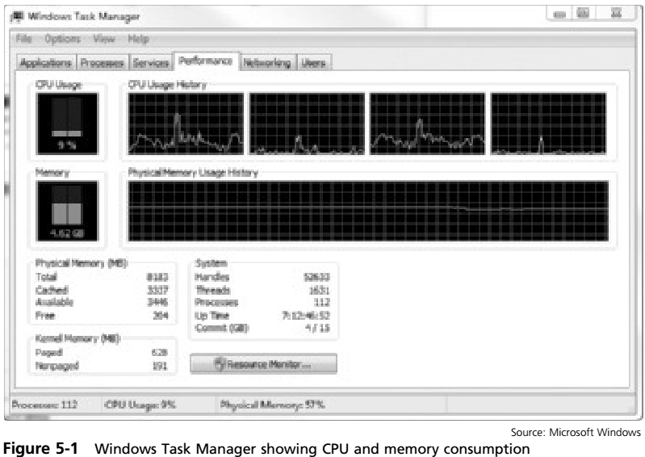

Slide 10
Probable Indicators of an Incident
Activities at unexpected times
Network traffic levels exceed baseline levels
Presence of unexpected new accounts
Periodic review indicates unfamiliar accounts
Unlogged new account with root or special privileges
Reported attacks
Verify user technical sophistication
Notification from IDPS
Must determine if notification real or a false positive

Slide 11
Definite Indicators
Definite indicators requiring IR plan activation
Use of dormant accounts
Changes to logs
Presence of hacker tools
Notifications by partner or peer
Notification by hacker
Confirmed events indicating attack underway
Loss of availability or integrity or confidentiality
Violation of policy or violation of law

Slide 12
Identifying Real Incidents
Actual incidents versus nonevents
Vast majority of incidents: false positives
Ways to process incidents
Incident center; geographically separate review locations; isolated incident candidate evaluations
Noise: legitimate activities wrongly reported
Activate feedback process to prevent flagging
Inherent in the nature of best-tuned systems
Causes of noise or false positives
Sensor placement; policy; lack of awareness

Slide 13
Identifying Real Incidents (cont’d.)
Data collection tuning process
Provides careful change analysis to data collection rules
False negative
Incident deserving attention that is not reported
New or modified systems placed in service
May need additional data collection process tuning
Tuning process objective
Allow valid incidents while controlling false positives

Slide 14
Intrusion Detection and Prevention Systems
Intrusion detection and prevention system (IDPS)
Network burglar alarm
Determines if network used in compliance with policy
Intrusion
Instigator attempting to gain unauthorized entry or disrupt normal operations
Access outside intended system or network use
Attack types: automated or self-propagating
Purpose of intrusion: harm an organization

Slide 15
Intrusion Detection and Prevention Systems (cont’d.)
Intrusion detection systems (IDSs)
Detects a violation and activates an alarm
Alarm types: audible, visual, silent
Custom configuration levels available
Intrusion prevention system (IPS)
Detects intrusion and prevents successful attack using an active response
IDPS source
http://csrc.nist.gov/publications/nistpubs/800-94/SP800-94.pdf

Slide 16
IDPS Terminology
Alarm or alert
Indication system just attacked or under attack
Alarm clustering
Consolidation of almost identical alarms into a single higher-level alarm
Alarm compaction
Form of alarm clustering based on similarities
Alarm filtering
Process of classifying attack alerts to distinguish or sort false positives from actual attacks more efficiently

Slide 17
IDPS Terminology (cont’d.)
Confidence value
Value associated with an IDPS’s ability to detect and identify an attack correctly
Evasion
Process by which attacker changes network packets format and/or timing to avoid being detected
False attack stimulus
Event triggering alarms causing false positive when no actual attack in progress
False negative
IDPS’s failure to react to an actual attack event

Slide 18
IDPS Terminology (cont’d.)
False positive
Alarm or alert indicating attack in progress or attack successful when there is no attack
Filtering
Process of reducing IDPS events in order to receive a better confidence in the alerts received
Noise
Ongoing activity from alarm events
Site policy
Rules and configuration guidelines governing IDPSs implementation and operation

Slide 19
IDPS Terminology (cont’d.)
Site policy awareness
IDPS’s ability to dynamically modify its site policies in reaction or response to environmental activity
True attack stimulus
Event triggering an alarm causing IDPS to react as if a real attack were in progress
Tuning
Process of adjusting an IDPS
Maximize true positive detection efficiency
Minimize both false positives and false negatives

Slide 20
Why Use an IDPS?
Prevent problem behaviors
Increase perceived risk of discovery and punishment
Detect attacks and security violations
Not prevented by other security measures
Detect and deal with preambles to attacks
Document existing threat to an organization
Act as quality control for security design and administration
Especially of large and complex enterprises
Provide useful information about intrusions

Slide 21
Why Use an IDPS? (cont’d.)
Straightforward deterrent measure
Increases fear of detection and discovery among would-be attackers or internal system abusers
NIST defined uses
Identifying security policy problems
Documenting the existing threat to an organization
Deterring individuals from violating security policies
Provides cover if network:
Fails to protect itself from known vulnerabilities
Unable to respond to rapidly changing threat environment

Slide 22
Forces Working against an IDPS
Tools fail to detect or correct a known deficiency
Vulnerability-detection performed too infrequently
Patch and upgrade installation delayed
Inability to disable or protect essential services
Use an IDPS for a Defense in Depth strategy
Doorknob rattling conducted by footprinting
Fingerprinting
Early warning allows time to prepare for attack
Automated responses lead to unintended consequence

Slide 23
Justifying the Cost
Prepare and defend business case using IDPS data
NIST IDPS key items
Total cost of ownership well exceeds acquisition costs
Designed with personnel availability around the clock
Justify IDPS using Defense in Depth concept
IDPS can provide information in post-attack review
Remedy deficiency and trigger improvement process
Forensic data
IDPS systems: Network-based, host-based, and application-based systems

Slide 24
IDPS Network Placement
Placement of sensor and detection devices or software programs
Has significant effect on IDPS operation
Three widely used IDPS placement options
Network-based
Host-based
Application-based

Slide 25
Network-Based IDPS
Network-based IDPS (NIDPS)
Monitors segment traffic
Looks for ongoing or successful attack indications
Resides on a computer or appliance connected to that network segment
Programmed to recognize attacks and respond
Examines packets
Looks for patterns indicating intrusion event under way or about to begin
Detects more attack types than host-based IDPS
More complex configuration, maintenance program

Slide 26
Network-Based IDPS (cont’d.)
Inline sensor
Deployment on firewall interior of a firewall
All traffic must pass through sensor, then report back to the NIDPS
NIDPS deployment
Watch specific host computer grouping on specific network segment
Installed to monitor all traffic between systems making up an entire network

Slide 27
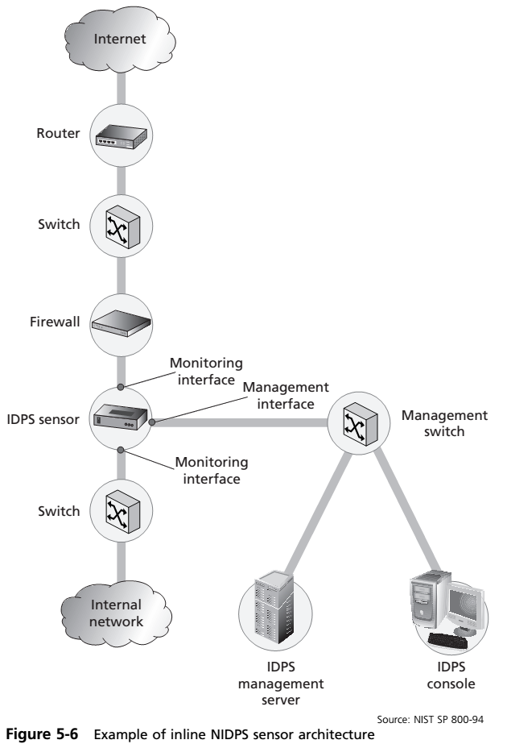

Slide 28
Network-Based IDPS (cont’d.)
Passive sensor
Sits off to the side of a network segment
Monitors traffic without mandating traffic physically pass through the sensor
Switched port analysis (SPAN) port or mirror port
Switch or key networking device placed next to a hub
NIDPS uses that device’s monitoring port
Snort open source software (http://www.snort.org)
For complex IDPS sensors and analysis systems
Manage and query system from a desktop computer

Slide 29
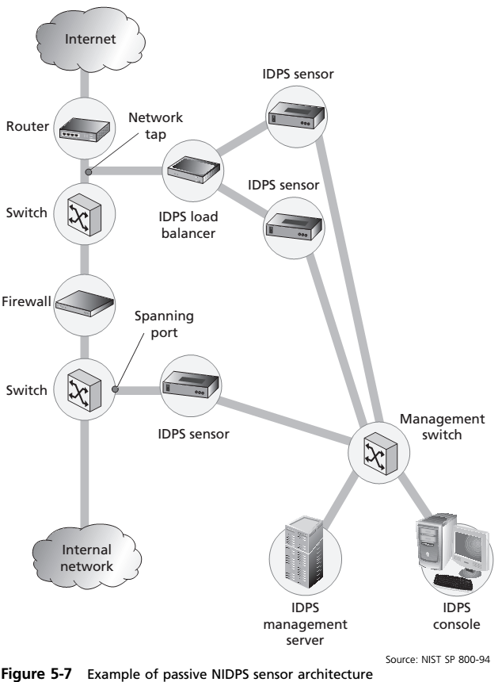

Slide 30
Network-Based IDPS (cont’d.)
Signature matching
NIDPSs look for attack patterns
Compares measured activity to known signatures in their knowledge base
Determines if attack occurred or may be under way
Uses special TCP/IP stack implementation
NIDPS looks for invalid data packets
Application protocol verification
Higher-order protocols examined for unexpected packet behavior or improper use
May have valid packets excessive quantities

Slide 31
Network-Based IDPS (cont’d.)
Signature matching (cont’d.)
DNS cache poisoning
Valid packets exploit poorly configured DNS servers
Inject false information
Corrupt servers’ answer to routine DNS queries from other systems on the network
Wireless NIDPS
Monitors and analyzes wireless network traffic
Looks for potential problems with wireless protocols
Sensor deployment: at the access points, on specialized components, or in mobile stations

Slide 32
Network-Based IDPS (cont’d.)
Wireless NIDPS (cont’d.)
Centralized management stations collect information
Detection
Unauthorized wireless LANs (WLANs) and WLAN devices; poorly secured WLAN devices; unusual usage patterns; use of wireless network scanners; DoS attacks and conditions; impersonation and man-in-the-middle attacks
Issues
Higher protocol monitoring; physical security; sensor range; access point and wireless switch locations; wired network connections; cost

Slide 33
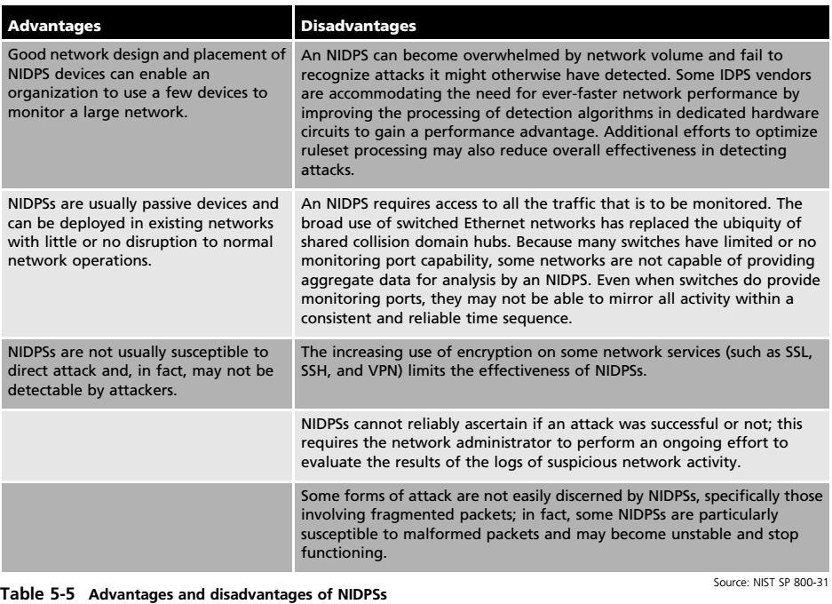
Network-Based IDPS (cont’d.)
Advantages and disadvantages of NIDPSs

Slide 34
Host-Based IDPSs
Host-based IDPS (HIDPS)
Resides on a particular computer or server (host)
Monitors activity on that system
Known as system integrity verifiers
Benchmarks and monitors key system files status
Detects when intruder creates, modifies, or deletes monitored files
Can monitor system configuration databases and stored configuration files
Uses principle of configuration or change management

Slide 35
Host-Based IDPSs (cont’d.)
Host-based IDPS (cont’d.)
Alert or alarm triggers
File attributes change, new files created, existing files deleted
Can monitor systems logs for predefined events
HIDPS log file provides an independent audit trail
Very reliable
False positive alert produced only when authorized monitored file changed
Can access encrypted information
Information to determine legitimate traffic present

Slide 36
Host-Based IDPSs (cont’d.)
HIDPS configuration
Simple change-based system
Relies on file classification into various categories
Triggers alert on changes within a critical data folder
Can log all activity and instantly page or e-mail any administrator
Can generate large volume of false alarms
Can monitor multiple computers simultaneously
Must identify and categorize folders and files
Common method: red, yellow, and green
Some systems use an alternative scale of 0–100

Slide 37
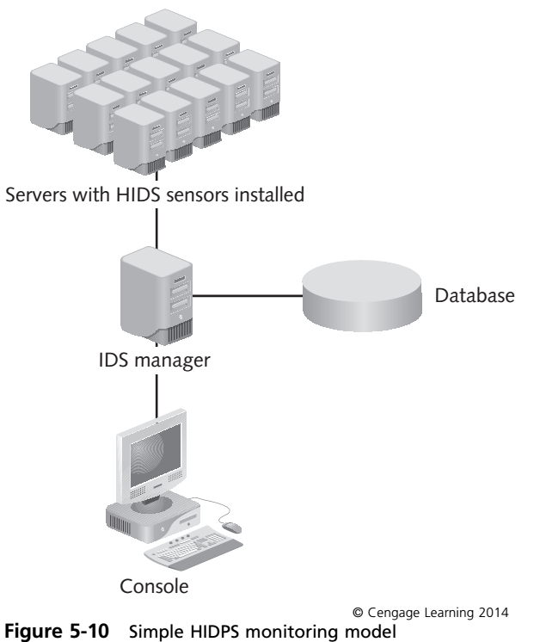

Slide 38
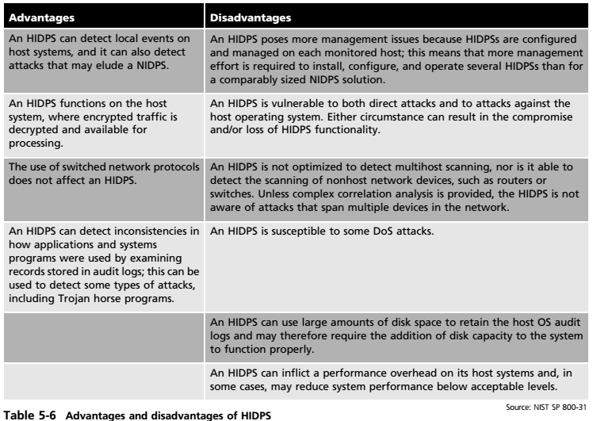
Host-Based IDPSs (cont’d.)
Advantages and Disadvantages of HIDPS

Slide 39
Application-Based IDPS
Application-based IDPS (AppIDPS)
Examines an application for abnormal events
Looks for anomalous occurrences
Tracks interaction between users and applications
Allows tracing of specific activity back to individual users
Can view encrypted data
Types of requests examined
File systems, network, configuration, execution space
The need for intrusion detection is organization dependent

Slide 40
Application-Based IDPS (cont’d.)
Advantages and disadvantages of AppIDPS

Slide 41
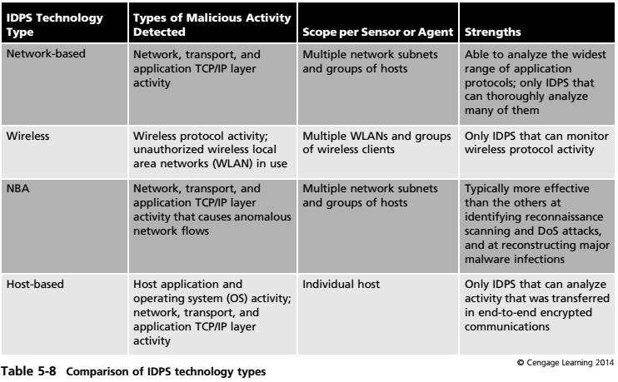

Slide 42
IDPS Detection Approaches
Signature-based IDPS (knowledge-based)
Examines data traffic in search of patterns matching known signatures
Weaknesses
Signatures must be continually updated
Time frame over which attacks occur
Anomaly-based IDPS (behavior-based IDPS)
Samples network activity and applies statistical analysis against a baseline
Clipping level
Measured activity outside baseline parameters

Slide 43
IDPS Detection Approaches (cont’d.)
Anomaly-based IDPS (cont’d.)
Advantage
Can detect new attack types
Disadvantages
Requires overhead and processing capacity
May not detect minor changes to system variables generating false positives

Slide 44
IDPS Detection Approaches (cont’d.)
Log file monitor (LFM)
Type of IDPS similar to the NIDPS
Reviews servers, network devices, other IDPSs log files
Can look at multiple log files from a number of different systems
Uses a holistic approach
Requires considerable resource allocation

Slide 45
Automated Response
New systems can respond incident threats autonomously
Based on preconfigured options
Goes beyond usual IDPS and IPS defensive actions
Trap and trace
Uses a combination of resources to:
Detect an intrusion
Trace the intrusion back to its source
Allows security administrators to take the offense
Legal issue: temptation to back hack

Slide 46
Automated Response (cont’d.)
Honeypots and honeynets
Honeypots
Servers configured to resemble production systems
Closely monitored network decoys
Advantages
Distracts adversaries from more valuable machines
Provides early warning about new attack trends
Allows in-depth examination of adversaries
Two general types
Production and research

Slide 47
Automated Response (cont’d.)
Honeytoken
System resource placed onto a functional system
No normal use for that system
Unauthorized access triggers notification or response
Honeynet (honeypot farm)
High-interaction honeypot
Designed to capture extensive information on threats
Network of systems designed for attackers interaction
Inbound connections: indicates probe, scan, attack
Outbound connections: indicates system compromise

Slide 48
Automated Response (cont’d.)
Legal issues with honeypots and honeynets
Line between enticement and entrapment
Fourth amendment to the U.S. Constitution
Electronic Communications Protection Act
Pen Register, Trap and Trace Devices law (Pen/Trap statute)
Wasp trap syndrome
Downside of current enhanced automated response systems may outweigh the upside

Slide 49
Incident Decision Making
Incident known to be underway
Must determine actual incidents and false positives
US-CERT steps to detect incidents
Collect incident candidates using well-documented procedures
Investigate candidates using systems and methods at your disposal
If candidate not authorized activity
Immediately initiate intrusion response procedures
NIST recommendations
Profile networks and systems

Slide 50
Incident Decision Making (cont’d.)
NIST recommendations (cont’d.)
Understand normal behaviors
Use centralized logging; create a log retention policy
Perform event correlation
Keep all hosts’ clocks synchronized
Maintain and use a knowledge base of information
Use Internet search engines for research
Run packet sniffers to collect data and filter data
Consider experience as being irreplaceable
Create diagnosis matrix for less-experienced staff
Seek assistance from others, when needed

Slide 51
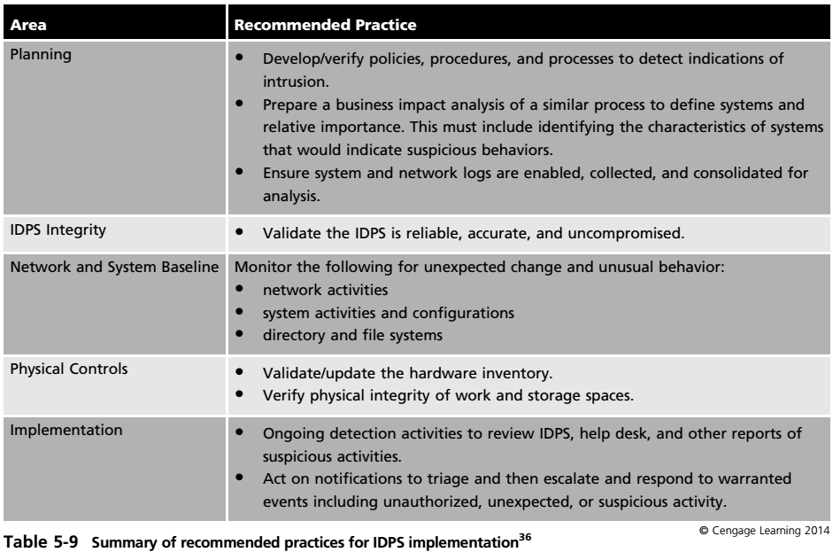

Slide 52
Collection of Data to Aid in Detecting Incidents
Routine data collection and analysis
Required to assist in incident detection and declaration
Data collected by automatic recording systems
Assist in better understanding normal and routine system operations that process, transmit, and store information
Understanding the norm
Assists in the detection of the abnormal

Slide 53
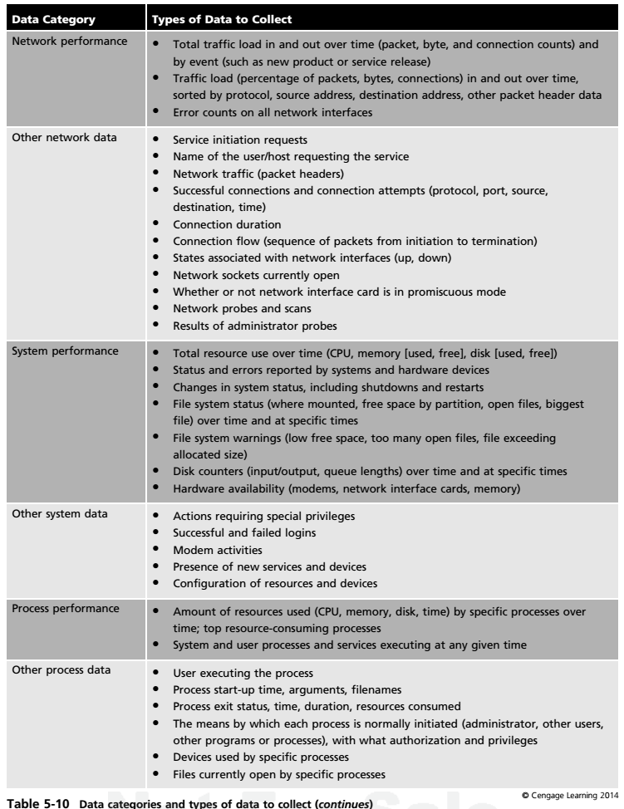

Slide 54
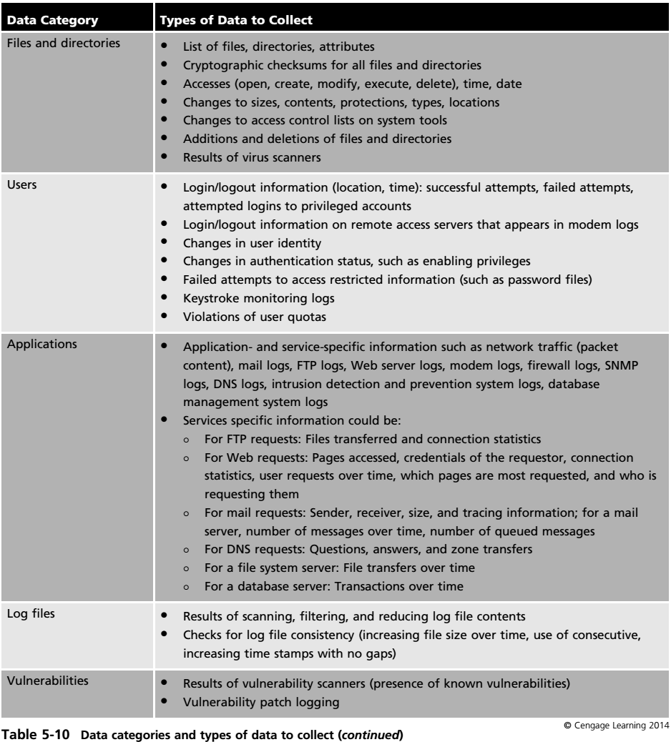

Slide 55
Collection of Data to Aid in Detecting Incidents (cont’d.)
Manage logging and other data collection mechanisms
Individual or aggregated log files
Critical to manage sources
Contain indicators and documentation of intrusion
Must first be enabled
Protect logs through server hardening
Managing logs
Be prepared to handle the amount of data generated by logging; rotate logs on a schedule
Be able to archive logs, encrypt logs, dispose of logs

Slide 56
Collection of Data to Aid in Detecting Incidents (cont’d.)
Detect compromised software
Use separate HIDPS sensor or agent to monitor the HIDPS itself
Quarantine and examine logs if compromise suspected

Slide 57
Collection of Data to Aid in Detecting Incidents (cont’d.)
Watch the network for unexpected behavior
Monitor networks for signs of intrusion
Notify users of monitoring
Review and investigate alert mechanism notifications
Review and investigate network error reports
Review network performance statistics and investigate anomalies
Identify unexpected, unusual, or suspicious network traffic and its possible implications
If reviewing network traffic on a system other than the one being monitored, ensure connection secure

Slide 58
Collection of Data to Aid in Detecting Incidents (cont’d.)
Watch systems for unexpected behavior (cont’d.)
Review systems storing, processing transmitting critical data
Notify users of monitoring
Review and investigate alert mechanism notifications
Review and investigate system error reports
Review system performance statistics and investigate anomalies
Continuously monitor process activity
Identify unexpected, unusual, or suspicious process, user or other behavior and possible implications

Slide 59
Collection of Data to Aid in Detecting Incidents (cont’d.)
Watch systems for unexpected behavior (cont’d.)
Periodically execute network mapping and scanning tools to understand what intruders learn about your networks and systems
Periodically execute vulnerability scanning tools on all systems
If reviewing network traffic on a system other than the one being monitored, ensure connection secure

Slide 60
Collection of Data to Aid in Detecting Incidents (cont’d)
Watch files and directories for unexpected changes
Best performed by using an HIDPS
Configure to perform a scheduled scan of systems
Compare current file version against an archive equivalent or hash value
Hash: useful in performing file verification
May show problems with false positives
Use a user reporting process for unusual file activity
Modification in size, content, or date
Critical to select correct files to monitor

Slide 61
Collection of Data to Aid in Detecting Incidents (cont’d)
Investigate unauthorized hardware attached to your organization’s network
Periodically check the network
Electronically and visually
Unauthorized equipment may tap into the system and redirect or record traffic without authorization
Inspect physical resources for signs of unauthorized access
Physical access trumps electronic security
Examine doors, windows, locks, ceilings, gates
Report signs of tampering or breaches

Slide 62
Collection of Data to Aid in Detecting Incidents (cont’d)
Review reports about suspicious and unexpected behavior
Promptly review all help desk reports, anonymous reporting hotlines, e-mail boxes
If problem detected early, may prevent spreading
Take appropriate actions
Must respond to an intrusion appropriately

Slide 63
Challenges in Intrusion Detection
Intrusion detection
Tedious and technically demanding process
Two key facets of incident detection
Effective use of technology to assist in detection
Necessity of cooperation
Between incident response and information security professionals and the entire IT department
Necessary to integrate IT systems and network administrators
As part of CSIRT operations, or CSIRT team building

Slide 64
Summary
Must classify events as they occur
NIST provides incident classification scheme
Three broad categories of incident indicators
Possible, probable, and definite
Must create process to collect and evaluate incident candidates
IDPS determines if network being used in ways out of compliance with policy
Several compelling reasons to acquire and use an IDPS

Slide 65
Summary (cont’d.)
Operations effected by sensor and detection devices placement or software programs
IDPS types
Network-based IDPS, host-based IDPS, application-based IDPS
Two widely used detection options
Signature based and statistical anomaly based
LFM: reviews the log files
Individual or aggregated log files
Data sources used for incident decision making

