Slide 1
Principles of Incident Response and Disaster Recovery, 2nd Edition
Chapter 9
Disaster Recovery: Preparation and Implementation

Slide 2
Objectives
Describe the ways to classify disasters, by both speed of onset and source
Explain who should form the membership of the disaster recovery team
List the key functions of the disaster plan
Explain the key concepts included in the NIST approach to technical contingency planning

Slide 3
Objectives (cont’d.)
List the elements of a sample disaster recovery plan
Describe the need for providing wide access to the planning documents while securing the sensitive content of the disaster recovery plans

Slide 4
Introduction
Disaster recovery planning (DRP)
The preparation for and recovery from a disaster, whether natural or man-made
The continuity planning management team (CPMT)
Forms the DR team, then assists in the development of the DR plan
Key role of a DR plan
Defining how to reestablish operations at the location where the organization is usually located

Slide 5
Disaster Classifications
Man-made disasters include:
Acts of terrorism, acts of war, and those acts of man that begin as incidents and escalate into disasters
Rapid-onset disasters
Those that occur suddenly, with little warning, taking the lives of people and destroying the means of production
Slow-onset disasters
Occur over time and slowly deteriorate the organization’s capacity to withstand their effects

Slide 6
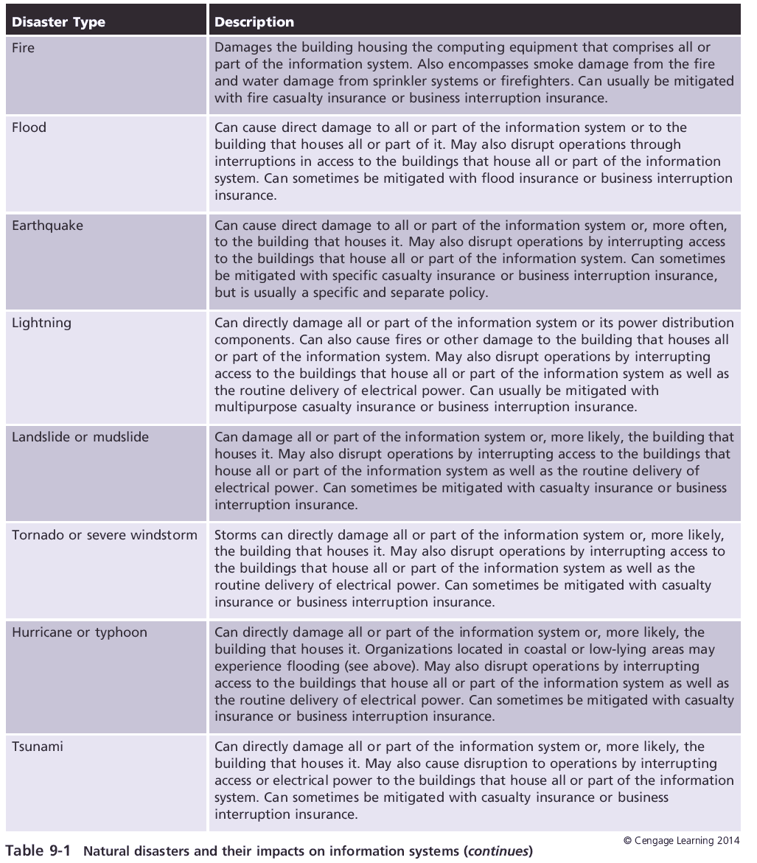

Slide 7
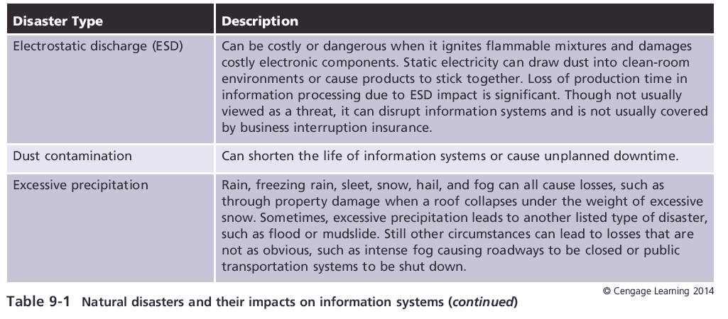

Slide 8
Forming the Disaster Recovery Team
The CPMT assembles a DR team
DR team
Responsible for planning for DR
Leads the DR process when the disaster is declared
Key considerations when developing the DR team
Its organization
The planning needed to identify essential documentation and equipment
Training and rehearsal

Slide 9
Organization of the DR Team
The primary DR team includes representatives from:
Senior management
Corporate support
Facilities
Fire and safety
Maintenance staff
IT technical staff
IT managers
InfoSec technicians
InfoSec managers

Slide 10
Organization of the DR Team (cont’d.)
Disaster management team
Responsible for all the planning and coordination activities
Communications team
Serves as the voice of the management, providing feedback to anyone desiring additional information
Computer recovery (hardware) team
Works closely with the hardware and applications teams to reestablish systems functions during recovery

Slide 11
Organization of the DR Team (cont’d.)
Network recovery team
Works to determine the extent of damage to the network wiring and hardware
Storage recovery team
Works with the other teams to recover information and reestablish operations
Applications recovery team
Recovers applications and reintegrates users back into the systems

Slide 12
Organization of the DR Team (cont’d.)
Vendor contact team
Works with suppliers and vendors to replace damaged or destroyed materials, equipment, or services
Damage assessment and salvage team
Provides initial assessments of the extent of damage to materials, inventory, equipment, and systems on-site
Business interface team
Works with the remainder of the organization to assist in the recovery of nontechnology functions

Slide 13
Organization of the DR Team (cont’d.)
Logistics team
Consists of the individuals responsible for providing any needed supplies, space, materials, food, services, or facilities at the primary site
Other teams as needed
Focus on the reestablishment of key business functions as determined by the BIA

Slide 14
Special Documentation and Equipment
Necessary equipment may include:
Data recovery software
Redundant hardware and components to rebuild damaged systems
Copies of building blueprints to direct recovery efforts
Key phone numbers
Alert roster first contacts
Fire and water damage specialists
Emergency supplies

Slide 15
Disaster Recovery Planning Functions
The seven-step DRP process recommended by NIST
Develop the DR planning policy statement
Review the business impact analysis (BIA)
Identify preventive controls
Create DR contingency strategies
Develop the DR plan
Ensure DR plan testing, training, and exercises
Ensure DR plan maintenance

Slide 16
Develop the DR Planning Policy Statement
The DR policy contains the following key elements
Purpose
Scope
Roles and responsibilities
Resource requirements
Training requirements
Exercise and testing schedules
Plan maintenance schedule
Special considerations

Slide 17
Review the Business Impact Analysis
DR-centric review of the BIA
Only requires a review of the BIA that was developed by the CPMT
Ensures compatibility with DR-specific plans and operations

Slide 18
Identify Preventive Controls
This is performed as part of the ongoing information security posture
Effective preventive controls
Implemented to safeguard online and physical information storage
The team should
Ensure that sufficient and secure off-site data storage is implemented, tested, and maintained

Slide 19
Develop Recovery Strategies
The after the action actions must be thoroughly developed and tested
DR strategies
Must include the steps necessary to fully restore the organization to its operational status
One key aspect of the DR strategy
The enlistment and retention of qualified general contractors

Slide 20
Develop the DR Plan Document
Disaster scenario
A description of the disasters that may befall an organization, along with information on their probability of occurrence
A brief description of the organization’s actions to prepare for that disaster
The best case, worst case, and most likely case outcomes of the disaster

Slide 21
Develop the DR Plan Document (cont’d.)
During the disaster
The planners develop and document the procedures that must be performed during the disaster, if any
After the disaster
Once procedures for reacting to a disaster are drafted, the planners develop and document the procedures that must be performed immediately
Before the disaster
Planners draft a third set of procedures listing those tasks that must be performed to prepare for the disaster

Slide 22
Develop the DR Plan Document (cont’d.)
Planning for actions taken during the disaster
DR usually begins with a trigger
Trigger: the point at which a management decision to react is made
Best way to plan for actions during a disaster is to develop disaster end cases
Determine what must be done to react to the disaster scenario
Once all signs of the disaster have ceased, the “actions during” phase is complete

Slide 23
Develop the DR Plan Document (cont’d.)
Planning for actions taken after the disaster
During this phase, lost or damaged data is restored, systems are scrubbed of infection, and everything is restored to its previous state
Follow-on incidents are highly probable when infected machines are brought back online
Forensic analysis
The process of systematically examining information assets for evidentiary material that can provide insight into how an incident transpired
The DR team must conduct an AAR

Slide 24
Develop the DR Plan Document (cont’d.)
Planning for actions taken before the disaster
“Before actions” include
Preventive measures to manage the risks associated with a particular attack
The actions taken to enhance the preparedness of the IR team
For DR and IR planning
When selecting an off-site storage location for data backups or stored equipment, extra care should be taken to minimize the risk at that storage location

Slide 25
Plan Testing, Training, and Exercises
Testing the DR plan is an ongoing activity
Recent survey from Symantec
At least “82 percent of organizations test their DR plans either once a year or more frequently”
Once all the individual components of the DR plan have been drafted and tested
The final DR plan can be created, similar in format and appearance to the IR plan

Slide 26
Plan Maintenance
The plan
Should be a dynamic document that is updated regularly to remain current with system enhancements
If the organization changes its size, location, or business focus
The DR management team should begin anew with the CP plan, and it should also reexamine the BIA

Slide 27
Information Technology Contingency Planning Considerations
Commonly found systems in production or development settings
Client/server systems
Data communications systems
Mainframe systems

Slide 28
Client/Server Systems
The client level includes:
Desktop, laptop, or netbook systems, tablets, as well as specialty devices, such as smartphones
Client/server systems contingency strategies must include
Backup media stored off-site or at an alternate site
Use of standardized hardware, software, and peripherals to enable backup and recovery
Documentation of all supported system configurations, with local copies of key vendor information

Slide 29
Client/Server Systems (cont’d.)
Client/server systems contingency strategies must include (cont’d.)
Coordination with security policies and system security controls used in the organization
Reliance on the systems priority and key data needs as documented in the BIA
Processes that aggressively limit the placement of data on client systems, with any local data kept for the minimum possible time

Slide 30
Client/Server Systems (cont’d.)
Client/server systems contingency strategies must include (cont’d.)
Sound procedures established to back up and periodically test restoration of local data
Automation of backup processes and proactive validation of the automated backup by repeatable processes
Coordination of all contingency solutions with the cyber IR plans and team operations

Slide 31
Client/Server Systems (cont’d.)
Client/server systems contingency solutions
Encryption tools
Widely used to ensure the confidentiality and integrity of communication between clients and servers
Recovery will rely on complete planning, training, and rehearsals

Slide 32
Data Communications Systems
Local area networks (LANs)
Used for an office or small campus, with segment distances measured in tens of meters
Each connection point is considered a node
Each system (client or server) is considered a host
Wide area networks (WANs)
A collection of nodes in which the segments are geographically dispersed

Slide 33
Data Communications Systems (cont’d.)
Data communications contingency strategies rely on
Complete and current documentation of the telecommunications networks
Coordination with service-providing vendors,
Coordination with organizational security policies and controls
Implementation of redundancy in critical components to remove single points of failure

Slide 34
Data Communications Systems (cont’d.)
Data communications contingency strategies rely on (cont’d)
Identification of remaining single points of failure as ongoing efforts to remove them progress
Monitoring of the networks to measure uptime and minimize downtime by providing early detection of failures
Integration of remote access and wireless LAN technology

Slide 35
Mainframe Systems
Rely on centralization of key capabilities
When client/server systems interact with mainframes
The client is often programmed to emulate much simpler data terminals
The data processing and data storage functions are completed by the mainframe, with the client performing only data display functions

Slide 36
Mainframe Systems (cont’d.)
Mainframe contingency strategies require:
Storage of backup media off-site
Documentation of all systems configurations to include details unique to specific vendor implementations
Coordination with network security policy and system security controls
Redundant system components
Coordination of all contingency solutions with the IR plans and team operations
Sequencing of replacement networking capabilities

Slide 37
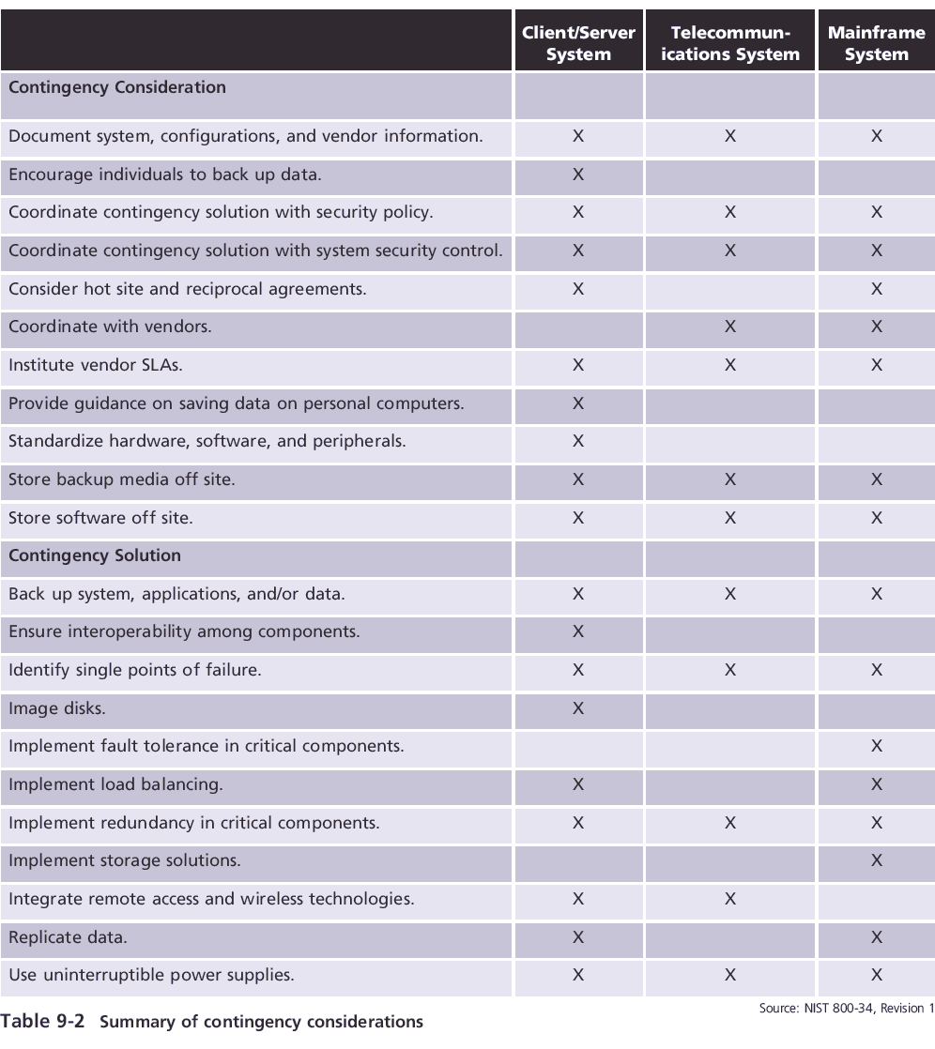

Slide 38
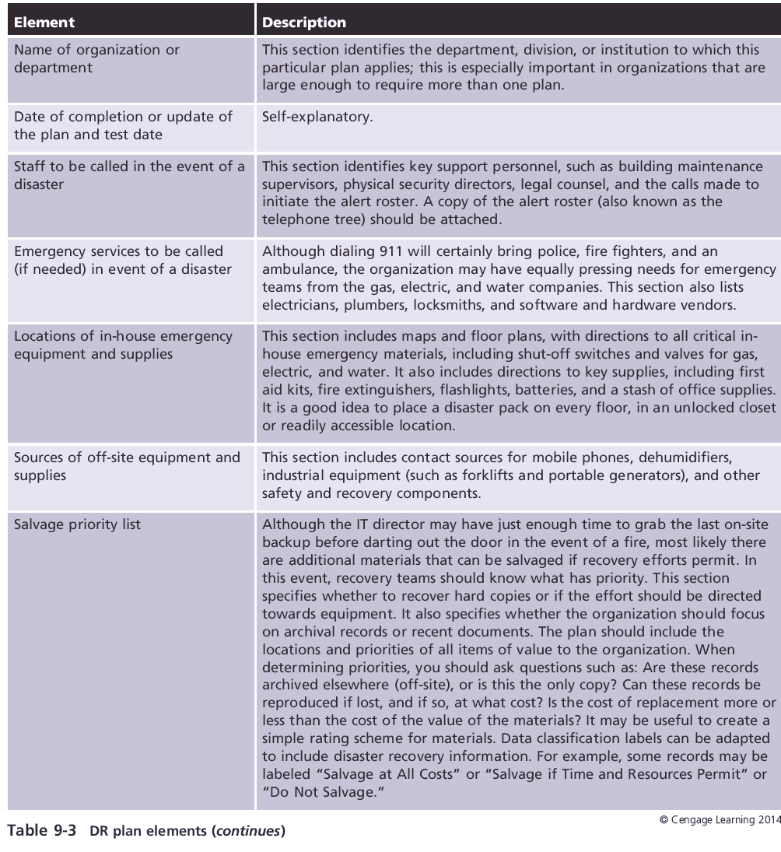
Sample Disaster Recovery Plans

Slide 39
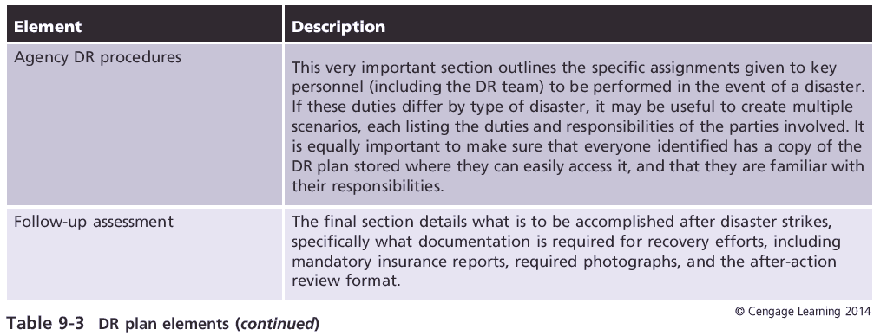
Sample Disaster Recovery Plans (cont’d.)

Slide 40
The Business Resumption Plan
DR and BC plans
Many organizations prepare them at the same time because they are related
Some combine them into a single planning document (business resumption plan) to reduce the effort and cost
Business resumption plan (BR plan)
Must support the immediate reestablishment of operations at an alternate site and eventual reestablishment of operations at the primary site

Slide 41
The DR Plan
The planning process for the DR plan
Should be tied to, but distinct from, that for the IR plan
When the plan is completed
It needs to be stored and kept available in as many locations and formats as possible

Slide 42
Summary
DR planning is the preparation for and recovery from a disaster
A DR plan can classify disasters as either natural or man-made
The CPMT assembles the DR team
The DR team consists of representatives from every major organizational unit
All members of the DR team should have multiple copies of the DR (and BC) plan

Slide 43
Summary (cont’d.)
The first step in the effort to craft any contingency plan (CP) is the development of enabling policy or policies
The NIST planning process adapted for DR planning
The DR team begins with the development of the DR policy
Training in the use of the DR plan can be used to test its validity and effectiveness

