Slide 1
Supply Management Training - Operations Management
Lesson 9:
Managing Inventories

Slide 2
Inventory Basics
Inventory is any asset held for future use or sale.
Inventory Management involves planning, coordinating, and controlling the acquisition, storage, handling, movement, distribution and possible sale of raw materials, component parts and subassemblies, supplies and tools, replacement parts, and other assets that are needed to meet customer wants and needs.

Slide 3
Main Types of Inventory
Raw materials, component parts, subassemblies, and supplies are inputs to manufacturing and the service-delivery process.
Work-in-process (WIP) inventory consists of partially finished products in various stages of completion that are waiting further processing.
Finished goods inventory is completed products ready for distribution or sale to customers.

Slide 4
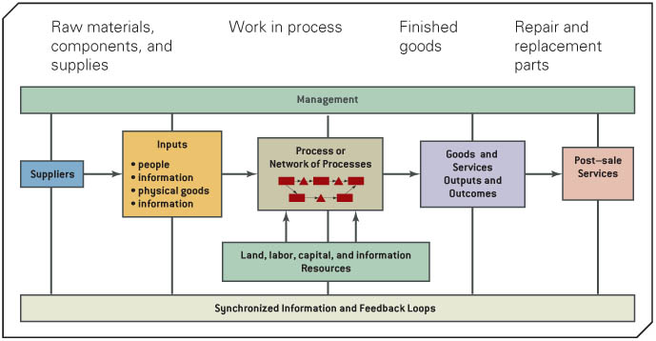
Role of Inventory in the Value/Supply Chain

Slide 5
Basic Inventory Management Decisions
When to order items from a supplier or when to initiate production runs if the firm makes its own items, and
How much to order or produce each time a supplier or production order is placed.

Slide 6
Inventory Costs Trade-offs
Ordering and set-up costs – are incurred as a result of the work involved in placing orders with suppliers or configuring tools, equipment, and machines within a factory to produce an item.
Inventory holding costs – are the expenses associated with carrying the inventory
Shortage costs – are costs associated with an item being unavailable when needed to meet demand
Unit cost of the item – is the price paid for purchased goods or the internal cost of producing them

Slide 7
Inventory Characteristics 1/2
Stock-keeping unit (SKU)
Independent Demand – unrelated to other SKU’s and needs to be forecasted.
Dependent Demand – directly related to another SKU (calculated, not forecasted).
Deterministic Demand – when uncertainty is not included. (no randomness, tight parameters)
Stochastic Demand – includes uncertainty to determine nature of demand. (sporadic, random, includes probability)

Slide 8
Inventory Characteristics 2/2
Static Demand – Stable.
Dynamic Demand – varies over time.
Lead Time – time between order placement and delivery.
Stock-out – inability to satisfy demand.

Slide 9
Discussion Question - 1
Which characteristic of inventory makes it more challenging to manage?
Dynamic or constant
Deterministic or stochastic
Constant deterministic or dynamic stochastic

Slide 10
ABC Inventory Analysis
“A” items account for a large dollar volume but a relatively small percentage of total items (typically controlled at a higher level).
“C” items account for a small dollar volume but a high percentage of total items (automated ordering system).
“B” items are between A and C items combination of A & C).

Slide 11
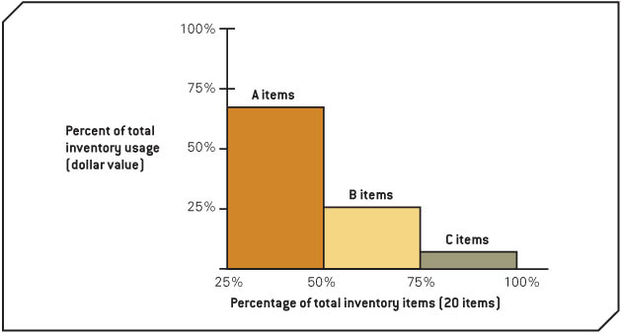
ABC Inventory Analysis Histogram

Slide 12
Discussion Question - 2
The Welsh Corporation uses 10 key components in one of its manufacturing plants.
Perform an ABC analysis from the data worksheet C12P3, Workbook on CourseMate website.
Explain your decisions and logic.

Slide 13
Inventory Re-order Systems
1) Fixed Quantity System
2) Economic Order Quality
3) Fixed Period System
4) Single-Period Inventory Model

Slide 14
1) Fixed Quantity System
The order quality or lot size is fixed; but the re-ordering time is variable
Used in department stores as items are scanned and removed from inventory once purchased, and once the inventory position falls below the re-order point, more is re-ordered.
Inventory position is defined as the on hand quantity, plus any orders placed that have not yet been received (called scheduled receipts) minus any backorders. IP = OH + SR - BO

Slide 15
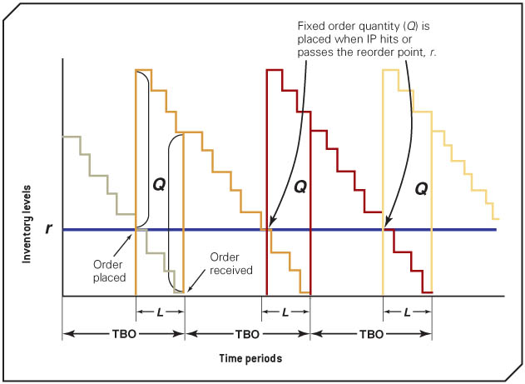
Fixed Quantity System with a Stable Demand

Slide 16
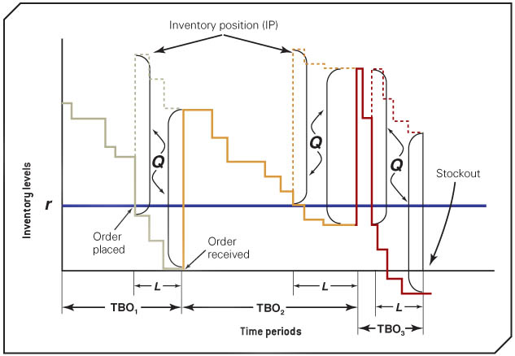
Fixed Quantity System Under an Highly Variable Demand

Slide 17
2) Economic Order Quantity (EOQ)
Economic Order Quantity (EOQ) model is that minimizes the total cost, which is the sum of the inventory-holding cost and the ordering cost.
Key assumptions:
Only one SKU considered
Entire quantity arrives in one shipment
Only order/setup and inventory-holding costs are relevant
No stock-outs permitted
Demand is deterministic and continuous
Lead time is constant

Slide 18
Economic Order Quantity Formula
EOQ Formula = sq root of (2 X annual demand X cost of placing order / Annual Carrying Cost per Unit)

Slide 19
3) Fixed Period Systems 1/2
Fixed period systems the inventory position is check only at fixed intervals, rather than on a continuous basis.
Two Principal decisions with fixed period systems:
The time interval between reviews
The replenishment level

Slide 20
Fixed Period Systems 2/2
EOQ provides the economic time interval as:
Time = EOQ/ annual demand
Optimal replenishment level is:
Optimal replenishment level = average demand per time period X (time + lead time)

Slide 21
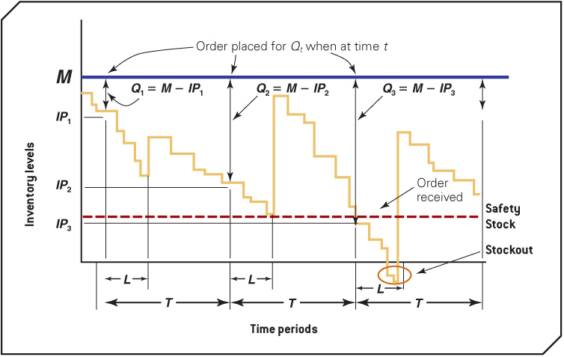
Operation of a Fixed Period System

Slide 22
4) Single Period Inventory Model (Marginal Economic Analysis)
Applies to situations of uncertainty and one either sells out or has scrap to be sold
Demand (greater than or equal to EOC) = the cost of under estimation / (the cost of underestimation + the cost of overestimation)

Slide 23
Discussion Question - 3
Discuss some of the issues that a small pizza restaurant might face in inventory management.
Would a pizza restaurant use a fixed order quantity or period system for fresh dough (purchased from a bakery on contract)?
What would be the advantages and disadvantages of each in this situation?

Slide 24
Discussion Question - 4
Crew Soccer Shoes Company is considering a change of their current inventory control system for soccer shoes. The information regarding the shoes is given below.
Demand = 100 pairs/week
Lead time = 3 weeks
Order cost = $35/order
Holding cost = $2.00/pair/yr
Number of weeks per year = 52

Slide 25
Discussion Question - 4
The company decides to use a fixed order quantity system. What would be the economic order quantity?
What is the Fixed Period (Economic Time Period)?
What is the Optimal Replenishment Level?

