Slide 1
The school to prison pipeline
Brigette Wilson
Myrita Wilhite

Slide 2
Dylan’s Story

Slide 3
Bronfenbrenner’s Ecological Systems
Illustrated by Severin
Provance
Notes:
Ecological- the relationship between groups of people and their local and global environment. As a part of human nature, those migrating from one part of the world to another carry with them their economic. Political, and cultural values, assumptions and worldviews.

Slide 4
Youth Offender
Individuals who have committed criminal acts that have resulted in the imposition of community-based or custodial court order.
Approximately 10-18 years of age
Males constitute about ¾ of youth offender populations
Caucasian youth predominate in juvenile justice system
Certain racial and ethnic groups are disproportionately represented

Slide 5
Demographic Characteristics Juvenile Arrests, 2019
https://www.ojjdp.gov/ojstatbb/crime/qa05104.asp?qaDate=2019&text=yes

Slide 6
Microsystem
Individual
Family peers
Siblings

Slide 7
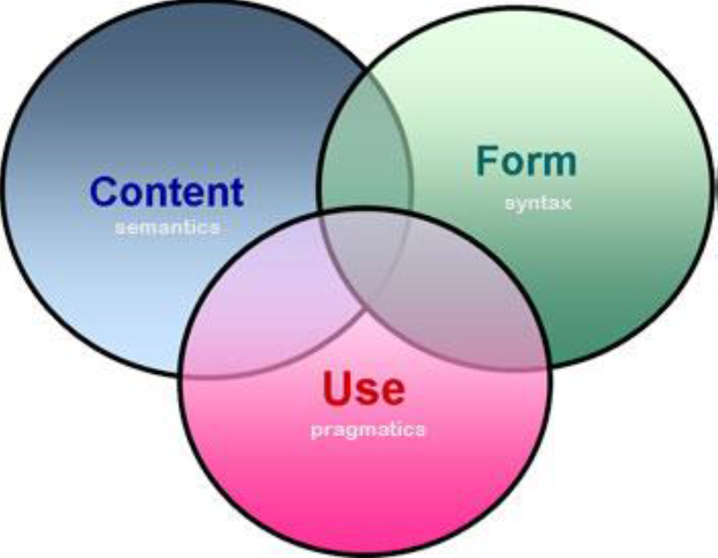
Language Disorder
An abnormal acquisition, comprehension, or use of spoken or written language.
Deficiencies in language can have a profound impact on a child’s academic, social and emotion development.
Disorders may involve any aspect of the form, content, or use components of the linguistic system.
Notes:
Youth offenders are required to negotiate a justice system that is highly reliant on language skills

Slide 8
Language Impairments Semantics
Reduced vocabulary
Depth of word knowledge
Restricted semantic categories
Word retrieval deficits
Poor word association skills
Limited word definition skills
Difficulty with figurative language forms (idioms, metaphors, humor)
Notes:
Semantics involves the meaning of individual words and the rules that govern the combinations of word meanings to form meaningful phrases and sentences.

Slide 9
Morphology Difficulty with Inflectional Markers
Plurals
Past tense
Auxiliary
Verbs
Possessives, etc.
Notes:
Morphology involves the structure of words and the construction of individual word forms from the basic elements of meaning (i.e.. Morphemes)

Slide 10
Syntax Problems With Simple & Complex Sentence Types
Negatives
Interrogatives
Passives
Relative clauses
Notes:
Syntax involves the rules governing the order and combination of words in the construction of well-formed sentences

Slide 11
Phonology
Sound System of language
Rules that govern permissible sound combinations
Notes:
Phonology involves the particular sounds that make up the sound system of a language and the rules that govern permissible sound combinations

Slide 12
Pragmatics
Reduced repertoire of communicative intentions
Poor shared/joint attention
Reciprocal turn-taking difficulties in conversation
Inability to repair message that are not understood by the listener
Difficulty with narrative discourse such as storytelling
Notes:
Pragmatic involves the rules governing the use of language in social context. .

Slide 13
Language Skills
Structural Skills
Pragmatic skills
Rules that relate various levels and combinations of sound to meaning
Form (phonology, morphology, syntax)
Content (semantics)
Appropriate use of language in social situations
Rules of conversational interaction
Cultural conversation use
Construction of logical narratives
Notes:
While language skills usually develop in a steady trajectory, acquisition can be disrupted as a result of biological and/or environmental factors (Paul & Norbury, 2012; Tomblin, 1996). The language difficulties that may result from such disruption can impact one, or a combination of skill domains (Larson & McKinley, 1995), and are estimated to affect 5 to 10% of the general population (Tomblin, 1996). If detected during the developmental period, language difficulties attract a variety of labels, including, but not limited to, specific language impairment (SLI), developmental language disorder (DLD), and language learning impairment (Bishop, 2014)

Slide 14
Language Acquisition & Social Cognitive Development
Caregiver-child attachment during development
Secure attachment relationships have greater competency in language skills
Language relationship is mediated by interactive experiences
Poor parental supervision and management techniques
Inconsistent use of discipline and reduced use of effective monitoring, that are associated with delinquency
Notes:
Grounded in caregiver-child attachment during development
Children with secure attachment relationships have greater competency in language skills than those with insecure attachment
evidence suggests that the attachment – language relationship is mediated by interactive experiences, individuals from low SES backgrounds whose caregivers may be less likely to communicate in ways that contribute to language development
Poor parental supervision and management techniques play in the development of antisocial in children
Research suggests that low SES is associated with caregiver-child interaction patterns, such as inconsistent use of discipline and reduced use of effective monitoring, that are associated with delinquency
Low SES backgrounds over-represented in the developmental experiences of youth offenders as well as less enriched early language environments

Slide 15
Structural Language Skills
Youth offenders perform significantly lower than same age non-offenders on receptive and expressive language test
Poorer receptive tasks
Require speed and accuracy of comprehension
Receptive measures can be a predictor of the severity of antisocial behavior

Slide 16
Pragmatic Language Skills
Can score up to 5 years below age equivalents
Difficulty decoding abstract language
Providing logical and sequential narrative
Producing narratives that consisted of adequate story grammar elements

Slide 17
The Connection between Youth Offenders and CSD
Studies of the prison population suggest that the numbers of prisoners with language and communication disorders is significantly higher than that of the overall population
Evidence emerging over the last decade indicates that juvenile offenders are likely to be at significant risk for previously unrecognized language impairment.

Slide 18
The Connection between Youth Offenders and CSD
Snow and Powell (2004a, b, 2005) suggest that high-risk adolescents whose conduct disturbances bring them into contact with the law are likely to display difficulties in understanding and using abstract language (e.g. idioms, metaphor), using narrative discourse to organize and convey novel information to a naïve listener, word finding difficulties, and grammatical immaturity relative to their non-offending peers.
The incidence rate of language problems in female incarcerated adolescents in the USA has been reported to range from 14 to 22% (Sanger et al. 1997, 2000, 2001) in comparison with the 5% estimated in the general adolescent US population (Larsen and McKinlay 1995).

Slide 19
The Connection between Youth Offenders and CSD
Sanger et al. (2001) tested 67 girls aged 13–17 who were incarcerated in the USA on the Clinical Evaluation of Language Fundamentals — 3 (CELF-3) (Semel et al. 1995) and the Adolescent WORD Test (Zachman et al. 1989).
Three had received speech and language intervention and 25 had received special educational services at some point in their life.
The results showed that 13 (19%) of the girls scored 1.3 standard deviations (SDs) below the mean on the two tests and met US eligibility criteria for speech pathology services, although use of IQ criteria suggested a larger proportion might need speech and language services (46%)

Slide 20
The Connection between Youth Offenders and CSD
Sanger et al. (2001) suggest that even when adolescents perform poorly on language tests they may not access services due to factors such as lack of motivation, lack of background knowledge or emotional antagonism.
Beitchman et al. (1999) suggest that communication difficulties are misinterpreted as non-compliance and conduct problems in the classroom environment
Whitmire (2000) suggests that adolescents with language disorders are vulnerable to problems in developing peer and family relationships, as well as in meeting the expectations and demands of school.

Slide 21
The Connection between Youth Offenders and CSD
Sanger et al. (2003) used self-report (questionnaires) to explore communication interaction in 13 incarcerated females aged 13–17 who were identified as having language difficulties (more than 1.3 SD below the mean on CELF-3 and the Adolescent WORD Test).
The results suggested that language difficulties were not being recognized and that communication problems tended to be labelled with terms such as ‘lazy’ or ‘out of control’.
Sanger et al. (2003) therefore suggest that language and communication skills should be investigated in adolescents who are experiencing social and/or schooling difficulties. Sanger et al. (2001) also suggest that speech and language pathologists need to be represented on teams planning for adolescent offenders

Slide 22
The Connection between Youth Offenders and CSD
Some studies have examined language abilities in children at risk of offending.
Cohen and co-workers in Canada (Cohen et al. 1993, Vallance et al. 1999) reported that around 50% of children and adolescents receiving services for a range of adjustment disorders (e.g. behavior disturbances, anxiety disorders) actually display language impairments when specifically tested.
They have speculated that the comorbidity of language and behavior disturbance results in a disproportionate ‘favoring’ of behavior when allocation and delivery of intervention services is considered.
This means that high-risk children may receive services aimed at improving their behavior problems, but there may be little or no attention paid to suboptimal development in the realms of expressive and receptive language competence.

Slide 23
The Connection between Youth Offenders and CSD
This in turn reduces the likelihood of school engagement, thus lessening the access that high-risk young people have to the protective effects of academic achievement.
The link between disadvantage in the early years and language difficulties later affecting school performance has been highlighted (Locke et al. 2002).
Persistent difficulty with language development has been correlated with a greater than usual chance of developing both mental health problems and involvement in criminal activities, although a causal link has not been established and this remains a contentious area for research.
A longitudinal study by Clegg et al. (1999) showed that one-third of children with developmental language disorders developed mental health problems with resulting criminal involvement in some cases

Slide 24
Exosystem
Extended Family
School board
Neighborhoods
Mass media
Parent’s work environment

Slide 25
Other Factors
Differences in educational experiences
Early educational intervention of some kind
Attendance at special education programs
Higher proportions of males than females
Ethnicity may impact language functioning
Early experience of maltreatment (out of home placement)
Neurological signs (clumsiness, tremors, and poor balance)

Slide 26
Macrosystem
Laws
History
Social conditions
Economic system
Culture

Slide 27
What is the School to Prison Pipeline?
A 2015 report by AJ+ and The Marshall Project, a nonprofit news organization that focuses on the criminal justice system, defined the School to Prison Pipeline as “a term that describes how American kids get pushed out of public schools and into the juvenile and criminal justice systems.”
The process often begins with zero-tolerance policies that result in harsh punishments like out-of-school suspensions.
“There’s extensive evidence linking student suspensions to worse long-term educational and life outcomes,” Executive Director of The Education Trust—New York Ian Rosenblum
Not only do students miss instruction time when they get suspended, the effects of the punishment compound throughout their educational career.

Slide 28
The School to Prison Pipeline
Policies were originally implemented to protect students
Historians cite the Columbine School Massacre in 1999 as an incident that sought to take extreme measures to make schools safe
But many of the harsh policies were implemented prior to 1999 in inner city schools.
Specific practices implemented in United States schools over the past ten years to reduce including zero tolerance policies and an increase in the use of School Resource Officers have created the environment for criminalization of youth in schools.
This results from patterns of discipline in schools mirroring law enforcement models.

Slide 29
The School to Prison Pipeline
The disciplinary policies and practices that create an environment for the United States school-to-prison link to occur disproportionately affect disabled, Latino and Black students which is later reflected in the rates of incarceration.
Between 1999 and 2007, the percentage of black students being suspended has increased by twelve percent, while the percentage of white students being suspended has declined since the implementation of zero tolerance policies.
Of the total incarcerated population in the United States, 61% are Black or Latino.

Slide 30
The School to Prison Pipeline
Juvenile crime rates are plummeting, and the number of Americans in juvenile detention has dropped. One report shows the juvenile incarceration rate dropped 41 percent between 1995 and 2010
But school discipline policies are moving in the opposite direction: out-of-school suspensions have increased about 10 percent since 2000. They have more than doubled since the 1970s. Black students are three times more likely to be suspended or expelled than white students, according to the Department of Education’s Office for Civil Rights
The state of Texas found students who have been suspended are more likely to be held back a grade and are more likely to drop out of school entirely
These issues have led the federal government to asking schools to examine their suspension policies

Slide 31
The School to Prison Pipeline
The reason the difference between juvenile detention and school discipline is so surprising — and the reason school discipline is seen as a growing concern — is that the two are connected, leading civil-rights advocates to talk about this "school-to-prison pipeline."
Especially for older students, trouble at school can lead to their first contact with the criminal justice system. And in many cases, schools themselves are the ones pushing students into the juvenile justice system — often by having students arrested at school.

Slide 32
Early Uses of “Pipeline” as Related to School or Incarceration
The term “educational pipeline” has been in academic use since at least 1960 to describe the successful movement of students through educational systems
Likewise, the term “leaky pipeline” has been used to describe problems with related completion rates or subject mastery for various demographic groups since at least 1986.
One of the first use of the term “pipeline” in relation to the incarceration of youth refers to the “pipeline” of “youth on the brink of becoming serious offenders” in 1996.
In 1997 Bill Ayers, in his ethnography of the Chicago Juvenile Court, described “beginning to see a straight line between failing schools and burgeoning youth jails.”

Slide 33
Early Uses of “Pipeline” as Related to School or Incarceration
In 2003 Pedro Noguera referred to the “educational pipeline,” the “path that would lead to prison,” and the role that administrators play in “matriculating young people from school to prison.”
Noguera cites Loïc Wacquant as describing “a growing correspondence between inner‐city schools and prisons.”
These scholars adapted the education pipeline and leaky pipeline metaphors to instead describe a process of moving students toward incarceration.

Slide 34
First Uses of the School‐to‐Prison Pipeline Metaphor
Wald & Losen (2003)
“Many observers, advocates, and educators have … crafted terms such as prison track and school‐to‐prison pipeline to … depict a journey through school that becomes increasingly punitive and isolating for its travelers. Many will be taught by unqualified teachers, tested on material they never reviewed, held back in grade, placed in restrictive special education programs, repeatedly suspended, and banished to alternative out‐placements before dropping or getting pushed out of school altogether. Without a safety net, the likelihood that these same youths will wind up arrested and incarcerated increases sharply.”

Slide 35
How the Current State of School Discipline Developed/ Why Some Districts are Working to Change
Here's how the current state of school discipline developed and why some districts and federal officials are working to change the status quo.
1) CONCERNS ABOUT CRIME LED SCHOOLS TO ADOPT 'ZERO TOLERANCE' POLICIES
In the 1970s, keeping students out of school as a punishment was relatively rare: fewer than 4 percent of students were suspended in 1973. But growing concern about crime and violence in schools led states and districts to adopt policies that required students to be suspended.
The Gun-Free Schools Act, passed in 1994, mandated a yearlong out-of-school suspension for any student caught bringing a weapon to school. And as states began adopting these zero-tolerance policies, the number of suspensions and expulsions increased. The suspension rate for all students has nearly doubled since the 1970s, and has increased even more for black and Hispanic students.

Slide 36
Current State of School Discipline / Policies for Change
Zero-tolerance policies have been widely criticized when schools have interpreted "weapon" very broadly, expelling students for making gun gestures with their fingers or for other weird things
For example, one student was suspended for chewing a Pop-Tart into a shape of a gun

Slide 37
The “Broken Window Theory of Policing
Other reasons for more suspensions
The Broken Window Theory - emphasizes the importance of cracking down on small offenses in order to make people feel safer and discourage more serious crimes; in schools, it translated into more suspensions for offenses that previously hadn't warranted them — talking back to teachers, skipping class, or being otherwise disobedient or disruptive.

Slide 38
Black kids disobedience interpreted differently

Slide 39
Use of School Resource Officers
At the same time, administrators started relying more heavily on actual police officers — in the form of School Resource Officers (SROs) stationed in schools.
From 1997 to 2007, the number of SROs increased by nearly one third.
Supposedly, the SROs were placed in school buildings to prevent mass school shootings like the one at Columbine High School in Colorado in 1998 — in other words, to protect students, not to police them.

Slide 40
Use of School Resource Officers
What impact does armed guards have on children’s development?

Slide 41
Use of School Resource Officers
But as often happens with law enforcement, resources that are supposed to be used for a rare occurrence often get used for more common occurrences simply because they're there.
About 92,000 were arrested in school during the 2011-2012 school year, according to US Department of Education statistics.
Most of these 92,000 arrests were for low-level violations: 74 percent of arrests in New York City public schools in 2012, according to a report published by the state courts were for misdemeanors or civil violations.

Slide 42
How the Current State of School Discipline Developed/ Why Some Districts are Working to Change
2) SCHOOLS HAVE OUTSOURCED DISCIPLINE TO JUVENILE COURTS AND OFFICERS IN SCHOOLS
When a school allows a School Resource Officer to arrest a student — or, less drastically and more commonly, refers a student to law enforcement or juvenile court as a form of discipline — they're turning that student over to the juvenile justice system.
That makes it that much easier for a student to get a juvenile record (so even if punishment for a first offense is light, punishment for a second offense is likely to be much harsher).
This happens way more at schools with officers. A report by the Justice Policy Institute found that, even controlling for a school district's poverty level, schools with officers had five times as many arrests for "disorderly conduct" as schools without them.

Slide 43
How the Current State of School Discipline Developed/ Why Some Districts are Working to Change
The juvenile court system is against this!
The chief judge of the juvenile court in Clayton County, Georgia has become an outspoken opponent of police in schools and the school-to-prison pipeline after placing officers on school grounds resulted in eleven times as many students getting sent to juvenile court.
He told Congress at a 2012 hearing that "the prosecutor’s attention was taken from the more difficult evidentiary and 'scary' cases—burglary, robberies, car thefts, aggravated assaults with weapons — to prosecuting kids that are not 'scary,' but made an adult mad."

Slide 44
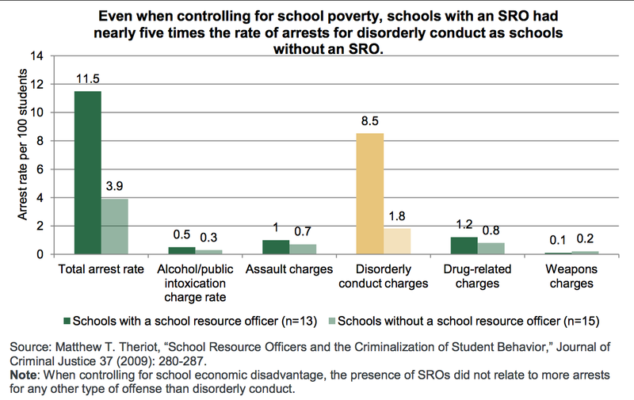

Slide 45
Trends May be Reversing
The Department of Education only started collecting detailed data on arrests and referrals for the last two iterations of its Office for Civil Rights report. So it's hard to be confident about trends. But there's some evidence that arrests and referrals are on the decline; referrals to law enforcement of students without disabilities, for example, went down about 9 percent between

Slide 46
How the Current State of School Discipline Developed/ Why Some Districts are Working to Change
3) BLACK STUDENTS ARE MORE LIKELY TO BE DISCIPLINED
Black students are suspended or expelled three times more frequently than white students. And while black children made up 16 percent of all enrolled children in 2011-12, according to federal data, they accounted for 31 percent of all in-school arrests.
The disparity begins in preschool: 48 percent of preschool children who are suspended more than once are black.
And students with disabilities are also suspended more frequently than students without disabilities.
This, too, can have a racial component. One study conducted in 2014 at Columbia University found that five-year-old boys whose fathers had been incarcerated were substantially less behaviorally "ready" for school than five-year-olds whose fathers hadn't been incarcerated - making them more likely to be placed in special-education classes for their behavioral disabilities.

Slide 47
How the Current State of School Discipline Developed/ Why Some Districts are Working to Change
Several studies have looked at the relationship between race, behavior, and suspension, and none have them have proven that black students misbehave at higher rates.
In 2002, it was found that white students were more likely to be disciplined for provable, documentable offenses — smoking, vandalism, and obscene language — while black students were more likely to be disciplined for more subjective reasons, such as disrespect.
Schools with more black students tend to have higher rates of suspension, researchers have found. Studies have found that the punitiveness of a school's discipline policy was positively correlated with the percentage of its students that were black. It wasn't correlated with students' rates of juvenile delinquency or drug use.

Slide 48
How the Current State of School Discipline Developed/ Why Some Districts are Working to Change
A landmark study of Texas discipline policies found that 97 percent of school suspensions were the choice of school administrators.
Only 3 percent of students had broken rules that made suspension a required punishment, such as carrying a weapon to school.
And those discretionary suspensions fell particularly hard on black students: they were 31% more likely to receive a discretionary suspension, even after controlling for 83 other variables.

Slide 49
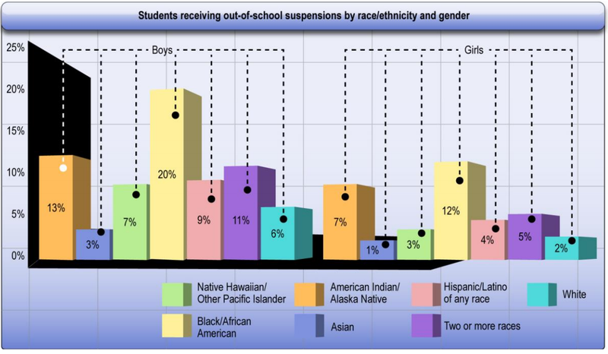

Slide 50
How the Current State of School Discipline Developed/ Why Some Districts are Working to Change
Many discretionary suspensions and arrests are for offenses that are difficult to define, like "insubordination" or "willful defiance," which can just mean a student has challenged the authority of a teacher or school administrator.
In California, for example, 40 percent of all suspensions during the 2010-11 school year were for "willful defiance" — which a US Department of Education defined as "any behavior that disrupts a classroom."
"Insubordination" was the most common cause of suspension in New York City public schools in 2013-14.
Even arrests by SROs are often for vague reasons: in New York in 2012, one of every six arrests in schools was for "resisting arrest" or "obstructing governmental administration" after the student had been in a conflict with an officer.

Slide 51
How the Current State of School Discipline Developed/ Why Some Districts are Working to Change
4) EVEN WHEN SCHOOLS AREN'T DELIBERATELY SENDING CHILDREN INTO THE JUVENILE JUSTICE SYSTEM, DISCIPLINING THEM MAKES IT MORE LIKELY THEY'LL END UP THERE
Students who are suspended are more likely to repeat a grade or drop out than students who were not.
School discipline policies were examined and analyzed in Texas 20 years ago. Data from every seventh-grader in the state in 2000, 2001, and 2002, was tracked that included academic and disciplinary records for six years. They found that 31 percent of students who were suspended or expelled repeated a grade, compared with only 5 percent of students who were not.

Slide 52
How the Current State of School Discipline Developed/ Why Some Districts are Working to Change
It's hard to prove causation; it's possible that students who misbehave would have ended up in academic trouble no matter how they were punished. But the Texas study found that students who had been suspended or expelled were twice as likely to drop out compared to students with similar characteristics at similar schools who had not been suspended.
Students who are disciplined by schools are also more likely to end up in the juvenile justice system. In the same study, students who were disciplined in middle or high school, 23 percent of them ended up in contact with a juvenile probation officer. That figure stands at 2 percent among those not disciplined. And students who have been suspended or expelled are three times more likely to come into contact with the juvenile probation system the following year than one who was not suspended.

Slide 53
How the Current State of School Discipline Developed/ Why Some Districts are Working to Change
It's hard to prove that suspensions cause delinquency in the same way they cause poor educational outcomes.
But researchers argue that just as out-of-school suspensions or expulsions don't do anything to improve a student's academic standing, they don't do anything to monitor his behavior or improve his safety, either.

Slide 54
How the Current State of School Discipline Developed/ Why Some Districts are Working to Change
5) THE EDUCATION DEPARTMENT IS PUSHING SCHOOLS TO CHANGE THEIR DISCIPLINE POLICIES
Federal government believed that expulsion and suspension should be a last resort
But this effort, by the Education Department and the Department of Justice, has been controversial because the guidance is based on "disparate impact."
Even if a policy doesn't mention race and is applied equally to students of all races, the federal government says schools should not use it if the consequences fall disproportionately on students of a particular race.
For example, if a school had a policy that all students who were caught using cell phones in class got an out-of-school suspension, and that school ended up suspending a disproportionate number of Latino students as a result of the policy, the federal government would urge the school to figure out if there was another way to achieve the same goal (a cell phone-free classroom) without removing students from the classroom.

Slide 55
How the Current State of School Discipline Developed/ Why Some Districts are Working to Change
Some conservatives argue that schools will become disorderly if teachers and administrators feel that they aren't able to remove disruptive students from the classroom.

Slide 56
How the Current State of School Discipline Developed/ Why Some Districts are Working to Change
6) SOME SCHOOL DISTRICTS ARE TAKING THE MATTER INTO THEIR OWN HANDS
Even before the Obama administration issued that guidance, though, some school districts were acting on their own. Some of the nation's largest districts are working to punish students in ways that don't involve suspension, trying to reform discipline so that students aren't referred to police, or both.
In Clayton County, Georgia, for example, where referrals from schools were overwhelming juvenile prosecutors, the juvenile courts made an agreement with the police force and the school district, restricting the cases in which police were allowed to arrest students in school or refer them to court.
The agreement had a huge impact in schools: the high-school graduation rate increased by 24 percent from 2004 to 2010, beating the national average.

Slide 57
How the Current State of School Discipline Developed/ Why Some Districts are Working to Change
Meanwhile, some large school districts are moving away from zero tolerance policies.
Broward County, Florida, one of the largest school districts in the country, decided in 2013 that schools, not police, would deal with students' nonviolent misdemeanors. The Chicago Public Schools are trying to reduce the number of suspensions, softening a policy under which students could be suspended for using a cell phone in school and ending suspensions for children younger than second grade, among other changes.
In Los Angeles, children under 13 won't be referred to police for minor offenses, after police issued 552 tickets to preteens during the 2013-14 school year.

Slide 58
How the Current State of School Discipline Developed/ Why Some Districts are Working to Change
New York City schools are taking a more targeted approach. The city unveiled proposals to overhaul its school discipline code.
If the changes go into effect, school principals will have to get the city Department of Education's permission to suspend any student for "insubordination," or for any suspension of a student in third grade or younger.
It would also no longer be possible to give "superintendent's suspensions" (a more serious level of suspension) to students involved in "minor physical altercations."

Slide 59
How the Current State of School Discipline Developed/ Why Some Districts are Working to Change
Other schools are exploring restorative justice programs, which focus on forming relationships between teachers, students, and administrators and giving students an opportunity to resolve problems by talking about them.
The Oakland School District has been testing this approach for 10 years and recently decided to expand it districtwide after schools using restorative justice reported that their suspension rates were cut in half.

Slide 60
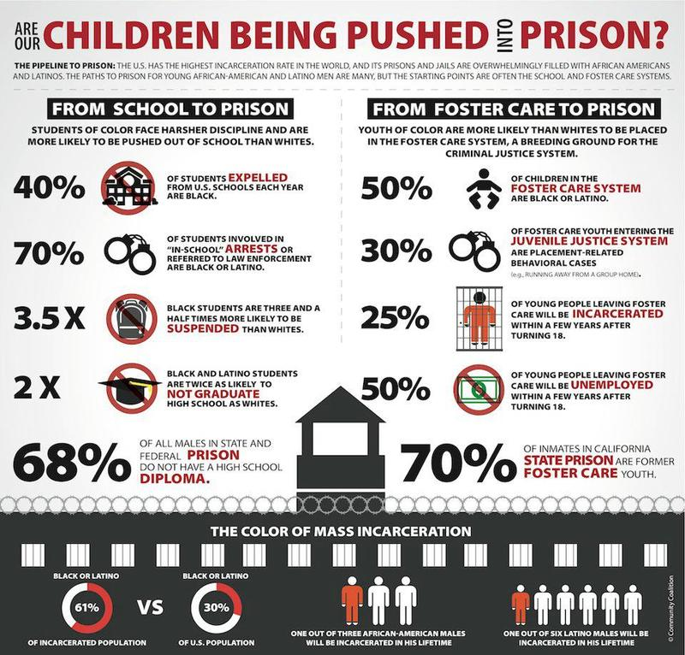

Slide 61
https://leader.pubs.asha.org/doi/10.1044/leader.FTR1.24062019.44
ASHA Leader
Dr. Shameka Johnson
Case Study
Group Discussion-application exercise

Slide 62
Complex Communication Disorders and the School to Prison Pipeline
ASD and other cognitive and communication disorders (CCDs) can put adolescents like the student in the case presented at increased risk for punishment because authorities may misinterpret their difficulties with problem-solving, expressive and receptive language, and executive functioning.
The problems often begin with zero-tolerance policies, in which schools hand down swift and severe punishment—suspension, expulsion or placement in juvenile detention—for student misconduct.
More than 80% of young people affected by these policies were found to have a communication disorder or a learning disability or some combination of theses, according to a 2018 article on CCDs and the school-to-prison pipeline in the Journal of Gender, Social Policy and the Law.

Slide 63
SLPs Role ASHA Leader Article
This is where speech-language pathologists—as advocates for people with communication disorders—come in.
SLPs are often the first line of contact with youth who have CCDs, particularly in schools.
Therefore, SLPs are in a position not only to provide services to these students, but also to educate the courts and justice system on their unique behaviors and needs—and to influence policy and legislative changes affecting them.

Slide 64
ASHA Leader
The ASHA leader article highlights an interesting area of specialized service provision called speech-language pathology forensic assessments and evaluations.
The SLP provides written reports that include professional opinion regarding recommendations that provide insight on how a youth’s cognitive-communication disorder may have had an impact on the youth’s decision, behavior, or action that was considered a status offense or crime in youth.
Court systems take the forensic assessments and evaluation reports into account when they make final decisions on treatment referrals and/or long-term placement (for example, juvenile detention center, psychiatric ward, alternative schools) for youth at risk for delinquency.

Slide 65
ASHA Leader
The SLP pointed out that the profession of Communication Sciences and Disorders needs to get involved.
As it stands, psychologists and forensic social workers are typically the professionals who address communication disorders among incarcerated youth.
It is time to distinguish communication disorders from mental illness in the juvenile justice system—and to bring in more SLPs.
This shift will require communication sciences and disorders programs to include more training on incarcerated youth with CCDs, as well as to conduct more research in this area.

Slide 66
Misdiagnoses are Common
Another significant issue to be addressed is mistaken classification of CCDs as mental health disorders.
Some research indicates that as many as 70% of youth in juvenile detention facilities have mental health disorders.
In the past, some researchers and professionals may—using inappropriate instruments like the Moller-Murphy Symptom Management Assessment Tool and have identified communication disorders as primary symptoms of mental illnesses.
However, although they may co-occur, communication disorders are certainly not the same as mental disorders.

Slide 67
Misdiagnoses are Common
Mental illnesses involve behavioral and mental patterns that cause significant distress or impairment of a person’s functioning.
A mental disorder is typically defined by how a person behaves, feels, perceives, or thinks.
Mental health treatment primarily targets a person’s ability to regulate their emotions and behavior through counseling, medication, or a combination of the two
In comparison, as SLPs know and can prove that a communication disorder can affect a person’s ability to process and produce speech and language, especially in social discourse.

Slide 68
Misdiagnoses are Common
As a result of misdiagnosis, a significant percentage of incarcerated youth likely have undiagnosed and untreated CCDs.
Meanwhile, there is minimal provision of speech-language pathology services in juvenile detention centers.
The lack of CCD awareness in these facilities and the courts means youth with these disorders may be grossly misunderstood.
For example, a Marshall Project report describes how the social difficulties of young people with ASD may put them at higher risk for arrest than their neurotypical peers.
The report cites rising numbers of youth with ASD being charged with child pornography; criminal intent is often assumed in these cases, with no consideration given to ASD-related social naiveté.

Slide 69
References
Roth, F.P & Worthington, C. K. (2016). Treatment resource manual for speech-language pathologist (5th ed.). San Diego, CA, Plural Publishing, Inc., 225-269.
Standford, S. (2019). Casualties of misunderstanding: communication disorders and juvenile injustice. The ASHA Leader https://doi.org/10.1044/leader.FTR1.24062019.44
Stavroola A.S. Anderson, David J. Hawes, Pamela C. Snow, (2016) Language impairments among youth offenders: A systematic review, Children and Youth Services Review, Volume 65,Pages 195-203, ISSN 0190-7409, https://doi.org/10.1016/j.childyouth.2016.04.004.

