Slide 1
Business & Society Ethics, Sustainability & Stakeholder Management 10th Edition
© 2018 Cengage

Slide 2
Chapter 13 Consumer Stakeholders: Information Issues

Slide 3
Learning Outcomes
Describe the consumer movement and identify the consumer’s Magna Carta and explain its meaning.
Identify product information issues that are affected by business’s social and ethical responsibilities. Identify major abuses of advertising and discuss specific controversial advertising issues.
Describe the role and functions of the Federal Trade Commission (FTC).
Explain recent consumer-related legislation that has been passed—Credit Card Act (CARD) and the Consumer Financial Protection Bureau (CFPB).
Discuss the strengths and weaknesses of self-regulation of advertising.
Identify the three moral models and their likely perspectives on consumer stakeholders.

Slide 4
Chapter Outline
The Consumer Movement
The Federal Trade Commission (FTC)
Self-Regulation in Advertising
Moral Models and Consumer Stakeholders
Summary
Key Terms

Slide 5
Consumer Stakeholders: Information Issues
As business seeks to come out of the worldwide recession, the pace of consumer spending has been stable to modestly higher over the last five years.
Consumers have become more cautious and selective.
Businesses need to pay careful attention to customer stakeholders, and their fair treatment.
Customer Relationship Management (CRM), the ability of an organization to effectively identify, acquire, foster, and retain loyal profitable customers.
“Satisfied customers tell three friends, but angry customers tell 3,000.”

Slide 6
The Consumer Movement
Consumerism/Consumer Movement-
A social movement seeking to augment the rights and powers of buyers in relation to sellers.
In addition to the rights enumerated in The Consumer’s Magna Carta (see next slide), consumers today want:
Fair value for money spent
A product that meets reasonable expectations
One with full disclosure of its specs
Truthfully advertised – and safe

Slide 7
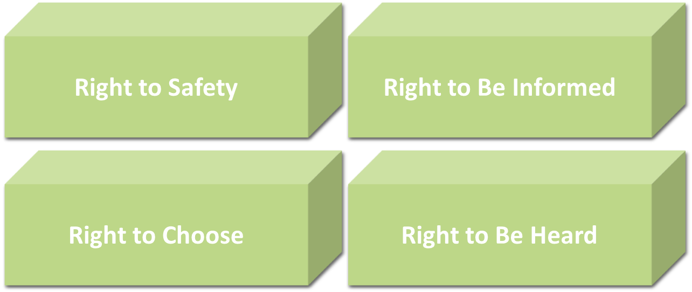
The Consumer’s Magna Carta

Slide 8
Ralph Nader’s Consumerism
Ralph Nader is considered the father of the modern consumer movement.
The impact of his book, Unsafe At Any Speed criticizing the auto industry and General Motors 40 years ago, was momentous.
Nader’s book gave rise to auto safety regulations and devices.
Nader built a new era—that of the consumer.

Slide 9
Consumerism Today
Many groups make up the loose confederation known as the consumer movement.
The power held by consumers is not the result of organized groups lobbying; their efforts are at the grassroots level.
Involves grassroots organizations, social media activism, and the rise of nonprofit organizations
Major issues fall into two groups:
Product/service information
Product/service itself

Slide 10
Consumer Problems with Business
High prices of products
Poor quality of products
Failure to live up to advertising claims
Hidden fees
Poor quality of after-sales service
Product breakage
Misleading packaging or labeling
Slack filling
Feeling that consumer complaints are a waste of time
Inadequate guarantees and warranties
Failure of company complaint handling
Dangerous products
Absence of reliable product/service information
Not knowing what to do if something is wrong with product

Slide 11
Product/Service Information Issues
Companies understandably want to portray their products in the most flattering light.
But efforts to paint a positive portrait of a product can easily cross the line into misinformation or deception—or absurdity:
An ad implores readers to switch to Verizon high-speed internet at a price that will “never go up.” But the fine print reveals, “rates increase after two years.”
What part of “never go up” do they fail to understand?
Product and service information is relayed by advertising.

Slide 12
Advertising Issues
Arguments for Advertising | Arguments Against Advertising
Informs consumers | It is wasteful and inefficient—and decreases our standard of living
Increases consumer satisfaction | Raises the price of products and is an unnecessary business cost
Promotes efficiency in the supply chain | Inefficient means of distributing information
Effective at reaching consumers | Ineffective
An economical means of reaching consumers | High cost

Slide 13
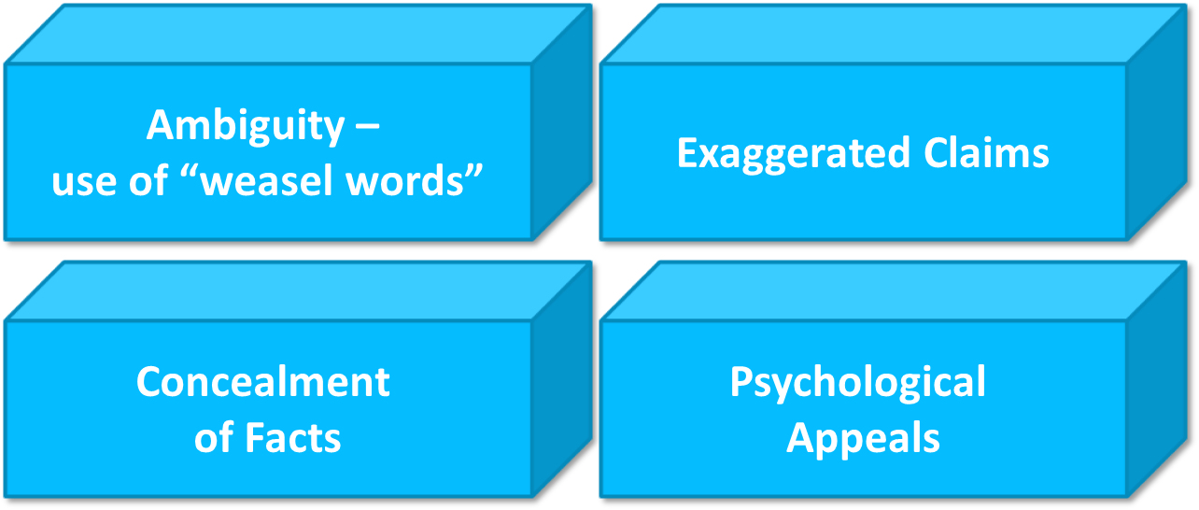
Advertising Abuses

Slide 14
Specific Controversial Advertising Issues (1)
Comparative Advertising – the practice of directly comparing a firm’s product with the product of a competitor: Coke vs. Pepsi, and Mac vs. PC.
Use of Sex Appeal in Advertising – this has been an ongoing ethical issue for decades. While ads using sex appeal work, they can have a serious impact on the physical and mental health of girls.
Advertising to children – “Kid-vid” advertising: the average child to sees 25,000–40,000 ads per year, including one promoting “shopaholic best friends.” Lacking cognitive development, children under the age of 8 are easy targets.
Marketing to the poor – High interest rates yield significant profits, but can bury the poor in debt.
Advertising alcoholic beverages – A voluntary ban on advertising hard liquor on TV has ended; youth exposure to liquor ads has increased 30-fold; some products target children

Slide 15
Specific Controversial Advertising Issues (2)
Cigarette Advertising – many oppose advertising a dangerous product, one that kills half its users; ads target the young and less-educated markets
Health and Environmental Claims – we are environmentally aware and health-conscious, and ads make health and environmental claims they may not meet.
Ad creep – advertising has crept everywhere, into places that were once not considered acceptable for advertisements, including school buses, textbooks, doctors’ offices, movies and historical monuments.
Social Media Advertising – used in all of the above. Controversial because of rapid growth and questionable use.

Slide 16
Warranties and Guarantees – (1 of 2)
Initially used by manufacturers to limit the length of time they were responsible for products.
Came to be viewed by consumers as tools to protect the buyer against defective products.
Implied Warranty -
Unwritten promise that there is nothing wrong with the product and its intended use.
Express Warranty -
Promise or affirmation of fact that the seller makes at the time of the sale.
Guarantee – a promise regarding product quality, less likely to be written.

Slide 17
Warranties and Guarantees – (2 of 2)
The Magnuson-Moss Warranty Act of 1975 set standards for what must be contained in a warranty, and its ease of being understood.
Full Warranty - Covers the entire product.
Limited Warranty - Certain parts or types of defects are not covered under the warranty.
Extended Warranty - Service plans that lengthen the warranty period and are offered at an additional cost.

Slide 18
Packaging and Labeling
Abuses in packaging and labeling were fairly frequent before the passage of the:
Federal Packaging and Labeling Act of 1967
Prohibits deceptive labeling on consumer products
Requires disclosure of certain important information on consumer products
The FTC and the Food and Drug Administration (FDA) have responsibilities under the Act.

Slide 19
Other Product Information Issues -
Other abuses led to passage of these laws:
Equal Credit Opportunity Act -
Prohibits discrimination in extending consumer credit.
Truth-in-Lending Act -
Requires all suppliers of consumer credit to fully disclose all credit terms.
Fair Credit Reporting Act -
Ensures that consumer-reporting agencies provide information in a manner that is fair and equitable.
Fair Debt Collection Practices Act -
Regulates the practices of third-party debt-collection agencies.

Slide 20
The Federal Trade Commission
The government’s major instrument for ensuring that business lives up to its responsibilities.
Major Activities of the FTC -
To prevent unfair methods of competition and anticompetitive pricing
To protect consumers from unfair or deceptive acts or practices
Administers consumer protection laws

Slide 21
The FTC in the 21st Century
Created the National Do-Not-Call Registry, which forbids telemarketers from calling consumers who sign up with the registry.
Required telemarketers to show their contact information on consumers’ caller ID systems.
Sued firms that made misleading claims for weight loss products, and recovered millions in settlements.
FTC preference was that business self-regulate when possible, and FTC action a last resort.
Current issues include robocalls, children’s online privacy, and data brokers.

Slide 22
Consumer Financial Protection Bureau –
Enforces consumer financial protection laws
Restricts unfair, deceptive, or abusive acts
Takes consumer complaints
Promotes financial education
Researches consumer behavior
Monitors financial markets
Enforces laws that outlaw discrimination
Credit Card Accountability, Responsibility, and Disclosure Act of 2009 (CARD) –
Rates and fees more fair and transparent

Slide 23
Self-Regulation in Advertising
Self Regulation –
the control of business conduct by the business itself or business associations.
The National Advertising Division’s Program –
The most prominent organization for advertising self-regulation by business.
NAD was created to help sustain high standards of truth and accuracy in national advertising.
Initiates investigations
Determines issues
Collects and evaluates data
Determines whether an advertisers claims are substantiated.

Slide 24
Moral Models and Consumer Stakeholders
How would the three types of moral managers models, discussed in Chapter 7, view consumer stakeholders?
The Moral Management Model best represents the highest ethical standards of consumer treatment, and is therefore the recommended model for business to follow.

Slide 25
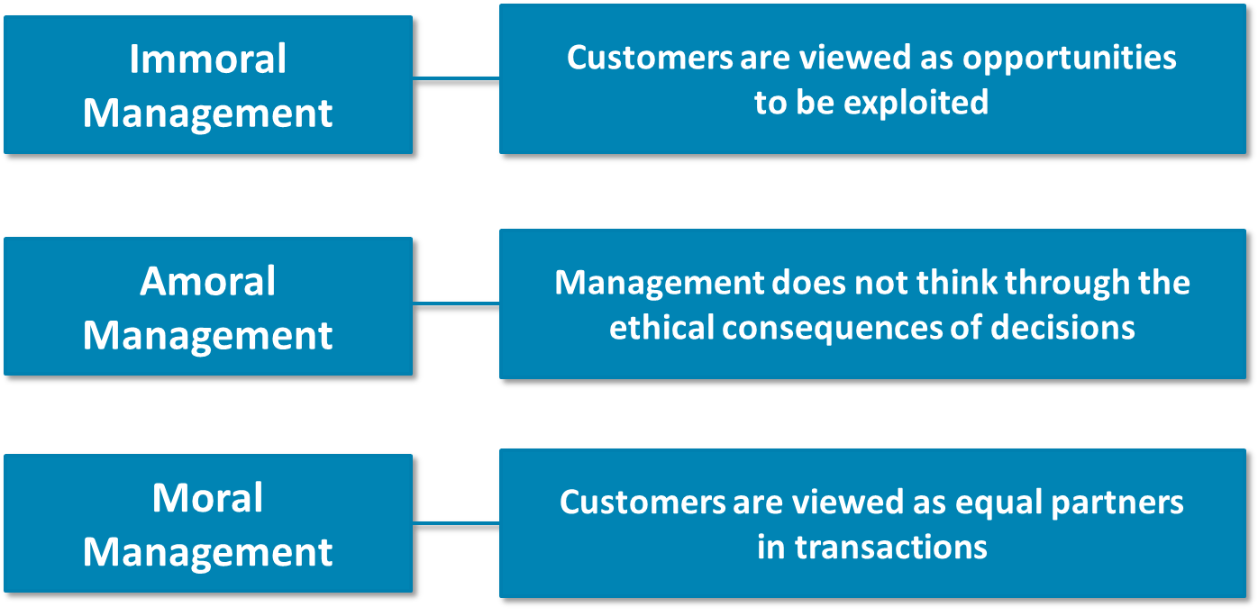
Three Moral Management Models

Slide 26
Key Terms (1 of 2)
accurate information
ad creep
adequate information
age compression
ambient advertising
ambiguous advertising
Children’s Television Act (CTA)
clear information
comparative advertising
concealed facts
Consumer Financial Protections Bureau (CFPB)
consumerism
Consumer’s Magna Carta
Credit Card Act of 2009
Customer Relationship Management (CRM)
exaggerated claims
express warranty
extended warranty
full warranty
green advertising
green guides
green marketing
green fatigue
green watchdogs
Guarantees
Implied warranty

Slide 27
Key Terms (2 of 2)
limited warranty
natural products
organic food
plot placement
product information
product placement
psychological appeals
puffery
pure self-regulation
right to be heard
right to be informed
right to choose
right to safety
Return fraud
Returns policies
self-regulation
social media advertising
warranties
weasel words

