Slide 1
Business & Society
Ethics, Sustainability & Stakeholder Management
10th Edition
© 2018 Cengage

Slide 2
Chapter 14
Consumer Stakeholders: Product and Service Issues

Slide 3
Learning Outcomes
Describe and discuss the two major product issues: quality and safety.
Explain the role and functions of the Consumer Product Safety Commission (CPSC).
Explain the role and functions of the Food and Drug Administration (FDA).
Outline business’s responses to consumer stakeholders, including customer service programs, and quality initiatives such as Total Quality Management (TQM), Six Sigma, Lean Six Sigma, Kaizen, and ISO 9000.

Slide 4
Chapter Outline
Two Central Issues: Quality and Safety
Consumer Product Safety Commission
Food and Drug Administration
Business’s Response to Consumer Stakeholders
Customer Service Programs
Total Quality Management Programs
Six Sigma Strategy and Other Process
Summary
Key Terms

Slide 5
Consumer Stakeholders:
Product and Service Issues
Sam Walton, founder of Walmart –
“There is only one boss. The customer. And he can fire everybody in the company…simply by spending his money somewhere else.”
Takata, Japanese auto supplier, becoming more well known. Many of today’s autos have Takata air bags.
In early 2016, bursting air bags linked to 10 deaths (9 in the U.S.) and dozens of injuries worldwide.
29 million air bags recalled. Later another 40 million rupture-prone air bags were recalled. Recall being called the biggest in U.S. History.

Slide 6
Two Central Issues -
The Issue of Quality -
Product quality means different things to different people.
Service quality usually means that the service was performed as expected and on time.
Interest in quality is driven by an increase in family income and demand for good value.
The Issue of Safety -
Nearly all consumer products or services entail some small degree of risk.
Today it is important that even financial services do not cause damage or financial harm.

Slide 7
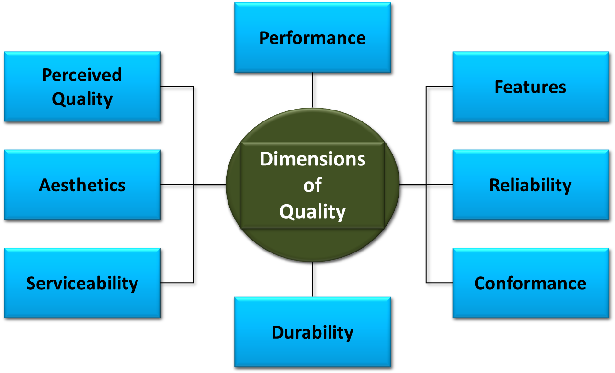
Critical Dimensions of Product Quality

Slide 8
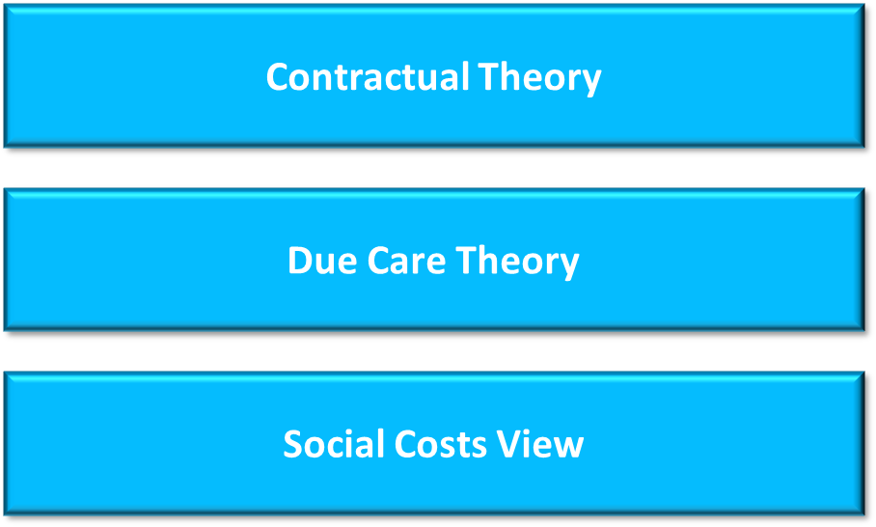
Ethical Underpinnings of Quality

Slide 9
The Issue of Safety
Who is liable for a defective product?
Historical Perspective -
Caveat emptor - “Let the buyer beware.”
This doctrine assumed that the buyer had as much knowledge of the product as the seller, but this was not correct.
Modern Day -
Caveat venditor – “Let the seller beware.”
But how safe should a product be?

Slide 10
Top Ten List of Safety Principles
Build safety into product design.
Do product safety testing for all foreseeable hazards.
Keep informed about and implement latest developments in product safety.
Educate consumers about product safety.
Track and address products’ safety performance.
Fully investigate product safety incidents.
Report product safety defects promptly.
If a defect occurs, promptly offer a comprehensive recall plan.
Work with the Consumer Product Safety Commission to make sure your recall is effective.
Learn from mistakes—yours and others’.

Slide 11
Product Liability (1 of 3)
Reasons for the concern -
The sheer number of cases where products resulted in illness, harm, or death.
The amount of the financial award.
Doctrine of strict liability -
  Anyone in the value chain of a product is liable for harm caused to the user if the product is unreasonably dangerous because of a defective condition.
The U.S. is a litigious society.

Slide 12
Product Liability (2 of 3)
Extensions of the strict liability rule –
Courts in several states and some countries have established a standard more demanding than strict liability:
Absolute liability – A manufacturer could be held strictly liable for failure to warn of a product hazard, even if the hazard was scientifically unknowable at the time of manufacture and sale.
Market share liability – Manufacturers who made the product share in the liability for injury according to their market shares. This doctrine was applied in delayed manifestation cases, but limited to those.

Slide 13
Product Liability (3 of 3)
Product Tampering and Product Extortion–
The Tylenol tampering cases of the 1980s are best known. As a result, firms began to use tamper-evident packaging.
Other cases include: Jell-O pudding, bottle water, oranges, candy, baby food, and Girl Scout cookies.
Product Liability Reform –
These issues have raised calls tor product liability reform, also known as tort reform. Tort law requires that the one causing injury pay the injured party. Businesses seek tort reform; consumer groups oppose it.

Slide 14
Consumer
Product Safety Commission -
An independent regulatory agency created by the Consumer Product Safety Act of 1972, which works to reduce the risk of injuries and deaths from products by:
  Developing voluntary standards with industry
  Issuing and enforcing mandatory standards
  Banning consumer products if no feasible standard would adequately protect the public
  Obtaining the recall of products or arranging for their repair
  Conducting research on potential product hazards
  Informing and educating consumers through media, state and local governments, private organizations, and by responding to consumer inquiries

Slide 15
CSPC Strategic Plan, 2011-2016
Mission | Protecting the public against unreasonable risks of injury from consumer products.
Vision | The CPSC is the recognized global leader in consumer Product safety
Goal 1 | Leadership in Safety
Goal 2 | Commitment to Prevention
Goal 3 | Rigorous Hazard Identification
Goal 4 | Decisive Response
Goal 5 | Raising Awareness

Slide 16
Food and Drug Administration (1 of 2)
Food and Drug Administration -
Grew out of experiments with food safety by Harvey W. Wiley in the late 1800s.
The FDA resides within the Health and Human Services Department.

Slide 17
Food and Drug Administration (2 of 2)
The FDA regulates -
Foods
Human prescription and non-prescription drugs
Vaccines, blood products, and other biologics
Medical devices
Electronic products
Cosmetics
Veterinary products
Tobacco products

Slide 18
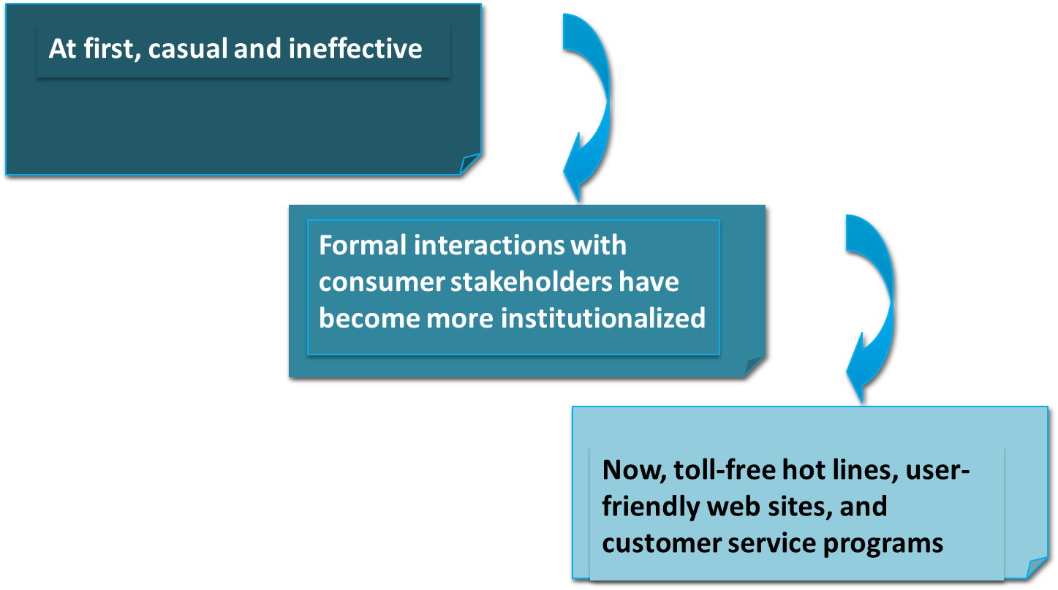
Business’s Response to Consumer Stakeholders

Slide 19
Customer Service Programs
Customer service or self service?
Retailers of all types have been pushing the idea of self-service. We check out our own groceries, pump our own gas, print our boarding passes, and fix our cable tv, following a computer voice.
Customers are frustrated with after-sale problems not quickly and easily remedied.
Experts know that the key to customer retention is customer service.
Building life-long devotion among customers takes serious commitment and hard work.

Slide 20
Seven
Principles of Customer Service
Keeping your word is where it begins.
Always be honest and tell it like it is.
Always think proactively, looking around the corner.
Deal with problems as best you can yourself, never passing the buck.
Do not argue with a customer because it is a lose/lose situation.
Accept your mistakes, learn from them, and do not repeat them.
Consistency is the name of the game for lasting success.

Slide 21
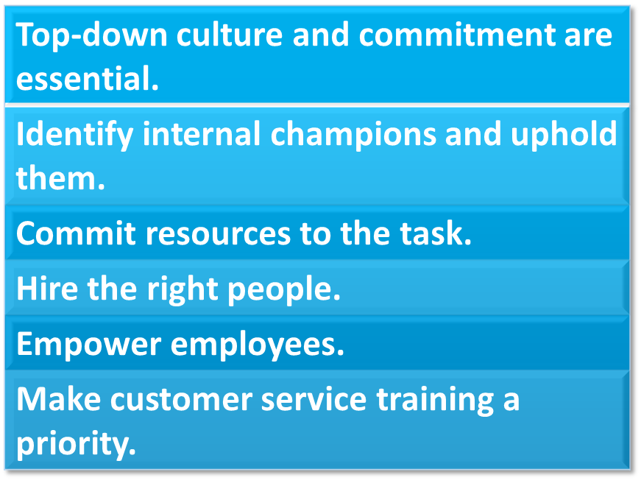
Creating a
Customer-Oriented Company

Slide 22
Total Quality Management – (1 of 2)
Has many characteristics, but essentially means –
All business functions are blended into an integrated philosophy built around quality, teamwork, productivity, and customer understanding and satisfaction.
TQM focuses on product quality and safety, focuses on the customer, and uses continuous improvement.
The customer is the final judge of quality.

Slide 23
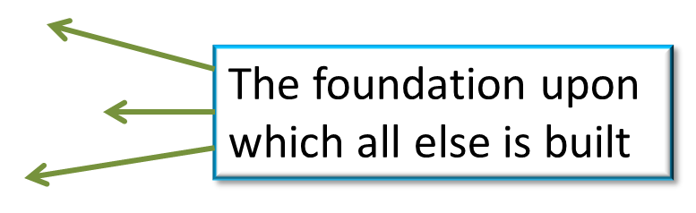
Total Quality Management – (2 of 2)
TQM emphasizes eight key elements -
  Ethics
  Integrity
  Trust
  Training
  Teamwork
  Leadership
  Recognition
  Communication

Slide 24
Six Sigma Strategy and Other Processes
Six Sigma -
A development within TQM that has become a way of life for many corporations.
Sigma is a statistical measure of variation from the mean; higher values of sigma mean fewer defects.
Six Sigma level of operation is 3.4 defects per million.
  Most companies have 6,000 defects per million.

Slide 25
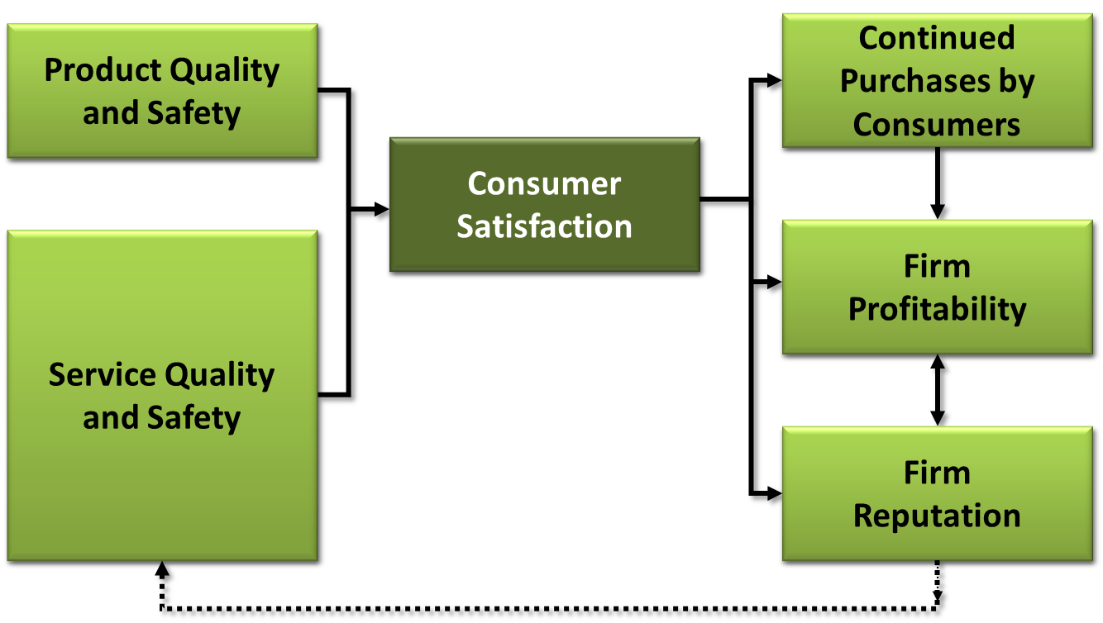
Consumer-Stakeholder Satisfaction Model

Slide 26
Key Terms
absolute liability
caveat emptor
caveat vendor
Caveat venditor
Consumer Product Safety Commission (CPSC)
Consumer Product Safety Improvement Act of 2008
consumer stakeholder satisfaction model
contractual theory
delayed manifestation cases
doctrine of strict liability
due care theory
Food and Drugs Act of 1906
Food and Drug Administration (FDA)
Food Safety Modernization Act
ISO 9000
Kaizen
Lean Six Sigma
Market share liability
Product extortion
Product liability risk management program
Product (products) liability
Six Sigma
social costs view
tort reform
Total Quality Management

