Slide 1
Chapter 7: Just-in-time and the agile supply chain

Slide 3
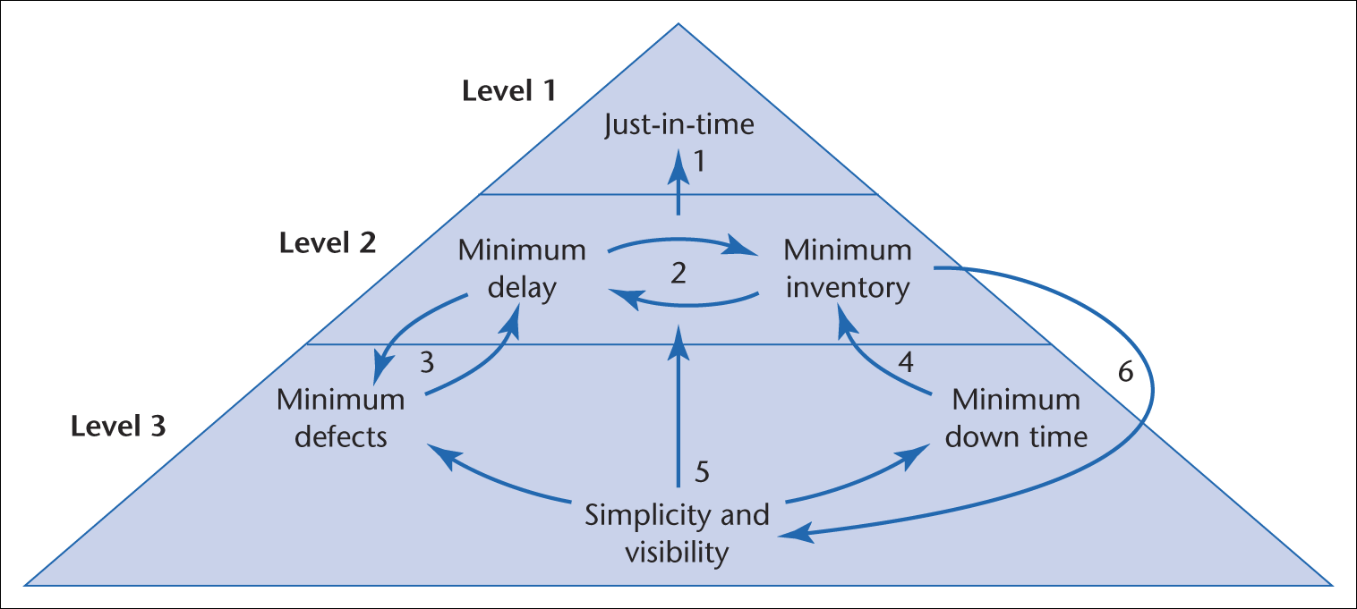
Figure 7.1 The pyramid of key factors that underpin JIT

Slide 4
Figure 7.2 The Smog production process

Slide 5
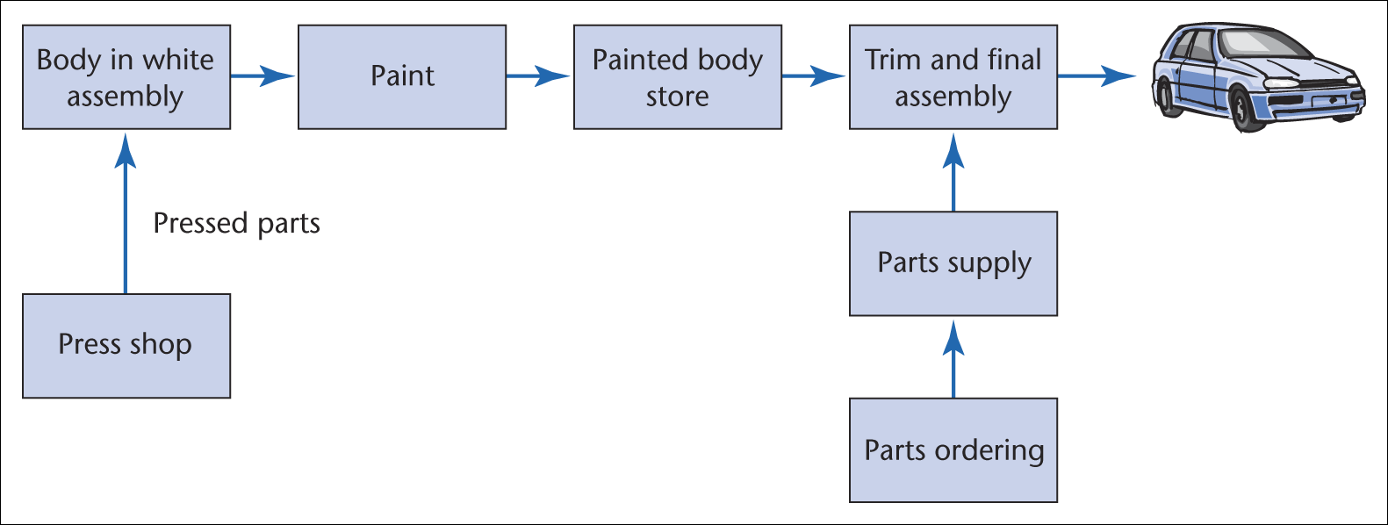
Figure 7.3 Basic tasks in a car assembly plant

Slide 6
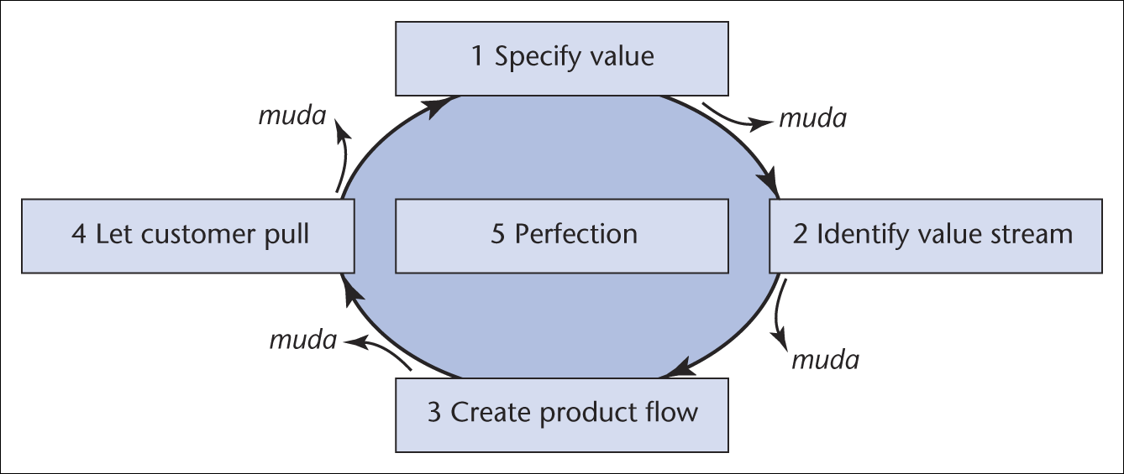
Figure 7.4 Lean thinking principles
(Source: After Womack and Jones, 2003)

Slide 7
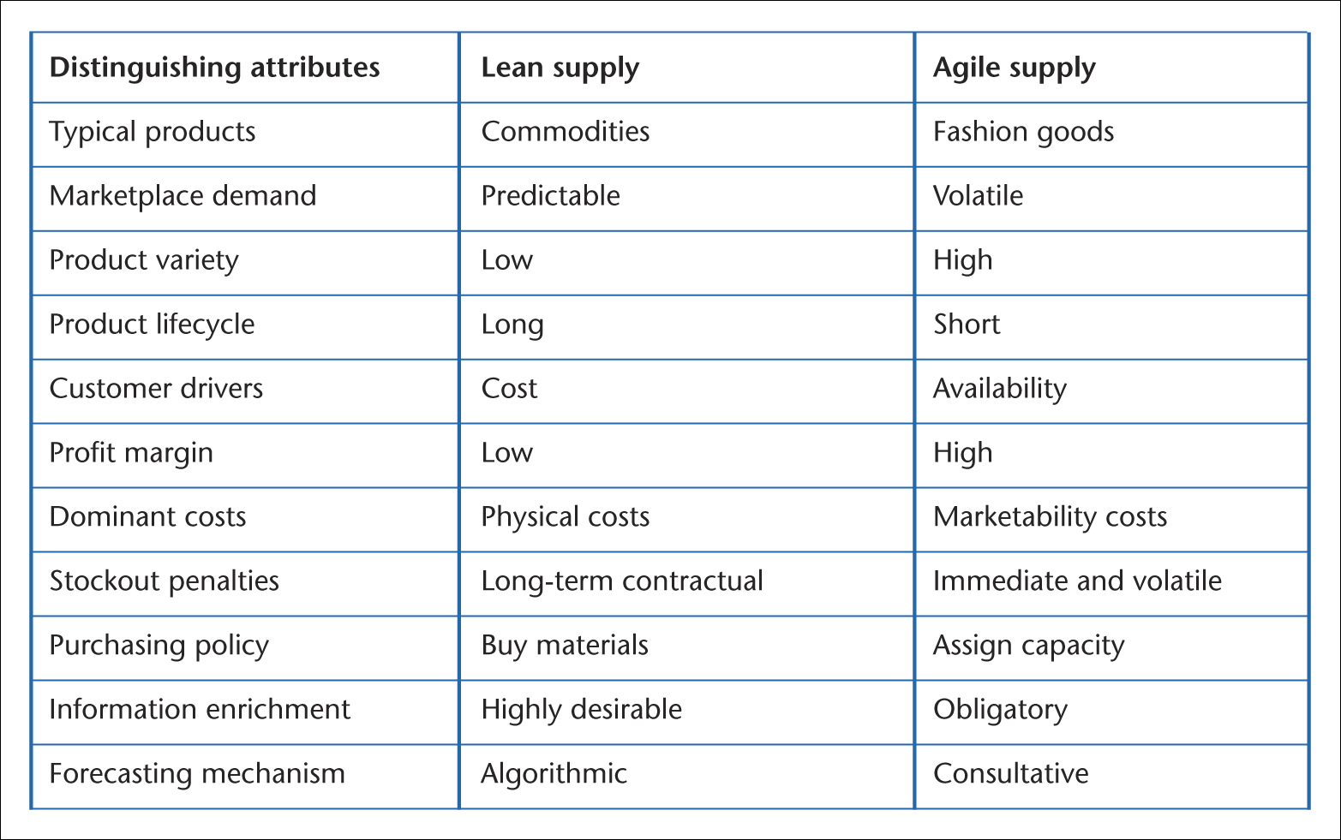
Table 7.1 Comparison of lean supply with agile supply: the distinguishing attributes

Slide 8
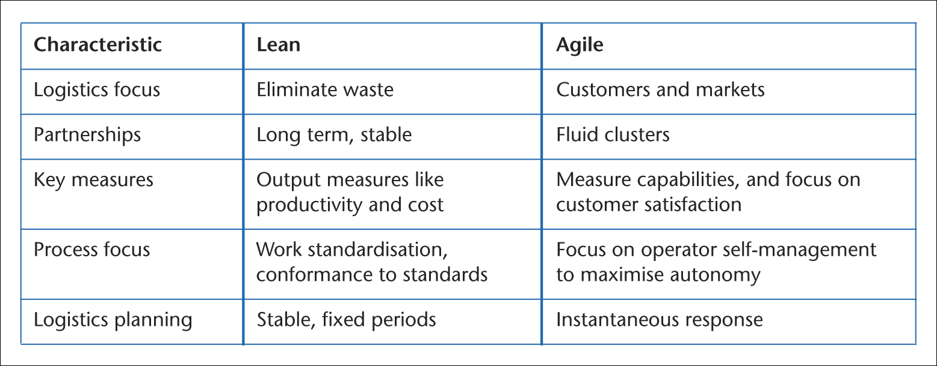
Table 7.2 Further characteristics of lean and agile supply

Slide 9
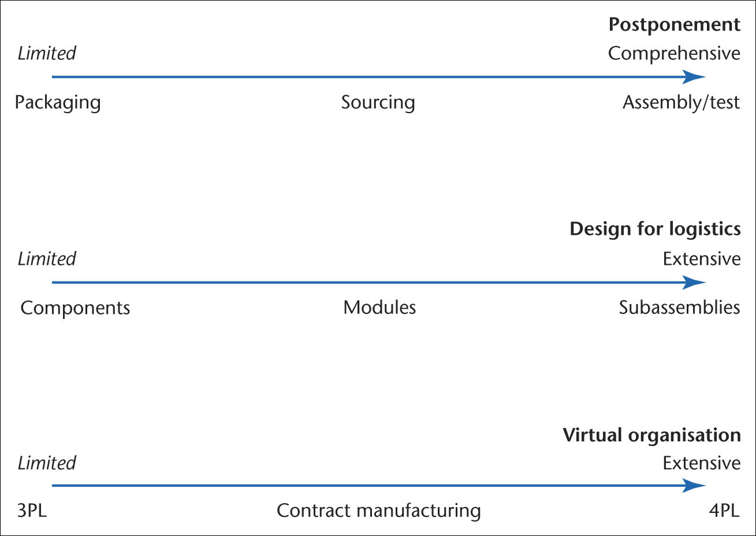
Figure 7.5 Supply capabilities supporting the agile supply chain

Slide 10
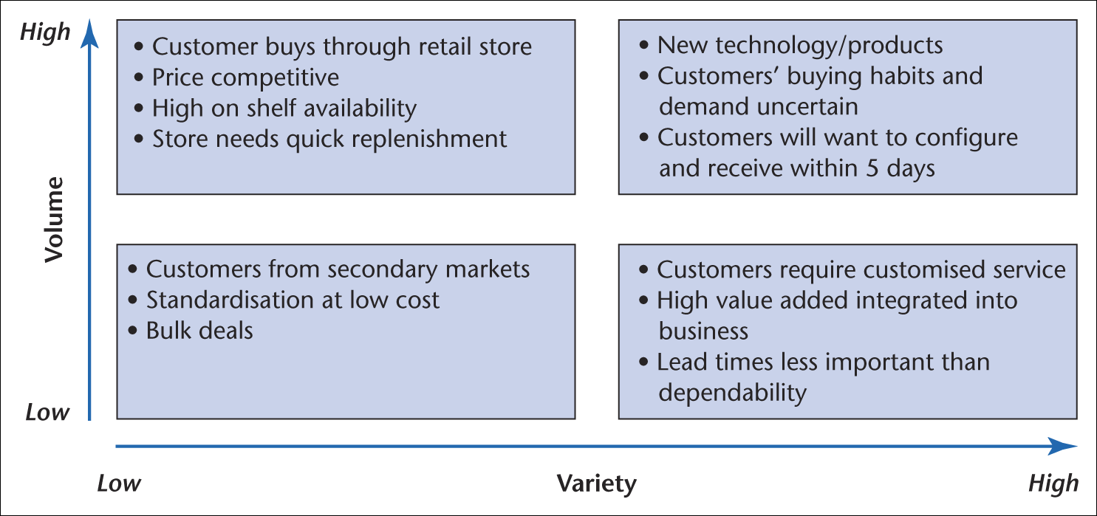
Figure 7.6 Segmenting the market

Slide 11
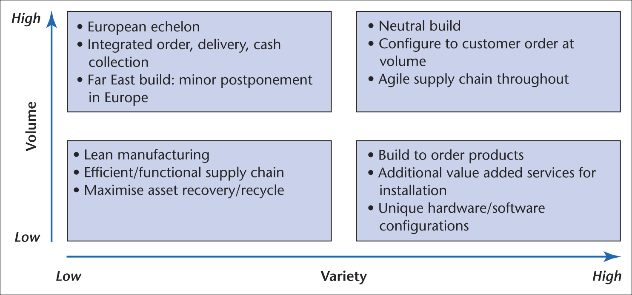
Figure 7.7 Supply chain response

Slide 12
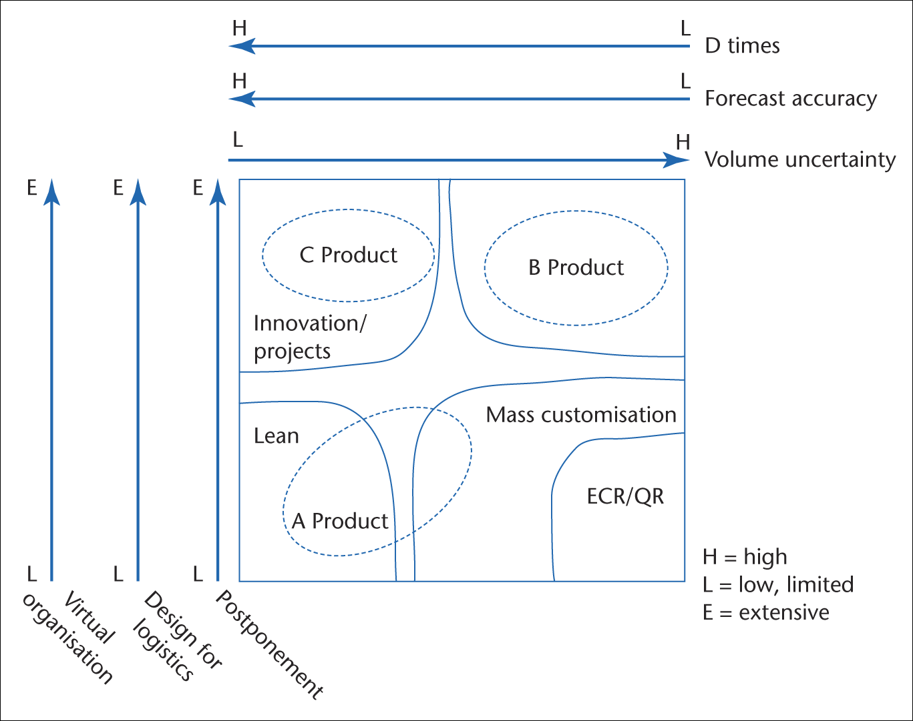
Figure 7.8 Classifying operating environments

