Slide 1
The United States, 1492-1865
HIS 315K
Professor Rachel Ozanne
Notes:
COURSE TITLE SLIDE:
PPT EDIT INSTRUCTIONS:
Always choose the baked-in PPT layout called "Title Slide"
PPT comes with Calibri as a default font. See below for the correct font, color, and sizes
Title = Helvetica or Arial, Bold, white, 40 pt.
Course Number = Helvetica or Arial, Bold, white, 30pt
Professors Name = Helvetica or Arial, Bold, white 30pt

Slide 2
Sex and Power in Early America
The United States, 1492-1865
Professor Rachel Ozanne
Notes:
INDIVIDUAL LECTURE SEGMENT VIDEO SLIDES - MONOCHROMATIC VERSION should stay static with voiceover.
PPT EDIT INSTRUCTIONS:
Always choose the baked-in PPT layout called "Section Header"
PPT comes with Calibri as a default font. See below for the correct font, color, and sizes
Topic= Helvetica or Arial, Bold, white, 40 pt.
Course Name= Helvetica or Arial, Regular, white, 30pt
Professor's Name = Helvetic or Arial, Regular, white, 30pt

Slide 3
Lecture Overview
I. Introduction
II. Patriarchalism
III. Comparison: Gender in New England and Virginia
IV. The Salem Witch Trials

Slide 4
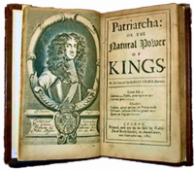
II. Patriarchalism
Lordly Fathers and Fatherly Lords
Authority
5th commandment
Robert Fimler, Patriarcha (1650)
Disobedience = sin

Slide 5
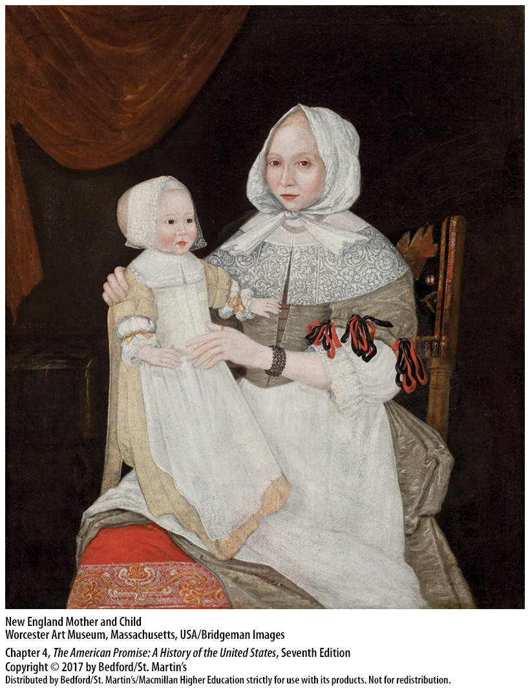
II. Patriarchalism
B. Good wife: a title and a role
No more nuns!
Coverture
Conjugal rights
Divorce not easy

Slide 6
III. Gender in New England and Virginia
New England a Reinforced Patriarchy
family stability
low mortality rates
fatherly authority
inheritance patterns
gender hierarchy: Anne Hutchinson

Slide 7
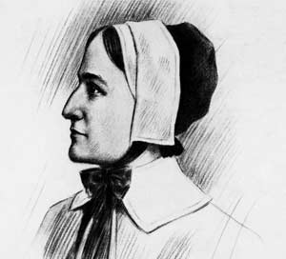
Anne Hutchinson’s Trial
What evidence can you find in the text that Hutchinson’s gender was a factor in the accusations brought against her?
What is a covenant of works? Why would that be so bad to Puritans?
How does Hutchinson defend her views?
What is her punishment? Why?

Slide 8
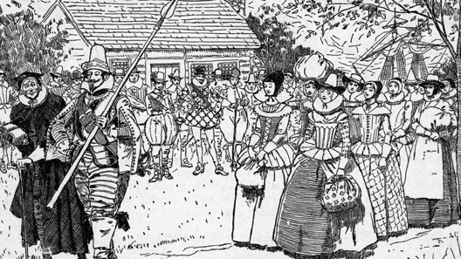
III. Gender in New England and Virginia
B. Virginia: a Fractured Patriarchy
Men > women (4:1)
high mortality rates
mobility
wealthy widows
(slavery, too)
1882 depiction of mail order brides coming to Virginia. Get the full story here.

Slide 9
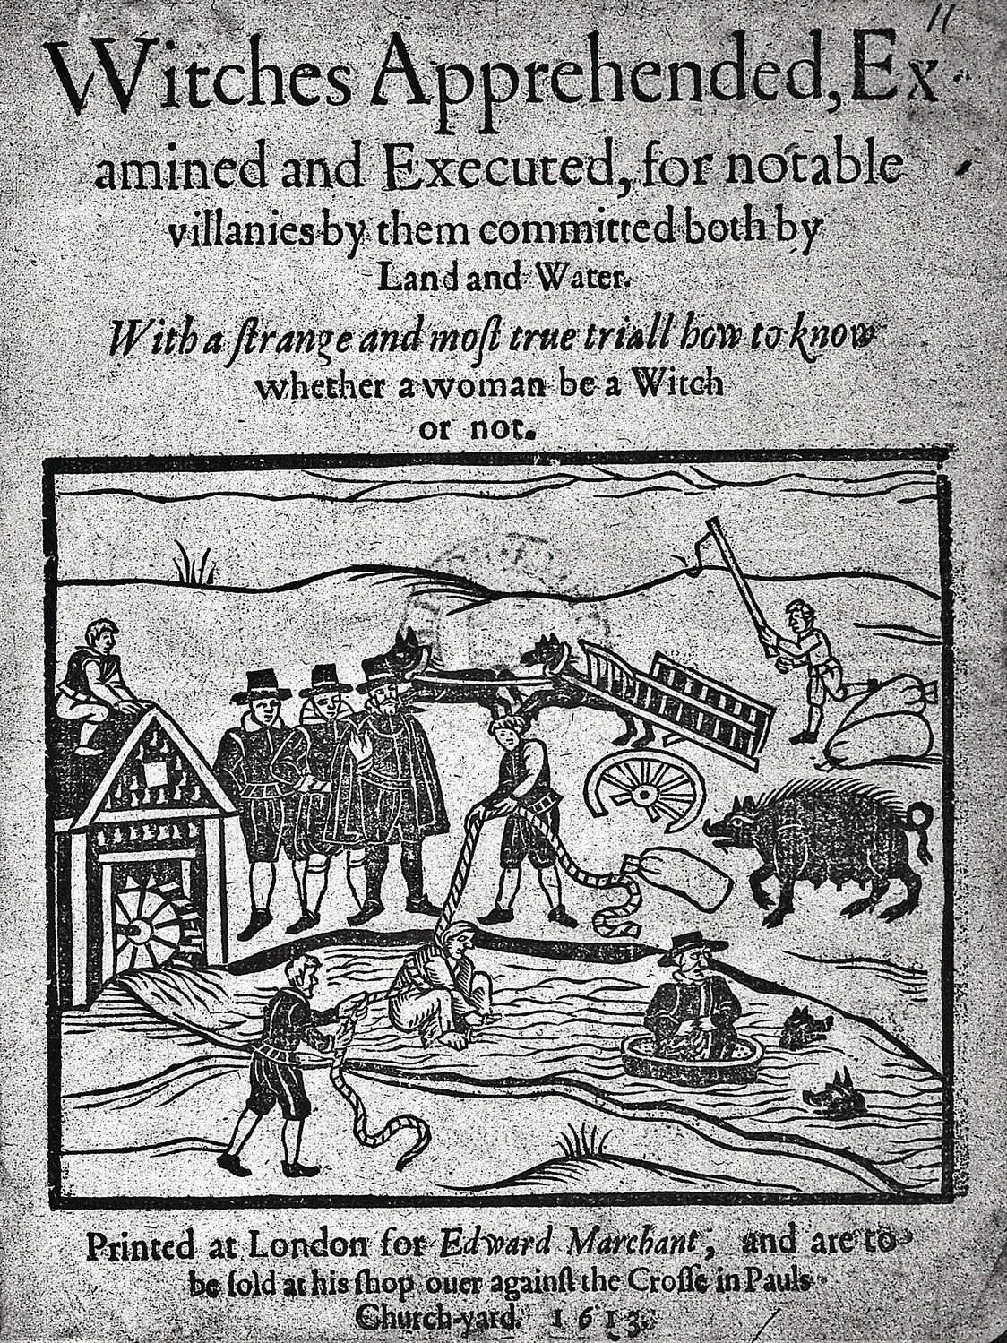
IV. The Salem Witch Trials
A. The “Witchhunt,” 1542-1736
1542: witchcraft a crime
“maleficium”
Old England
2000 cases in 200 years
New England
324 trials
36 executions
80% accused were women
1613 Pamphlet about a witch trial

Slide 10
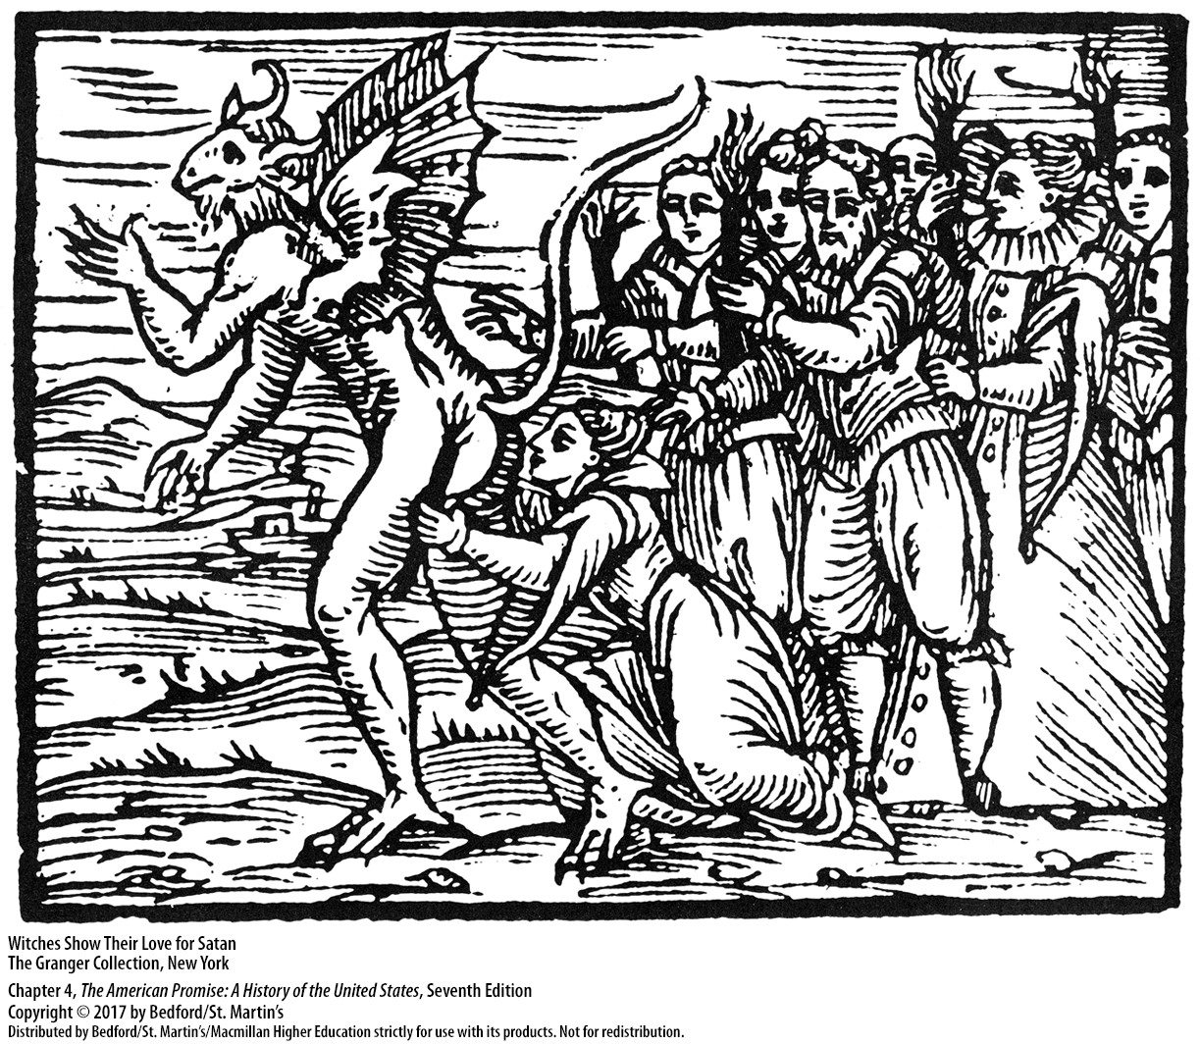
IV. The Salem Witch Trials
B. Why Women?
crime against patriarchy
easy targets
religious views (Eve, sexuality)
property issues

Slide 11
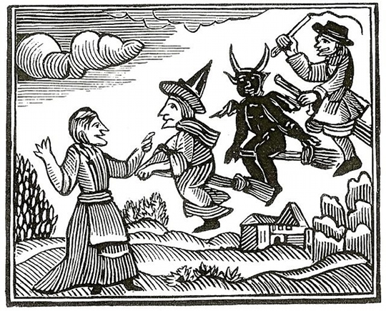
IV. The Salem Witch Trials
C. Salem, 1692: Last Stand of the Old Order
150 people accused; 20 executed
folk magic
accusations across social class
Woodcut depicting witches from Cotton Mather’s 1689 Wonders of the Invisible World

Slide 12
IV. The Salem Witch Trials
D. The Decline of Witchcraft
1706: last witch trial in English N. American colonies
1735: Witchcraft decriminalized

Slide 13
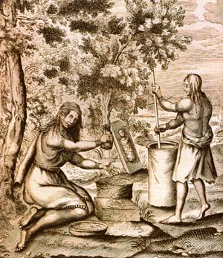
V. Race, Gender, & Sex
A. Native Americans
Gender roles
Sexual mores
European views
Explorers & Traders
Priests and religious leaders
17th-century woodcut of Iroquois Women

Slide 14
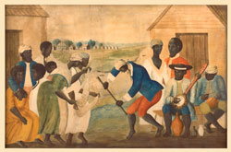
V. Race, Gender, & Sex
B. African Americans
Paternalism in slavery
Marriages & Families
Enslaved women’s bodies & sex
18th-century painting of slave community

Slide 15
Want to Know More?
https://uncpress.org/book/9780807846230/good-wives-nasty-wenches-and-anxious-patriarchs/
https://www.penguinrandomhouse.com/books/122783/founding-mothers-and-fathers-by-mary-beth-norton/
https://www.upenn.edu/pennpress/book/14030.html
https://networks.h-net.org/node/2718/reviews/3303/abbott-perdue-sifters-native-american-womens-lives
https://wwnorton.com/books/The-Devil-in-the-Shape-of-a-Woman/
https://www.oupress.com/books/9784660/women-and-power-in-native-north-america

