Slide 1
ITS 832
Week 8: Global Technology Challenges Faced by Management
Dr. Grimes

Slide 2
Objectives
By the end of this week, you should be able to:
Describe the risks and challenges of global management
Explain ways companies are implementing technology globally

Slide 3
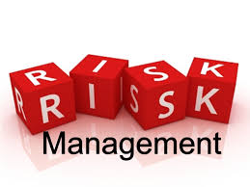
What is Risk Management
Risk is an uncertain event that may have a positive or negative impact on the project.
Risk management is the process of identifying and mitigating risk.

Slide 4
Why is it important?
Risk affects all aspects of your projects
It increases the probability of a positive event
It reduces the occurrence of a negative event.

Slide 5
Types of Risks
Schedule Risk
Cost Risk
Quality Risk
Scope Risk
Resource Risk
Customer Satisfaction Risk

Slide 6
Plan Risk Management
Analysis and decision making to implement risk management.
Appropriate to size and complexity of the project or organization.
Stakeholders will be involved in planning risk management.

Slide 7
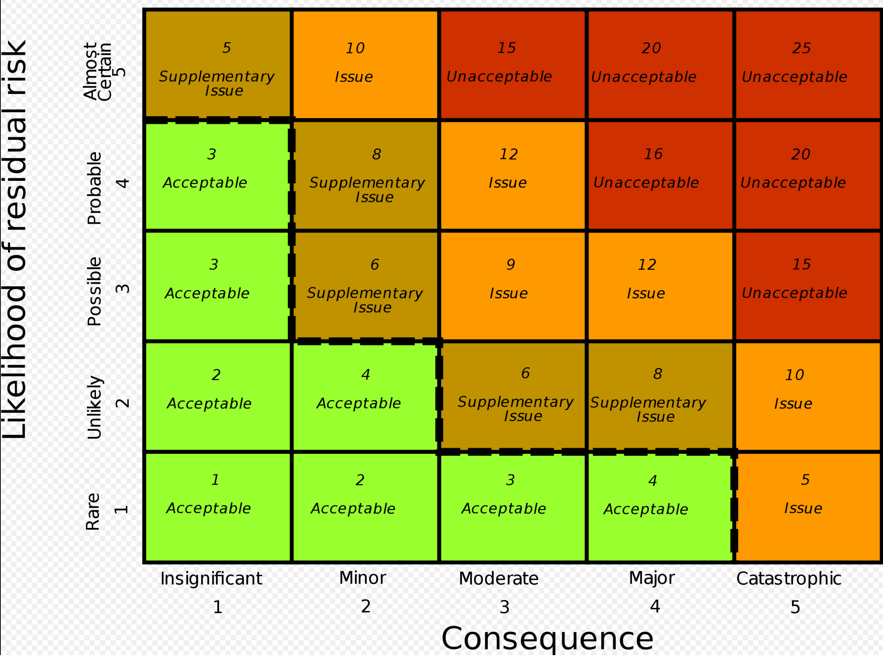
Qualitative Risk Analysis
Assess impact of the identified risk
Assess likelihood of the identified risk
Individual risks are evaluated in the qualitative risk analysis.
Often visualized in a 2-factor risk matrix

Slide 8
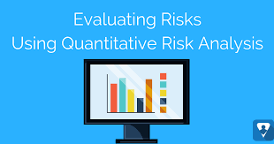
Quantitative Risk Analysis
Quantifies the possible outcomes for the project and assesses the probability of achieving specific project objectives
Provides a quantitative approach to making decisions when there is uncertainty
Creates realistic and achievable cost, schedule or scope targets

Slide 9
Qualitative vs Quantitative
Qualitative: risk-level Quantitative: project-level
Qualitative: subjective evaluation of probability and impact Quantitative: probabilistic estimates of time and cost
Qualitative: quick and easy to perform Quantitative: time consuming
Qualitative: no special software or tools required Quantitative: may require specialized tools

Slide 10
Plan Risk Response
Negative risk or threat
Avoid
Transfer
Mitigate
Accept
Positive risk or opportunity
Exploit
Share
Enhance

Slide 11
What are the benfits of risk management?
Effective use of resources
Fewer surprises and failures
Strategic planning
Raised awreness of the risks
Quick response to new opportunities
Enhancing communications
Internal audit programs

Slide 12
10 Risks Impacting Global Management
Increase of Cybercrime
State-sponsored cyberattacks
The use and storage of data
Extreme weather
Vulnerability of supply chains
Global financial instability
Innovation
Sustainability
Terrorism
Management itself is a business risk

Slide 13
Assignments
Read
Textbook: Chapter 7: Kressel, H., & Lento, T. V. (2012). Entrepreneurship in the Global Economy : Engine for Economic Growth. Cambridge, UK: Cambridge University Press. http://search.ebscohost.com/login.aspx?direct=true&AuthType=shib&db=nlebk&AN=465765&site=eds-live
Ives, B., & Jarvenpaa, S.L. (1991). Applications of Global Information Technology: Key Issues for Management. MIS Quarterly, 15(1), 33. https://doi.org/10.2307/249433
Week 8: Research paper
Find a peer-reviewed scholarly journal article discussing implementing information technology globally. Complete a review of the article by writing a 2-3 page overview of the article. This will be a detailed summary of the journal article, including concepts discussed and findings. Additionally, find one other source (it does not have to be a peer-reviewed journal article) that substantiates the findings in the article you are reviewing.
Once you find the article, you will read it and write a review of it. This is considered a research article review.
Your paper should meet these requirements:
Be approximately four to six pages in length, not including the required cover page and reference page.
Follow APA 7 guidelines. Your paper should include an introduction, a body with fully developed content, and a conclusion.
Support your answers with the readings from the course and at least two scholarly journal articles to support your positions, claims, and observations, in addition to your textbook. The UC Library is a great place to find resources.
Be clearly and well-written, concise, and logical, using excellent grammar and style techniques. You are being graded in part on the quality of your writing.

