Slide 1
International management
© 2018 by McGraw-Hill Education. This is proprietary material solely for authorized instructor use. Not authorized for sale or distribution in any manner. This document may not be copied, scanned, duplicated, forwarded, distributed, or posted on a website, in whole or part.

Slide 2
Chapter 6
Organizational Cultures and Diversity

Slide 3
Learning Objectives
Define exactly what is meant by organizational culture, and discuss the interaction of national and MNC cultures
Identify the four most common categories of organizational culture that have been found through research, and discuss the characteristics of each

Slide 4
Learning Objectives (continued)
Provide an overview of the nature and degree of multiculturalism and diversity in today’s MNCs
Discuss common guidelines and principles that are used in building multicultural effectiveness at the team and the organizational levels

Slide 5
Deloitte: Key Findings regarding Culture and Global Leadership
Cultural diversity
Lies in the eye of the beholder
Positively contributes to professional and personal enjoyment of the project and project outcome
Indirectly encourages project members to rethink their usual working habits and expectations
Dominance amongst team members reduces bias to interact with people who have common characteristics

Slide 6
Advantages of Global Virtual Teams
Working virtually can reduce team process losses associated with any cliques commonly experienced by face-to-face teams
Having members span many different time zones can literally keep a project moving around the clock
Cohesive teams that are capable of quickly solving complex problems and making effective decisions provide a competitive advantage

Slide 7
Organizational Culture
Pattern of shared basic assumptions that:
Is learned by the group as it solves problems of external adaptation and internal integration
Have worked well enough to be considered valid
Are to be taught to new members as the correct way to perceive, think, and feel in relation to those experiences

Slide 8
Characteristics of Organizational Culture
Observed behavioral regularities, as typified by common language, terminology, and rituals
Norms, as reflected by things such as:
Amount of work to be done
Degree of cooperation between management and employees

Slide 9
Characteristics of Organizational Culture (continued 1)
Dominant values that the organization advocates and expects participants to share
Include high product and service quality, low absenteeism, and high efficiency
Philosophy that is set forth in the MNC’s beliefs regarding how employees and customers should be treated

Slide 10
Characteristics of Organizational Culture (continued 2)
Rules that dictate the dos and don’ts of employee behavior
Relate to areas such as productivity, customer relations, and intergroup cooperation
Organizational climate or overall atmosphere of the enterprise
Reflected in the participants’ interaction with others, behavior with customers, and perception of how the higher-level management treats them

Slide 11
Interaction between National and Organizational Cultures
Diagnosing Organizational Culture for Strategic Application (DOCSA)
Set of proprietary cultural-analysis techniques and programs that help identify the dimensions of organizational culture
Proposed by Hofstede

Slide 12
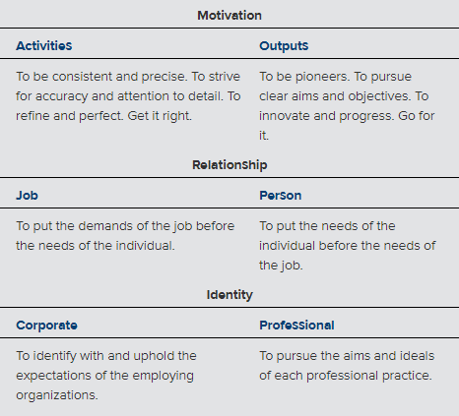
Table 6.1 - Dimensions of Corporate Culture

Slide 13
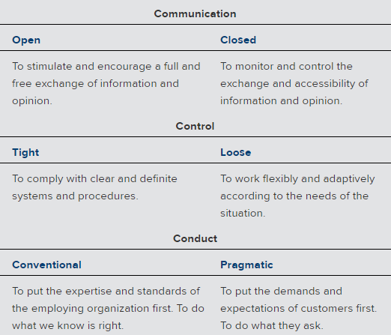
Table 6.1 - Dimensions of Corporate Culture (continued)

Slide 14
Interaction between National and Organizational Cultures (continued)
Even in the presence of multinational alliances, partners will bring different organizational cultures with them
Difficult for an MNC with a strong organizational culture to break into foreign markets
Unfamiliarity with divergent national cultures

Slide 15
Steps to Integrate Organizational Cultures
Two groups have to establish the purpose, goals, and focus of their merger
Mechanisms are developed to identify most important organizational structures and management roles
Groups have to determine who has authority over the resources
Identify the expectations of all involved parties and facilitate communication between departments and individuals in the structure

Slide 16
Determining Organizational Culture
Important aspects
General relationship between the employees and their organization
Hierarchical system of authority that defines the roles of managers and subordinates
General views that employees hold about the MNC’s purpose, destiny, goals, and their place in them

Slide 17
Figure 6.2 - Organizational Cultures

Slide 18
Family Culture
Strong emphasis on hierarchy and orientation to the person
Results in a family-type environment that is power-oriented and headed by a leader who is regarded as a caring parent
Management assumes a parental relationship with personnel
Ensures proper treatment of employees and their continued employment

Slide 19
Family Culture (continued)
Characterized by traditions, customs, and associations
Bind the personnel together
Make it difficult for outsiders to become members
Can catalyze and multiply energies of personnel and appeal to their deepest feelings and aspirations
Foreign to most managers in the United State

Slide 20
Eiffel Tower Culture
Strong emphasis on hierarchy and orientation to the task
Jobs are well defined, employees know what they are supposed to do, and all activities are coordinated from the top
Culture is narrow at the top and broad at the base
Relationships are specific, and status remains with the job

Slide 21
Eiffel Tower Culture (continued 1)
Managers seldom create off-the-job relationships with employees
Operates like a formal hierarchy, which is impersonal and efficient
Each role is described, rated for difficulty, complexity, and responsibility and has a salary attached to it
Jobs are awarded to the best fit between role and person

Slide 22
Eiffel Tower Culture (continued 2)
Learning involves the accumulation of skills necessary to fit a role, and organizations:
Use qualifications in deciding how to schedule, deploy, and reshuffle personnel to meet needs
Employ assessment centers, appraisal systems, training and development programs, and job rotation to manage personnel
Ill-equipped to handle things when changes need to be made

Slide 23
Guided Missile Culture
Strong emphasis on equality in the workplace and orientation to the task
Work-oriented culture where the work is undertaken by teams or project groups
Egalitarian and task-driven
Changes can happen quickly
Loyalty to profession and project are often greater than loyalty to the organization itself

Slide 24
Motivation in Guided Missile Culture
Tends to be more intrinsic
Team members become enthusiastic about, and identify with, the struggle toward attaining their goal
Helps minimize both intragroup and intergroup conflicts

Slide 25
Incubator Culture
Strong emphasis on equality and personal orientation
Little formal structure
Based on the premise that an organization’s role is to serve as incubators for self-expression and self-fulfillment of their members
Participants confirm, criticize, develop, and find resources for, or to help complete, the development of an innovation

Slide 26
Incubator Culture (continued)
Creates an environment where participants thrive on an intense, emotional commitment to the nature of work
Changes are fast and spontaneous
Motivation remains highly intrinsic and intense
Leadership is achieved and not gained by position

Slide 27
Table 6.3 - Summary Characteristics of the Four Corporate Cultures
Characteristic | Family | Eiffel Tower | Guided Missile | Incubator
Relationships between employees | Diffuse relationships to organic whole to which one is bonded | Specific role in mechanical system of required interaction | Specific tasks in cybernetic system targeted on shared objectives | Diffuse, spontaneous relationships growing out of shared creative process
Attitude toward authority | Status is ascribed to parent figures who are close and powerful | Status is ascribed to superior roles that are distant yet powerful | Status is achieved by project group members who contribute to targeted goal | Status is achieved by individuals exemplifying creativity and growth
Source: Adapted from Fons Trompenaars and Charles Hampden-Turner, Riding the Waves of Culture: Understanding Diversity in Global Business, 2nd ed. (New York: McGraw-Hill, 1998), p. 183.

Slide 28
Table 6.3 - Summary Characteristics of the Four Corporate Cultures (continued 1)
Characteristic | Family | Eiffel Tower | Guided Missile | Incubator
Ways of thinking and learning | Intuitive, holistic, lateral, and error correcting | Logical, analytical, vertical, and rationally efficient | Problem centered, professional, practical, and cross-disciplinary | Process oriented, creative, ad hoc, and inspirational
Attitudes toward people | Family members | Human resources | Specialists and experts | Co-creators
Ways of changing | “Father” changes course | Change rules and procedures | Shift aim as target moves | Improvise and attune
Ways of motivating and rewarding | Intrinsic satisfaction in being loved and respected | Promotion to greater position, larger role | Pay or credit for performance and problems solved | Participation in the process of creating new realities
Source: Adapted from Fons Trompenaars and Charles Hampden-Turner, Riding the Waves of Culture: Understanding Diversity in Global Business, 2nd ed. (New York: McGraw-Hill, 1998), p. 183.

Slide 29
Table 6.3 - Summary Characteristics of the Four Corporate Cultures (continued 2)
Characteristic | Family | Eiffel Tower | Guided Missile | Incubator
 | Management by subjectives | Management by job description | Management by objectives | Management by enthusiasm
Criticism and conflict resolution | Turn other cheek, save other’s face, do not lose power game | Criticism is accusation of irrationalism unless there are procedures to arbitrate conflicts | Constructive task-related only, then admit error and correct fast | Improve creative idea, not negate it
Source: Adapted from Fons Trompenaars and Charles Hampden-Turner, Riding the Waves of Culture: Understanding Diversity in Global Business, 2nd ed. (New York: McGraw-Hill, 1998), p. 183.

Slide 30
Multiculturalism and Diversity
Effect varies depending on the stage of the firm in its international evolution
Phase I - Domestic corporations
Phase II - International corporations
Phase III - Multinational corporations
Phase IV - Global corporations

Slide 31
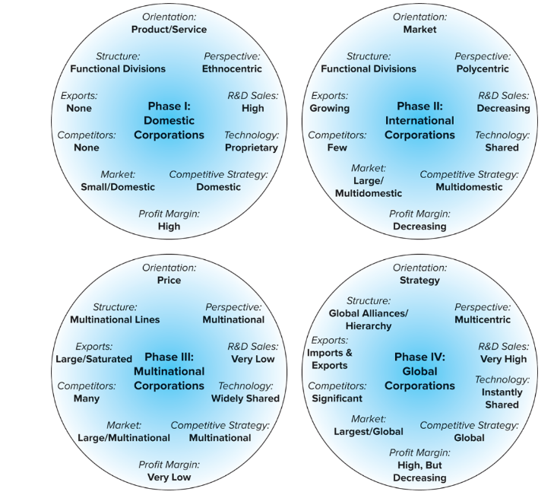
Figure 6.4 - International Corporation Evolution

Slide 32
Figure 6.5 - Locations of International Cross-Cultural Interaction

Slide 33
Impact of International Cultural Diversity
Domestic firms
Affect neither the firm’s organizational culture nor its relationship with its customers or clients
Can be impacted only by domestic multiculturalism
International firms
Strongly impact external relationships with potential buyers and foreign employees
Diversity focus is from the inside out

Slide 34
Domestic Multiculturalism
Culturally distinct populations can be found within organizations almost everywhere in the world
Can be examined within the same ethnic groups
Example - Among small Chinese family businesses, the viewpoints of the older generation differ sharply from those of the younger generation

Slide 35
Group Multiculturalism
Homogeneous groups
Members have similar backgrounds and generally perceive, interpret, and evaluate events in similar ways
Token groups
All members but one have the same background
Bicultural groups
Two or more members represent each of two distinct cultures
Multicultural groups
Composed of individuals from three or more different ethnic backgrounds

Slide 36
Potential Problems of Diversity
Rooted in people’s attitudes
Include:
Erroneous perceptions caused by preconceived stereotypes
Inaccurate biases
Inaccurate communication or miscommunication
Result of using unclear words, manner in which situations are interpreted, and differences in perceptions of time

Slide 37
Advantages of Diversity
Enhances creativity, leads to better decisions, and results in more effective and productive performance
Helps generate more and better ideas
Prevents groupthink
Social conformity and pressures on individual members of a group to conform and reach consensus
Enhances relationships with customers

Slide 38
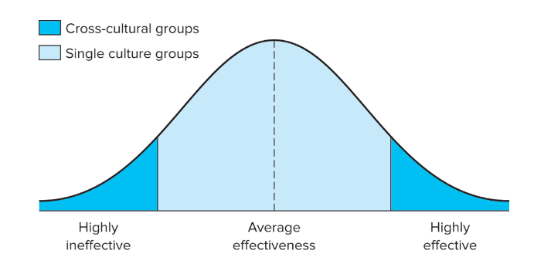
Figure 6.6 - Group Effectiveness and Culture

Slide 39
Multicultural Team Effectiveness
Focus of attention must be determined by the stage of team development
Entry stage - Focus on building trust and developing team cohesion
Work stage - Focus is directed toward describing and analyzing the problem or task that has been assigned
Action stage - Focus shifts to decision making and implementation

Slide 40
Multicultural Team Effectiveness - Guidelines
Select team members based on task-related abilities and not based on ethnicity
Team members must recognize and be prepared to deal with their differences
Team leader must help the group to identify and define its overall goal
Distribute power according to each person’s ability to contribute to the task
Provide the team with positive feedback on their process and output

Slide 41
In the International Spotlight - Nigeria
If you were a consultant for Filmhouse, how would you advise Kene Mpkaru regarding his next moves in Nigeria?
What specific aspects of the country would be positive for the company? What factors are negatives?
How would you deal with the wealth gap in the country?

Slide 42
In the International Spotlight - Nigeria (continued)
Would you advise Filmhouse to concentrate on Nollywood productions or would you try to attract Hollywood movies?

Slide 43
Review and Discuss
Some researchers have found that when Germans work for a U.S. MNC, they become even more German, and when Americans work for a German MNC, they become even more American
Why would this knowledge be important to these MNCs?

Slide 44
Review and Discuss (continued 1)
When comparing the negotiating styles and strategies of French versus Spanish negotiators, a number of sharp contrasts are evident
What are three of these, and what could MNCs do to improve their position when negotiating with either group?

Slide 45
Review and Discuss (continued 2)
In which of the four types of organizational cultures—family, Eiffel Tower, guided missile, incubator—would most people in the United States feel comfortable?
In which would most Japanese feel comfortable?
Based on your answers, what conclusions could you draw regarding the importance of understanding organizational culture for international management?

Slide 46
Review and Discuss (continued 3)
Most MNCs need not enter foreign markets to face challenges of dealing with multiculturalism
Do you agree or disagree with this statement?
Explain your answer

Slide 47
Review and Discuss (continued 4)
What are some potential problems that must be overcome when using multicultural, diverse teams in today’s organizations?
What are some recognized advantages?
Identify and discuss two of each
A number of guidelines can be valuable in helping MNCs to make diverse teams more effective
What are five of these?

