Slide 1
Chapter 14
HR Metrics and Workforce Analytics

Slide 2
TOPIC AND CHAPTER OBJECTIVES
Why metrics is a HOT topic
Metrics vs. workforce analytics
The need for decision making in order for metrics to be effective
The limitations of the traditional HR metrics
The role of benchmarking

Slide 3
TOPIC AND CHAPTER OBJECTIVES
Understanding: data mining and other related workforce analytics activities and presentations
HR dashboards
The needed organization impact of metrics and workforce analytics
What HRIS does to support workforce analytics/metrics

Slide 4
Brief History of Metrics
Days of scientific management – Taylor, and Organizational Psychology – 1911–1913
Saratoga Institute List / SHRM
Kaplan Nortan – balanced scorecard
Lean manufacturing
Six Sigma

Slide 5
MAIN OBJECTIVE OF HR METRICS AND WORKFORCE ANALYTICS
HR metrics and analytics compose an information system
Managers make different and better decisions as a result of information
Decisions have an impact on company’s strategy and goals
Causes demand for more metrics

Slide 6
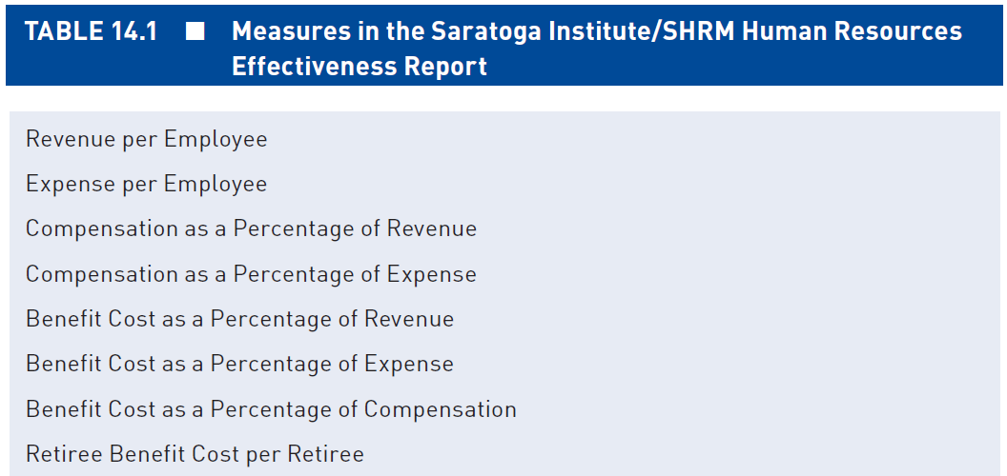
25 OF 30 SUGGESTED HR METRICS – SARATOGA/SHRM

Slide 7
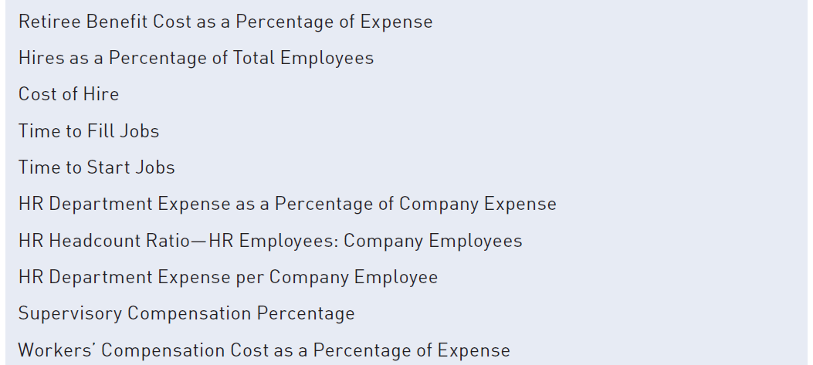
25 OF 30 SUGGESTED HR METRICS – SARATOGA/SHRM

Slide 8
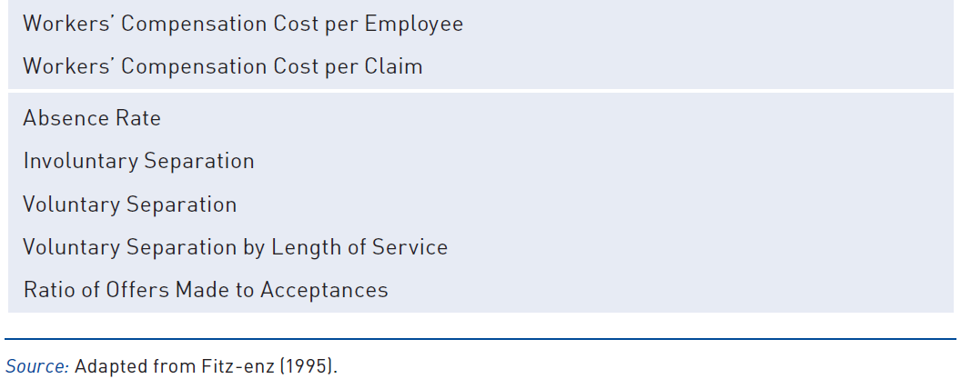
25 OF 30 SUGGESTED HR METRICS – SARATOGA/SHRM

Slide 9
USING HR METRICS AND WORKFORCE ANALYTICS
Metrics are data that reflect descriptive detail about organizational outcomes or processes.
Analytics refer to strategies for combining data elements into metrics for examining relationships.
Understanding these combinations help managers make more informed and better decisions.

Slide 10
LIMITATION OF METRICS
Many derived solely from accounting systems
Focus on costs – limited value to strategy
If managers are only provided information about costs, with little or no information about benefits, costs are likely to become the primary driver of managerial decisions. This perpetuates the still common perception of HR as a “cost center.”

Slide 11
LIMITATION OF METRICS
Tended to aggregate data to the level of the organization. As such, they offer limited information that could be used to identify and diagnose within-organization differences.
“After the Fact”
This results in slow responses to problems or opportunities. Because they provide data “after the fact,” these are described as “feedback” metrics.

Slide 12
HR METRICS AND WORKFORCE ANALYTICS
Major distinction between them
Metrics are data (numbers) that reflect some detail about given outcomes (e.g., success in recruiting new employees)
Metrics reflect characteristics of the organization’s HR programs and activities.
Analytics refer to strategies for combining data elements into metrics and for examining relationships or changes in metrics.

Slide 13
WORKFORCE ANALYTICS
Workforce analytics refer to strategies for combining data elements into metrics and for examining relationships or changes in metrics. Understanding these combinations is done to inform managers about the current or changing state of human capital in an organization in a way that can impact managerial decision making.

Slide 14
WORKFORCE ANALYTICS
The importance of this view is that the analytics an organization needs depend on the problems and opportunities that currently face its managers. Understanding what opportunities and problems managers face suggest relevant analyses that can support better decisions. These analyses then determine what metrics the organization needs in order to compute these analyses and how those metrics should be calculated.

Slide 15
HR ACTIVITIES AS PART OF METRICS AND ANALYTICS USAGE
Reporting
Dashboards
Benchmarking
Data mining
Predictive analyses
Operational experiments
Workforce modeling
Better problem solving and decision making

Slide 16
BENCHMARKING
The Saratoga Institute’s benchmarking efforts were the first to develop information on standard HR metrics regarding the use and management of human capital. Benchmarking data is useful in that it provides insights into what is possible.
However, a challenge in using HR metrics as benchmark data is that an organization’s human resource practices and the use of its HR staff reflect current challenges facing that organization. As a result, most organizations have an HR department, but the specific functions performed by these departments vary widely across organizations.

Slide 17
BENCHMARKING
Consequently, direct comparisons of HR benchmarking data from one’s own organization to data from other organizations may not provide realistic guidelines for either goal setting or forecasting the potential effectiveness of remedial actions an organization might undertake.

Slide 18
BIG DATA AND DATA MINING
Data mining refers to efforts to identify patterns that exist within data and that may identify unrecognized causal mechanisms that can be used to enhance decision making.
To identify these causal mechanisms, data mining uses correlation and multiple regression methods to identify patterns of relationships in extremely large datasets.

Slide 19
BIG DATA AND DATA MINING
Data mining has a number of important applications, but the caveat with its use is that it can also uncover spurious and nonsensical relationships (e.g., taller employees make better leaders; older employees have longer tenures).
Current interest in Big Data reflects efforts to analyze the extremely large data sets created by many transaction systems. Often these datasets can be many terabytes (210 gigabytes) or more.

Slide 20
BIG DATA AND DATA MINING
Many web-based applications and transaction sites, like those generated by Amazon.com, Google, and many social media sites, generate large numbers of transactions.
Efforts in Big Data reflect attempts to mine these very large data sets for patterns that can provide additional insight for managers about customer preferences or process characteristics that managers can use to drive greater sales, increase customer satisfaction, and reduce costs.

Slide 21
PREDICTIVE ANALYSIS/SCORECARDS
Predictive analysis involves attempts to develop models of organizational systems that can be used to predict future outcomes and understand the consequences of hypothetical changes in organizations.
For example, if the organization discovered a correlation between employee job satisfaction and turnover, HR could use these data to suggest modifications to the employees’ work situation or their benefits.

Slide 22
PREDICTIVE ANALYSIS/SCORECARDS
Efforts to develop balanced scorecards are examples of elementary predictive systems. They involve identifying leading indicators of important organizational outcomes and the nature of the relationships expected to lead to them.
Engaging in efforts to test the assumptions in these models over time can lead to enhancements in the quality of the models’ underlying predictive analyses, either by identifying additional leading indicators or better specifying the nature of the relationships between predictors and outcomes.

Slide 23
OPERATIONAL EXPERIMENTS
The evidence-based management movement argues that managers should base their decisions on data drawn from the organization and evidence about the actual functioning of its systems rather than using personal philosophies or untested personal models or assumptions about “how things work.” One of the most effective methods for developing the evidence on which to base decisions is through operational experiments conducted within the organization.
Michael J. Kavanagh and Richard D. Johnson - Human Resource Information Systems: Basics, Applications, and Future Directions, 3e © 2012 SAGE Publications, Inc.

Slide 24
OPERATIONAL EXPERIMENTS
Google uses operational experiments to test the effectiveness of the ad words used on its website. Rather than simply relying on intuition or “expert judgment” about which ad wording is more effective, it creates an experiment. It configures its site to alternate the presentation of competing ad text to visitors to its site and then tracks the number of “click-throughs” on the ad for a period of time. Given the large number of daily hits, Google can get objective data on the effectiveness of the various ads in a relatively short time and then adopt the ad wording demonstrated to be most effective.
Michael J. Kavanagh and Richard D. Johnson - Human Resource Information Systems: Basics, Applications, and Future Directions, 3e © 2012 SAGE Publications, Inc.

Slide 25
WORKFORCE MODELING
Workforce modeling attempts to understand how an organization’s human capital needs would change as a function of some expected change in the organization’s environment. This change may be a shift in the demand for the organization’s product, entry into a new market, divestiture of one of the organization’s businesses, or a pending acquisition of or merger with another organization.

Slide 26
DASHBOARDS AND INFOGRAPHS
Dashboards are a component of reporting. Dashboards reflect efforts to align real-time analysis of organizational and HR processes, as well as an increased capacity to aggregate organizational data.
In many instances, pictures can provide a more compelling way to present the story resulting from an analysis, particularly when that story is based on complex analyses that build upon insights from a number of different data sources. Infographs combine a number of data elements, often incorporating pictures, figures, tables, and text to help tell a story more effectively than can be done by any of these elements.

Slide 27
USING METRICS AND ANALYTICS FOR MEASUREMENT
Getting Started – Determine problem and organizational outcomes
Identify the “why” of addressing problem
Put HR metrics and analytics in context
Reporting results to managerial decision-makers
Push methods
Pull methods

Slide 28
REMEMBER
Don’t “do metrics”
Bigger is not always better
HR metrics and analytics is a journey—not a destination
Be willing to learn
Avoid the temptation to measure everything aggressively

Slide 29
THE FUTURE? IS NOW
A definite competitive advantage
Tools exists TODAY
Computing infrastructure is in place
Cloud makes it accessible all the time
Vendors are building better templates of dashboards
Vendors integrating metrics in standard product deliverables

Slide 30
THE FUTURE? IS NOW
By using HR metrics and workforce analytics, decision-makers will acquire the ability to more effectively manage and improve HR programs and processes, as well as to improve the effectiveness of HRIS use. Using this acquired ability, managerial decision-makers may be able to modify entire employment systems to manage the company’s human capital more effectively.

