Slide 1
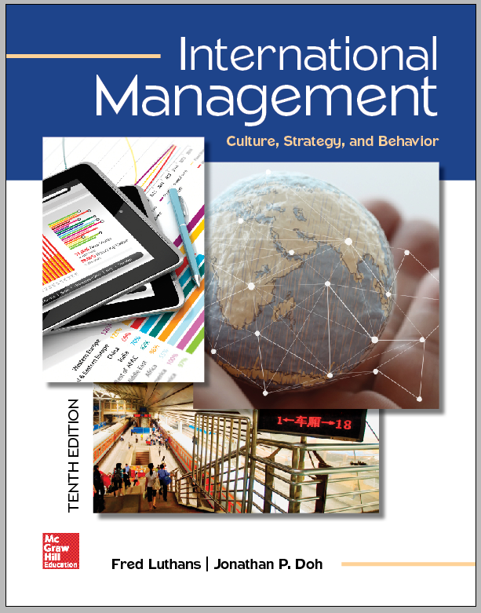
International Management
© 2018 by McGraw-Hill Education. This is proprietary material solely for authorized instructor use. Not authorized for sale or distribution in any manner. This document may not be copied, scanned, duplicated, forwarded, distributed, or posted on a website, in whole or part.

Slide 2
Chapter 4
The Meanings and Dimensions of Culture

Slide 3
Learning Objectives
Define the term culture, and discuss some of the comparative ways of differentiating cultures
Describe the concept of cultural values, and relate some of the international differences, similarities, and changes occurring in terms of both work and managerial values

Slide 4
Learning Objectives (continued)
Identify the major dimensions of culture relevant to work settings, and discuss their effects on behavior in an international environment
Discuss the value of country cluster analysis and relational orientations in developing effective international management practices

Slide 5
Culture
Acquired knowledge that people use to interpret experience and generate social behavior
Forms values
Creates attitudes
Influences behavior

Slide 6
Characteristics of Culture
Learned
Shared
Transgenerational
Symbolic
Patterned
Adaptive

Slide 7
Areas Affected by Culture
Technology transfer
Managerial attitudes
Managerial ideology
Business-government relations
Human thinking and behavior

Slide 8
Priorities of Cultural Values
United States | Japan | Arab Countries
Freedom | Belonging | Family security
Independence | Group harmony | Family harmony
Self-reliance | Collectiveness | Parental guidance
Equality | Age/seniority | Age
Individuality | Group consensus | Authority
Competition | Cooperation | Compromise
Efficiency | Quality | Devotion
Time | Patience | Patience
Directness | Indirectness | Indirectness
Openness | Go-between | Hospitality

Slide 9
Cultural Impact on International Management: Centralized versus Decentralized Decision Making
Centralized - Top managers make all important organizational decisions
Decentralized - Decisions are diffused throughout the enterprise
Middle- and lower-level managers actively participate in and make key decisions

Slide 10
Cultural Impact on International Management: Safety versus Risk
Organizational decision makers are risk-averse and have great difficulty with conditions of uncertainty in some societies
Some societies encourage risk taking and decision making under uncertainty is common

Slide 11
Cultural Impact on International Management: Individual versus Group Rewards
Individual rewards - Given to personnel who do outstanding work in the form of bonuses and commissions
Group rewards - Required by cultural norms, and individual rewards are frowned upon

Slide 12
Cultural Impact on International Management: Informal versus Formal Procedures
Informal societies - Much is accomplished through informal means
Formal societies - Formal procedures are set forth and followed rigidly

Slide 13
Cultural Impact on International Management: High versus Low Organizational Loyalty
High loyalty - People identify very strongly with their organization or employer
Low loyalty - People identify with their occupational group
Such as engineer or mechanic

Slide 14
Cultural Impact on International Management: Cooperation versus Competition
Some societies encourage cooperation between their people
Others societies encourage competition between their people

Slide 15
Cultural Impact on International Management: Short-term versus Long-term Horizons
Some cultures focus most heavily on short-term horizons
Such as short-range goals of profit and efficiency
Some cultures are more interested in long-range goals
Such as market share and technological developments

Slide 16
Cultural Impact on International Management: Stability versus Innovation
Culture of some countries encourages stability and resistance to change
Culture of others puts high value on innovation and change

Slide 17
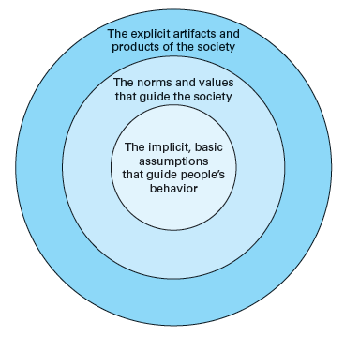
Figure 4.1 - Model of Culture

Slide 18
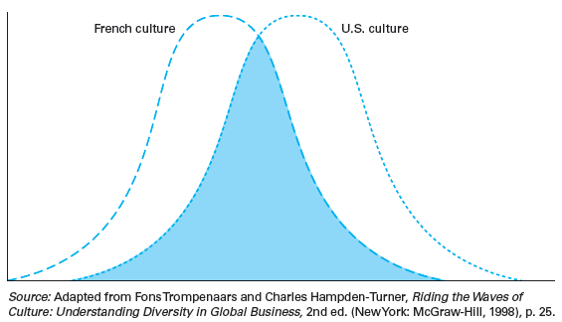
Figure 4.2 - Comparing Cultures as Overlapping Normal Distributions

Slide 19
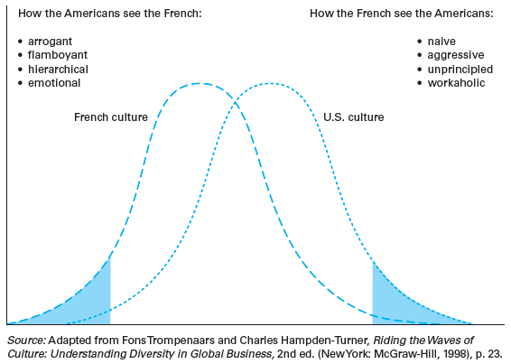
Figure 4.3 - Stereotyping from Cultural Extremes

Slide 20
Values
Basic convictions that people have about:
Right and wrong
Good and bad
Important and unimportant
Learned from the culture in which an individual is reared
Differences in cultural values may result in varying management practices

Slide 21
Hofstede’s Cultural Dimensions
Power distance
Uncertainty avoidance
Individualism and collectivism
Masculinity and femininity
Time orientation
Indulgence versus restraint

Slide 22
Power Distance
Extent to which less powerful members accept that power is distributed unequally
High-power-distance countries
People blindly obey superiors
Centralized with tall organizational structures
Examples - Mexico, South Korea, and India
Low-power-distance countries
Decentralized with flatter organizational structures
Have smaller ratio of supervisor to employee

Slide 23
Uncertainty Avoidance
Extent to which people feel threatened by ambiguous situations and have created beliefs and institutions that try to avoid these
High-uncertainty-avoidance countries
High need for security and strong belief in experts and their knowledge
Highly structured organizational activities, more written rules, and less managerial risk taking

Slide 24
Uncertainty Avoidance (continued)
Low-uncertainty-avoidance countries
Less structured organizational activities, fewer written rules, more managerial risk taking, higher labor turnover, and more ambitious employees

Slide 25
Individualism and Collectivism
Individualism: Tendency of people to look after themselves and immediate family only
Highly individualistic countries - Wealthier, support the Protestant work ethic, have greater individual initiative, and promote based on market value
Collectivism: Tendency of people to belong to groups and to look after each other in exchange for loyalty

Slide 26
Masculinity and Femininity
Masculinity: Dominant social values are success, money, and things
Femininity: Dominant social values are caring for others and quality of life

Slide 27
Time Orientation
Defined as dealing with society’s search for virtue
Long-term-oriented societies - Focus on the future and on achieving long-term results, are able to adapt traditions when conditions change, and tend to save and invest
Short-term-oriented societies - Focus on quick results, do not tend to save, believe in absolutes, and value stability and leisure

Slide 28
Indulgence versus Restraint
Indulgent societies encourage instant gratification of natural human needs
Perceived happiness, life in control, positive emotions, and satisfaction of basic needs
Restrained cultures regulate and control behavior based on social norms
Less happiness, sense of helplessness, less likely to remember positive emotions, and unmet basic needs

Slide 29
Trompenaars’s Cultural Dimensions
Universalism versus particularism
Individualism versus communitarianism
Neutral versus emotional
Specific versus diffuse
Achievement versus ascription
Time
Environment

Slide 30
Universalism versus Particularism
Universalism: Belief that ideas and practices can be applied everywhere without modification
Countries with high universalism - Formal rules and close adherence to business contracts
U.S., UK, Germany, Sweden, and Australia

Slide 31
Universalism versus Particularism (continued)
Particularism: Belief that circumstances dictate how ideas and practices should be applied
Countries with high particularism - Legal contracts are modified and the way deals are executed change as people get to know each other
China, Indonesia, and Venezuela

Slide 32
Individualism versus Communitarianism
Individualism - People regard themselves as individuals
Stress personal and individual matters and assume personal responsibility
Communitarianism: People regard themselves as part of a group
Value group-related issues, achieve in groups, and assume joint responsibility

Slide 33
Neutral Culture versus Emotional Culture
Neutral: Emotions are held in check
High-neutral cultures - People act stoically and maintain composure
Emotional: Emotions are expressed openly and naturally
High-emotional cultures - People smile a lot, talk loudly, and greet each other with enthusiasm

Slide 34
Specific versus Diffuse
Specific culture
Large public space is shared with others and small private space is guarded closely and shared with only close friends
People are open and extroverted and have a strong separation of work and personal life

Slide 35
Specific versus Diffuse (continued)
Diffuse culture
Public and private spaces are similar in size
Public space is guarded because entry into public space affords entry into private space
People are indirect and introverted and work and private life are closely linked

Slide 36
Achievement versus Ascription
Achievement culture: People are accorded status based on how well they perform their functions
High status is given to high achievers
Ascription culture: Status is attributed based on who or what a person is
Status is based on age, gender, or social connections

Slide 37
Time Orientation
Sequential - Only one activity at a time, appointments are kept strictly, and plans are followed as laid out
Synchronous - Multitasking, appointments are approximate and easily changed, and schedules are subordinate to relationships
Cultures can be past- or present-oriented or future-oriented

Slide 38
Dealing with Environment
Inner-directed - People believe in controlling outcomes
Dominant attitude toward environment
Outer-directed - People believe in letting things take their own course
Flexible attitude, characterized by a willingness to compromise and maintain harmony with nature

Slide 39
GLOBE Project
GLOBE - Global Leadership and Organizational Behavior Effectiveness
Extends and integrates previous analyses of cultural attributes and variables
Evaluates nine different cultural attributes using middle managers from different organizations in many countries

Slide 40
Phases of GLOBE Project
First two phases - Evaluate nine different cultural attributes using middle managers from different organizations in many countries
Scholars surveyed managers in financial services, food processing, and telecommunications industries
Third phase - Examines the interactions of culture and leadership in upper-level management positions

Slide 41
GLOBE's Cultural Dimensions
Uncertainty avoidance
Power distance
Collectivism I: Societal collectivism
Collectivism II: In-group collectivism
Gender egalitarianism
Assertiveness
Future, performance, and humane orientations

Slide 42
GLOBE Country Analysis
Corresponds with those of Hofstede and Trompenaars
Variations - Variable definitions and methodology
GLOBE provides a current comprehensive overview of general stereotypes that can be analyzed for greater insight

Slide 43
Be the Management Consultant
As a consultant looking for opportunities in Africa, how would you gauge the prospects of moving a business into South Africa?
What are your immediate concerns about this move? What are the pros and cons of opportunities in South Africa?

Slide 44
Be the Management Consultant (continued)
How does the fact that traditional South African companies are increasing their presence in other African countries factor into your decision?

Slide 45
Review and Discuss
What is meant by the term culture?
In what way can measuring attitudes about the following help differentiate between cultures: centralized or decentralized decision making, safety or risk, individual or group rewards, high or low organizational loyalty, cooperation or competition?
Use these attitudes to compare the United States, Germany, and Japan, and based on your comparisons, what conclusions can you draw regarding the impact of culture on behavior?

Slide 46
Review and Discuss (continued 1)
What is meant by the term value?
Are cultural values the same worldwide, or are there marked differences?
Are these values changing over time, or are they fairly constant?
How does your answer relate to the role of values in a culture?

Slide 47
Review and Discuss (continued 2)
What are the four major dimensions of culture studied by Geert Hofstede?
Identify and describe each
What is the cultural profile of the United States? Of Asian countries? Of Latin American countries? Of Latin European countries?
Based on your comparisons of these four profiles, what conclusions can you draw regarding cultural challenges facing individuals in one group when they interact with individuals in one of the other groups?

Slide 48
Review and Discuss (continued 3)
Why do you think Hofstede added the fifth dimension of time orientation and the sixth dimension related to indulgence versus restraint?
As people engage in more international travel and become more familiar with other countries, will cultural differences decline as a roadblock to international understanding, or will they continue to be a major barrier?
Defend your answer

Slide 49
Review and Discuss (continued 4)
What are the characteristics of each of the following pairs of cultural characteristics derived from Trompenaars’s research: universalism vs. particularism, neutral vs. emotional, specific vs. diffuse, achievement vs. ascription?
Compare and contrast each pair

Slide 50
Review and Discuss (continued 5)
How did project GLOBE build on and extend Hofstede’s analysis? What unique contributions are associated with project GLOBE?
In what way is time a cultural factor? In what way is the need to control the environment a cultural factor?
Give an example for each

