Slide 1
International Management
© 2018 by McGraw-Hill Education. This is proprietary material solely for authorized instructor use. Not authorized for sale or distribution in any manner. This document may not be copied, scanned, duplicated, forwarded, distributed, or posted on a website, in whole or part.

Slide 2
Chapter 3
Ethics, Social Responsibility, and Sustainability

Slide 3
Learning Objectives
Examine ethics in international management and some of the major ethical issues and problems confronting MNCs
Discuss some of the pressures on and actions being taken by selected industrialized countries and companies to be more socially and environmentally responsive to world problems

Slide 4
Learning Objectives (continued)
Explain some of the initiatives to bring greater accountability to corporate conduct and limit the impact of corruption around the world

Slide 5
Sustaining Sustainable Companies
Shift in focus from traditional market-responsive strategies to broader approaches
Help incorporate business and social or environmental goals
Triple bottom line approach
Simultaneously considers social, environmental, and economic sustainability
Could help harness business and managerial skills to impact human and environmental conditions

Slide 6
Ethics
Study of morality and standards of conduct
Victim of subjectivity as it yields to the will of cultural relativism
Cultural relativism - Belief that:
Ethical standard of a country is based on the culture that created it
Moral concepts lack universal application

Slide 7
Ethical Dilemmas
Dilemmas arising from conflicts between ethical standards of a country and business ethics are most evident in:
Employment and business practices
Recognition of human rights, including women in the workplace
Corruption

Slide 8
Corporate Social Responsibility (CSR) versus Ethics
CSR
Actions taken by a firm to benefit society beyond the requirements of the law and the direct interests of the firm
Based more on voluntary actions
Ethics
Study of or the learning process involved in understanding morality
Area of ethics has a lawful component and implies right and wrong in a legal sense

Slide 9
Ethical Theories and Philosophy
Kantian philosophical traditions
Aristotelian virtue ethics
Utilitarianism
Eastern philosophy

Slide 10
Kantian Philosophical Traditions
Entities have responsibilities based on a core set of moral principles that go beyond those of narrow self-interest
Reject consequences as morally irrelevant when evaluating the choice of an agent
Ask one to consider choices as implying a general rule, or maxim
Must be evaluated for its consistency as a universal law

Slide 11
Aristotelian Virtue Ethics
Focus on core, individual behaviors and actions and how they express and form individual character
Consider social and institutional arrangements and practices in terms of their contribution to the formation of good character in individuals
For Aristotle, moral success and failure largely come down to a matter of right desire, or appetite

Slide 12
Aristotelian Virtue Ethics (continued)
Virtue theory
States that one’s formation is a social process
Relies heavily on existing practices to provide an account of:
What is good
What character traits contribute to pursuing and realizing the good in concrete ways

Slide 13
Utilitarianism
Form of consequentialism
Favors the greatest good for the greatest number of people under a given set of constraints
Acts are morally correct if they maximize utility
Attained when the ratio of benefit to harm is greater than the ratio resulting from an alternative act

Slide 14
Eastern Philosophy
Broadly includes various philosophies of Asia
Indian philosophy, Chinese philosophy, Iranian philosophy, Japanese philosophy, and Korean philosophy
Holds that:
People are an intrinsic and inseparable part of the universe
Attempts to discuss the universe from an objective viewpoint are inherently absurd

Slide 15
Human Rights Issues
Present challenges for MNCs
Absence of universally adopted standards of what constitutes acceptable behavior
Basic rights
Life, freedom from slavery or torture, freedom of opinion and expression, and a general ambiance of nondiscriminatory practices
Women’s rights and gender equity can be considered a subset of human rights

Slide 16
Issues Faced by Women in the Workplace
Most still experience the effects of a glass ceiling
Lack of promotions to upper management positions
Partially due to social factors and perceived levels of opportunity or lack thereof
Pervasive throughout the world

Slide 17
Issues Faced by Women in the Workplace - Examples
Japan
Women employees are subject to sexual harassment, two-track recruiting processes, and unequal opportunities for growth
France, Germany, and Great Britain
Witnessed an increase in the number of women in managerial positions but only in low-level managerial positions

Slide 18
Labor Policy Issues
Political, economic, and cultural differences interfere with the establishment of a universal foundation for employment practices
Difficulty in deciding working conditions, expected consecutive work hours, and labor regulations
Frequent offshoring due to differences in labor costs
Ensuring that all contractors along the global supply chain are compliant with company standards

Slide 19
Labor, Employment, and Business Practices in China
Workers are not paid well
Forced to work 12-hour days, seven days a week to meet demand
Some cases involve the usage of child labor
Example - Foxconn
2010 - Issue of low wages headlined after a number of workers committed suicide

Slide 20
Environmental Protection and Development
Poor countries are more focused on improving the welfare of their citizens
Environmental Kuznets Curve (EKC)
Relationship between per capita income and the use of natural resources and/or the emission of wastes has an inverted U-shape

Slide 21
Environmental Kuznets Curve (EKC)
Reasons behind the inverted U-shape of the EKC
Composition of production and/or consumption
Preference for environmental quality
Institutions that are needed to internalize externalities
Increasing returns to scale associated with pollution abatement

Slide 22
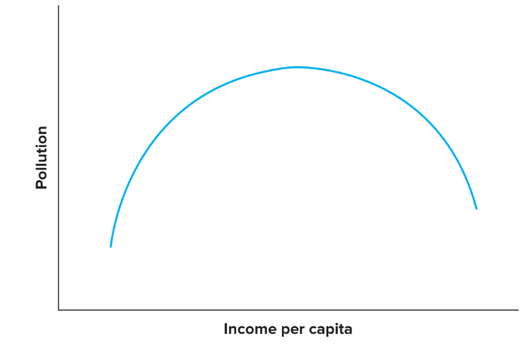
Figure 3.1 - Environmental Kuznets Curve

Slide 23
Environmental Protection and Development (continued)
United Nations Climate Change Conference, 2015
Tried to achieve an international consensus on environmental reform
Adopted the Paris Agreement

Slide 24
Phenomena in Response to Globalization
Difficulty in attempts to balance organizational and cultural roots
Offshoring low-cost labor-intensive practices
Transferring a large percentage of current employees of all types to foreign locations
Creates issues related to corporate citizenship

Slide 25
Reconciling Ethical Differences across Cultures
Integrative Social Contracts Theory (ISCT)
Attempts to navigate a moral position that does not force decision makers to engage exclusively in relativism versus absolutism
Offers one framework to help reconcile fundamental contradictions in international business ethics between home and host countries

Slide 26
Corporate Social Responsibility (CSR)
Social, economic, and environmental expectations of each company are based on the desires of the stakeholders
Pressurize MNCs to pay greater attention to CSR
Nongovernmental organizations (NGO)
Private, not-for-profit organizations
Seek to serve society’s interests by focusing on social, political, and economic issues

Slide 27
Nongovernmental Organizations
Urge MNCs to be more responsive to a range of social needs in developing countries
Activism has helped generate substantial changes in corporate management, strategy, and governance
Regarded as counterweights to business and global capitalism

Slide 28
Nongovernmental Organizations (continued)
Collaborate with MNCs on social and environmental projects
Contribute to the well-being of the community and to the reputation of the MNC

Slide 29
Responses to Social and Organizational Obligations
MNCs follow codes of conduct, including the U.N. Global Compact, the Global Reporting Initiative, and “SA8000” standards
Commit to maintain certain standards in their domestic and global operations
Help offset the concern that companies move jobs to avoid higher labor or environmental standards
Contribute to raising the standards in the developing world

Slide 30
Responses to Social and Organizational Obligations (continued)
Fair trade
Organized social movement and market-based approach
Aims to help producers in developing nations obtain better trading conditions and promote sustainability

Slide 31
Sustainability
Development that meets humanity’s needs without harming future generations
Helps companies recognize that dwindling resources will eventually halt productivity
World Economic Forum, Davos, Switzerland
Focused on how sustainable consumption can be used to ease problems related to the need for rapid business scaling

Slide 32
Corporate Governance
System by which businesses are directed and controlled
Specifies distribution of rights and responsibilities among stakeholders
Spells out rules and procedures for corporate decision-making
Provides the structure for setting company objectives and means for attaining those objectives and maintaining performance

Slide 33
Corporate Governance (continued)
Rules and regulations differ among countries and regions
The UK and U.S. systems are outsider systems because of dispersed ownership of equity among a large number of outside investors
Many continental European countries are insider systems in which ownership is more concentrated
Differences in legal systems affect shareholders’ and other stakeholders' rights

Slide 34
Corporate Governance: Crony Capitalism
Occurs in nations with:
Less well-developed legal and institutional protections
Poor property rights
Emerges where weak corporate governance and government interference can lead to:
Poor performance
Risky financing patterns
Macroeconomic crises

Slide 35
Foreign Corrupt Practices Act (FCPA)
Makes it illegal for U.S. companies and their managers to attempt to influence foreign officials through:
Personal payments
Political contributions
In complying with the provisions, U.S. firms must be aware of changes in the law
Makes FCPA violators subject to Federal Sentencing Guidelines

Slide 36
Other Anticorruption Measures
Formal agreement by many industrialized nations to outlaw the practice of bribing foreign government officials
Includes nations that belong to the Organization for Economic Cooperation and Development (OECD)
Fails to outlaw most payments to political party leaders but does indicate growing support for antibribery initiatives

Slide 37
Other Anticorruption Measures (continued)
Organization of American States (OAS) Inter-American Convention Against Corruption
Established by Latin American countries
Transparent Agents Against Contracting Entities (TRACE) standard
Developed as a means of preventing the shift of corrupt practices to suppliers and intermediaries

Slide 38
International Assistance
Governments and corporations are collaborating to provide assistance to locales through global partnerships
Recent study identified the top priorities around the world for development assistance
Uses a cost-benefit analysis of where investments would have the greatest impact

Slide 39
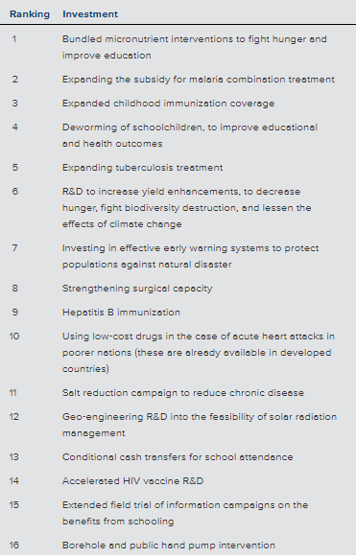
Table 3.3 - Copenhagen Consensus Development Priorities
Source: Copenhagen Consensus 2012.

Slide 40
U.N. Sustainable Development Goals
Poverty - End poverty in all its forms everywhere
Food - End hunger, achieve food security and improved nutrition, and promote sustainable agriculture
Health - Ensure healthy lives and promote well-being for all at all ages

Slide 41
U.N. Sustainable Development Goals (continued 1)
Education - Ensure inclusive and equitable quality education and promote lifelong learning opportunities for all
Women - Achieve gender equality and empower all women and girls
Water - Ensure availability and sustainable management of water and sanitation for all

Slide 42
U.N. Sustainable Development Goals (continued 2)
Energy - Ensure access to affordable, reliable, sustainable, and modern energy for all
Economy - Promote sustained, inclusive, and sustainable economic growth; full and productive employment; and decent work for all
Infrastructure - Build resilient infrastructure, promote inclusive and sustainable industrialization, and foster innovation

Slide 43
U.N. Sustainable Development Goals (continued 3)
Inequality - Reduce inequality within and among countries
Habitation - Make cities and human settlements inclusive, safe, resilient, and sustainable
Consumption - Ensure sustainable consumption and production patterns
Climate - Take urgent action to combat climate change and its impacts

Slide 44
U.N. Sustainable Development Goals (continued 4)
Marine ecosystems - Conserve and sustainably use the oceans, seas, and marine resources for sustainable development
Ecosystems - Protect, restore, and promote sustainable use of terrestrial ecosystems; sustainably manage forests; combat desertification; halt and reverse land degradation; and halt biodiversity loss

Slide 45
U.N. Sustainable Development Goals (continued 5)
Institutions - Promote peaceful and inclusive societies for sustainable development; provide access to justice for all; and build effective, accountable, and inclusive institutions at all levels
Sustainability - Strengthen the means of implementation and revitalize the global partnership for sustainable development

Slide 46
In the International Spotlight - Cuba
Would you advise a company to become an early investor in Cuba?
Do you think Airbnb’s investment in Cuba will eventually see success and become a reliable profit stream?
Do you think Cuba will ultimately become an attractive long-term tourist destination for Americans?

Slide 47
Review and Discuss
How might different ethical philosophies influence how managers make decisions when it comes to offshoring of jobs?
What lessons can U.S. multinationals learn from the political and bribery scandals in recent years, such as those affecting contractors doing business in Iraq (Halliburton) as well as large MNCs such as Siemens, HP, and others? Discuss two

Slide 48
Review and Discuss (continued 1)
In recent years, rules have tightened such that those who work for the U.S. government in trade negotiations are now restricted from working for lobbyists for foreign firms
Is this a good idea? Why or why not?

Slide 49
Review and Discuss (continued 2)
What are some strategies for overcoming the impact of counterfeiting?
Which strategies work best for discretionary (for instance, movies) versus nondiscretionary (pharmaceutical) goods?

Slide 50
Review and Discuss (continued 3)
Why are MNCs getting involved in corporate social responsibility?
Are they displaying a sense of social responsibility, or is this merely a matter of good business? Defend your answer

