Slide 1
ITS 832
Week 4: Blockchain Applications
Dr. Grimes

Slide 2
Objectives
By the end of this week, you should be able to:
Describe blockchain uses in a social setting
Explain how blockchain can be used in a digital economy

Slide 3
Blockchain Outside of Currencies
Digital currencies were the first application of blockchain technology
This lesson we will discuss using blockchain in:
Internet of Things (IoT)
Government (public sector)
Health care
Finance

Slide 4
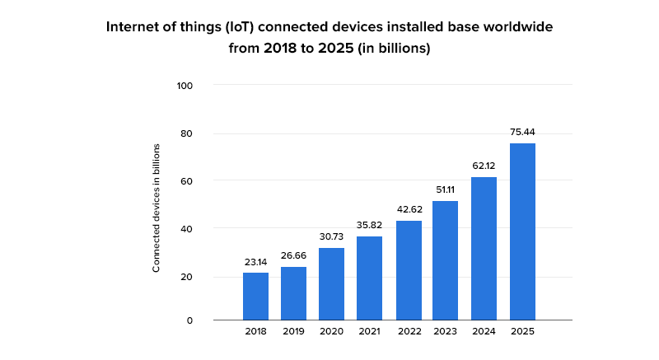
IoT
Also referred to as the Internet of Everything (IoE).
Estimate by 2025: 75.44 billion connected IoT devices

Slide 5
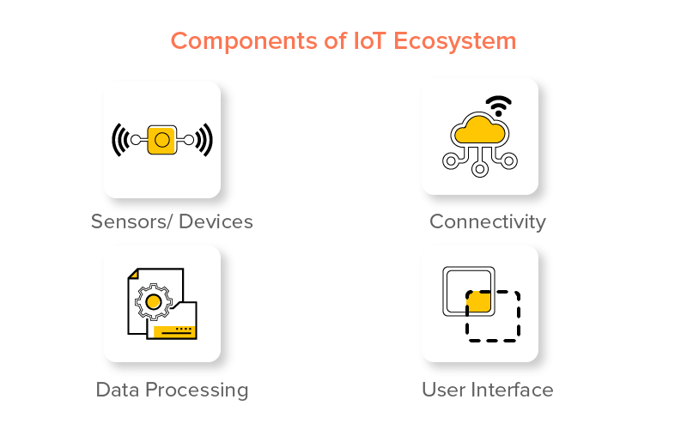
IoT Technology
4 Major Components of IOT
Sensors/Devices
Connectivity
Data Processing
User Interface

Slide 6
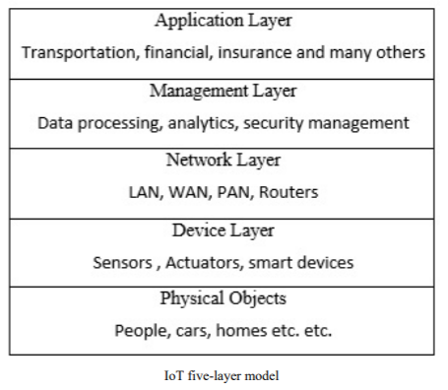
IoT Layers

Slide 7
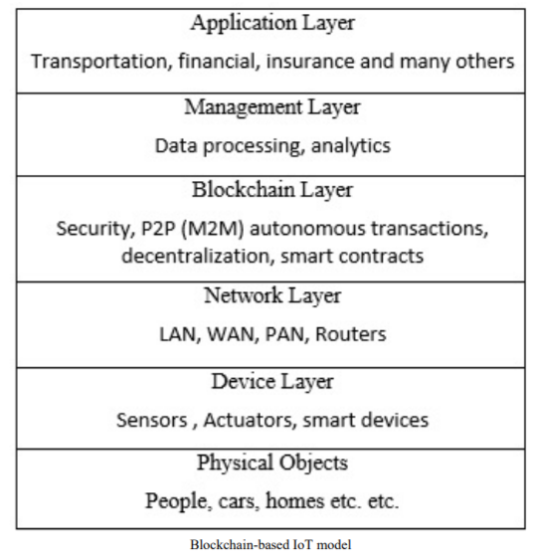
IoT and Blockchain

Slide 8
Government Use Cases
Border control
Voting
ID

Slide 9
Health Use Cases
Electronic Medical Records
Insurance
Distribution of pharmaceuticals

Slide 10
Assignments
Read
Textbook, Chapter 11: Mastering Blockchain http://search.ebscohost.com/login.aspx?direct=true&AuthType=shib&db=nlebk&AN=1488410&site=eds-live.
Kshetri, N. (2017). Will blockchain emerge as a tool to break the poverty chain in the Global South? Third World Quarterly, 38(8), 1710–1732. https://doi.org/10.1080/01436597.2017.1298438
Varghese, J. J., Sharma, D., & Singh, N. K. (2019). Analysing the Impact of Blockchain Technology in India’s Digital Economy. Global Journal of Enterprise Information System, 10(3), 94–99. https://doi.org/10.18311/gjeis/2019
Research paper
Find a peer-reviewed scholarly journal article discussing blockchain technology. Complete a review of the article by writing a 2-3 page overview of the article. This will be a detailed summary of the journal article, including concepts discussed and findings. Additionally, find one other source (it does not have to be a peer-reviewed journal article) that substantiates the findings in the article you are reviewing.
Once you find the article, you will read it and write a review of it. This is considered a research article review.
Your paper should meet these requirements:
Be approximately two to four pages in length, not including the required cover page and reference page.
Follow APA 7 guidelines. Your paper should include an introduction, a body with fully developed content, and a conclusion.
Support your answers with the readings from the course and at least two scholarly journal articles to support your positions, claims, and observations, in addition to your textbook. The UC Library is a great place to find resources.
Be clearly and well-written, concise, and logical, using excellent grammar and style technique
Reminder that all assignments for the week are due at 11:59PM eastern time on Sunday

