Slide 1

Health Care Human Resource Management
HSA320
Legal, Ethical, and Safety Issues
in the Healthcare Workplace
Notes:
Welcome to Health Care Human Resource Management.
In this lesson we will discuss legal, ethical, and safety Issues in the healthcare workplace.
Next slide.

Slide 2
Topics
Basic Concepts of Law in the Healthcare Workplace
Tort Reform
Human Resource-Related Legislation
Basic Concepts of Ethics in the Healthcare Workplace
Decision Model for Healthcare Dilemmas
Code of Ethics
  Doctor – Patient Relationship
  Other Healthcare Code of Ethics
Developing a Code of Ethics
Ethics and Research
Workplace Bullying
Notes:
The following topics will be covered in this lesson:
Basic Concepts of Law in the Healthcare Workplace;
Tort Reform;
Human Resource-Related Legislation;
Basic Concepts of Ethics in the Healthcare Workplace;
Decision Model for Healthcare Dilemmas;
Code of Ethics, more specifically, Doctor–Patient Relationships and Other Healthcare Code of Ethics;
Developing a Code of Ethics;
Ethics and Research; and
Workplace Bullying.
Next slide.

Slide 3

Basic Concepts of Law in the Healthcare Workplace
Law
Common Law
Statutes
Rules and Regulations
Criminal Law
Civil Law
Torts
Negligence
Intentional Torts
Assault and Battery
Invasion of Privacy
Medical Malpractice
Notes:
The healthcare industry is one of most heavily regulated industries in the United states. Those who provide, receive, pay for, and regulate healthcare services are affected by law.
Law is a body of rules for the conducts of individuals and organizations. When the judiciary system interprets previous legal decisions with respect to a case, they create common law. Legislatures create laws that are called statutes. Both common law and statutes are then interpreted by administrative agencies by developing rules and regulations that interpret the law. Criminal law is concerned with actions that are illegal based on court decisions.
Civil law focuses on the wrongful acts against individuals and organizations based on contractual violations. In civil law, torts, derived from the French word for wrong, is a category of wrongful acts or negligence that can result in different types of health care violations. Medical malpractice cases are examples of torts.
There are two basic healthcare torts: One is negligence, which involves the unintentional act or omission of an act that could negatively contribute to the health of a patient and, the second is intentional torts, such as assault and battery and invasion of privacy.
In the healthcare industry, intentional torts such as assault and battery would be a surgeon performing surgery on a patient without his or her consent. An example of invasion of privacy would be the violation of patients’ health records. Medical malpractice is the improper or negligent treatment of a patient by a provider which results in injury, damage or loss.
Next slide.

Slide 4

Tort Reform
Defensive Medicine
Monetary Cap
Voluntary Hospitals
Informed Consent
Standard Care
Notes:
As a result of the number of malpractice claims in the United States, malpractice insurance premiums have increased, which has resulted in the introduction of defensive medicine, which means that providers order more tests and provide more services than necessary to protect themselves from malpractice lawsuits.
As a result of the recent malpractice insurance crisis, more states have adopted statutory caps on monetary damages that a plaintiff can recover in malpractice claims. States believe that a monetary cap on malpractice claims would limit the increase of malpractice insurance premiums.
Many legal factors have also contributed to the increase in claims. Voluntary hospitals, which are private and not for profit, are no longer exempt from malpractice suits. Employers now have to take responsibility for their employees’ wrongdoing. The concept of informed consent parameters, which means the patient is provided accurate information prior to any medical treatment, has expanded and therefore increased claims have occurred. The acceptable standard of care, which is used to be strictly based on a similar community’s medical care standard, has now become a state or national standard, which has also resulted in increased claims.
Next slide.

Slide 5
Human Resources-Related Legislation
Table 2
Equal Pay Act of 1963: | All employers must provide equal pay to both genders that have the same position with equal responsibilities and skills. Enforced by the U.S. Department of Labor.
Civil Rights Act of 1964, Title VII: | Landmark legislation. Prohibits discrimination of protected classes based on gender, race, color, religion, and national origin. Enforced by the EEOC. Applies to employers with 15 or more employees.
Age Discrimination in Employment Act of 1967 (ADEA): | Protects employees and job applicants 40 years or older from discrimination in hiring, firing, promotion, layoffs, training, benefits, and assignments. Enforced by EEOC. Applies to employers with 20 or more employees.
Occupational Safety and Health Act of 1970: | This act requires employers to provide a safe and healthy work environment. Guidelines for working with hazardous chemicals and for working ergonomically. Enforced by the Occupational Safety and Health Administration.
Rehabilitation Act of 1973: | Employers with 50 or more employees and with federal funding of $50,000 must submit an affirmative action plan. Amended to ensure that healthcare facilities are accessible for the disabled. Enforced by the Office of Federal Contract Compliance Programs.
Notes:
Human Resource Management must also train employee with respect to the impact of employment-related legislation. The following several slides will outline major human resources-related legislation that influences the healthcare industry.
Starting from 1963 to 1973, the table shown here provides you a detailed rundown of human resources–related legislation.
Next slide.

Slide 6
Human Resources-Related Legislation, cont’d.
Table 2 (Continued)
Employee Retirement Income Security Act of 1974 (ERISA): | Regulates pensions and benefit plan for employees. Forbids employers from firing employees so the employers do not have to pay the employee’s medical coverage. Give employees the right to sue for breaches of any fiduciary duty. Enforced by the U.S. Department of Labor.
Pregnancy Discrimination Act of 1978. | Protects female employees who are pregnant against discrimination. Applied to employers with 15 or more employees. Enforced by the EEOC.
Consolidated Omnibus Budget Reconciliation Act of 1986: (COBRA): | Passed to ensure that if an individual changes jobs, he or she can still obtain health insurance. Enforced by the U.S. Department of Labor.
Worker Adjustment and Retraining Notification Act of 1989: | Employers with 100 employees or more must give their employees 60 days notice of layoffs and closings. U.S. Department of Labor has no enforcement role but can assist with job placement.
Notes:
From 1974 to 1989, the following Acts were put into play that focused on human resources-related legislation: ERISA, Pregnancy Discrimination Act of 1978, COBRA, Worker Adjustment and Retraining Notification Act of 1989 and the Worker Adjustment and Retraining Notification Act of 1989.
Next slide.

Slide 7
Human Resources-Related Legislation, cont’d.
Table 2 (Continued)
Americans with Disabilities Act of 1990 (ADA): | Protects the disabled from employment discrimination. Encourages businesses to provide reasonable accommodation in the workplace for qualified individuals that have disabilities but are able to perform a job. Applies to employers with 15 or more employees. Enforced by the EEOC. Its 2008 amendments expanded the concept of disabilities.
Older Workers Benefit Protection Act of 1990 (OWBA): | Amended the ADEA. Benefits must be provided to both younger and older workers. Gives time to accept early retirement options and allows employees to change their mind if they want to litigate against their company. Enforced by EEOC.
Civil Rights Act of 1991: | Amendment to 1964 Act. Enables individuals to receive monetary damages up to $300,000 because of intentional discrimination. Enforced by the EEOC. Applies to employers with 15 or more employees. This Act also established the Glass Ceiling Commission that examined the lack of protected classes in senior management positions.
Notes:
Then as you can see here, several acts were passed that targeted human resources-related legislation from 1990 to 1991: ADA, OWBA and Civil Rights Act of 1991.
Next slide.

Slide 8
Human Resources-Related Legislation, cont’d.
Table 2 (Continued)
Family Medical Leave Act of 1993 (FMLA): | Requires employers with 50 or more employees within a 75 –mile radius who work more than 25 hours per week and who have been employed more than 1 year to provide up to 12 work weeks of unpaid leave to an employee during any 12-month period so the employee may provide care for a family member or obtain care for himself or herself. Enforced by the U.S. Department of Labor.
Uniformed Services Employment and Reemployment Right Act of 1994 (USERRA): | Workers are entitled to return to their job after military service. Returning employees are not penalized from raises or promotions because they were in the military. The U.S. Department of Labor’s (DOL) Veterans’ Employment and Training Service (VETS) enforces USERRA.
Health Insurance Portability and Accountability Act of 1996: (HIPAA): | Increased restrictions on patient information confidentiality by creating a standard for patient information sharing. Enforced by U.S. Health and Human Services.
Notes:
From 1993 to 1996, additional Acts that targeted human resources-related legislation were also passed: FMLA, USERRA, and HIPAA.
Next slide.

Slide 9
Human Resources-Related Legislation, cont’d.
Table 2 (Continued)
Pension Protection Act of 2006: | Amendment to Civil Rights Act of 1991. Landmark legislation that strengthens employer funding requirements for employee pension plans and creates a stronger pension insurance systems. Enforced by the U.S. Department of Labor.
National Defense Authorization Act of 2008: | Expanded the FMLA to include families of military service members, which means that an employee may take up to 12 weeks of leave if a child, spouse or parent has been called to active duty in the armed forces. Enforced by the U.S. Department of Labor.
Genetic Information Non-discrimination Act of 2008: | Prohibits U.S. insurance companies and employers from discriminating based on genetic test results. Enforced by the EEOC.
Notes:
From 2006 to 2008, the Pension Protection Act of 2006, National Defense Authorization Act of 2008, and Genetic Information Non-discrimination Act of 2008 were passed.
Next slide.

Slide 10
Human Resources-Related Legislation, cont’d.
Table 2 (Continued)
Lilly Ledbetter Fair Pay Act of 2009: | An amendment to Title VII of the Civil Rights Act of 1964 that also applies to claims under the Age Discrimination in Employment Act of 1967 and ADA and provides protection for unlawful employment practices related to compensation discrimination. Enforced by the EEOC.
Patient Protection and Affordable Care Act of 2010 (PPACA): | Controversial legislation that requires individuals to purchase health insurance by 2014. Contested by several states for its constitutionality, provisions of the Act will be reviewed by the Supreme Court in 2012.
Notes:
Finally, here are the latest Acts passed that targeted human resources-related legislation from 2009 to 2010: Lilly Ledbetter Pay Fair Act of 2009 and PPACA.
Next slide.

Slide 11
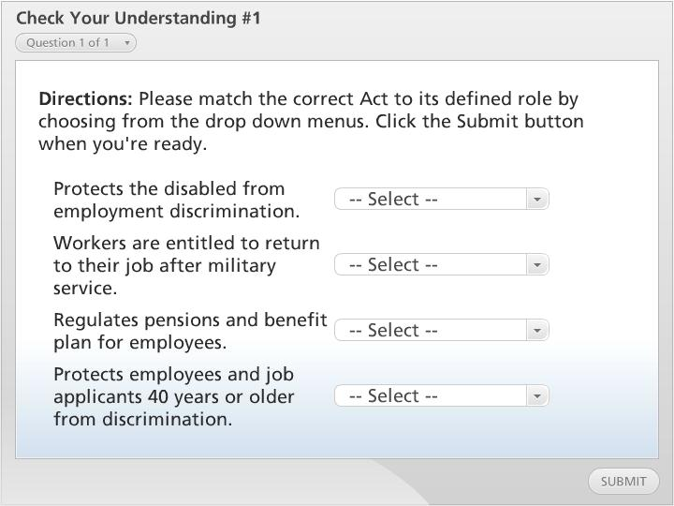



Check Your Understanding #1

Slide 12

Basic Concepts of Ethics in the Healthcare Workplace
Ethical Standards
Healthcare Ethical Dilemma
Autonomy
Beneficence
No Malfeasance
Justice
Dignity
Notes:
Ethical standards are considered one level above legal standards because individuals make a choice based on what is the right thing to do, or what one ought to do, not what are the minimal actions required by law. Ethics is concerned with what are right and wrong choices as perceived by society and its individuals. A healthcare ethical dilemma is a problem, situation, or opportunity that requires an individual, such as a healthcare provider, to choose an action between two obligations.
The role of ethics in the healthcare industry is based on five basic values that all healthcare providers should observe:
Respect for autonomy: Decision making may be different and healthcare providers must respect their patients’ decisions.
Beneficence: The healthcare provider having the patient’s best interest in mind.
No malfeasance: The healthcare provider will not cause any harm when taking action
Justice: Healthcare providers will make fair decisions.
Dignity: Patients should be treated with respect.
Next slide.

Slide 13
Decision Model for Healthcare Dilemmas
PLUS Decision-Making Model
Step 1- Define the Problem
Step 2- Identify the Alternatives to the Problem
Step 3- Evaluate the Identified Alternatives
Step 4- Make the Decision
Step 5- Implement the Decision
Step 6- Evaluate the Decision
Notes:
Healthcare dilemmas require guidelines to process a solution to the dilemma. Codes of ethics and HR training can assist with a solution. HR training can include a decision-making model that will assist the individual to process the steps in resolving the situation. Lets review the PLUS Decision Model steps.
But before we do so let’s look at a healthcare dilemma scenario. An oncologist has a patient who has an advance stage melanoma, or better known as skin cancer. The prognosis is that the patient has three to six months to live. The oncologist has developed an experimental treatment program that has severe side effects but may give the patient an additional six months. The patient prefers alternative remedies for medical treatment such as natural remedies.
The following are the steps to resolve this dilemma:
Step One: Define the problem. This is the most important part of the process. This step should define the problem and the ultimate outcome of the decision-making process.
Step Two: Identify the alternative, or alternatives, to the problem. List the possible alternatives to the desired outcome. Attempt to identify at least three as a minimum, but five are preferred.
Step Three: Evaluate the Identified alternatives. Discuss the positive and negative impact of each alternative.
Step Four: Make the decision. In the healthcare industry, the decision must include the patient’s best interest and his or her values, which can be conflicting at times.
Step Five: Implement the decision. Once the decision has been made, the physician actually finds a physician referral that would help her patient.
Step Six: Evaluate the decision. An evaluation component of any decision will provide data to asses if the decision was successful.
Next slide.

Slide 14
Codes of Ethics
Code of Ethics
Doctor-Patient Relationship
  The American Medical Association
  American College of Physicians and Harvard Pilgrim Health Care Ethics Program
Other Healthcare Codes of Ethics
  American Nurses Association
  Healthcare Executives Code
Notes:
Codes of ethics provide a standard for operation so that all participants understand that if they do not adhere to this code, there may be negative consequences. The foundation of health care is the relationship between the patient and physician. As a result of many public ethical crises that have occurred, particularly in the business world, many organizations have developed codes of ethics.
Physicians have been guided by many healthcare codes of ethics. The American Medical Association, the professional membership organization for physicians, created a Code of Medical Ethics for physicians in 1847. In 2000 and 2001, the American College of Physicians and Harvard Pilgrim Health Care Ethics Program developed a statement of ethics for managed care.
Other healthcare code of ethics exists as well. The American Nurses Association established a code for nurses in 1985 and was most recently revised in 2001. Healthcare executives have a code of ethics that was established in 1941 that describes the relationship with their stakeholders and was most recently updated in 2007.
Next slide.

Slide 15

Developing a Code of Ethics
When Developing Code of Ethics, it must be:
Written clearly
Specifically developed
Current
Follow a specific outline
Notes:
A code of ethics must be written clearly because employees at all organizational levels will use it. If a certain employee category needs a specific code of ethics, then a written code should be specifically developed for that category. The code must be current in laws and regulations. According to industry scholars, Driscoll and Hoffman, the following outline is recommended for developing a code of ethics:
Memorable title;
Leadership letter;
Table of contents;
Introduction;
Core values of the organization;
Code provisions; and
Information and resources.
Next slide.

Slide 16
Ethics and Research
Institutional Review Boards (IRBs)
Research Informed Consent
Common rule
Notes:
The conduct of research involving human subjects requires assessment of the risks and benefits to the human subjects, which must be explained clearly to them before the consent to participate in the research is given. The principles of ethical research are monitored by institutional review boards. An IRB is a group that has been formally designated to review and monitor medical research involving human subjects. An IRB has the authority to approve required modifications, or disapprove research.
Research informed consent is one of the basic ethical protections for human subject research. Informed consent protects human subjects because it allows the individual to consider personal issues before participating in medical research.
Common rule elements include a written statement that includes the purpose and duration of the study, the procedures and if they are experimental, and foreseen risks as well as potential benefits. Also included is any alternative procedure that may benefit the subject.
Next slide.

Slide 17

Workplace Bullying in Health Care
Workplace Bullying
Impact of Workplace Bullying
Legal Implications of Workplace Bullying
Notes:
Workplace bullying is receiving increased attention worldwide as a negative organizational issue. It is considered a serious and chronic workplace stress that can lead to diminished work productivity and work quality. Workplace bullying is an ongoing workplace behavior between employees, which can result in negative outcomes for the targeted employees.
The impact of workplace bullying can increase work stress anxiety, lower work productivity and cause depression. If not addressed by management, it can affect the overall morale of the workforce. Low morale often results in high employee turnover, which can be detrimental to the organization success.
As far as the legal implication of workplace bullying, there is no specific legislation in the United States that forbids workplace bullying. Unfortunately, eighty percent of the workplace bullying is not illegal. There are two federal laws that can be applied in workplace bullying: the Occupational Safety and Health Act of 1970 and Title VII of the Civil Rights Act of 1964.
Under the Occupational Safety and Health Act of 1970, the employer must provide a safe and healthful working environment for its employees. Under Title VII of the Civil Rights Act, if a protected class employee is bullied by another employee, the action can be illegal based on the concept of a hostile work environment, which is illegal under sexual harassment.
Next slide.

Slide 18
Recommendations to Eliminate Workplace Bullying
Adopt a Policy of Zero Tolerance
Create an organizational culture
Reward Behaviors
Develop and Educational Program
Notes:
To reduce the prevalence of workplace bullying, it is important that employers implement policies to eliminate this behavior. The following are recommendations for organizations including healthcare organizations:
One, Adopt a policy of zero tolerance for workplace bullying and develop measures to discipline bullies in the workplace.
Two, Create an organizational culture that focuses on a positive work environment enabling all individuals to pursue their careers
Three, Reward behaviors that encourage teamwork and collaboration among employees and their supervisors
And Four, Develop an educational program for all employees on what constitutes workplace bullying
Next slide.

Slide 19
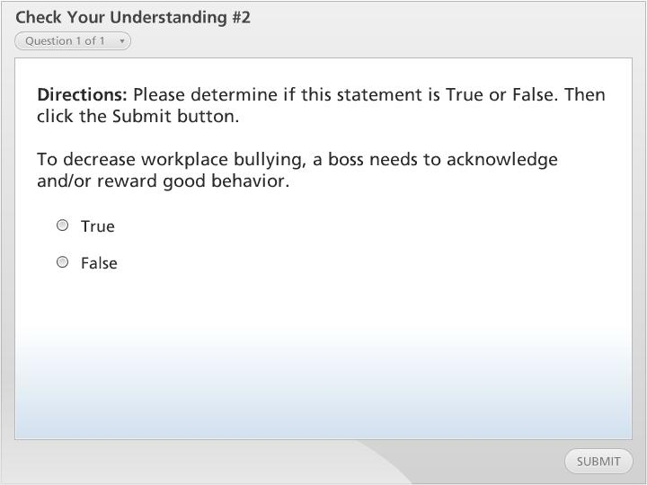
Check Your Understanding #2

Slide 20
Summary
Basic Concepts of Law in the Healthcare Workplace
Tort Reform
Human Resource-Related Legislation
Role of Ethics and the Five Basic Values
Decision Model for Healthcare Dilemmas
Code of Ethics and the Doctor-Patient Relationship
How to Develop a Code of Ethics
Ethics and Research
Workplace Bullying
Notes:
We have reached the end of this lesson. Let’s take a look at what we’ve covered.
We started out by discussing the basic concepts of ethics in the healthcare workplace.
We then took a look tort reform to reduce litigation and claims in healthcare by discussing the following: defensive medicine, monetary cap, voluntary hospitals, informed consent, and standard of care.
Then we examined human resource – related legislation that influences the healthcare industry, starting from 1963 to 2010.
We then went over the role of ethics and the five basic values healthcare providers should observe.
Next, we examined the decision model for healthcare dilemmas, which included steps to resolving situations.
Moving on, our next topic of discussion addressed the code of ethics, which covered doctor-patient relationship and other healthcare code of ethics.
We then talked about ethics and research and how the institutional review board monitors such research.
And finally, we discussed workplace bullying by looking at the impact of workplace bullying, legal implications of workplace bullying and recommendations to eliminate workplace bullying.
This completes this lesson.

