Slide 1

Health Care Human Resource Management
HSA320
What is Human Resource Management?
Notes:
Welcome to Health Care Human Resource Management.
In this lesson we will discuss Organizational Design and Structure.
Next slide.

Slide 2
Topics
Major milestones of human resource management (HRM)
The role of human resources in health care organizations
Notes:
The following topics will be covered in this lesson:
Major milestones of human resource management; and
The role of human resources in health care organizations.
Next slide.

Slide 3
Major Milestones of HRM
Table 1
2000 – 1500 B.C. | Chinese use employee-screening techniques. Greeks use an apprentice system.
1700 to early 1800 | U.S. evolved from agricultural nation to industrial nation. Great Britain experienced rapid industrialization. Great Britain immigrants brought industrialization knowledge to the U.S. A new U.S. labor system established a division of labor: management and employees.
1790-1820 | Labor unions were established to protect employees ‘ rights.
1900 | B.F. Goodrich Company established the first HR department.
1902 | National Cash Register established to promote welfare of employees.
1911 | Frederick W. Taylor : Scientific management principles established differential pay system.
Notes:
At what point in history did the concept of human resource management emerge?
The table shown here provides you a detailed rundown of the those key moments.
As you can see it started all the way back in two thousand B.C. where the Chinese use employee-screening techniques. Of course they were much different than how we screen potential employees today but the concept has been used for thousands of years.
Next slide.

Slide 4
Major Milestones of HRM, cont’d.
Table 1 (Continued)
1913 | U.S. Department of Labor was established t promote welfare of employees.
1920 - 1930 | Hawthorne studies: Increased productivity by changing the physical work environment of the employees.
1935 | Social Security Act was passed, which created “old age” insurance for those retirement age. Through payroll taxes, employees pay a portion of their wages to contribute to the fund.
1938 | Fair Labor Standards Act of 1938 established federal minimum wage laws.
1960 - 1980 | The following Acts focused on employee discrimination and safety: Equal Pay Act of 1963 Civil Rights Act of 1964 Occupational Health and Safety Act of 1970 Pregnancy Discrimination Act of 1978
Notes:
As we move closer to the current time period, we see the U.S. Department of Labor was established to promote welfare of its employees.
Then from 1960 all the way up to 1980 we saw there were several Acts put into play that focused on employee discrimination and safety.
Next slide.

Slide 5
Major Milestones of HRM, cont’d.
Table 1 (Continued)
1990 | The following Acts were established to prohibit discrimination against disabled workers and workers greater than 40 years of age: Americans with Disabilities Act of 1990 Older Workers Benefit Protection Act of 1990
2008 - 2009 | Legislation prohibited genetic testing and compensation discrimination: Genetic Information Nondiscrimination Act of 2008 Lilly Ledbetter Fair Pay Act of 2009
2010 | Controversial legislation that requires individuals to purchase health insurance by 2014. Patient Protection and Affordable Care Act of 2010 (PPACA) This Act was contested by several states for its constitutionality, provisions of the Act will be reviewed the Supreme Court most likely in 2012.
Notes:
Then as you can see here in recent years, several acts were passed that targeted employee protection.
Next slide.

Slide 6
Role of Human Resources in Healthcare Organizations
Workplace Issues where HR is called upon:
  Legal, Ethical, and Safety Issues
  Job Analysis and Design
  Recruitment, Selection, and Retention
  Healthcare Employee Benefits
  Motivating Healthcare Employees
  Labor Unions and Health Care
  Terminating Employees
Notes:
The role of human resource management is that of a partnership between the HR department and management regardless of the organizational type. Most HR departments have similar responsibilities. The HR and management partnership is unique in the healthcare industry because many healthcare organizations have a dual administrative structure of clinical managers and health services managers that supervise two distinct groups of employees with different responsibilities and different training needs.
For example, clinical managers have training or experience in a specific clinical area and, accordingly have more specific responsibilities than do generalists or health services managers. In this instance, directors of physical therapy are experienced physical therapists, nurse managers have nursing degrees, but most health service managers have a bachelor’s degree or master’s degree in health services.
This slide describes specific workplace issues where the role of the HR management is integrated to ensure that the issues on the screen are addressed throughout the organization.
Next slide.

Slide 7
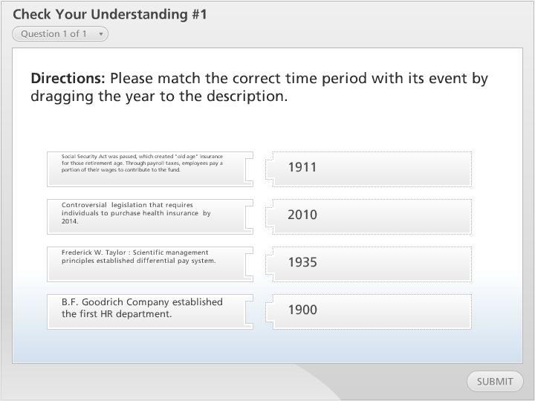



Check Your Understanding #1

Slide 8

Recruitment, Selection, and Retention
Legally Defensible
Recruitment
Selection Process
Retention
Notes:
The HR department is also responsible for collaboration with management to ensure that recruitment and selection process is legally defensible, which means the process is systematic and fair in order to objectively and fairly recruit and select potential employees. A legally defensible process must adhere to legal standards.
Recruitment consists of any activity that focuses on attracting the appropriate candidates to fulfill job openings in the organization. Once candidates are identified, the next step is the selection process.
Selection process identifies the best employees for the organization. The selection process must abide by the appropriate legal standards. Once a organization selects the preferred candidate, the organization should create a culture to retain its valued employees.
Then just to note before we move on any further - retention refers to the ability of an organization to retain its employees for long periods of time.
Next slide.

Slide 9
Legal, Ethical, and Safety Issues
Legal Relationship
Federal and State Laws
Occupational Safety and Health Administration (OSHA)
Joint Commission on Accreditation of Healthcare Organization
Notes:
Employees at all levels should have an understanding of basic legal and ethical principles that affect the work environment, particularly in the healthcare industry. The legal relationship between the organization and the consumer – the healthcare provider and the patient is the foundational relationship of all healthcare activities. Ethical behaviors, which are considered actions that are the right thing to do, not simply what is required by law, must also be addressed because the healthcare industry is fraught with difficult situations that involve ethical dilemmas.
Federal and state laws have been passed and policies have been implemented to protect both the healthcare and provider and the healthcare consumer. The passage of new laws and amendments of older laws reflect needed changes to protect healthcare participants. It is the role of the HR department and management to train employees at all levels regarding employment-related legislation. It is also the responsibility of HR and management to create an ethical organizational culture by providing ethics training and codes of ethics.
Another major employment issue is that of a safe working environment. According to the federal Occupational Safety and Health Administration, also known as OSHA, it is the responsibility of the organization to monitor and ensure a safe and healthy work environment for employees. Healthcare employees are exposed to toxic chemicals, contaminated blood, bacteria, and radiation. Hospitals, laboratories, physicians’ and other healthcare providers’ offices, and skilled nursing facilities require constant surveillance by OSHA to monitor workplace standards.
Joint Commission on Accreditation of Healthcare Organizations also reviews health and safety standards for both patients and employees. In collaboration with HR departments, OSHA provides training and educational materials to inform employees about the dangers of the workplace.

Slide 10

Job Analysis and Design
Job Analysis
Job Design
  Team Designs
  Job Schedule Redesign
Notes:
When starting or expanding any organization, the first goal is to determine its overall mission. If the mission is long-term care, for example, the first major decision is to decide how the work or tasks will flow through the organization to accomplish this goal. Healthcare organizations have integrated technology into their operations, such as the implementation of electronic patient health records. This type of major transition would require a review of the workflow to ensure this new activity would be successful. Evaluating the workflow of any organization is the first step in job development to produce the desired outputs of an organization.
The second step in job development is job analysis. Job analysis is a process of determining the different tasks that are associated with a specific job, according to Dessler. It is the foundation of HR management. Job analysis is the tool for organizations to understand what type of staffing and training is required to ensure the high performance of employees. Job analysis enables the organization to develop job descriptions and specifications to recruit individuals that have specific knowledge, skills and abilities for these jobs.
The next step in the process of job development is job design. Job design defines how tasks are performed and the types of tasks that are part of a job, according to a publication by Mathis and Jackson in 2006. Job design can be considered a retention strategy to encourage employee satisfaction. In healthcare, job design is less flexible than in other industries because many job responsibilities have legal restrictions and standards.
Team designs, such as functional teams, project teams, self-direct teams, task forces, and virtual teams are used in healthcare organizations. Job design in teams can be an important tool to ensure that teams fulfill their designated goals.
Job schedule redesign, such as flextime or compressed work schedules, may be an incentive for employee satisfaction and motivation. Once job analyses and job designs are performed, the next step is to recruit the best employees for these jobs.
Next slide.

Slide 11
Healthcare Employee Benefits
Employee Benefits
Mandatory Benefits
Voluntary Benefits
Notes:
Now, let’s briefly look at some benefits offered to employees.
Employee benefits are a typical responsibility of the HR department. HR personnel educates employees about employee benefits and administers these benefits programs.
Mandatory benefits are those benefits that are required by law such as, social security, unemployment insurance, workers’ compensation, and unpaid family and medical leave.
Employee voluntary benefits such as, retirement plans, paid leave, and different types of family care can all be considered a recruitment tool because they can attract qualified candidates. Just to note, these benefits are not required by law.
Next slide.

Slide 12
Motivating Healthcare Employees
Employment Development
Employee Training Programs
Job Redesign
Job Enrichment
Notes:
The goal of healthcare organizations is to provide the highest quality of patient care. Research on high-performing organizations, including healthcare organizations, reveals that employees are motivated to perform well by the quality of the work environment including employee empowerment, training, and career development programs, pay for performance, management transparency, and work-life balance philosophy.
Employee development consists of programs that focus on the expansion of an employee’s career. Development programs tend to be long term and are awarded to employees that the organization believes have potential for promotion.
Employee Training Programs improve an employee’s performance in his or her current job. Training can occur before a new employee starts a job or training can be given to employees during their tenure. Development and training programs can be a source of motivation to employees to improve their performance.
Job redesign such as job enlargement, which expands the number of tasks in a job and job enrichment, which increases the responsibilities of a job, are both motivational strategies. Both of these job redesigns provide a sense of employee empowerment because the employer is recognizing the ability of the employee to increase his or her workload.
Next slide.

Slide 13
Labor Unions and Health Care
Labor Unions
National Labor Relations Act (NLRA)
Service Employees International Union (SEIU)
National Nurses United (NNU)
Notes:
In the early 1900s, the establishment of unions occurred because of the industrialization of the United States and the consequent unfair treatment employees by management. Labor unions are membership labor organizations formed to protect their member employee rights. The main goal is to ensure that management treats its employees fairly.
The National Labor Relations Act was passed in 1935. It protects the rights of workers to form unions, defined unfair labor practices and established the National Labor Relations Board, which is responsible for NLRA regulatory oversight.
In 2007, the Service Employee International Union created a separate national healthcare union, which is the largest healthcare union nationally. SEIU Healthcare represents hospitals, nursing, long-term care, and many outpatient facilities. Unions representing physicians are affiliated with SEIU.
The National Nurses United is the largest nurses union in the United States, representing 150,000 members. It was created by the merging of the California Nurses Association, the National Nurses Organizing Committee, and the United American Nurses.
Next slide.

Slide 14
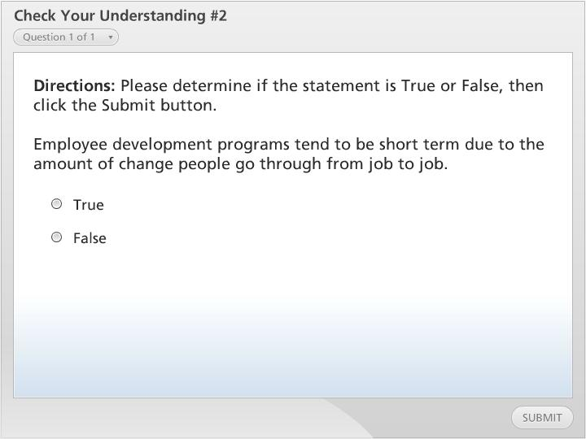
Check Your Understanding #2

Slide 15

Terminating Employees
What is Employment?
Expectations of the Employer
Expectations of the Employee
Six Reasons for Healthcare
Employee Termination
Notes:
Employment is a legal relationship between an employee and an employer. Both employers and employees have established rights. Employers are expected to provide a safe working environment for their employees while employees are expected to perform to the best of their ability in accordance with their job description and organizational policies or they may risk being terminated or fired from their jobs.
According to McKinnies, Collins, Collins & Matthews, a recent survey for healthcare managers showed that there are six reasons for healthcare employee termination:
Poor performance;
Ethical misconduct;
Excessive absences;
Poor attitude;
Personality conflicts; and
Substance abuse.
Next slide.

Slide 16
Current Trends in Health Care
Demographics and Diversity in the Workforce and the Population
Information Technology Impact
Teamwork and Accountable Care
Pay for Performance
Social Media Communication
Notes:
Let’s take a look at the next few slides to discuss in details the current trends in health care which include:
Demographics and diversity in the workforce and population;
Information technology impact;
Teamwork and accountable care;
Pay for performance; and
Social media communication.

Slide 17
Demographics and Diversity in the Workforce and the Population
Demographics and Diversity
Global Economy
Medical Tourism
% | Workforce Projection for 2018
79% | Caucasian
12% | African American
9% | Asian and other minorities
47% | Females in the workplace
Notes:
It is a fact that individuals will require healthcare services as they age. With the increase in life expectancy in the United States, it is projected that an additional three million healthcare jobs will be created by 2018 to care for this population.
There is also an increase in the diversity of the U.S. workforce as you can see in the chart on this slide.
The United States participates in a global economy. The U.S. economy has become borderless as a result of information technology. Competing in the global economy has affected the area of human resource management. Employees must be trained in cross-cultural competencies.
U.S. citizens are traveling outside the U.S. for medical procedures, which has created a medical tourism industry because the procedures are often less costly overseas. Even with travel costs, international procedures are much less expensive than U.S. medical procedures.
Next slide.

Slide 18
Information Technology Impact
Health or Medical Informatics
Health Information Systems
Health Information Technology (HIT)
Notes:
Health or medical informatics is the science of computer application that supports clinical and research data in different areas of health care. It is a methodology of how the healthcare industry thinks about patients and how treatments are defined and evolved.
Health information systems are systems that store, transmit, collect, and retrieve the data.
The goal of health information technology is to manage health data for use by patients and consumers, insurance companies, healthcare providers, healthcare administrators, and any stakeholder that has an interest in health care. The focus of HIT is the national implementation of an electronic patient record. A major issue with HIT is sharing and protecting patient information electronically. Human resource management is responsible for protecting the privacy of both employee and patient information.
Next slide.

Slide 19
Teamwork and Accountable Care in Health Care
Institute of Medicine Report
Accountable Care Organization (ACO)
Inter-professional Education
Notes:
The Institute of Medicine Report is easily misunderstood. It says that building a Safer Health System treats the issue of preventable medical errors, which, according to the report, are in part the result of poor teamwork implementation. The report further states that effective teamwork can increase effective patient care.
Accountable Care Organization is a model of teamwork in healthcare. It consists of a network of organizations and healthcare providers that offer coordinated care. Their accountability is to improve clinical outcomes for designated populations. If the outcomes are met or exceeded, the group of physicians receives a financial bonus; however, there may be excessive penalties for not reaching the targets.
Inter-professional education is another form of teamwork, which occurs when two or more professionals from different healthcare sectors engage in a dialogue so they can learn from each other, promoting inter-professional interaction. Inter-professional education promotes effective collaboration during patient care. It is an effective way of providing different perspectives on how to care for a patient within a team.
Next slide.

Slide 20

Pay for Performance
Pay for Performance
Value-based Purchasing
Notes:
Pay-for-performance is an umbrella term for initiatives aimed at improving the quality, efficiency, and overall value of health care. These arrangements provide financial incentives to hospitals, physicians, and other health care providers to carry out such improvements and achieve optimal outcomes for patients.
Value-based purchasing seeks to reward hospitals for improving the quality of care by redistributing Medicare payments among them so that hospitals with high performance in terms of quality receives a greater portion than do the lower performing hospitals, according to Shoemaker in 2011.
Pay for performance and value-based purchasing are terms that describe healthcare payment systems that reward healthcare providers for their efficiency, which is defined as providing higher quality care for less cost. They are another form of an accountable care organization.
Next slide.

Slide 21
Social Media use in Health Care
Patient Engagement
Communication with Other Physicians
Healthcare Education
Notes:
Social media is an electronic tool that provides a platform for customer satisfaction to create public awareness of their business. Examples of social media includes, Facebook, Twitter, and YouTube.
These forms of social media is used increasingly by healthcare organizations not only as recruiting tool but also as a communication tool for patient engagement, employees, and providers. The Mayo Clinic and the U.S. Department of Veterans Affairs are exploring ways to use social media for patient engagement including education.
Physicians use Twitter to communicate easily and quickly with other physicians. YouTube provides the opportunity to make available brief videos regarding certain points in healthcare education.
Next slide.

Slide 22
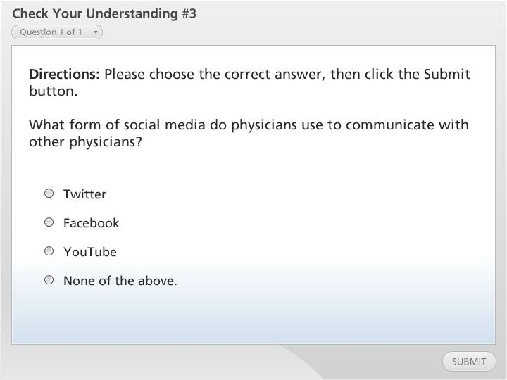
Check Your Understanding #3

Slide 23
Summary
Major milestones of human resource management
The roles of human resource management
Current trends in health care
Notes:
We have reached the end of this lesson. Let’s take a look at what we’ve covered.
We started our discussion by reviewing the major milestones of human resource management starting from 2000 – 1500 B.C., all the way up to 2010. This allowed one to see at what point in history did the concept of human resource management emerge.
Then we examined the roles of human resource management in healthcare for the following issues, individually: Legal, Ethical & Safety, job analysis and design, recruitment, selection, and retention, healthcare employee benefits, motivating healthcare employees, labor unions and health care, and finally terminating employees.
Finally, we discussed the current trends in healthcare, such as: demographics and diversity, information technology impact, teamwork and accountable care, pay for performance, and social media communication.
This completes this lesson.

