Slide 1
Chapter 10
Assessing Family Functioning in Diverse Family and Cultural Contexts

Slide 2
Learning Objectives
Take a broad view of how families are defined and how family functioning is understood
Understand the role of self-awareness in family assessment and how cultural values influence beliefs and values about family membership and family functioning
Describe the dimensions of family structure, including homeostasis, boundaries, power and decision making, roles, rules, life cycle, and sociopolitical environment

Slide 3
Learning Objectives (continued)
Discuss family adaptive capacity, including stress and resilience
Describe the role of culture, human rights, and social justice in the definition and expression of family system characteristics
Develop specialized assessment skills and strategies to observe patterns of interaction that underlie family system structure

Slide 4
Family
Shared understanding of elements of family structure
Elements
Way in which family membership is composed
Various functions that the family serves as an enduring institution in society

Slide 5
Family Functions
Functions | Explanation
Procreation | Families ensure the evolutionary survival of the human species
Provide for physical needs | Families obtain and distribute resources that are instrumental for physical health and economic survival
Provide secure attachment bonds | Families provide members with a sense of psychological security and safety
Primary socialization of children | Families teach and reinforce social norms and rules necessary for successful performance in the social world
Regulate sexuality | Family structure establishes boundaries that limit sexual relationships among its members
Satisfy emotional needs | Families provide members with affection, companionship, and a sense of belonging

Slide 6
Self-Awareness in Family Assessment
Family worldviews shared by clients and social workers act in harmony
Reinforce normative definitions of family structure and functions
Social workers can represent community values about families that may not be shared by the client
Should be aware of potential differences and act deliberately to understand them

Slide 7
Family Systems Framework
Shows how families organize to achieve their goals and perform their functions
Defines properties and characteristics of families rather than of any particular individual within the family

Slide 8
Dimensions of a Family Systems Framework
Homeostasis: Conservative property of family systems that strives to maintain the status quo
Operates through a pattern of feedback loops
Boundaries and boundary maintenance
Includes external family boundaries, internal boundaries, and family subsystems
All families fall somewhere in a continuum of boundary functioning between enmeshment and disengagement
Family decision making, hierarchy, and power

Slide 9
Dimensions of a Family Systems Framework (continued 1)
Family roles
May be enacted, prescribed, or perceived
Communication styles of family members
Social workers should assess the congruency of messages
Levels - Verbal, nonverbal, and contextual
Receiver skills and sender skills are important facets of assessing communication styles

Slide 10
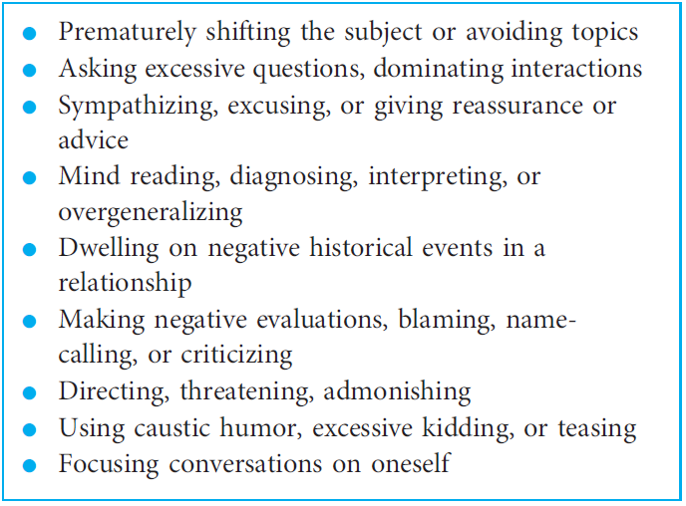
Table 10.3 - Communication Barriers

Slide 11
Dimensions of a Family Systems Framework (continued 2)
Family life cycle
Family rules
Explicit and implicit rules
Flexible and rigid rules
Social environment
Family adaptive capacity
Family stressors
Family strengths and resilience

Slide 12
Assessment Skills and Strategies
Observing patterns of interaction
Interviewing skills and circular questioning
Genograms
Standardized scales

Slide 13
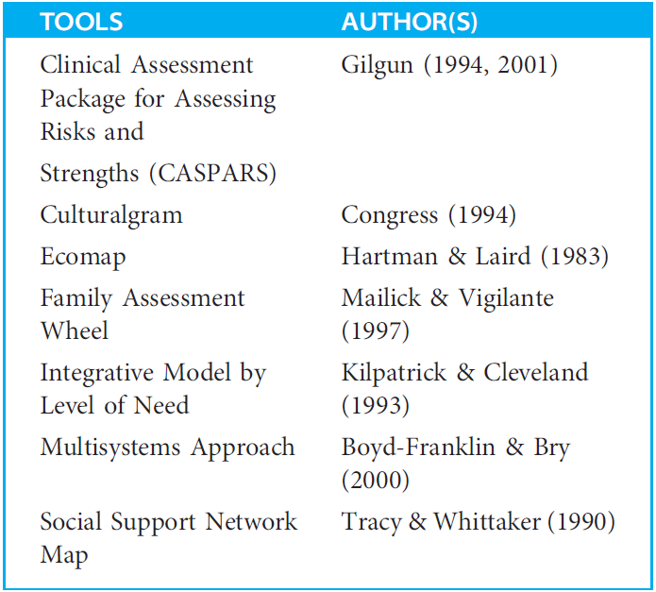
Table 10.4 - Tools for Understanding Families

