Slide 1
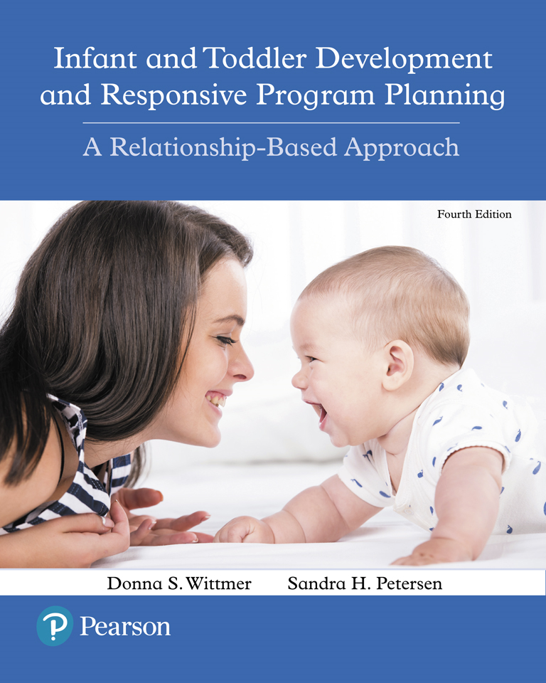
Infant and Toddler Development and Responsive Program Planning: A Relationship-Based Approach
Fourth Edition
Chapter 12
Creating a Relationship-Based Curriculum
Copyright © 2018, 2014 Pearson Education, Inc. All Rights Reserved
Notes:
If this PowerPoint presentation contains mathematical equations, you may need to check that your computer has the following installed:
1) MathType Plugin
2) Math Player (free versions available)
3) NVDA Reader (free versions available)

Slide 2
Learning Outcomes
12.1 Describe the foundational elements of a responsive relationship- based program.
12.2 Explain and evaluate the teachers’ roles in a relationship-based program.
12.3 Explain how to create a family and culturally sensitive program.
12.4 Describe how to plan in a responsive, relationship-based format

Slide 3
Beliefs and Assumptions
Adults’ beliefs about the nature of children influence the attitudes that they have about their role in children’s lives.
Do babies have rights?
Discuss video on p. 297: The U N Convention on the Rights of the Child
Are babies capable learners?
Discuss the video on page 297

Slide 4
What are the Needs of Infants & Toddlers?
Security
Responsive, interested adults
Food, warmth, diapering, rest
Protection Safe environments
Healthy routines
Intimacy (Lally)
What do we mean by intimacy in this context?
Attuned dialogue (Gonzalez-Mena & Eyer)
What is attuned dialogue?
How do we know that I/T feel securely attached?

Slide 5
What is Important for Infants and Toddlers to Learn? (1 of 2)
Learning domains
Emotional
Social
Language
Cognitive
Motor

Slide 6
What is Important for Infants and Toddlers to Learn? (2 of 2)
Teachers must focus on helping infants and toddlers develop a sense of identity as a person of worth. (Lally)
Readiness for change and flexibility with decisions
Ability to get along
Competence with language and use of words and logic instead of aggression
A belief they can make a difference in their own lives and those around them
A profound sense of the importance of equal opportunity and the rights of each individual
Ability to be gifted parents
(Szanton, 2001)

Slide 7
How Do Children Develop and Learn?
How do infants and toddlers learn?
Integrated
Learning happens across domains, in an inter-related way
Developmental
Young infants, mobile infants, toddlers are distinct age ranges with unique needs and interests
Play
Active exploration of the environment
Increases in complexity of materials and interactions
Acting on a world that responds to those actions (contingent)
Long amounts of time; real choices

Slide 8
How to Encourage Play
Read a “Letter from a Toddler” (p. 304)
Why do you think play is important?

Slide 9
The Infant-Toddler Professional’s Role -Creating A Relationship-Based Program
Develop foundation of relationship-based community
Structure program for relationships
Build caring, responsive relationships with families, diverse cultures, community
Use a responsive planning process
Create flexible schedule with responsive routines
Set up a responsive environment
Provide toys, opportunities - individually, culturally, age-appropriate
Use a relationship-based approach to guidance

Slide 10
Creating a Relationship-Based Community
Creating a Relationship-based community
Home-like environments that “Connect and nurture people”
Homebases
Attachment groups

Slide 11
The Importance of Teachers’ Emotional Connections and Healthy Relationships (1 of 2)
Making Emotional Connections
Develop strong, positive, secure relationships with the children.
Be attuned emotionally and physically to children’s cues and communication attempts, reflect on their meaning, and relate as needed by the child.
Interact by taking balanced turns (reciprocal interactions)-and matching the pace.
Be approachable, accessible, and available to children-both emotionally and physically.

Slide 12
The Importance of Teachers’ Emotional Connections and Healthy Relationships (2 of 2)
Making Emotional Connections
Maintain a pleasant and positive emotional tone throughout the day.
Respond to children’s distress and intense emotional displeasure calmly-in a way that comforts them-and helps them regulate themselves.
Notice, identify, encourage, and show admiration for strengths, interests, and new skills.
Appreciate development and differences-help each child feel appreciated for his/her uniqueness.

Slide 13
Helping Infants and Toddlers Learn
Teachers protect children and help them feel safe and healthy.
Teachers help children feel a sense of belonging.
Teachers are intentional.
Teachers follow children’s lead for what they need.
Teachers imitate and encourage the child in an interaction.
Teachers scaffold learning in all domains of development

Slide 14
Relationships with Families and Culturally Sensitive Care
“no matter what culture a person comes from, the goal should be to develop a person-to-person relationship”
(Gonzalez-Mena, 2001)

Slide 15
A Family and Culture-Centered Program
Support the relationship between the child and family.
Make family members feel welcome.
Involve families in program.
Develop a system for daily exchange information.
Provide opportunities to express differences, beliefs, values, concerns.
Reflect on your cultural beliefs about child rearing.
Dialogue with others about differing cultural beliefs.

Slide 16
Responsive, Relationship-based Planning
The Planning Process
Respect
Value what the child is trying to do and how the child feels.
Admire the child’s feelings, goals, and how the child is learning.

Slide 17
The Planning Process (1 of 4)
Reflect
Observe, think, and feel.
How is the child showing you how he or she feels?
What are the child’s goals?
What is the child learning?
How is the child trying to learn it?
What does the child need?

Slide 18
The Planning Process (2 of 4)
Relate
Be responsive by observing with
interest
interacting
communicating
sharing feelings
changing the physical environment.

Slide 19
The Planning Process (3 of 4)
Respect: Child’s emotions, efforts, goals, learning, relationships
Reflect
What am I doing?
How am I feeling?
What am I learning?
Relate
What will you do to support my development?
Responsive interactions
Environment, toys, materials, and experiences

Slide 20
The Planning Process (4 of 4)
I’m exploring and learning
See page 324: Table 12-6
What else can you add to the table that children are learning?

Slide 21
Copyright

