Slide 1
Chapter 2: How to Lead Organizational Change: Frameworks

Slide 2
Chapter Overview
Chapter 2 differentiates between HOW to change and WHAT to change. Change leaders must understand both.
This chapter focuses on HOW to create change
Six process-oriented models of planned, purposeful change are discussed
The last of these is the Change Path Model: it is the guiding framework used in this book
These six models will give you language to articulate models of how to bring about organizational change

Slide 3
Getting a Handle on the Change Challenge
Two distinct aspects in any change management situation need to be addressed:
WHAT needs to change
HOW to bring about that change

Slide 4
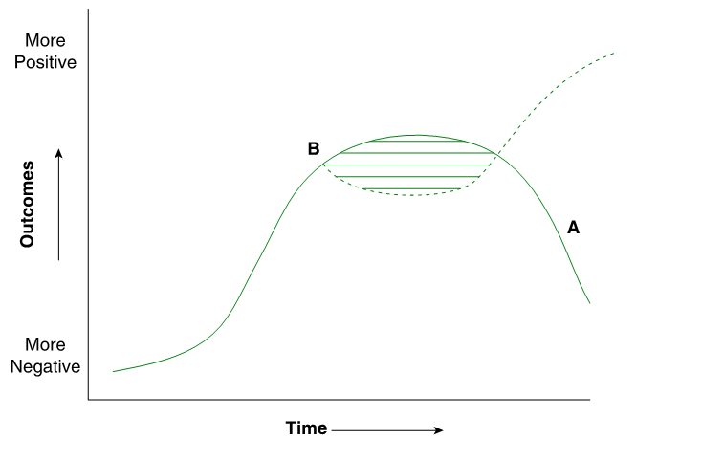
Sigmoid Curve

Slide 5
Nature of Managed Organizational Change: Lewin’s View
Unfreeze
Change
Refreeze

Slide 6
Kotter’s Eight-Stage Process
Establishing a sense of urgency
Creating a guiding coalition
Developing a vision and strategy
Communicate the change vision
Empower employees
Generate short-term wins
Consolidate gains and produce more change
Anchor the new approaches in the culture

Slide 7
Gentile’s Giving Voice to Values
Clarification and articulation of one’s values
Post decision-making analysis and implementation plan
The practice of speaking one’s values and receiving feedback from peers

Slide 8
Duck’s Five-Stage Change Curve
Stagnation
Preparation
Implementation
Determination
Fruition

Slide 9
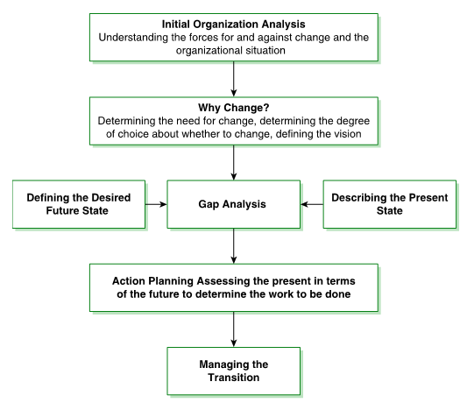
Beckhard and Harris’ Change Process Model

Slide 10
The Change Path Model
Awakening
Chapter 4
Acceleration
Chapter 9
Institutionalization
Chapter 10
Mobilization
Chapters 5 through 8

Slide 11
Components of the Model
Awakening: Why change? What data helps to wake people up?
Mobilization: Gap analysis—the desired future state and the present state
Acceleration: Getting there from here—action planning and implementation
Institutionalization: Monitoring, measuring the change, and helping to make the change stick

Slide 12
Toolkit Exercise 2.2 Interview a Manager
Interview a manager who has been involved in implementing an organizational change. Ask them to describe the change, what they were trying to accomplish, and what happened?
HOW did the managers work to make things happen? Who did they involve? How did they persuade others? What resources did they use?
Describe WHAT was being changed. Why were these things important?
Which was more important to the change in the end: HOW things were changed or WHAT was changed?

Slide 13
Summary
We need to differentiate between WHAT needs to change and HOW to change
This chapter has focused on the HOW change is accomplished, i.e., the process
The HOW of change is all about managing the process. This chapter gives us ways of thinking about this process with particular attention to the Change Path Model

