Slide 1
Chapter 11 Ethical Leadership

Slide 2
Learning Objectives
Define ethical leadership
Examine requirements for ethical leadership
Realize the benefits that come from effective ethical leadership
Understand how ethical leadership impacts organizational culture
Learn about the different styles of conflict management

Slide 3
Learning Objectives (continued)
Understand how employees can be empowered to take on responsibilities in ethical leadership
Examine leader–follower relationships
Learn about leadership styles and how they influence ethical leadership
Use the RADAR model to determine how ethical leaders handle misconduct situations

Slide 4
Ethical Leadership
Ability to create an ethical culture by motivating employees and enforcing organizational policies and norms
Involves:
Helping employees implement shared ethical values
Supporting others in incorporating an ethical culture into their daily decisions

Slide 5
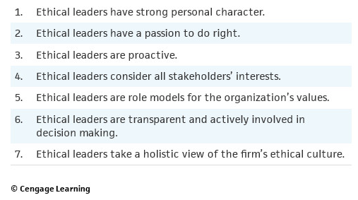
Table 11.2 - Seven Habits of Strong Ethical Leaders

Slide 6
Benefits of Ethical Leadership
Directly impacts the corporate culture of the firm
Enhances ethical behavior patterns when employees are rewarded for their ethical conduct
Leads to employee satisfaction and commitment
Creates strong relationships with external stakeholders
Impacts the long-term market evaluation of the firm

Slide 7
Ethical Leadership and Organizational Culture
Approaches to leadership
Compliance-based approach - Emphasizes obedience to rules and regulations and sets processes in place to ensure compliance
Integrity-based approach - Views ethics as an opportunity to implement core values and empowers employees
Leaders can be unethical, apathetic, or ethical
Can impact the development of an organizational culture

Slide 8
Ethical Business Conflicts
Occur when divergent views on a decision conflict with organizational goals
Help identify ethical issues that have to be resolved
Transparent communication ensures that the management is aware of ethical conflicts
Failure to act on employee concerns may lead to more group conflict
Employees can either ignore the issue, confront the other person, or report the conflict

Slide 9
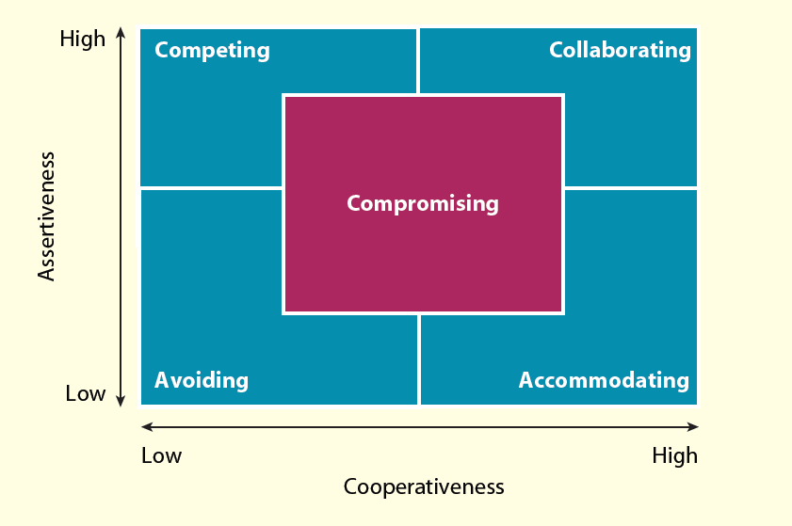
Figure 11.1 - Conflict Management Styles

Slide 10
Ethical Leaders and Employee Empowerment
Ethical leaders should empower employees to:
Make ethical decisions
Be responsible for their conduct
Employee empowerment is essential to create a values-based organizational culture
Values-based culture encourages employees to express concerns, bring up ethical issues, and resolve conflicts

Slide 11
Leadership and Communication
Communication for Becoming a Better Leader
Have the tough conversations that you have been meaning to have
Stop talking and listen more
Pick up the phone or walk down the hall to actually talk with someone rather than relying on more impersonal emails
Communicate bad news in the same way, with the same zest, as good news
Share performance feedback with others regularly
Be purposeful and thoughtful in how you communicate
Ask for feedback so you can improve your skills
Work on your blind spots in your leadership abilities

Slide 12
Figure 11.2 - Four Categories of Communication

Slide 13
Leader–Follower Relationships
Communication is essential for leader–follower congruence
Leader–follower congruence: When leaders and followers share the same vision, ethical expectations, and objectives for the company
Helps leaders avoid social isolation
Mutually beneficial relationships can be created by listening, giving respect, and providing feedback to the employees

Slide 14
Ethics Programs and Communication
Programs that help communicate values to the employees
Codes of ethics
Ethical training
Formal and informal interpersonal communication assists in building leader–follower relationships

Slide 15
Power Differences and Workplace Politics
Employees may ignore observed misconduct at work if their concerns are not addressed appropriately
Ones who feel intimidated by power differences avoid communication with the leader
Workplace politics involves gossip, manipulation, playing favorites, and taking credit for another’s work
May lead to lower morale, higher turnover, and negative behaviors among employees

Slide 16
Feedback
Occurs through informal or formal systems
Employee-to-leader feedback is essential
Leaders should strike a balance in providing positive and negative feedback
Ways to generate employee feedback
Interviews, anonymous surveys, ethical audits, and websites

Slide 17
Leadership Styles and Ethical Decisions
Styles that build strong organizational values among employees contribute to shared standards of conduct
Attributes for leadership - Character, stewardship, and experience
Emotional intelligence: Ability to manage oneself and one’s relationships with others effectively
Leadership styles based on emotional intelligence
Coercive, authoritative, affiliative, democratic, pacesetting, and coaching

Slide 18
Types of Leaders
Transactional leader
Creates employee satisfaction through negotiation for desired behaviors or levels of performance
Transformational leader
Strives to raise employee commitment and fosters trust and motivation
Authentic leader
Practices corporate values daily and forms long-term relationships with stakeholders

Slide 19
RADAR Model
Describes an ethical leader’s duty to:
Recognize ethical issues
Avoid misconduct whenever possible
Discover ethical risk areas
Answer stakeholder concerns when an ethical issue comes to light
Recover from a misconduct disaster by improving upon weaknesses in the ethics program

