Slide 1
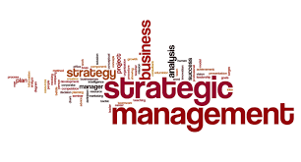
Chapter 1
By the end of this lecture, you should be able to:
Have a greater understanding of strategic management concepts
Understand what is required for PR 1

Slide 2
Definition of Strategic Management
Strategic management is a process through which:
Organizations analyze and learn from their internal and external environments
Establish strategic direction (mission, vision, values)
Create strategies that are intended to move the organization in that direction, and
Implement those strategies
All in an effort to satisfy key stakeholders
Groups or individuals who can significantly affect an organization’s activities

Slide 3
Progress Report 1
PR 1
Company Overview
Define domain (geographic market, segment of business, primary competition, target market)
Mission, Vision, Values (discussed in Ch. 3)
New statements constructed to meet specific criteria as discussed
Achieving sustainability through people, profit, and planet
Stakeholders
Identify 10 key stakeholders for your company
State why they are important
Note: Information in red is explained in today’s slides

Slide 4
Domain
Geographic market area
Location of properties (i.e., where does your company operate-domestic, international, etc.)
Segment of business
Products and services provided
Primary competition
Who are your main competitors?
Target market
Customer segments
Stakeholders
Groups or individuals who can significantly affect an organization’s activities

Slide 5
Domain Example: McDonald’s
Geographic market area
Global company with locations in 118 countries
Segment of business
Fast food with a variety of products including hamburgers/sandwiches, chicken, fish, salads, sides, breakfast, and non-alcoholic beverages, including coffee drinks
Primary competition
Burger King, Wendy’s, Yum Brands (KFC; Taco Bell; Pizza Hut)
Target market
Families with children, young and middle-aged adults
Stakeholders
Employees, customers, suppliers, competitors, local communities, local governments, environment, investors/stockholders, franchisee owners, activist groups, and unions

Slide 6
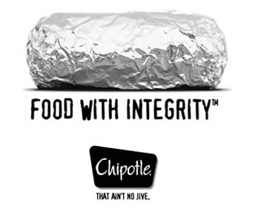
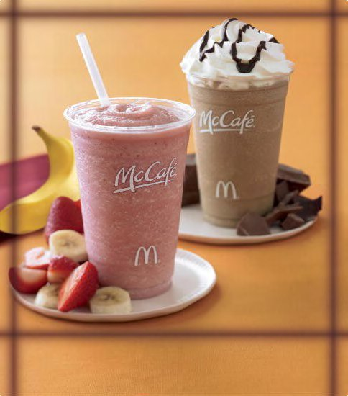
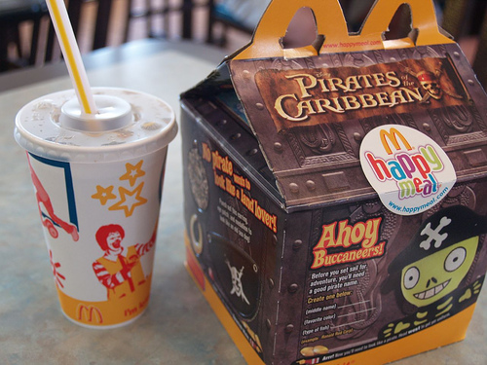
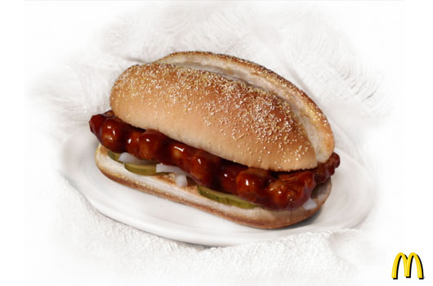
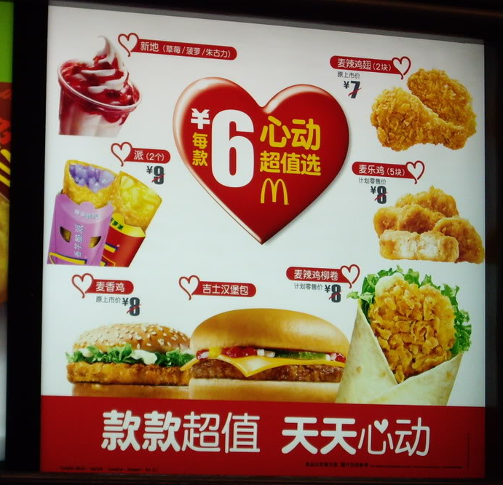
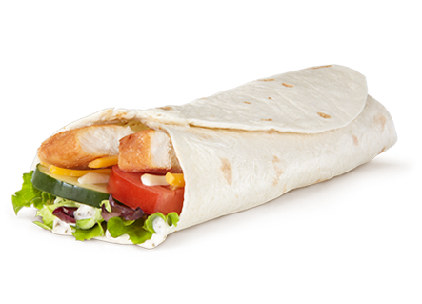
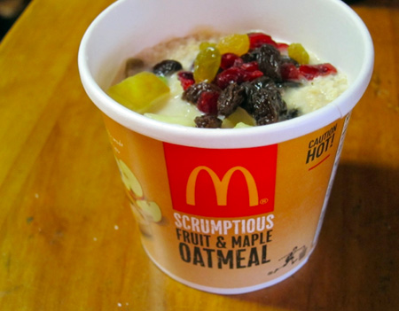
Successful Product
Launches at McDonald’s

Slide 7
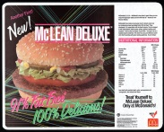
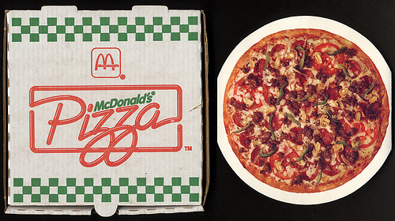
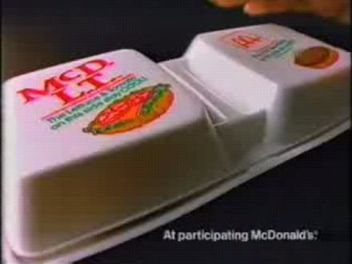
Product Fails

Slide 8
McDonald’s Challenges
Focusing on rapid growth and neglecting customer needs led to a decline in profits.
Devised a recovery strategy, which included:
New menu items
Redesigned restaurants
A focus on making a deeper connection with customers
Executives plan to remain focused on the core business
Strategy should restrict a company to what it does better than any other company. When companies do not have a clear mission and vision, and strategy of how to achieve that mission and vision, problems arise.

Slide 9
McDonald’s Challenges
McDonald’s faced another challenge as bad press and the movie Supersize Me showed the health risks associated with eating McDonald’s.
As consumers become more health conscious (i.e., sociocultural trend), McDonald’s has shifted their strategy once more.
This includes addressing issues directly regarding product quality.

Slide 10
Strategic Planning Process vs. Strategic Thinking
Strategic thinking leads to creative solutions and new ideas.
Thinking about the future 5,10,15,20 years ahead in a creative, often unconventional manner.
Top 5 Innovative Companies: Apple, Alphabet (Google), Amazon, Microsoft and Samsung (Forbes, 2020)
The strategic planning process is often rigid and unimaginative, with detailed instructions pertaining to every aspect of the process
The best firms use both!

Slide 11
Emergent versus Deliberate Strategies
planning process
Deliberate strategies occur when managers plan to pursue an intended strategic course
Emergent strategies are used when the strategy is not planned but develops from a sequence of events over time

Slide 12
The Strategic Management Process
Analyze the Environment, Stakeholders and Organizational Resources (Chs. 2 & 4)
Strategy Formulation
Strategy Implementation
Establish
Strategic
Direction
(Ch. 3)
Formulate Strategies
Business-Unit (Ch. 5)
Corporate-Level (Ch. 6)
Implement Strategies
& Establish Controls
(Chs. 7 & 8)

Slide 13
Three Perspectives on Strategic Management
 | Traditional | Resource-Based | Stakeholder
View of firm | An economic entity | A collection of resources, skills and abilities | A network of relationships
Approach to strategy formulation | Situation analysis of internal and external environments (SWOT) leading to mission and strategies | Analysis and acquisition of organizational resources, skills, and abilities | Analysis of the power, rights, influence, and demands of stakeholders
Source of competitive advantage | Adapt to the environment by taking advantage of strengths and opportunities and overcoming weaknesses and threats (SWOT) | Possession of resources that are valuable, rare and difficult to imitate | Superior linkages with stakeholders

Slide 14
Traditional Strategic Management Process
Situation Analysis
(external environment)
Strategic
Direction
(mission & goals)
Strategy Formulation
(take advantage of strengths/overcome weaknesses & threats)
Strategy Implementation
(development & execution of implementation plans)

Slide 15
The Organization as a Bundle of Resources
General Organizational
Resources
Firm Reputation
Brand Names and Patents
Contracts
Stakeholder Relationships
Financial Resources
Internal and External Sources of Financing
Financial Strength
Physical Resources
Plants and Equipment
Organizational Locations
Access to Raw Materials
Organizational
Knowledge
and Learning
Human Resources
Skills, Background and Training of Managers and Employees
Organization Structure

Slide 16
Stakeholder View
Activist
Groups
Competitors
Local
Communities
The Organization
Owners/Board of Directors
Managers
Employees
Suppliers
Customers
Unions
The Media
Financial
Intermediaries
Government Agencies
and Administrators

Slide 17
Levels of Strategy Formulation
Corporate-level: where to compete
Business-level: how to compete
Functional-level: the functional
details of how resources will be
managed to achieve those business
level strategies
Corporate
Business
Functional

Slide 18
Levels of Strategy Formulation McDonald’s Example
Corporate-level:
Where: Locations in 118 different countries, mostly franchised locations
Business-level:
How: The company competes in each of its location depending on the needs of the specific market
Functional-level:
Details: How the strategy is implemented in the operational areas of marketing, information systems, operations, finance, innovation, and human resources
Functional

Slide 19
Next Steps
Start researching your assigned company for your group project
Understand where the company operates, what products/services the company provides, the target customers, and the stakeholders
Consider what factors are happening both internal to the company (Strengths and Weaknesses) and external to the company (Opportunities and Threats) that may influence the company’s strategy.
Functional

