Slide 2
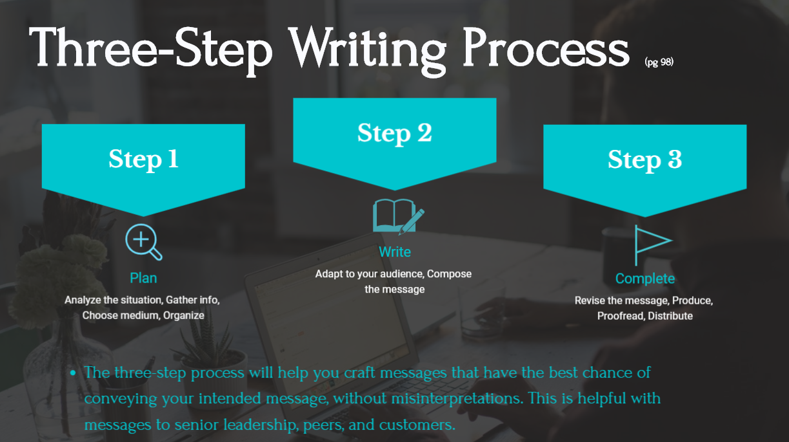

Slide 3
This helps you connect with the reader without sounding rigid, helps to keep you relatable, and helps to better communicate the intended message to the reader.

